Slide 1
ist 263

Slide 2
Agenda
Lifecycle/Style Doc/Site Maps
CSS Colors
CSS Backgrounds
CSS Box Model

Slide 3
Life Cycle and Style Document

Slide 4
What is the life cycle?
Define Project
Planning
Design
Develop
Test
Maintain

Slide 5
Style Documents (this is not CSS)
Syracuse University Brand/Style Documents
https://www.syracuse.edu/assets/documents/syracuse-university-brand-guidelines_07-29-202116-15-33.pdf
Syracuse University Brand/Style Documents
https://www.microsoft.com/en-us/legal/intellectualproperty/trademarks

Slide 6
What is a Sitemap?

Slide 7
Why build a Sitemap?
Organization Your Content
Having Clear Organization Helps User Find Content
Need for SEO (Search Engine Optimization)

Slide 8
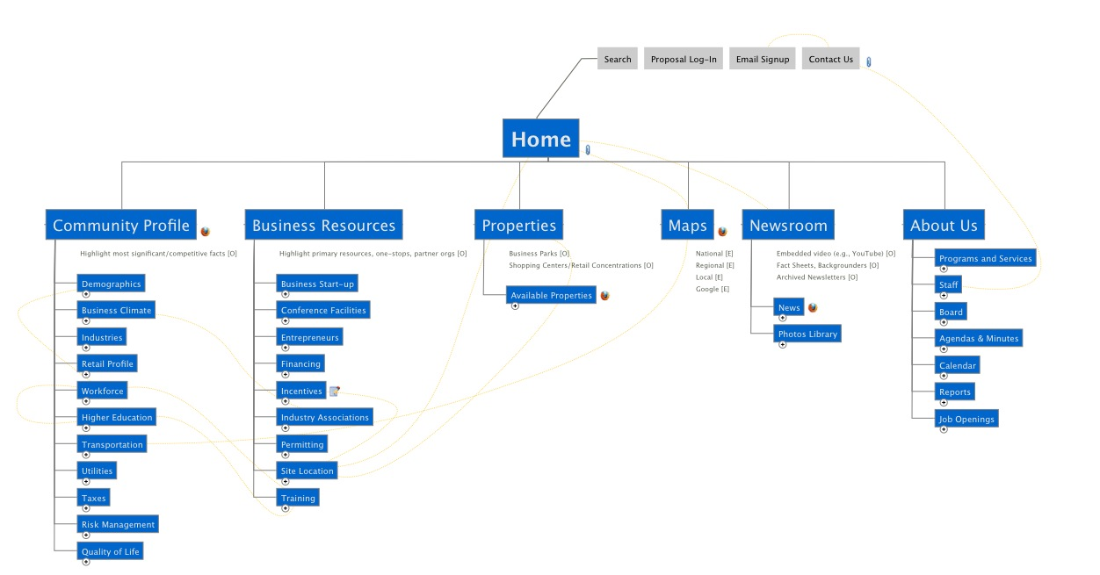
Sitemap Examples

Slide 9
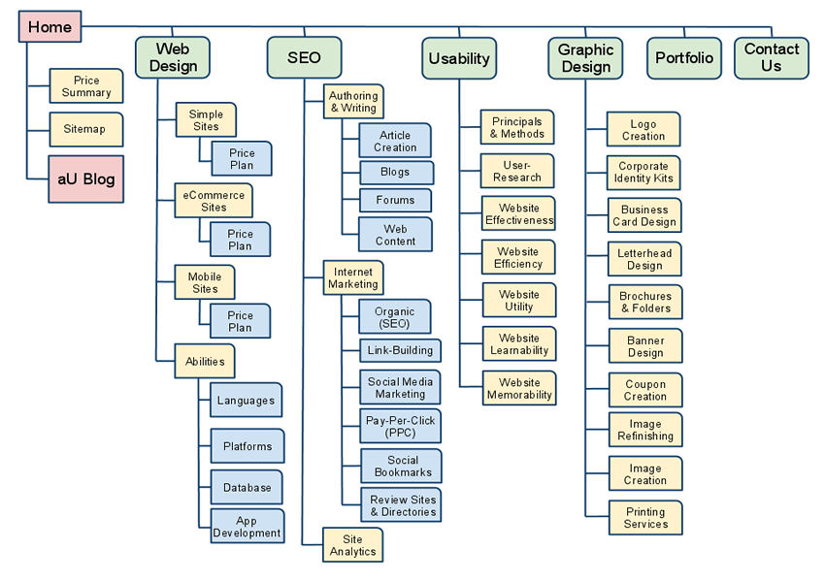

Slide 10
Demo MS Word Sitemaps

Slide 11
CSS Colors

Slide 12
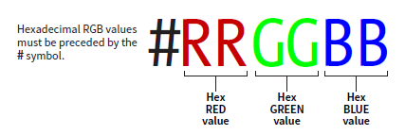
Hex Color

Slide 13
Color Pickers
Google Color Picker

Slide 14
New Selector

Slide 15
New Selector - Pseudo Selectors
Applies a style to a state of an element
What does an element look like when your mouse is over it
What does an element look like after it’s been clicked
What does a form filed look like when it is the one you are using
Etc.

Slide 16
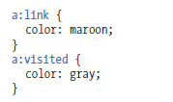
Pseudo Selectors

Slide 17
Pseudo Selectors

Slide 18
Css Backgrounds

Slide 19
Background Colors
body {background-color: coral;}

Slide 20
Background Images
body { background-image: url("paper.gif"); }

Slide 21
CSS Box Model

Slide 22
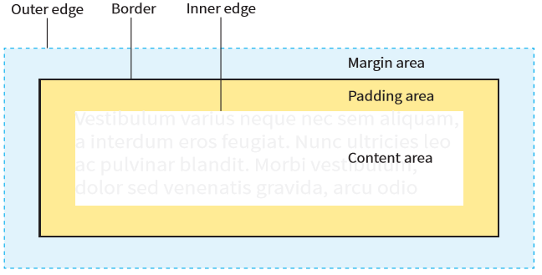
Element Box

Slide 23
Box Dimensions

Slide 24
Borders, Margins and Padding

Slide 25
participation

Slide 26
Time permitting:
Make page with a background image of Otto (our mascot) that repeats across the screen vertically and horizontally?
Add a paragraph that says: “I bleed orange.”
Change the background color of the paragraph to anything you want using the hex numbering system.
Put a non-black border around your paragraph.

