Slide 1
Analyse government’s medical emergency service failure and predict his improvment

Slide 2
Problem
The medical emergency system service since his effective deployment, is rated 23% of patient’s satisfaction with a rising death level along the years.
Due to that failure, the government want to understand the raisons and the different factors influencing the failure. The government’s goals is to master all these factors so that it can turn this failure into success.
The project’s aim is to use data from different sources like csv patient’s requests phone call record, geolocation of medical structure participating to the medical emergency service, csv file of district location in the town of Yaoundé; to predict medical structure able to better addressed a medical case, or closer to the patient’s location.

Slide 3
Data acquisition and cleaning
Two main sources :
Call center transcription files
District geolocation’s file

Slide 4
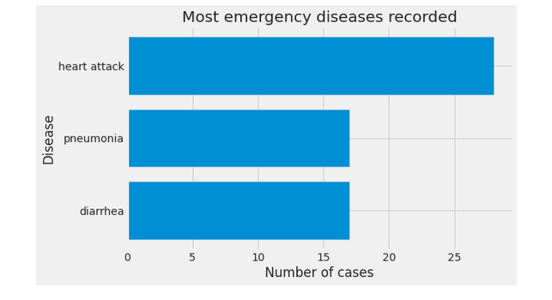
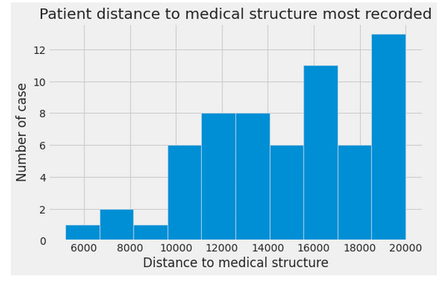
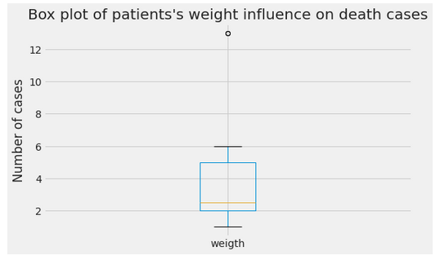
Exploratory data

Slide 5
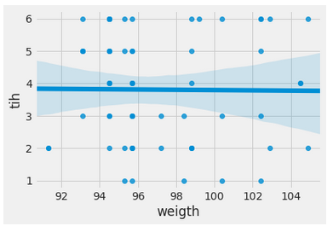
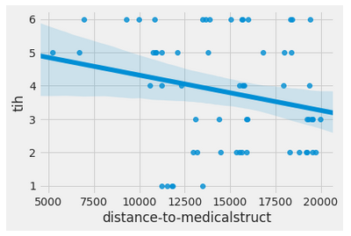
Regression model

Slide 6
Conclusion
Solutions should be :
- The government have to add more medical structure in the service, so that the in every district we have at least one medical structure capable to address patient case.
- The emergency care service should then be able to redirect the patient to the nearest medical structure from his location.
- Government has to associate more specialist doctor to the service and in each hospital delivering the service

