Slide 1
Bitcoin Transactions, Network and Nodes

Slide 2
Bitcoin Transactions
Bitcoin transactions include the following data:
Version
Number of inputs
Inputs
Number of outputs
Outputs
Time Lock
The following is an example; note the fields in the metadata:
hash is the hash of the transaction which is essentially its id
ver is version,
vin_sz is number of inputs,
vout_sz is number of outputs

Slide 3
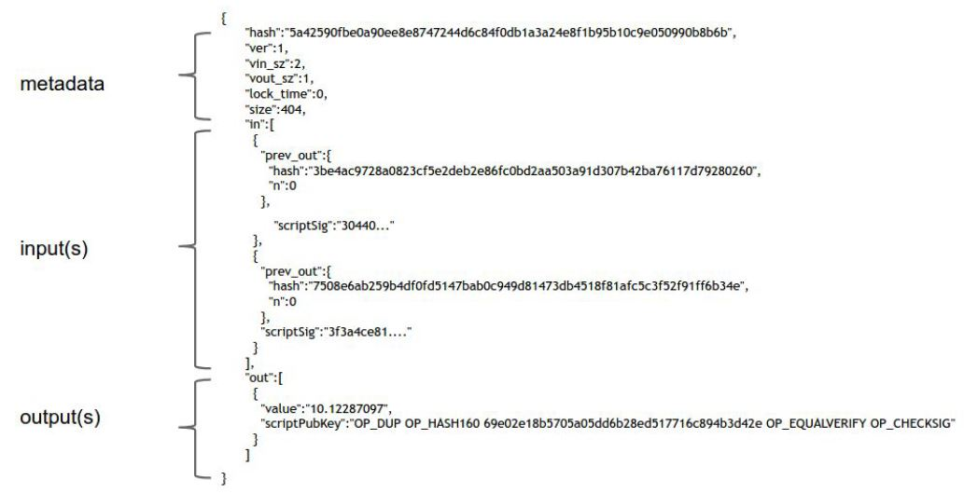
Bitcoin and Cryptocurrency Technologies, Narayanan, Bonneau, et. al

Slide 4
Bitcoin Block Explorers
The Bitcoin blockchain is public and is stored at every node.
There are many sites that have tools that provide a way to view the blocks and the transactions, such as
https://btc.com/
https://www.blockchain.com/explorer
https://live.blockcypher.com/btc/ (or live.blockcypher.com/btc-testnet/)
Most blockchain viewers provide drilldown and the ability to follow the chain of transfers of any given output (or input), or to view all transactions for any given address.

Slide 5
Block Explorers
Btc.com has quite a lot of info including the hash rates of the largest mining pools.
Blockcypher.com also has estimates of fees, as well as drilldown by block on the most recent blocks, and drilldown on transactions in the most recent block.
Notice that there are varying amounts of fees as a higher fee will make it more likely that a miner will include the transaction in the next block.
In Blockchain.info, if you drill down to a transaction you will see its scripts (more on these coming up).
You may also notice “weight” as one of its properties. Weight is related to the impact of the transaction size and is a factor used once segwit was envisioned and implemented. For traditional transactions it’s 4 x transaction size. For those with segwit, the additional fields in the segwit portion are discounted.

Slide 6
Bitcoin Transaction Scripts
As shown in a preceding slide, inputs to Bitcoin transactions include
A hash pointer to the transaction whose output is being spent
An index of which output of that transaction is being spent
Script signature information to redeem that output; for example a public key and a signature
The signature itself is the result of signing the current transaction info with a private key
Each output of a bitcoin transaction includes a script
That script implicitly indicates the type of transaction
To redeem the output, the recipient must supply script signature parameters that when combined with the output script, return true (without throwing an error)

Slide 7
Basic Transactions and Scripts
So a typical transaction contains
Input(s): previous transaction id, output position #, and a redeem script with a signature
Output(s): amount and public key script to hold the coins, typically containing the address to receive the coins
- Bitcoin has a stack-based scripting language that is used to validate transactions.
For a transaction to validate, the redeem script attempting to spend coins is prepended to the address script holding the coins (usually resulting in the redeem script values being pushed onto the stack at the start of execution), and the script is run. If it runs without error then then transaction validates.

Slide 8
P2PKH Transactions
There are several types of transactions, P2PKH (“Pay to Public Key Hash”) is the most common.
Originally Pay to Public Key (P2PK) was the common transaction type. In this type of transaction the recipient’s public key must be specified.
P2PKH uses an address, which is essentially a hash of a public key. So the public key of the coin holder is not exposed until those coins are spent, thus increasing anonymity.

Slide 9
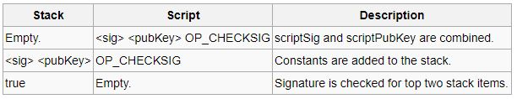
P2PK Script
Pay-to-Pubkey
Output script: <pubKey> OP_CHECKSIG
Required Input scriptSig: <sig> (only the signature need be supplied)
OP_CHECKSIG is used directly without first hashing the public key (unlike P2PKH). This was used by early versions of Bitcoin where people paid directly to public keys and/or their IP addresses, before Bitcoin addresses were introduced. It is still valid and is the default for the mining genesis transaction. The disadvantage of this transaction form is that the whole public key needs to be known in advance, implying longer payment addresses, and that it provides less protection in the event of a break in the ECDSA signature algorithm.

Slide 10
P2PKH Transactions
In a P2PKH transaction, the “recipient” is actually a public key script of the following form
OP_DUP //duplicates whatever is on top of the stack
OP_HASH160 //pops the top value and pushes its hash
public key hash //pushes the public key hash (from the address)
OP_EQUALVERIFY //pops the top two values and verifies that they are equal
OP_CHECKSIG //pops a key, then pops a signature and validates the transaction
The redeem script to spend the coins must contain the following
transaction signature //pushes the signature
public key //pushes the public key
To verify spending the coins, the former is appended to the latter and the combined script is run.
If it runs without error, the transaction signature is valid.

Slide 11
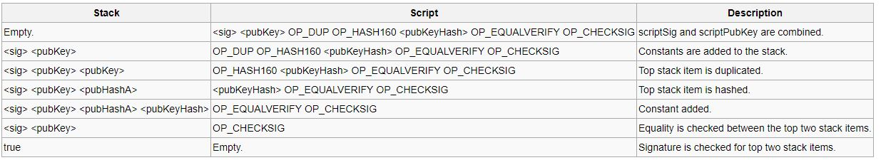
P2PKH Script
Pay-to-PubKeyHash (the vast majority of transactions are P2PKH)
Output script: OP_DUP OP_HASH160 <pubKeyHash> OP_EQUALVERIFY OP_CHECKSIG
Required Input scriptSig: <sig> <pubKey>
To spend coins that have been sent to a Bitcoin address, the recipient provides both the signature and the public key. The script verifies that the provided public key does hash to the hash in scriptPubKey, and then it also checks the signature against the public key.
en.bitcoin.it/wiki/Script

Slide 12
Other Bitcoin Transactions
Other common types of transactions are Multisig (P2MS) and P2SH (Pay to Script Hash)
(and recently “segwit” transaction versions* – more on that later)
A multisig transaction is one in which multiple signatures (m of n) are required.
The public key script (address) specifies how many signatures are required (m), the list of public keys that are potential signatories (n public keys), and the check multisig command.
There is a limitation on the maximum number of potential signatories which depends on the key lengths (compressed or uncompressed) and type of transaction (P2SH or not), but in any case the max is no more than 15, and more commonly 3 (unless P2SH).
*https://github.com/bitcoin/bips/blob/master/bip-0141.mediawiki

Slide 13
Multisig Scripts
The public key script is:
m {public keys} n OP_CHECKMULTISIG
The redeem script to spend it would be:
OP_0 {signatures}
When they are concatenated, all of the values are pushed onto the stack (so OP_0 is at the bottom and the n before the OP_CHECKMULTISIG is at the top) then the check is done
It pops n: how many public keys there are, then pops that many keys, then pops how many are required, then pops that many signatures
A 0 byte is required at the end, which is what OP_0 is
For each signature it will then iterate through the public keys to look for a match
If there are sufficient valid signatures, the transaction validates

Slide 14
Multisig Usages
Multisig transactions can serve many purposes, the most common of which are
A business account with multiple partners, where all or a majority are required to sign off on spending
Additional security, where another signature has to come from either another person or another device

Slide 15
Multisig Drawbacks
But a multisig transaction has a number of disadvantages;
It contains a lengthy payment script that may have to be sent to numerous partners (effectively like sending an address for payment)
That lengthy script must be stored in the UTXO until spent
The public keys are part of the script (rather than their hashes)

Slide 16
P2SH Transactions
P2SH is Pay to Script Hash. The output script contains only
OP_HASH160
A hashed value
OP_EQUALVERIFY
The redeem script must contain the serialized script as the top value on the stack. If other parameters are required by that script they should precede the script so they’ll be pushed on the stack first
{ …<sig(s)>… } <serialized script>
To validate;
The signatures and serialized script are pushed onto the stack
The serialized script is hashed and compared to the output script’s hashed value
If they match, the script itself is verified (must be a valid script, not P2SH)
The script is pushed onto the stack and executed, using any signatures as necessary
As usual, if it returns true the transaction is valid

Slide 17
P2SH Transactions
Theoretically any script could be hashed in a P2SH transaction
But there are script element and transaction size limitations
And in practice, most Bitcoin nodes use a white-list of valid transaction script formats. So while any non-standard script could be hashed to a valid P2SH transaction, it likely could never be redeemed.
Multi-sig of course is a valid script format, and most Multi-sig transactions now are sent as P2SH transactions, with the hash of the multi-sig script in the P2SH transactions

Slide 18
P2SH Benefits
P2SH has a number of benefits, particularly when the script is a multisig script
The original transaction size is reduced
The size of the script holding the coins in the UTXO is reduced
It provides a much simpler receiving address than a multisig script
In general it provides additional privacy in not displaying the actual script
In particular it does not display public keys as is done in a multisig script

Slide 19
Time Locks
Each transaction has an optional nLocktime (“lock_time”) parameter that indicates how soon the transaction can be included in the blockchain. That parameter can be either a block number or a Unix Epoch timestamp.
In addition, there is a OP_CHECKLOCKTIMEVERIFY script function that can be applied on an output level. It takes a single supplied parameter (similar to the nLocktime value), and verifies that the spending transaction’s nLocktime is greater than that. (added December 2015)

Slide 20
Time Locks
There is now also a relative time lock; the OP_CHECKLOCKSEQUENCEVERIFY script function lets a transaction essentially define a waiting period after a previous transaction is confirmed and its UTXO is recorded on the blockchain. (added May 2016)
The issue of timelocks has some interesting ramifications and complexity to it and is discussed in various BIPs (112, 113)
https://github.com/bitcoin/bips/blob/master/bip-0112.mediawiki
https://github.com/bitcoin/bips/blob/master/bip-0113.mediawiki

Slide 21
Other Scripts
Unspendable: Burn, Timestamping additional data
OP_RETURN {OP_DATA}
Return (which implicitly means return false) causes the transaction to be unspendable
Transactions such as this do not need to be stored in UTXO because they are unspendable
The optional OP_DATA means additional data can be included, the meaning of which can be interpreted in any way by any coordinated group of users. There is an 80 byte maximum size for the output data. This is sometimes used to hold the hash of a longer document or other item, proving ownership or possession at the time of the transaction.
Script codes: https://en.bitcoin.it/wiki/Script

Slide 22
Network
The Bitcoin network is a peer to peer network (P2P) or a decentralized network with no central point of failure or command.
All the nodes, or computers, that participate in the network are equal – there is no hierarchy – or no topology as the network is flat.
The Bitcoin network is a collection of nodes running the Bitcoin P2P protocol with other protocols such as stratum, used for mining or for lightweight mobile wallets (where the full block chain is not downloaded).

Slide 23
Network
Although the network is flat and all nodes are equal, some nodes perform a different task.
A full node does routing, holds a full copy of the blockchain database, may perform mining, and provides wallet services.
Any node has to provide the routing function to participate in the network.
Routing is just another way of saying that the node validates and passes on transactions and blocks as well as discovering and maintaining connections to other nodes, whether they are full nodes or not.
Some nodes don’t hold a full copy of the blockchain and verify transactions by using the Simplified Payment Verification, or SPV.

Slide 24
Network
Mining nodes now typically run specialized application specific integrated circuit chips to solve the proof of work algorithm.
Some of the mining nodes are full nodes while others are lightweight participating in pool mining and using a pool server to maintain a full node.
Wallets can be a full node – as is the case with downloading the full bitcoin client onto your desktop.
Mobile wallets however can’t hold the entire blockchain due to space requirements and are essentially simplified payment verification nodes or lightweight nodes.
Apart from these main classifications there are other servers and nodes running other protocols - such as alternative wallets and specialized mining pools. The main Bitcoin network currently averages about 8,000 to 10,000 nodes at any time.

Slide 25
Network
Usually clients learn about other clients by connecting to another client and issuing the 'getaddr' command.
When joining the network for the first time a new node must discover at least one other existing node. The ways that it finds other nodes are:
DNS seeding. The Bitcoin client includes a list of host names for DNS services that are seeded.
IP addresses of well known nodes. This is still in the Bitcoin client, though the exact IP addresses change every so often. This is used as a last resort.
Previously IRC was used, but did not lend itself to scaling

Slide 26
Network
The new node sends a series of messages and then if the other node wishes to form a connection it replies.
The new node must form multiple new connections to the network, as sometimes some nodes go offline from time to time as people switch their computers off.
Once this is done, the new node is meshed into the network and network resilience is further improved.

Slide 27
Full Node
A full node is a program that fully validates transactions and blocks.
Almost all full nodes also help the network by accepting transactions and blocks from other full nodes, validating those transactions and blocks, and then relaying them to further full nodes.
Most full nodes also serve lightweight clients by allowing them to transmit their transactions to the network and by notifying them when a transaction affects their wallet.
If not enough nodes perform this function, clients won’t be able to connect through the peer-to-peer network—they’ll have to use centralized services instead.

Slide 28
Full Node
Bitcoin Core full nodes have certain requirements. There are no firm minimum system specs, but the following are general guidelines. Running a node on weaker hardware may still work but also may experience some problems.
Suggested Requirements:
Desktop or laptop hardware running recent versions of Windows, Mac OS X, or Linux.
350 GB of free disk space, accessible at a minimum read/write speed of 100 MB/s.
2 gigabytes of memory (RAM)
A broadband Internet connection with upload speeds of at least 400 kilobits (50 kilobytes) per second
bitcoin.org/en/full-node

Slide 29
Full Node
Suggested Requirements (continued):
An unmetered connection, a connection with high upload limits, or a connection you regularly monitor to ensure it doesn’t exceed its upload limits. It’s common for full nodes on high-speed connections to use 200 GB upload or more a month. Download usage is around 20 GB a month, plus around an additional 340 GB the first time you start your node.
6 hours a day that your full node can be left running. (You can do other things with your computer while running a full node.) More hours would be better, and best of all would be if you can run your node continuously.
bitcoin.org/en/full-node

Slide 30
Block Storage and Files
Bitcoin blocks are linked by the hash of the previous block in a block’s header
That hash is also the index of the block
Bitcoin stores blocks internally in a binary structure (in blknnnn.dat files)
Bitcoin stores block indices and transaction indices in a LevelDB database
The UTXO database is also a LeveDB database
(prior to 2013 both were Berkeley DBs)
The Bitcoin Core wallet.dat file is a Berkeley DB

Slide 31
Block Storage
The block storage is transparent and accessing the block storage on a DB level is problematic for a running node.
But the Bitcoin Core client provides the necessary tools and APIs to access blocks or transactions.
So one could build one’s own block explorer, wallet, research tool, or other Bitcoin application.

