Slide 1
Bitcoin and Cryptography
Bernard Parenteau
bparente@fit.edu

Slide 2
Cryptography
Cryptography is central to the security of most all blockchains and cryptocurrencies, including Bitcoin.
Digital signatures using public-private key cryptography prove prior ownership and enable spending in most cryptocurrencies, including Bitcoin.
Hashing is used extensively; providing verification that transaction history blocks have not been altered, as the basis of the Proof of Work mining incentive, and more.

Slide 3
Symmetric and Asymmetric Cryptography
Symmetric cryptography is where data is encrypted and decrypted with the same key. For example when you encrypt data or a document with a password, and that password is then used to decrypt it; that is symmetric cryptography.
This is also typically used in file and database encryption.
Public-private key cryptography is asymmetric cryptography, meaning that the key used to decrypt is different from the key used to encrypt. When data is encrypted with the private key, it can only be decrypted with the public key, and vice versa.

Slide 4
Symmetric and Asymmetric Cryptography
Asymmetric cryptography is typically more computationally heavy, particularly for longer messages. So many schemes use asymmetric cryptography to pass a symmetric cryptographic key that is then used to encrypt/decrypt messages in the session.
One side must have a public key that is known or discoverable by the other.
In SSL/TLS and other protocols the website must send a certificate (issued by a Certificate Authority) to the user so they can verify the website’s identity and get their public key. The user’s browser can then encrypt a message to the server using their public key, and only the server can decrypt. There is some housekeeping setup but basically the website and user can then agree on communication details and a symmetric key that will be used to encrypt/decrypt subsequent messages in the session.

Slide 5
Public-Private Key Algorithms
There are several asymmetric algorithms including DSA (Digital Signature Algorithm), RSA (Rivest-Shamir-Adleman), Elliptical Curve cryptography (aka ECDSA), and others.
Bitcoin uses Elliptic Curve cryptography with the secp256k1 standards. Those standards refer to the specific elliptic curve equation that is used.
Bitcoin was a relative pioneer in using these standards. The curve used lends itself to efficient processing and has been well-tested.
The elliptical curve function is generically y² = x³ + ax + b, and in Bitcoin’s case is actually y² = x³ + 7 over numbers that are modulo a very large prime number.

Slide 6

Bitcoin ECDSA curve
Elliptic curve actually refers to a function that can be thought of as graphed on and x and y axis.
y = x³ + 7
https://en.bitcoin.it/wiki/File:Secp256k1.png

Slide 7
Bitcoin ECDSA
The curve has several valuable properties, including that intersecting lines have 3 intersection points (for vertical lines, the point at infinity is used as the third) and tangents of points on the curve will have just one intersection point with the curve.
When intersection points P and Q are “added” the result is the other intersection point of the line between them and the curve.
When a point P on the curve is “added” to itself the result is that point’s tangent line’s other intersection point with the curve.
Repeated adding of a point to itself is ECDSA’s “multiplication”, which is used in the generation of the public key from the private key (and generator point)
For details of ECDSA addition and multiplication functions, see:
https://en.wikipedia.org/wiki/Elliptic_curve_point_multiplication

Slide 8
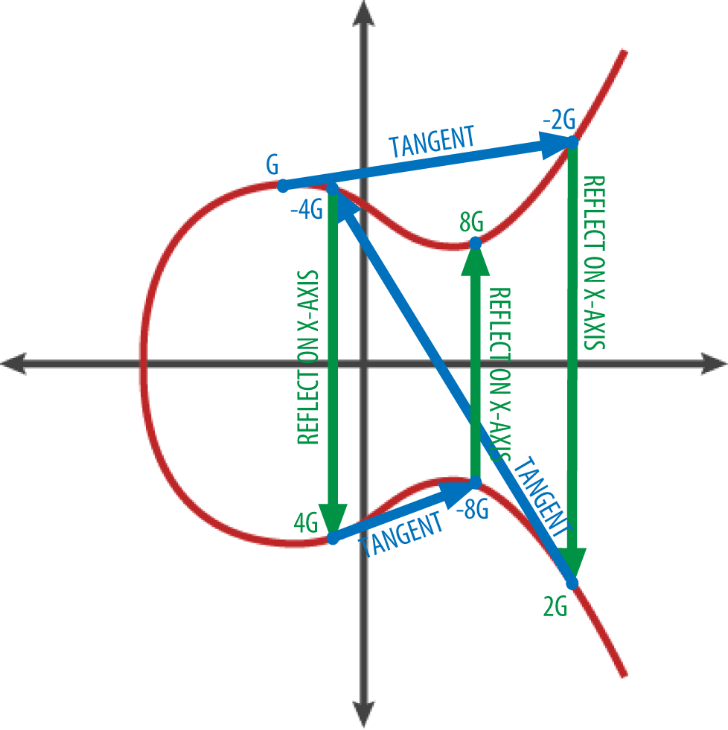
Bitcoin ECDSA
From Mastering Bitcoin, Antonopoulos

Slide 9
Bitcoin ECDSA
The variables used in the equation by Bitcoin are 256 bit numbers, so the coordinates are unimaginably large.*
And in Bitcoin (like other ECDSA), the function is over a field of numbers up to a very large prime number, meaning the coordinates are actually the modulos (remainders) of division by that very large prime number. So the actual graph looks more like a scatter-plot, but it retains the properties of the underlying function. (see stackexchange link below)
https://bitcoin.stackexchange.com/questions/21907/what-does-the-curve-used-in-bitcoin-secp256k1-look-like
Given a randomly selected 256 bit private key, a point on the curve (the base point, or generator point G, defined in Bitcoin’s secp256k1 spec) is multiplied by that value to get another point on the curve which is the public key (in compressed form it’s the x value, with a prefix).
These private and public keys will have properties that data encrypted in a certain way by one can be decrypted or verified by the other.
*Every 10 bits is 1024 and so represent a little more than three 0’s in decimal (1,000). So 250 bits in decimal is more than a 1 followed by 25 sets of three 0s.

Slide 10
Secp256k1
The secp256k1 standard was not commonly used before Bitcoin became popular but since has gained in popularity due to several nice properties, one perhaps lesser-known.
Most commonly-used elliptic curves have a random structure, but secp256k1 was constructed in a special non-random way which allows for especially efficient computation.
As a result, it is often more than 30% faster than other curves if the implementation is sufficiently optimized.
https://en.bitcoin.it/wiki/Secp256k1

Slide 11
Secp256k1 v Secp256r1
Unlike other popular NIST (National Institute of Standards and Technology) curves, secp256k1's constants were selected in a predictable way, which reduces the possibility that the curve's creator inserted any sort of backdoor into the curve.
This is of particular interest as secp256r1 was more commonly used at the time Bitcoin was created, and the specifications of secp256r1 were similar to those of another elliptic curve random number generator algorithm Dual_EC_DRBG which was found to have a secret “backdoor”*.
The US National Security Agency (NSA) developed the algorithms and that backdoor was known to the NSA, if not originally at least after it was first mentioned as a possibility by cryptography researchers, though it was still promoted by the NSA.
*https://arstechnica.com/information-technology/2015/01/nsa-official-support-of-backdoored-dual_ec_drbg-was-regrettable/

Slide 12
Secp256k1 v Secp256r1
If a similar weakness was in secp256r1 as was in the elliptic curve random number generator algorithm DUAL_EC_DRBG, which is entirely possible, that would make calculation of the private key from a secp256r1 public key less computationally intensive than just brute force (which is not feasible given the size of the numbers).
So it was fortunate, if not prescient, that Bitcoin chose secp256k1 rather than secp256r1 which was more commonly used at the time of Bitcoin’s creation.

Slide 13
Secp256k1 v Secp256r1
No vulnerabilities have been found in secp256k1, though it is possible that there are some given the fixed parameters and fixed, seemingly arbitrary, generator point. And it was the NSA that originally developed and gave the algorithms to the NIST.
And in any case, now most Bitcoin transactions (P2PKH, P2SH) don’t display public keys until the outputs are spent, which provides another buffer against a vulnerability in secp256k1.

Slide 14
Extended Keys
BIP-0032 introduces extended keys and Hierarchical Deterministic wallets (“HD Wallets”)* and describes how multiple private keys can be generated from a single extended key.
BIP stands for Bitcoin Improvement Proposal and is the form that all proposed and actual updates to the Bitcoin Core code are described in.
The extended key in BIP-0032 consists of the usual 256 bit private key plus another 256 bit value called a chain code
From these, up to 2³¹ (> 2 billion) child private keys can be derived.
And each child key can itself be used to derive children, in a classic tree structure
A key has access to all its children, but a child key does not have access to siblings or ancestors
*https://github.com/bitcoin/bips/blob/master/bip-0032.mediawiki

Slide 15
Extended Keys
The idea is that a company may have a master private key and create child private keys for its departments or branches
Or the public master key could be used by auditors to review transactions from all departments
Note: doing both of the above can be a security leak as the master private key may be able to be inferred or calculated given the master public key and one or more child private keys
The other use of extended keys is that a wallet could create effectively any number of additional addresses as needed, and the backup would need only the original parent key

Slide 16
Bech32
Bech32 is a segwit address format specified by BIP-0173, and is sometimes referred to as bc1 address format
The data part includes only digits and lower case alphabetic characters excluding "1", "b", "i", and "o“, resulting in 32 possible characters, for base 32 encoding
A Bech32 string is at most 90 characters long and consists of:
A human-readable part, from 1 to 83 ASCII characters in length, which indicates the type of data. For Bitcoin segwit addresses “bc” means mainnet and “tb” means testnet.
A separator, which is always "1". (In case "1" is allowed inside the human-readable part, the last one in the string is the separator.)
A data part, at least 6 characters long and only consisting of the Bech32 characters
The last six characters of the data part form a checksum and contain no information
Rationale
Why use base32? The lack of mixed case makes it more efficient to read out loud or to put into QR codes. (and a base that is a power of 2 may be appealing for binary data)
Why call it Bech32? "Bech“ is a convenient acronym for BCH (which is the error detection algorithm used) and Bech32 sounds like and may imply base 32.
https://github.com/bitcoin/bips/blob/master/bip-0173.mediawiki

Slide 17
Bech32 v Base58
For most of its history, Bitcoin has relied on base58 addresses with a truncated double-SHA256 checksum. However, both the character set and the checksum algorithm have limitations*:
Base58 needs a lot of space in QR codes as it cannot use the alphanumeric mode because of the mixed upper and lower case characters with different meanings.
The mixed case in base58 makes it inconvenient to reliably write down, type on mobile keyboards, or read out loud.
The double SHA256 checksum is slow and has no error-detection guarantees.
Most of the research on error-detecting codes only applies to character-set sizes that are a prime power (integer exponent of a prime number), which 58 is not.
Base58 decoding is complicated and relatively slow.
(more on Base58 addresses in another lecture)
*https://github.com/bitcoin/bips/blob/master/bip-0173.mediawiki

Slide 18
Hashing and Hash Algorithms
We’ve seen that Bitcoin transactions typically pay to a hashed address. So what is a hash?
A hash function​ is a mathematical function with the following properties:
Its input can be any string of any size.
It produces a fixed size output. For Bitcoin, that is a 256‐bit output size, though for hashing in general it need not be 256 bits.
Regardless of the input string length, the hash function will retain its relative efficiency. More technically, computing the hash of an n‐bit string should have a running time that is O(n). In other words, for an input string that was 10 times as long as another, it would take no more than 10 times as long to compute. It does not get exponentially more time-consuming as the length of the input increases.
In practice, it must be relatively efficient to compute.

Slide 19
Hashing and Hash Algorithms
A secure hash function also needs the property that given a hash output, it is practically impossible to determine the input.
Since any string of any length could be an input, and outputs are limited to strings of 256 bits, clearly multiple inputs must match to the same output.
So more precisely the required property is that there is no computationally feasible way to determine a possible input from a given output.

Slide 20
Hashing and Hash Algorithms
For that property to hold, the potential inputs must not be limited to a finite set (especially a relatively small set) because if they were the hashes to all those could be pre-calculated and compared to any given output to determine the input.
Ideally, no potential inputs should be particularly likely, or they would be vulnerable to looking up the precalculated outputs (e.g. in “Rainbow Tables”).
Given that for Bitcoin the inputs are, or include, public keys (random 256 bit numbers), this is satisfied.
These latter points, relating to the unpredictability of inputs, are equivalent to saying in information theory terminology, that our set of inputs must have high min-entropy.

Slide 21
Hashing and Hash Algorithms
The other hash function property that we need for an application such as mining is “puzzle‐friendliness”.¹
​For example, say
x is an input string (from an unpredictable set of inputs; one with high min-entropy)
y is a nonce (a number to be chosen by the problem solver)
z is an n-bit hash output of x concatenated with y.
n is the bit length of z
A hash function is said to be puzzle‐friendly if given x and z, the computations (i.e. time) required to find y such that the Hash result of x concatenated with y equals z is not less than on the order of 2^{n} .¹
Which means that it is exponentially difficult to find a nonce that when included with the input, produces the desired output
¹Note: see reference 1, the Bitcoin and Cryptocurrency Technologies text (chapter 1) for more mathematical detail on the hash properties described here, and for the basis of some of the preceding.

Slide 22
Hashing and Hash Algorithms
The hash function used in Bitcoin is SHA-256. Actually double SHA-256 as the hashed value is again hashed to get the result.
There are many other hash algorithms, from simple checksums to increasingly sophisticated functions such as SHA-256 and beyond.
SHA stands for Secure Hash Algorithm and there are several varieties.

Slide 23
Hashing and Hash Algorithms
In some cases the numeric suffix of the name (e.g. 256 in SHA-256) refers to the length of the output. There are longer and shorter versions of SHA.
In other cases, the numeric suffix refers to what is essentially a version number. SHA-1 was effectively the original which was developed by the NSA (US National Security Agency). Its output is 160 bits.
For the last decade or so, SHA-1 has been thought to be vulnerable in that collisions (inputs resulting in the same output) could be found.
SHA-2 encompasses a set of algorithms with varying output length, from SHA-224 to SHA-512 varieties, including the SHA-256 used by Bitcoin.

Slide 24
Hashing and Hash Algorithms
SHA-1 and SHA-2 were based on MD algorithms (Merkle-Damgard) as used in the family of algorithms by that name (i.e. MD1, … MD5). MD5 has 128 bit output.
As mentioned, SHA-1 was thought to be potentially vulnerable to collisions. In recent years there have been demonstrated attacks on SHA-1, MD5, and earlier versions.
Since 2015 there have been SHA-3 versions released by NIST (National Institute of Standards and Technology).
SHA-3 is based on a different Algorithm, Keccak, than preceding SHA versions. SHA-3 was designed such that it could be substituted for earlier versions.
NIST has not withdrawn SHA-2 as it is still considered secure. And though there are SHA-512 versions, SHA-256 is still considered sufficiently secure. (with 2²⁵⁶ or approx 10⁷⁷ possible output values).

Slide 25
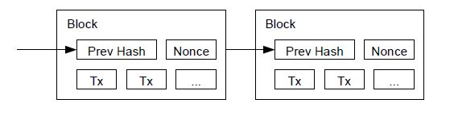
Hash Pointers
​​Bitcoin transactions are grouped into blocks and each block is linked to the previous block with a hash pointer.
A hash pointer is a pointer to where data is stored together with (or as) a cryptographic hash of the value of that data.
In the case of Bitcoin the hash is the block id whose location can be looked up in an internal index table
A Blockchain can be thought of as a linked list of hash pointers, where each transaction block contains a hash pointer to the previous block.
Diagram from original Satoshi Nakamoto Bitcoin whitepaper

Slide 26
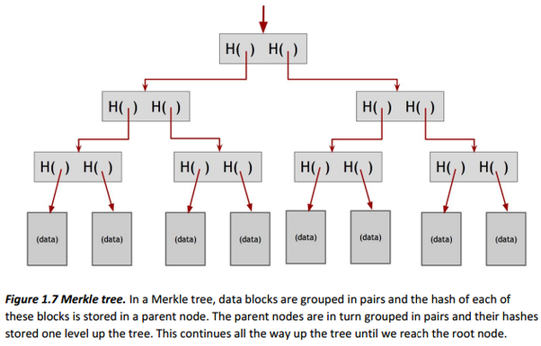
Merkle Trees
​​Hash pointers are also used in Merkle trees, which are like binary trees.
Merkle trees are used within Bitcoin blocks to enable efficient verification that a transaction is contained in a block (log₂ (n) hashes)
https://www.quora.com/What-is-the-coolest-data-structure-What-makes-it-so-cool

Slide 27
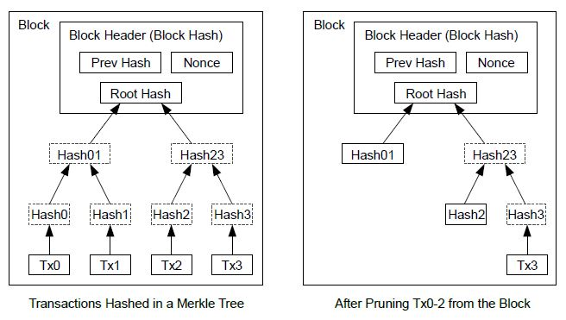
Bitcoin Merkle Trees
Bitcoin also uses this Merkle tree structure to enable trimming spent transactions from history thereby saving space but still allowing transaction verification.
Diagram from original Satoshi Nakamoto Bitcoin whitepaper
See https://bitcoin.stackexchange.com/questions/50674/why-is-the-full-merkle-path-needed-to-verify-a-transaction

Slide 28
Other Cryptocurrencies’ Cryptographic Techniques
Although Bitcoin’s cryptography secures its blockchain, its blockchain is publicly available and inferences can be made about transactions.
Other cryptocurrencies have additional security features that are meant to guarantee, or at lease enhance, anonymity.
Monero uses stealth addresses in that a new address is generated for each transaction (even if multiple transactions send funds to the same address that address wouldn’t be saved on the blockchain) so multiple transactions cannot be linked to a single address. It also uses “Ring Signatures” so the actual signer of a transaction cannot be determined, and RingCT (Ring Confidential Transactions) that allows transaction verification without knowledge of the transaction amount. However Monero transaction processing is computationally heavy and therefore relatively slow, which would be problematic with higher transaction volumes.

Slide 29
Other Cryptocurrencies’ Cryptographic Techniques
Zcash uses a cryptographic technology called zkSnarks that allows verification with less knowledge. zkSnarks technology is however also computationally heavy.
Bitcoin verification requires the sender’s public key, the previous transaction in which they received the amount they are spending, and all the output addresses. This is not true for Zcash.
Zcash is run by a for-profit company and sponsored in part by several US and Israeli government agencies.
Zcash began as a fork of Bitcoin.
There are now several other coins forked from Zcash (ZenCash, Komodo, Zclassic)

Slide 30
Other Cryptocurrencies’ Cryptographic Techniques
Dash uses mixing to enhance privacy. Mixing is something that can also be done with Bitcoin. A third party “mixer” takes multiple transactions from multiple senders, and sends them through several iterations of sets of transactions with different amounts in each before the final destination is reached for each (less a small fee for the mixing). This makes transactions very difficult to trace.
On the potential downside is that the mixing servers must be trusted, and the process takes several rounds of transactions which can take some time in Bitcoin and add to the total transaction fees.
Other coins with a focus on privacy include Verge (with a tor equivalent for ip address obfuscation), PIVX, Sumokoin and others.

Slide 31
Further Reading suggested by Link 1 (“Bitcoin and Cryptocurrency Technologies” text, Narayannan et al)
An accessible overview of digital cash schemes focused on practical issues:
P. Wayner. Digital Cash: commerce on the net (2nd ed). Morgan Kaufmann, 1997.
A cryptographically-oriented overview of e-cash systems (Chapter 1) and micropayments (Chapter 7):
B. Rosenberg (ed.) Handbook of Financial Cryptography and Security. CRC Press, 2011.
Although not Chaum’s earliest paper on e-cash, this is arguably the most innovative, and it formed a template replicated by many other papers:
D. Chaum, A. Fiat, M. Naor. Untraceable electronic cash. CRYPTO 1998.
Many papers improved the efficiency of Chaum-Fiat-Naor using modern cryptographic techniques, but arguably the most significant is:
J. Camenisch, S. Hohenberger, A. Lysyanskaya, Compact e-cash. Theory and Applications of Cryptographic Techniques, 2005
Some practical security observations on the financial industry and proposals, including Mondex:
R. Anderson. Security Engineering (2nd ed). Wiley, 2008.
An overview of the implementation of Chaum’s ecash proposal:
B. Schoenmakers. Basic security of the ecash payment system. State of the Art in Applied Cryptography, 1997.
Two papers cited by Satoshi Nakamoto in the Bitcoin whitepaper that are integral to Bitcon’s design:
A. Back. Hashcash - A Denial of Service Counter-Measure, Online, 2002.
S. Haber, W. S. Stornetta. Secure names for bitstrings. CCS, 1997.

Slide 32
References
https://lopp.net/pdf/princeton_bitcoin_book.pdf
https://cryptography.io/en/latest/hazmat/primitives/asymmetric/
http://www.secg.org/sec2-v2.pdf
https://crypto.stackexchange.com/questions/8914/ecdsa-compressed-public-key-point-back-to-uncompressed-public-key-point
https://en.bitcoin.it/wiki/Secp256k1
https://en.wikipedia.org/wiki/Elliptic_Curve_Digital_Signature_Algorithm
http://chimera.labs.oreilly.com/books/1234000001802/ch07.html#block_hash
https://web.archive.org/web/20130718172549/https://www.rsa.com/rsalabs/node.asp?id=2182
https://github.com/bitcoin/bips/blob/master/bip-0032.mediawiki

