Slide 1
Bitcoin Wallets
Bernard Parenteau
bparente@fit.edu

Slide 2
Addresses
As we’ve seen, most Bitcoin transactions are Pay to Public Key Hash, which is paying to an Address that is derived from a public key.
The recipient then needs to supply the public key and to use the corresponding private key to sign a transaction to spend the Bitcoins that they received.
Some Bitcoin transactions are Pay to Script Hash, in which case the script must be supplied to later spend the Bitcoins.
In both cases the transaction pays to a “hash” or an address.

Slide 3
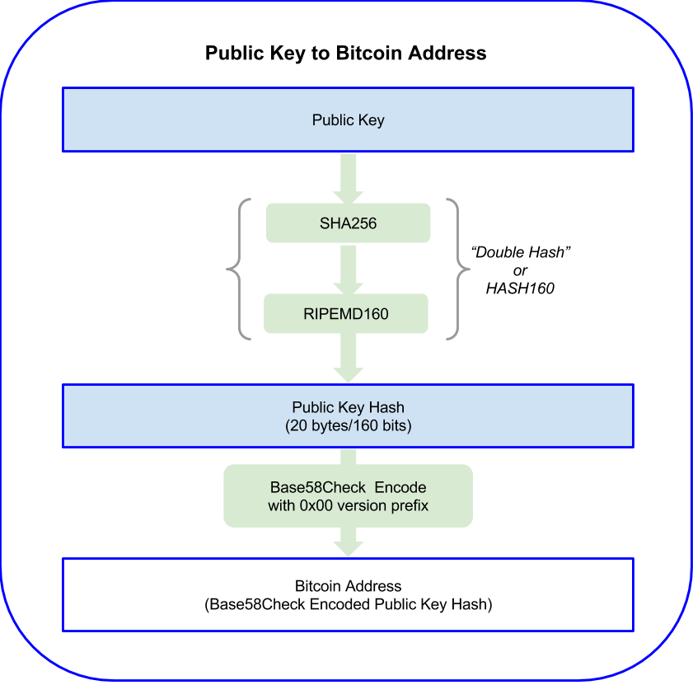
Mastering Bitcoin, Antonopoulos

Slide 4
Addresses
Looking at Bitcoin transactions and clicking on an address, we may see both a Bitcoin address and a Hash160.
The Hash160 is 20 bytes, displayed as 40 hexadecimal digits. This is the hashed value of the public key or script.
The Bitcoin address contains a leading byte (“version”) that indicates type, the 20 byte Hash160 value, and a trailing 4 byte checksum, both added to help avoid address mistakes.
Wallets and other payment software can check that the first 21 bytes hash to a value that starts with the checksum. If not, it’s a typo, and is not a valid address.
So the Bitcoin address is 25 bytes, and usually displayed in Base 58.
Base 58 contains digits 1 to 9 and all upper and lower case letters not including capital O and capital i (I) and lower case L (l).
So in Base 58: 1 means 0 … 9 means 8, A means 9, and z means 57.

Slide 5
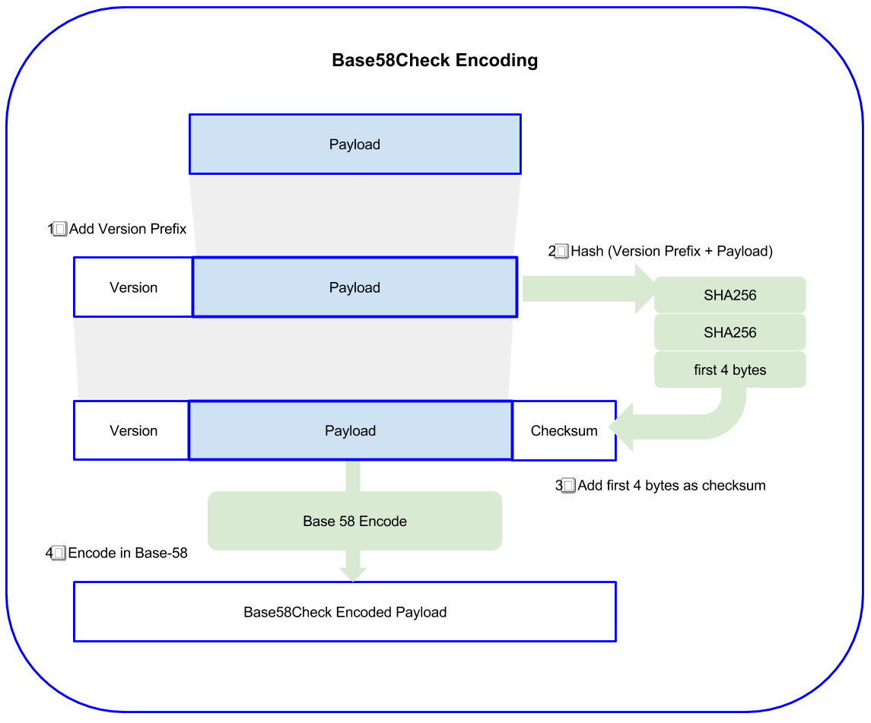
Mastering Bitcoin, Antonopoulos

Slide 6
Base 58 Encodings and Prefixes
Type Version prefix (hex) Base-58 prefix
Bitcoin P2PKH Address 0x00 1*
Bitcoin P2PKH Testnet Address 0x6F m or n
P2SH, Multisig Address 0x05 3 (testnet: 2)
BECH32 Address bc1
Private Key WIF 0x80 5, K or L
WIF: Wallet Import Format (https://en.bitcoin.it/wiki/Wallet_import_format)
BIP38 Encrypted Private Key 0x0142 6P
Used for paper wallets (https://bitcoinpaperwallet.com/bip38-password-encrypted-wallets/)
BIP32 Extended Public Key 0x0488B21E xpub
Used for hierarchical keys
* There is no 0 in base 58; the first character is 1 which represents 0

Slide 7
Bitcoin Address QR Codes
Bitcoin addresses can also be displayed as QR codes
QR (Quick Response) codes are the square black and white checkerboard of small squares that are scanned and used in many applications.
Originally developed by the Japanese automotive industry in the 1990s, it has become widely used with its ability to store more info than the standard UPC barcode.
Bitcoin QR codes allow scanning by mobile software to facilitate easy payments
A merchant can display the code for their payment address, and mobile software such as Zxing (Android) can read the code
Many mobile wallets have built in ability to generate and read QR codes

Slide 8
Wallets
So to receive Bitcoin, one needs a public key, and to spend Bitcoins that are received one needs the corresponding private key.
Bitcoin wallets don’t really hold funds, of course. The Bitcoin blockchain essentially holds all the coins.
Bitcoin wallets are ways to securely generate and store private keys and public keys that can be used to send and receive funds.
“Hot wallets” are those that are connected to the internet and immediately able to send/receive funds.
“Cold wallets” or “cold storage” or “offline …” means that the wallet that holds the keys is not network-connected.

Slide 9
Wallets
In addition to the hot/cold distinction, there are several types of wallets:
Software wallets
Desktop / Mobile / Online
Full nodes / Lightweight
Open Source /Proprietary
Hardware wallets
Paper wallets

Slide 10
Bitcoin Core Wallet
The Bitcoin Core is a full node, open source, desktop application that includes a Bitcoin wallet.
It is part of the Bitcoin reference client, originally developed by Satoshi Nakamoto and maintained by Bitcoin.org.
It is written in C++ and can be found at https://github.com/bitcoin/bitcoin/tree/master/src/wallet
Full node means that when you download the wallet you will also download the entire Bitcoin blockchain.
This will take time and disk space; the blockchain size is well over 300GB. (expect a few hours or so with good download speeds).
Since you will have the entire Blockchain history you can now independently verify transactions on the network and do not need to trust anyone else in the system.

Slide 11
Bitcoin Core Wallet
The positive aspects include:
It is trusted and has good security controls and privacy for incoming and outgoing transactions.
Compatibility with Tor
GUI or command line tools
Fully validates bitcoin transactions
Contributes to decentralized bitcoin system
The potential downsides include:
The initial download can take a while depending on the connection, and will require well over 300GB + of disk space
Can be expensive on metered connections
The GUI is not the most user-friendly
It stores only Bitcoin

Slide 12
Electrum Wallet
Electrum is a Lightweight (Simple Payment Verification, not full-node) Bitcoin wallet that is very highly regarded.
https://electrum.org
Electrum is free, decentralized, and considered one of the more feature-rich yet efficient and secure desktop Bitcoin wallets.
It’s open source, so minimal chance of malicious code as code can be verified.
It is one of the few wallets that allows you to replace the fee you’ve set to an already broadcasted transaction. This is useful when transaction confirmation is delayed due to congestion, waiting transactions and the resultant spiking fees.
It has many other features including multisig, recovery, key export, etc.
It also has built-in support for hardware wallets for cold storage.
It’s available for desktop and mobile.

Slide 13
Exodus Wallet
Exodus is a desktop multicurrency wallet with a very nice GUI.
It supports dozens of crypto-currencies.
It’s not open source, so some may perceive this as a risk. Given that, it may be advisable to not use it to hold large amounts.
The GUI is intuitive, easily navigated, and contains the nice features found in online exchange accounts such as displaying cumulative values, and the ability to transact in any of the many supported cryptocurrencies.
It uses a cross-currency trading interface, ShapeShift, to facilitate immediate cross-currency trading.

Slide 14
Armory
Armory is an open source desktop Bitcoin wallet that is meant to offer the maximum in security for even large amounts of Bitcoin.
One of the important features is the integration with cold storage in the form of offline wallets.
These offline wallets require no synchronization except for the initial transfer of a “watching-only wallet” to the online computer with the online Armory wallet.
The watching-only wallet functions similar to a regular wallet except that it does not contain any private data and so cannot send coins.
But it can generate new addresses and verify incoming payments the same way a regular wallet does.
To send coins from an offline wallet, the user creates an “unsigned” transaction with the watching-only wallet, then takes it to the offline computer (e.g. via a USB stick) to obtain the signature from the cold storage wallet.
The transaction can then be brought back to the online computer to be finalized and transmitted. So the private keys remain offline in cold storage.

Slide 15
Mobile Wallets
The most popular mobile wallets include Mycelium (Android), breadwallet (iOS), Copay (iOS & Android), and Jaxx (Android), and Trust Wallet (iOS & Android).
A number of the wallets mentioned in previous slides, such as Electrum also have mobile app interfaces
A number are open source and free, including breadwallet, Copay and Trust Wallet
Most have reasonably good security, a nice user interface and the usual send/receive features with QR generation and scanning
Many also support linkage with bank accounts for coin purchases.

Slide 16
Web Wallets
Many exchanges provide services that can be thought of as online wallets
Users log on and then have access to their accounts / wallets

Slide 17
Web Wallets: Copay, GreenAddress
Copay
An open source, online Bitcoin wallet created by BitPay, one of the largest Bitcoin payment services
Available for desktop (Windows, Mac, Linux) as well as mobile
Supports multisig transactions
Open source, available since 2014
GreenAddress
Online Bitcoin wallet created by GreenAddress, Malta
Available for desktop (Windows, Mac, Linux) as well as mobile
Easy access for balance watch checks
Two factor authentication
Supports multisig transactions
Supports hierarchical keys, P2SH
API

Slide 18
Hardware Wallets
A hardware wallet is a physical electronic device, built for the sole purpose of securing bitcoins.
Hardware wallets are perhaps the most secure
They are effectively “cold storage”
The hardware wallet must be connected to your computer, phone, or tablet, or to temp storage such as a memory stick containing a transaction, before a transaction can be signed so bitcoins can be spent.
Since they are hardware, they are not free; most are priced in the $60 to $150 range
A hardware wallet is a good choice if you’re most concerned about security with reasonably convenient features.

Slide 19
Hardware Wallets
Your private keys are maintained in a secure offline environment on the hardware wallet, fully protected even should the device be plugged into a malware-infected computer.
Hackers would have to steal the hardware wallet itself, but even then, it is typically protected with a PIN code.
If the hardware wallet is stolen, lost or damaged users can recover their coins with their backup code.
The most popular hardware wallets include Trezor, Ledger Nano S, and KeepKey

Slide 20
Trezor
Trezor was one of the first popular Bitcoin hardware wallets and remains one of the leading hardware wallets.
It now also has support for most ERC20 tokens
It has a web interface that works through a downloadable Trezor Bridge desktop app or a Chrome extension to connect to the Trezor hardware wallet.
There is also a Trezor Manager app for Android
Transactions can be entered through the interface and confirmed through the connected hardware
When the Trezor hardware is connected, it must be unlocked with its PIN

Slide 21
Paper Wallets
Paper wallets are printed hard-copies of private key / public key pairs and their QR codes, with the private side typically sealable.
Many wallets support scanning and Wallet Import Format.
The downsides include
One has to be careful when generating and printing to ideally not be connected, and to use a dumb printer.
There is also the issue of storage; paper is easily destroyed and not particularly durable.

Slide 22
Paper Wallets
There are several sites that support paper wallets and random key generation
Bitaddress.org is an open-source random address and key generator that uses the browser’s JavaScript engine, so no keys are sent over the internet, and use mouse movement to create randomness
That random sequence is then used to generate your public and private keys, which are displayed on the next screen for printing
Bitcoinpaperwallet.com will create a printout of a colorful paper wallet with the appropriate fold lines and will sell you tamper-evident stickers for sealing it shut.
Mycelium offers an even more secure way to generate paper wallets, with a USB dongle that you plug directly into your printer. The device generates a paper wallet that automatically gets printed out, without ever having touched your computer.

Slide 23
CoolWallet S
Cool Wallet S syncs a mobile wallet to a chip on a credit card sized card using Bluetooth
So a physical second factor must be used to send coins
The card contains a couple small rechargeable Lithium Ion batteries which can usually go over a month between recharges
A card is paired with a wallet, and can actually be paired with multiple wallets
The mobile wallet can be recovered with the passphrase.

Slide 24
CoolWallet S
When a transaction is to be signed, the card must be in proximity to the mobile device with the wallet
The mobile wallet sends transaction info to the card which displays a summary and lets the users approve signing it or not
The card is relatively resilient, even being waterproof
If the card is lost or damaged, another card may be sync’d with the wallet.

Slide 25
Hierarchical Wallets
Hierarchical wallets allow use of an essentially unlimited number of private keys generated and available only on the cold side, with corresponding public addresses available on the hot side, with only a short, one-time communication between the two sides.
The technique relies on public/private cryptographic properties specific to the specific algorithm
In typical key generation there is a function that generates a secret private key and from that derives a public key (which in turn can generate an address)
In a hierarchical wallet, instead of generating a single private key and address a hierarchical function generates private key generation parameters and address generation parameters.
Given the address generation info, the hot side can generate a sequence of addresses: the address generation function takes the address generation info and any integer i and generates the i 'th address in the sequence.
Similarly the cold side can generate a sequence of private keys using the private key generation info.

Slide 26
BIP-0032
BIP-0032 introduces Hierarchical Deterministic wallets (“HD Wallets”)* and describes how multiple private keys can be generated from a single extended key.
That extended key consists of the usual 256 bit private key plus another 256 bit value called a chain code
From these, up to 2³¹ (> 2 billion) child private keys can be derived.
And each child key can itself be used to derive children, in a classic tree structure
A key has access to all its children, but a child key does not have access to siblings or ancestors
The idea is that a company may have a master private key and create child private keys for its departments or branches
Or a wallet could create effectively any number of additional addresses as needed, and the backup would need only the original parent key
*https://github.com/bitcoin/bips/blob/master/bip-0032.mediawiki

Slide 27
Hierarchical Wallets
The cryptographic property that makes this useful is that for every i , the i ’th address and i ’th secret key “match up” — that is, the i ’th secret key controls, and can be used to spend, bitcoins from the i ’th address just as if the pair were generated the usual way.
So it’s as if we have a sequence of regular key pairs.
The other important cryptographic property here is security: the address generation info doesn't leak any information about the private keys.
That means that it's safe to give the address generation info to anybody, and so that anybody can be enabled to generate the 'i'th key.
Not all digital signature schemes that exist can be modified to support hierarchical key generation.
Some can and some can't, but the digital signature scheme used by Bitcoin, ECDSA, does support hierarchical key generation, allowing this feature.
That is, the cold side generates arbitrarily many keys and the hot side generates the corresponding addresses.

Slide 28
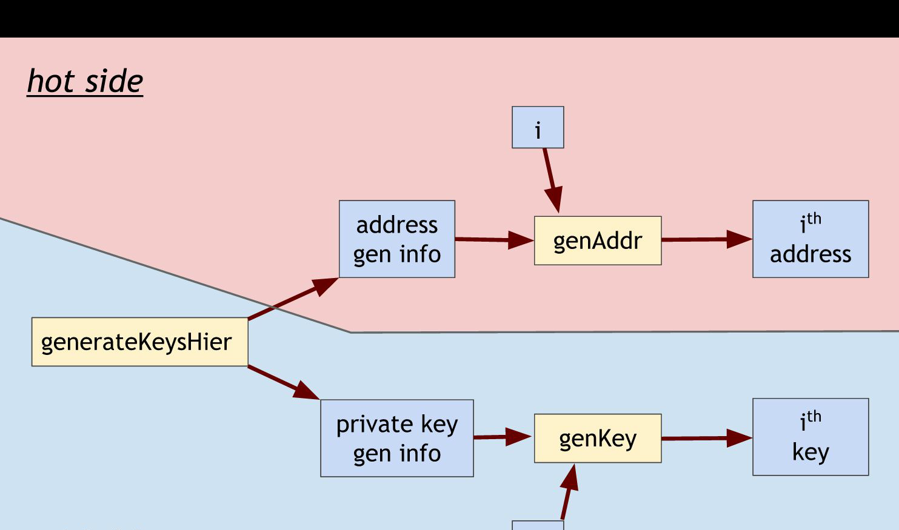
Bitcoin and Cryptocurrency Technologies, Narayan, Bonneau, et. al.

