Slide 1
CryptoCurrency Mining
Bernard Parenteau
bparente@fit.edu

Slide 2
Bitcoin Mining
After validating transactions, bitcoin nodes add them to the transaction pool (“mempool”) of transactions waiting to be mined into a new block.
A mining node collects, validates and relays new transactions just like any other node.
In addition, a mining node will then aggregate these transactions into a temporary candidate block.
To build its candidate block a mining node selects transactions from the memory pool by calculating a priority and adding the highest priority transactions first.
Mastering Bitcoin, Antonopoulos

Slide 3
Bitcoin Mining
Transactions are prioritized based on the value and age of the UTXOs that are being spent.
The first 50 kilobytes of transaction space in a block are set aside for high priority transactions.
A mining node will fill the first 50 kilobytes, prioritizing the highest priority transactions first, regardless of fee.
Mastering Bitcoin, Antonopoulos

Slide 4
Bitcoin Mining
Priority = Sum (Value of input * Input Age) / Transaction Size
- Value of input is in satoshis (100m per bitcoin)
- Input Age is the number of blocks since the input’s UTXO block
- Transaction Size is its size in bytes.
For a transaction to be considered “high priority” its priority must be greater than 57,600,000, which corresponds to one bitcoin (100m satoshis), aged one day (144 blocks) in a transaction of 250 bytes total size.
High Priority > 100,000,000 satoshis * 144 blocks / 250 bytes = 57,600,000 or 1 BTC one day old with average transaction size

Slide 5
Bitcoin Mining
High priority transactions can be sent without any fees, if there is enough space in the block.
The mining node then fills the rest of the block with transactions that carry at least the minimum fee, prioritizing those with the highest fee per kilobyte of transaction.
If there is any space remaining in the block, the mining node may choose to fill it with no-fee transactions. Some do and some don’t.

Slide 6
Bitcoin Mining
After the transactions are in the block a timestamp is added.
The node then fills in the difficulty target, which defines the required Proof-of-Work difficulty to make this a valid block.
The difficulty is stored in the block as a “difficulty bits” metric, stored in exponential format.
The final field is the nonce, which is initialized to zero.

Slide 7
Bitcoin Mining
With all the other fields filled, the block header is now complete and the process of mining can begin.
The goal is now to find a value for the nonce that results in a block header hash that is less than the difficulty target.
The mining node will need to test billions or trillions of nonce values before a nonce is found that satisfies the requirement.

Slide 8
Hashing, Bitcoin Hashing
A hash algorithm takes an arbitrary-length data input and produces a fixed-length deterministic result.
SHA-256 is the hash function used in bitcoin’s mining process.
With SHA-256, the output is always 256 bits long, regardless of the size of the input.
For any specific input, the resulting hash will always be the same and can be calculated and verified relatively easily by anyone using the same hash algorithm.
The key characteristic of any cryptographic hash algorithm is that it is virtually impossible to find two different inputs that produce the same fingerprint.
As a corollary, it is also virtually impossible to select an input in such a way as to produce a desired result, other than trying random inputs.

Slide 9
Hashing Difficulty
In the simplest terms, mining is the process of hashing the block header repeatedly, changing one parameter, until the resulting hash matches a specific target, i.e. the result is less that a certain number
Bitcoin has a target block time of 10 minutes, which is achieved by regularly adjusting the difficulty.
Difficulty re-targeting occurs automatically and on every full node independently.
Every 2016 blocks, all nodes re-target the Proof-of-Work difficulty.
The equation for retargeting difficulty measures the time it took to find the last 2016 blocks and compares that to the expected time of 20160 minutes (two weeks based upon a desired 10 minute block time).

Slide 10
Hashing Difficulty Limitations
In the early days of bitcoin, a miner could find a block by iterating through the nonce until the resulting hash was below the target.
As difficulty increased, miners often cycled through all 4 billion values of the nonce without finding a block.
However, this was easily resolved by updating the block timestamp to account for the elapsed time.
Since the timestamp is part of the header, the change would allow miners to iterate through the values of the nonce again with different results.

Slide 11
Hashing Difficulty Limitations
Once mining hardware exceeded 4 GH/sec however, this approach became increasingly difficult as the nonce values were exhausted in less than a second.
As ASIC mining equipment started pushing and then exceeding the TH/sec hash rate, the mining software needed more space for nonce values in order to find valid blocks.
The timestamp could be stretched a bit, but moving it too far into the future would cause the block to become invalid.
A new source of “change” was needed in the block header.

Slide 12
The Extra Nonce Solution
The solution was to use the coinbase transaction as a source of extra nonce values.
Since the coinbase script can store between 2 and 100 bytes of data, miners started using that space as extra nonce space, allowing them to explore a much larger range of block header values to find valid blocks.
Eight bytes of extra nonce, plus the 4 bytes of “standard” nonce allow miners to explore a total 2⁹⁶ (8 followed by 28 zeroes) possibilities per second without having to modify the timestamp.
If, in the future, a miner could run through all these possibilities, they could then modify the timestamp.
There is also more space in the coinbase script for future expansion of the extra nonce space.

Slide 13
Bitcoin Mining Hashrate Growth
2009 - 0.5 MH/sec to 8 MH/sec (x 16 growth)
2010 - 8 MH/sec to 116 GH/sec (x 14,500 growth)
2011 - 16 GH/sec - 9 TH/sec (x 562 growth)
2012 - 9 TH/sec - 23 TH/sec (x 2.5 growth)
2013 - 23 TH/sec - 10 PH/sec (x 450 growth)
2014 - 10 PH/sec - 300 PH/sec (x 30 growth)
2015 - 300 PH/sec -800 PH/sec (x 2.5 growth)
2016 - 800 PH/sec – 2.4 ExH/sec (x 3 growth)
2017 – 2.4 ExH/sec – 16 ExH/sec ( x 6.5 growth)
2018 – 13 ExH/sec – 62 ExH/sec (x 4 growth)
2019 – 40 ExH/sec – 97 ExH/sec(x2 growth)
2020 – 90 ExH/sec – 140 ExH/sec (dropped after mining reward halving)
https://blockchain.info/charts/hash-rate
https://bitinfocharts.com/comparison/bitcoin-hashrate.html

Slide 14
Bitcoin Mining Hardware
Mining hardware; historical list
https://en.bitcoin.it/wiki/Mining_hardware_comparison
Major mining hardware vendors include
Bitmain
Canaan
Ebang

Slide 15
Bitcoin Mining Services, Pools
Many of the top miners are actually Mining Pools, as can be inferred from the names of the top miners. (see chart)
Mining Pools are groups of miners that work together to solve the hash nonce problem.
Some pools are open in that allow anyone to join and contribute their hashpower.
Their compensation will be relative to the overall mining revenue of the pool; specifically relative to their hashpower vs the total pool hashpower (less a fee, of course).

Slide 16
Bitcoin Mining Services, Pools
There are several Cloud mining Services that allow a user to pay for a variable amount of hash power and in return promise proportionate income.
Many of these have been found to be outright scams, while others are merely unprofitable (as mentioned in What is Bitcoin Mining and How Does it Work? (2021 Updated) (buybitcoinworldwide.com))
One that was believed to be legit, though not necessarily profitable was
https://www.genesis-mining.com/ (may no longer be active)
Profitability depends in large part on the price of Bitcoin

Slide 17
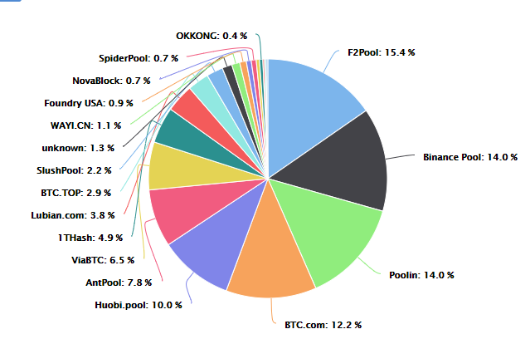
Mining Concentration
January 2019
Above from https://btc.com/stats/pool Feb 10, 2021
see also https://blockchain.info/pools

Slide 18
Top Bitcoin Miners
F2Pool
F2Pool was launched in 2013, China’s oldest, has been top 5 since. F2Pool also mines a number of other popular altcoins as well.
Binance Pool, Huobi.pool
Binance and Huobi are two of the largest cryptocurrency exchanges in the world, and in the last couple years each has geared up a mining pool operation.
Poolin
Founded in November 2017 by three former Bitmain employees, it shot to the top with the highest hashrate by late 2019 and has remained in the top 3 since.
BTC.com
The pool was launched in September 2016, and is currently owned by Bitmain Technologies Ltd., the same Chinese firm that runs AntPool.

Slide 19
Top Bitcoin Miners
AntPool
AntPool is operated by privately-owned Bitmain Technologies Ltd. originally based in Beijing, China, currently setting up headquarters in Singapore. The company was created to design and produce ASIC chips for bitcoin mining, and is the largest producer of mining equipment.
ViaBTC
Another Chinese pool, reportedly controlled by Bitmain.
Slush
Slush is one of the oldest mining pools, having been started in 2010. With the rise of the Chinese miners, Slush pool has dropped but is still close to top 10 in Bitcoin mining share. It is one of the more popular pools for individuals.

Slide 20
Mining Countries
China
China historically has been the largest bitcoin mining country, and likely still is though exact figures are difficult to determine.
Power is largely from coal and is relatively inexpensive
Since late 2017 Chinese mining companies have been looking to expand to other countries as well, at least in part due to pressure from governmental officials
After banning initial coin offerings and calling on local exchanges to halt virtual currency trading in 2017, Chinese authorities outlined proposals in early 2018 to limit bitcoin mining power consumption.
Iceland
Most power is green; geothermal, water
Cooling costs are substantially less given the climate
Estimated to use more power on mining than residential in 2018 (https://qz.com/1204840/iceland-will-use-more-electricity-mining-bitcoins-than-powering-homes/)

Slide 21
Mining Countries
Other popular mining locations include Canada and locations in the US with very low power rates (e.g. Washington state and upstate New York).
Officials in many of these locations are not happy with this trend.
Canada has become a desirable mining location with relatively low electricity costs in some provinces, and relatively low cooling costs due to its climate
Canada’s Hydro Quebec was inundated with requests from cryptocurrency miners looking to setup operations in energy-rich province Quebec, in early 2018.
Bitmain told Reuters that it has been mining in Canada since 2016, although the location of their Canadian operations was not revealed.

Slide 22
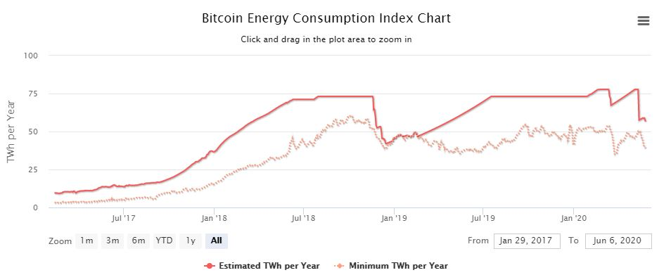
Bitcoin Mining Energy Consumption
see for more info https://digiconomist.net/bitcoin-energy-consumption

Slide 23
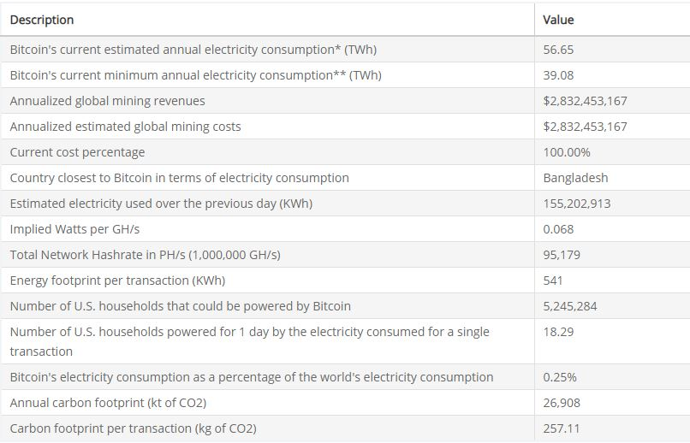
Bitcoin Mining Energy Consumption
https://digiconomist.net/bitcoin-energy-consumption (May 26, 2020)
Digiconomist: general alarmist about Bitcoin power consumption, probably overstated.

Slide 24
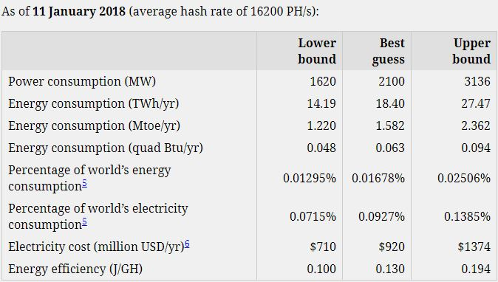
Bitcoin Mining Energy Consumption
Alternative estimates from early 2018 (not updated since), likely more realistic: see url*
note the percentage of world electricity consumption, about 2/3 of previous estimate
*http://blog.zorinaq.com/bitcoin-electricity-consumption/

Slide 25
Bitcoin Mining Energy Consumption
From blog.zorinaq.com/bitcoin-electricity-consumption/:
Bitcoin’s level of power consumption can be presented in a way to make it look large:
Bitcoin uses as much electricity as entire countries such as Iceland (18.1 TWh/yr)
Bitcoin uses as much as 1.7 million average American homes (18.3 TWh/yr)
Or look small:
Bitcoin uses only a third of the output of the Three Gorges Dam (90 TWh/yr)
Bitcoin uses less electricity than decorative Christmas lights in the world (the US alone spends 6.63 TWh/yr on them)
In any case, cryptocurrency mining consumes a very large amount of electricity. Bitcoin mining is only part of it.
This could become even more of an issue as environmentalists become more aware.
See https://www.vox.com/2019/6/18/18642645/bitcoin-energy-price-renewable-china for a discussion of estimations of mining energy usage.

