Slide 1
Lightning Network
Bernard Parenteau
bparente@fit.edu
2021

Slide 2
Bitcoin Scaling
Scalability is major issue with Bitcoin
With a maximum of 1MB of transactions per 10 minutes and each transaction validated and stored by all nodes, the throughput of Bitcoin is quite limited by comparison to other payment methods such as credit cards, paypal, etc.
Visa’s payment network can process many 100s, even 1000s of times the number of transactions.
Segwit effectively increased maximum throughput by decreasing the average transaction size so that more could be in a block.
But the increase in throughput was somewhat limited, less that doubling it.

Slide 3
Bitcoin Scaling Issues
This limitation on throughput leads to congestion, increasing fees, and increasing delays during high-volume periods.
The average transaction fee exceeded $15 from mid December 2017 to mid January 2018, hitting well over $40. And it also spiked to over $6 in May 2020 around the mining reward halving, and after falling back rose substantially as the price appreciated in late 2020 and early 2021, exceeding $20 per average transaction.*
If transaction fees are non-trivial it makes Bitcoin an unattractive option for small purchases.
And with the block confirmation time, it’s even less so for merchants.
As such, the Bitcoin network as originally designed is unable to scale to the point where it could handle a substantial portion of overall payments, particularly smaller transactions.
*https://bitinfocharts.com/comparison/bitcoin-transactionfees.html#1y

Slide 4
Lightning Network
One of the most widely discussed and most anticipated Bitcoin scalability proposals was the Lightning Network.
The Lightning Network is sometimes called a layer 2 protocol in that it sits atop the blockchain (e.g. Bitcoin) layer.
It’s developed by Lightning Labs (https://lightning.engineering/) and other groups and has been ported to work with LiteCoin and other coins. There are several implementations of the Lightning Network. https://github.com/bcongdon/awesome-lightning-network#implementations
It is made up of multiple two-party payment channels in a hub and spoke system such that almost any party could connect to another via a series of two-party channels (somewhat similar to the internet).
https://lightning.network/lightning-network-paper.pdf

Slide 5
Lightning Network
Each two-party channel starts with both parties contributing funds to a multisig address that they mutually control.
A transaction refunding the amounts is also created and signed by both parties but not sent to the Bitcoin blockchain (actually two identical transactions, one held by each of the participants)
As funds move from one party to the other, the previous refund transaction is superseded (and effectively “invalidated”) and a new tentative refund transaction, reflecting the new breakdown, is created but not submitted to the Bitcoin blockchain.
At any time, either of the participants may submit their refund transaction and cash out to close their channel.

Slide 6
Commitment Transactions
These transactions that refund the channel balances to the participants are called Commitment transactions.
Both participants in the channel, “a” and “b”, will have a Commitment transaction signed by the other (call them C1a and C1b), that reflects the current balances.
These Commitment transactions are not broadcast immediately but rather are held by each participant, each holding a version of the transaction that the other participant has signed.
Either party can close out the channel at any time by broadcasting the transaction.

Slide 7
Commitment Outputs
Each of these Commitment/Refund transactions (one held by each participant) has two outputs;
1. An output to the counterparty for that counterparty’s current share of the channel balance, which is redeemable by them immediately
2. An output to the holder of the transaction for their balance, which contains a script that “timelocks” the balance for a period of time
*(There may actually be a third for transactions in progress)

Slide 8
Commitment Script
That script that timelocks the holder’s balance is actually redeemable in one of two ways:
By the holder, provided any transaction that attempts to spend it cannot happen until a certain time delay has been met (meaning that it is “timelocked” for a certain number of blocks, for example 1000)
Or by a special “breach remedy” transaction (not yet created), which could spend/redeem it immediately

Slide 9
Breach Remedy Transactions
Then, as the balance in the channel changes, the participants will want to create new updated Commitment/Refund transactions (C2a/C2b) reflecting the updated balances.
And they will also want to insure that neither side would broadcast a transaction refunding the old superseded balances (C1a or C1b) .
They can do this by creating, signing, and exchanging the special breach remedy transactions that would enable the other side to immediately spend the previous timelocked output of the old commitment transaction (C1a or C1b), if that old transaction were ever to be broadcast.
This effectively invalidates the previous Commitment/Refund transactions

Slide 10
Breach Remedy
Of course they then need to monitor the blockchain to insure that an old commitment transaction is not broadcast, and if it is they would need to broadcast the Breach Remedy transaction before the timelock expired.
If either side broadcast an old invalid refund transaction, their counterparty could claim the entire channel balance:
The counterparty part is immediately redeemable
Once updated balance transactions are created each counterparty will have Breach Remedy transaction that can immediately redeem the other output

Slide 11
Lightning Network; Offchain
None of the Commitment/Refund transactions (or Breach Remedy transactions) are ever actually submitted to the Bitcoin blockchain as long as the channel remains open.
The intended effect is to allow the two-party channels to effectively keep minor transactions and updated balances off-chain
This will enable efficient micro-transactions, while allowing the network to scale to many times current throughput capacity.

Slide 12
In-Progress Transactions
Lightning uses Hash Time Locks for transactions in progress
A potential recipient must first generate a code and send the hash to the party from whom he’s requesting a payment (the hash is sent off-chain, manually, not via lightning).
The transmission of the code across the network also determines the fees and timelock parameters.
The sending party will then tentatively send the payment to the recipient with the balance timelocked; essentially held in escrow by the channels.
The payment remains in escrow until either
The recipient replies with the source of the hash code indicating that they have received the payment
The payment times out, and is returned to the sender.
*See from slide 36: https://lightning.network/lightning-network.pdf

Slide 13
Routing
Lightning nodes begin with seed nodes and use a gossip protocol similar to Bitcoin to discover and connect to other nodes
When two nodes open a channel between themselves, they optionally broadcast it to the network
This optional broadcast effectively gives nodes the option to have public or private channels
Nodes keeps a map of the overall system to determine routing (the size of which can vary)

Slide 14
Routing
One of the differences between Lightning payment routing and most data network routing is that in the case of Lightning, the route is constructed by the payment sender (source routing), rather than being determined by the routers along the path.
Nodes have a map of the entire network including statistics on each node.
Each implementation of Lightning has its own way to calculate the default path, usually by minimizing fees.
Sending nodes can implement any methodology in determining the routing path.
https://bitcoin.stackexchange.com/questions/83014/routing-in-bitcoin-lightning-network

Slide 15
Routing
In addition, Lightning employs onion routing (like Tor) for multi-hop payments, which means that intermediate nodes in the payment path know only the identity of their immediate predecessor and successor in the route and pass along an encrypted payload.
Onion routing effectively hides the identities of payment senders and receivers, enhancing privacy, and combined with source routing is censorship-resistance.
And the Lightning Network also supports Tor nodes (though a node with both Tor and IP connections is required to transfer between the two).
https://blog.lightning.engineering/posts/2018/05/30/routing.html

Slide 16
Risks
The technical risks are being mitigated as the network has been actively tested for a couple years now.
An earlier update addressed the issue of making the network resistant to DDOS attacks by using a flag in the Bitcoin header to indicate when a block was full so it wouldn’t count in the number of blocks to wait. This would avoid the situation where the Bitcoin network could be flooded with small transactions preventing a Breach Remedy transaction from appearing.
As far as business risks; it’s been noted that the Lightning network may actually aid centralization in terms of the gateway and routing nodes.
A user will need to find a gateway that they trust to set up a channel, with a commitment amount up to the max cumulative transaction amount with that partner gateway node.
In some senses this is not unlike full-reserve correspondent banking where the balances are not only fully-collateralized but actually even over collateralized by the max channel amounts.

Slide 17
Lightning Paper
The Lightning Network was first described in a paper by Joseph Poon and Thaddeua Dryja in 2015, with the revised version at:
http://lightning.network/lightning-network-paper.pdf
The specifications were developed later in 2016 and since then several interoperable implementations have been created
The fuller specification, known as Lightning BOLT (Basis of Lightning Technology) can be found at
https://github.com/lightningnetwork/lightning-rfc/blob/master/00-introduction.md
An extensive set of resources can be found at
https://github.com/bcongdon/awesome-lightning-network

Slide 18
Lightning Implementations
There are several interoperable implementations of the Lightning Network in various languages
The version in Golang, called LND, is done by Lightning Labs, as are several complementary projects (https://github.com/lightningnetwork/lnd)
The version in C, which runs on Linux, was done by Blockstream is called Elements or c-lightning and can be found at https://github.com/ElementsProject/lightning
The version in Scala is done by ACINQ, is called éclair and can be found at https://github.com/ACINQ/eclair
There is also a test version (in Go) done by MIT’s Digital Currency Initiative at https://github.com/mit-dci/lit
There are also various Desktop apps and wallets, web interfaces, mobile apps and wallets, explorers and other apps
https://github.com/bcongdon/awesome-lightning-network

Slide 19
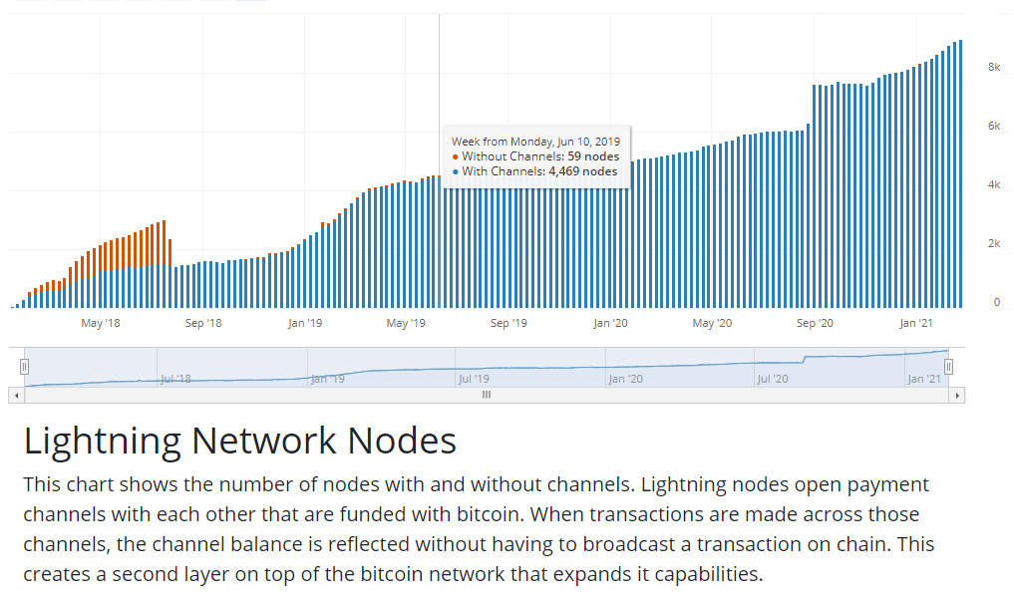
Lightning Status
https://bitcoinvisuals.com/lightning

Slide 20
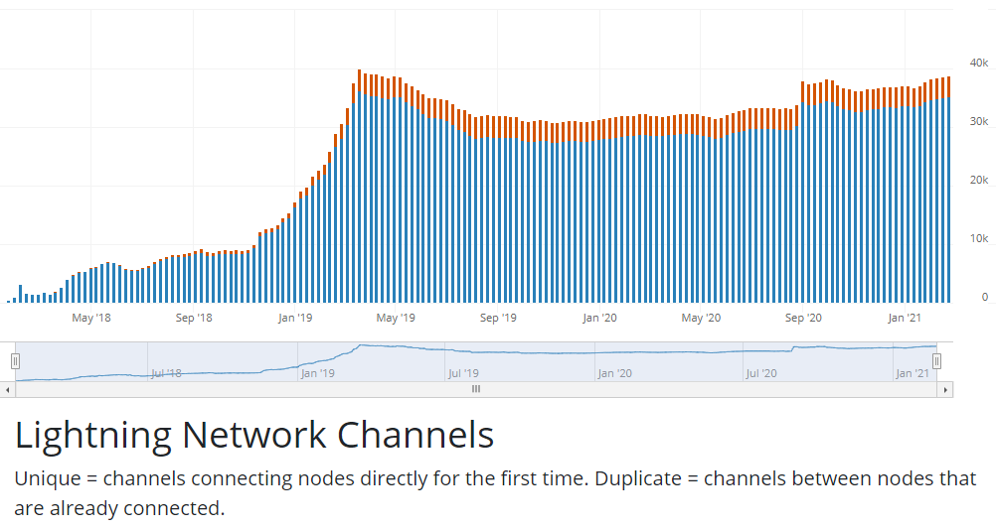
Lightning Status
https://bitcoinvisuals.com/lightning

Slide 21
Lightning Status
https://1ml.com/statistics
https://defipulse.com/lightning-network
https://www.coindesk.com/kraken-exchange-integrate-bitcoin-lightning-2021
https://www.coindesk.com/okex-exchange-to-integrate-bitcoins-lightning-network-for-faster-cheaper-transactions
https://www.coindesk.com/vietnam-bitcoin-exchange-lightning-network

Slide 22
Lightning for Other Coins
The Lightning Network conceivably could also be used to do inter-blockchain coin swaps
And since it’s open source, it can be (and has been) adapted for other cryptocurrencies.
LiteCoin and Decred are among the other coin networks that have tested Lightning implementations
https://wiki.ion.radar.tech/tutorials/altcoin
However many altcoin networks were designed to be massively scalable in the first place, so something like Lightning is not needed to solve scalability.

