Slide 1
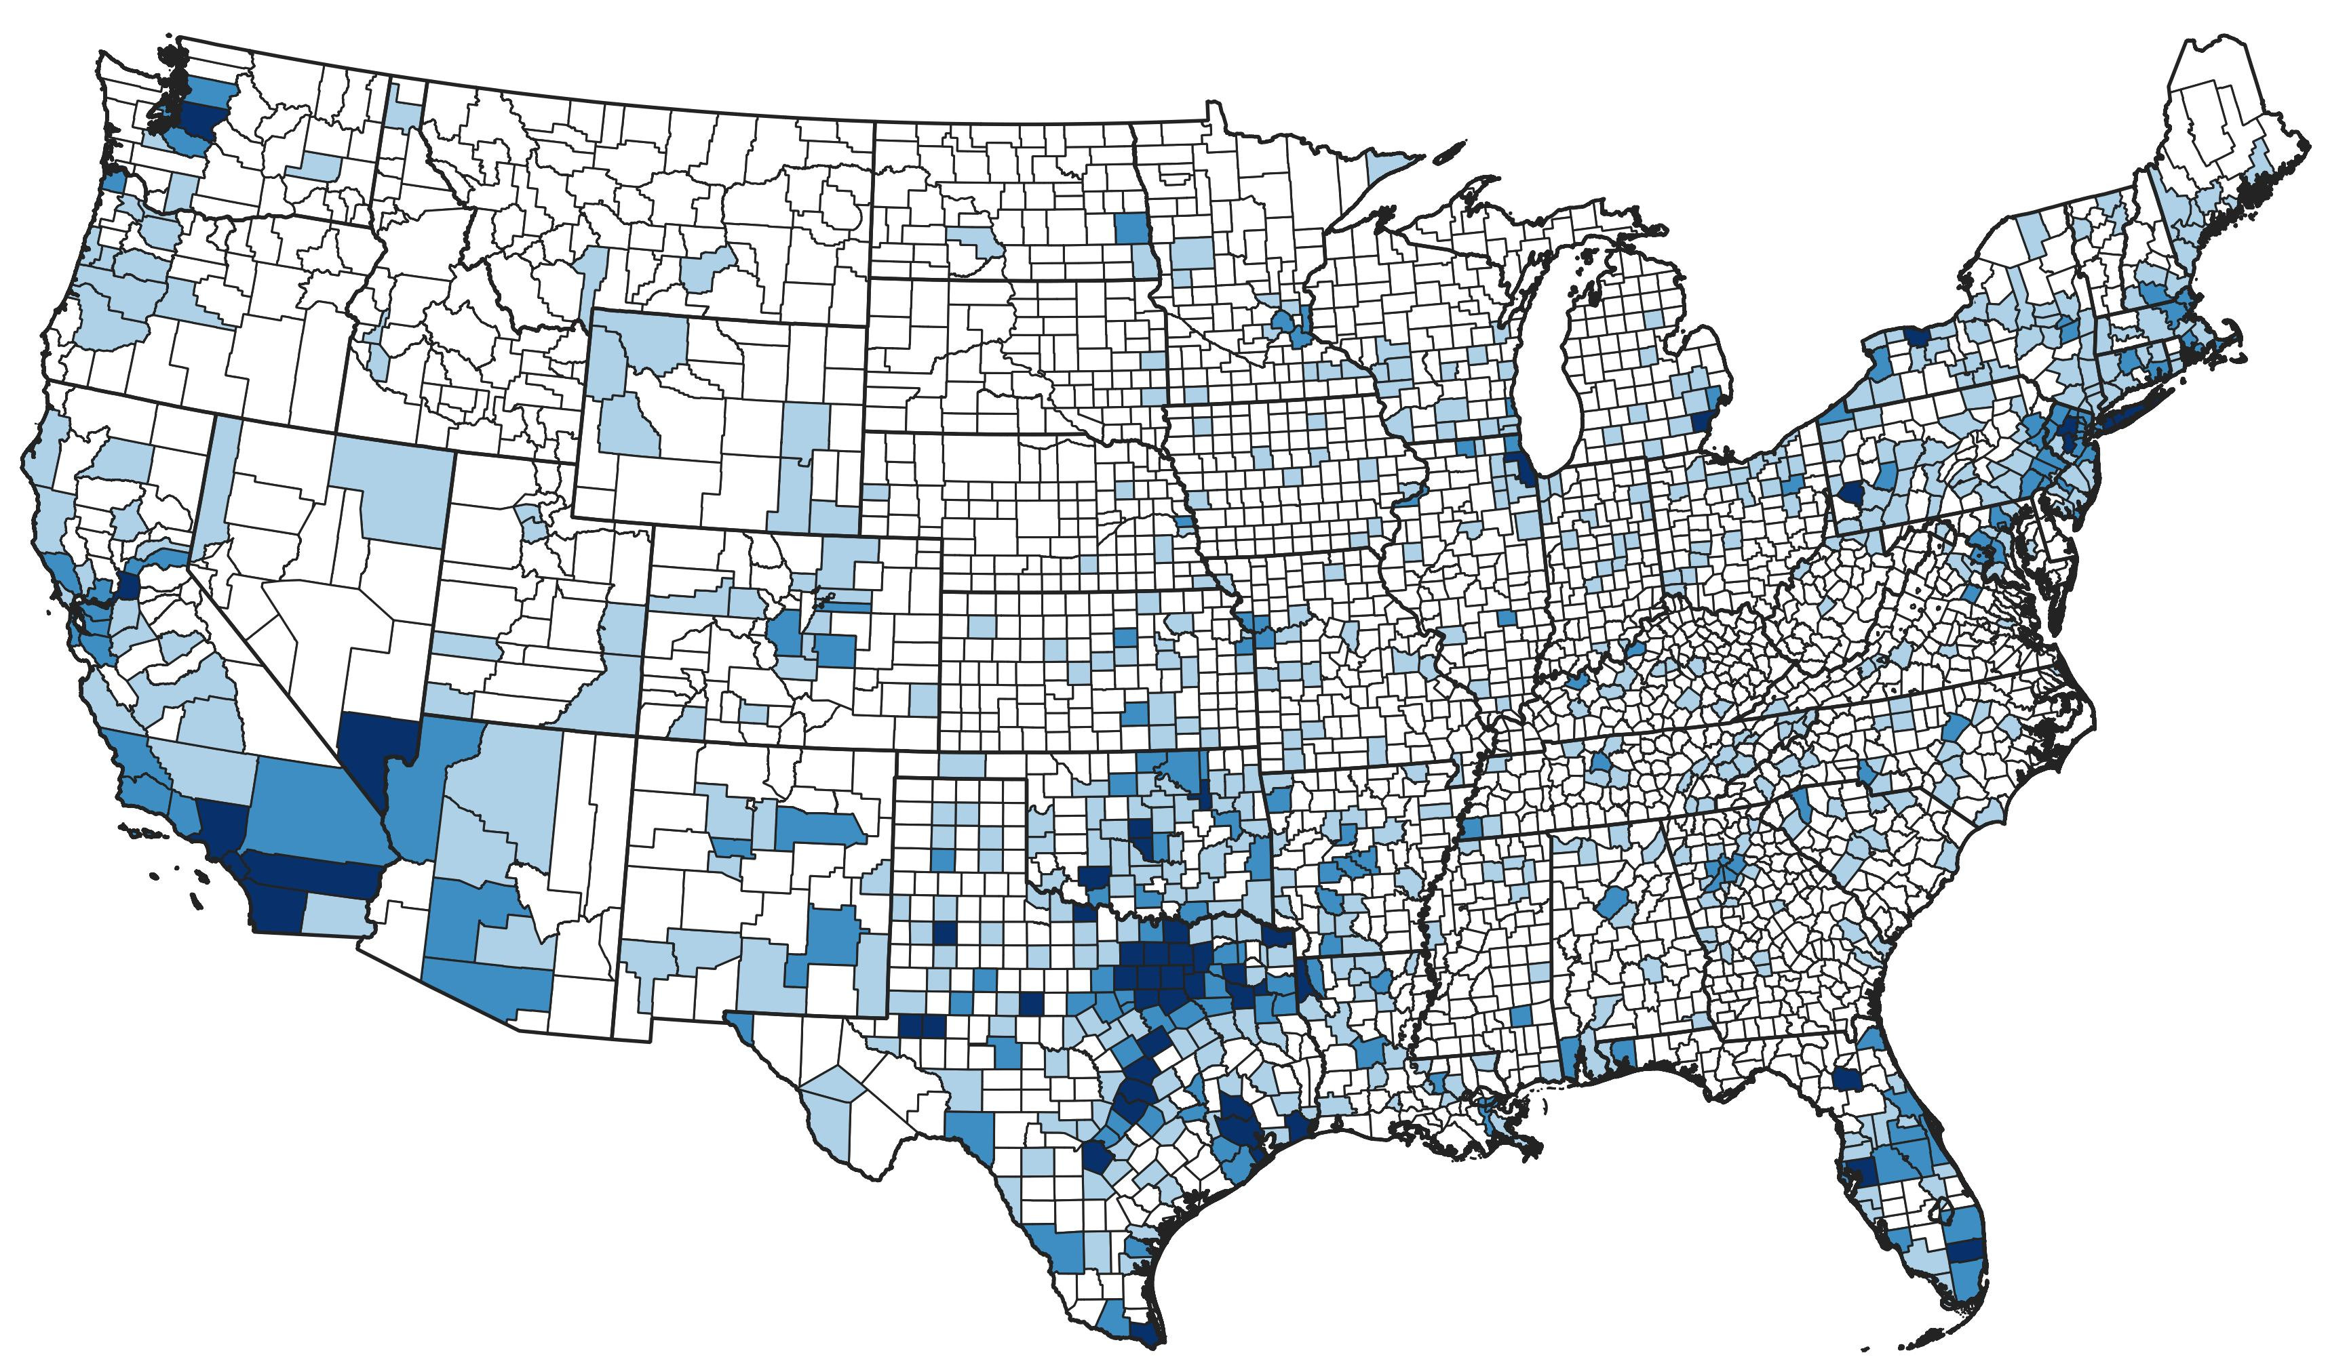
United States of America
County Coloring Book

