Slide 1



Proiect CAD
Circuit for controlling the concentration of carbon monoxide in an enclosure
Student: Bălășcău Patricia-Andreea
Coordonator: Assist. Prof. Fizeșan Raul-Traian, PhD

Slide 2



Topics:
1. Project Requirements and Overview
2. Block Diagram
3.The circuit
4. Active Linear Bridge- Sensor Interface (Part 1/2)
5. Non-Inverting Voltage Domain Converter- Sensor Interface (Part 2/2)
6. Non-Inverting Hysterezis Comparator
7/8. Orange Led. Resistive relay
9. Selection of Components
10. DC sweep analysis (1/2)
11. DC sweep analysis (2/2)
12. LED and relay simulations (1/2)
13. LED and relay simulations (2/2)
14. Worst case/Monte Carlo analysis
15. Conclusion

Slide 3

Project Requirements and Overview:
The carbon monoxide sensor is resistive, with its resistance decreasing from 200 kΩ to 25 kΩ as CO concentration increases from 600 to 17.000 ppm.
The target detection range is 700–8.000 ppm.
The supply voltage is 14 V, and the sensor output varies between 2–12 V.
A relay-controlled fan turns on when CO exceeds 8000 ppm and off below 700 ppm; an orange LED also indicates the high level.
Sensor resistance is converted into voltage using:
A linear active bridge,
A non-inverting voltage domain converter to fit the desired range,
A hysteresis comparator to detect threshold crossings and control the fan and LED.
indoor carbon monoxide concentration [ppm] | the measurement range of the sensor [ppm] | Sensor resistance [kΩ] | Vcc [V] | LED Colour
700 – 8.000 | 600 – 17.000 | 200 - 25 | 14 | Orange

Slide 4
Block Diagram:
Non-inverting voltage domain converter
Non-inverting hysteresis comparator
Linear active bridge
CO resistive sensor
ON
Relay circuit module
LED system
OFF

Slide 5
The circuit:

Slide 6

Active Linear Bridge
Sensor Interface (Part 1/2)
The active bridge converts the resistance variation of the CO sensor into a linear voltage.
It uses operational amplifiers with negative feedback, ensuring stability and linearity of the output signal.
The design is based on voltage divider and superposition principles, leading to a simplified output formula.
Output Voltage Equation:
$V_{out1}=(\frac{R_{1}}{R_{1}+R_{2}}−R_{4}∙\frac{R_{2}}{R_{3}(R_{1}+R_{2})}​)⋅V_{CC}$​
Assuming $R_{1}=R_{2}=R_{3}=a$, the expression becomes:
$V_{out1}=7−7∙\frac{R_{4}}{a}$​​
To ensure $V_{out1}>0$(single-supply op-amp):
⇒ $\frac{R_{4}}{a}<1$ ⇒ a > $R_{4max}$
Selected: a=301 kΩ, compatible with E96 series and design specs.
Output Range [here]:
$$\left\{\begin{aligned}V_{out1min}=\text{2.348 [}\text{V}\text{] } \text{(}\text{at} \text{R}\text{4​=200}\text{k}\text{Ω}\text{)} \\ V_{out1max}=\text{6.418 [}\text{V}\text{] (}\text{at} \text{R}\text{4​=25}\text{k}\text{Ω}\text{)}\end{aligned}\right.$$

Slide 7
2. Non-Inverting Voltage Domain Converter
Sensor Interface (Part 2/2)
Role: To shift and amplify the signal so that the output voltage Vout2 swings between 2V and 12V.
Vout2​ increases with CO concentration, as a non-inverting amplifier converts Vout1 ∈ [2.348; 6.418 V] into a [2V; 12V] output range [here]
Observation: The buffer isolates the voltage divider from the amplifier, keeping Vref ​ stable and ensuring correct simulation.
Voltage (max,min) | Value [V]
Vout2 | 12 | 2
Vout1 | 6.418 | 2.348

Slide 8
3. Non-Inverting Hysterezis Comparator
This stage detects when the input voltage (Vout2) crosses two thresholds and switches the output (Vout3) between 0V and 14V. It uses an AD822 op-amp with positive feedback (via R9) for hysteresis. The inverting input receives a reference voltage (Vreff) from a resistor divider (R11, R12).
If Vout2 > VthH = 6.52 V → Vout3= 14 V → fan ON, LED ON
If Vout2 < VthL = 2.0612 V → Vout3= 0 V → fan OFF, LED OFF
Thresholds VthH and VthL are calculated based on Vreff, resistor ratios (R9/R10), and output levels [here]. This ensures noise immunity and stable switching.

Slide 9

Orange Led
Resistive relay
The forward current through the LED is 20 mA, with a forward voltage of 2 V. The relay has a trigger voltage of 5 V, an operating current of 40 mA, and an internal coil resistance of 125 Ω.
N-type MOSFETs were used to provide enough current for the LED to luminate brightly (20mA) and for the voltage drop across the relay to be 5V.
LED operation: ensuring 20 mA current through a 2 V.
Relay switching: ensuring a 5 V drop across the 125 Ω relay coil.
The required resistor for the LED was calculated as:
$$R_{LED}=\frac{5V−2V}{20mA}=150Ω$$
The relay current:
$$I_{relay}=\frac{5V}{125Ω }=40 mA$$

Slide 10

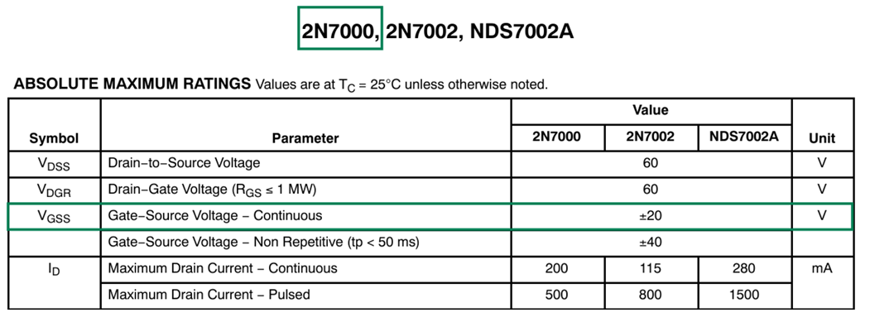
Selection of Components
1
All resistors used are from the E96 standard series, with 1% tolerance for high accuracy. They are through-hole components, each rated at 1/4 W.
3
Resistors
2
The AD822 op-amp was selected for its single-supply operation (5V–30V) and rail-to-rail output, ensuring accurate voltage levels in the hysteresis comparator.
Operational amplifiers
3
- 610 nm emission, 2V forward voltage at 20 mA.
- 125 Ω resistance at 5V voltage drop.
LED
Relay
Two N-MOSFETs (2N7000) used to drive relay and LED. Activated by HIGH gate voltage;
- gate-source voltage rated to ±20V.
4
3
NMOS

Slide 11

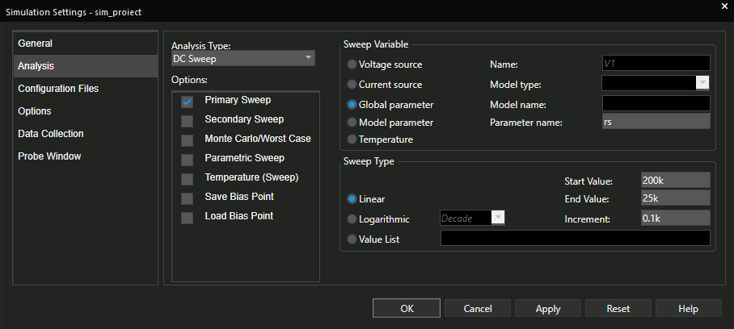
DC sweep analysis (1/2)
DC sweep of global parameter was used to check if V_{out2} swings linearly with R_{S}, if V_{out3} switches at the required CO concentration thresholds and if the LED and the relay work properly.

Slide 12
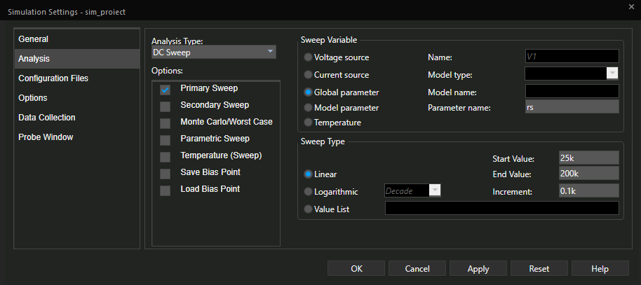
DC sweep analysis (2/2)
A new simulation profile was created to show the VTC of the hysteresis comparator, in 2 parts:

Slide 13
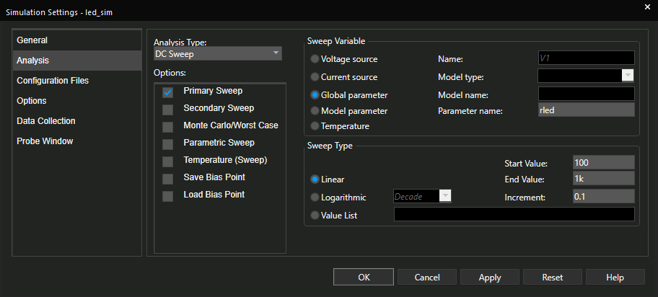
LED and relay simulations (1/2)

Slide 14
LED and relay simulations (2/2)
The final simulation confirms correct hysteresis behavior of Vout3, with proper switching of both the LED (at 40 mA) and the 5 V relay, according to CO concentration thresholds.

Slide 15
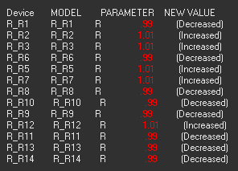
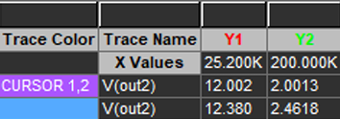
Worst case/Monte Carlo analysis
In the worst-case scenario, the target output was 12 V. Due to resistor tolerances, the simulated output reached 12.380 V, leading to an error of:
Relative error = (12.380 − 12) / 12 × 100 = 0.19%
In the case of nominal values, the error was only 0.001%
Observation: Using resistors with tighter tolerance would significantly reduce this error and make the output closer to the nominal 12 V value.
Output File

Slide 16
Worst case/Monte Carlo analysis
Monte Carlo Analysis
Purpose: To evaluate how resistor tolerances statistically affect the output voltage (Vout2)
Results:
Histogram of Vout2_max shows variation of upper voltage threshold
Histogram of Vout2_min shows variation of lower threshold
Output range varies slightly but stays within functional limits
✅ Conclusion: If the tolerance of the components was decreased, the range on the x-axis would vary between values closer to the mean.

Slide 17
Conclusion
Simulations confirmed correct system behavior under varying CO levels. The design is functional, low-cost, and adaptable for real applications. €48 / 237 RON The total estimated component cost is approximately, with potential for reduction by sourcing cheaper alternatives.
The full project documentation can be accessed here: [here]
Total time dedicated to this project: cca. 40-45 hours

