Slide 1
Term Project
Barbara Payne
DSC 530 – Data Exploration and Analysis
2021 January Flight Prediction

Slide 2
Statistical Questions
What flights are more likely to be longer? Is there more flights that happen at longer distances?
What are the highest days of flights? Are cancelled flights to happen more on a certain day of a week than another?

Slide 3
Variables and their Meaning
DAY_OF_MONTH – What date the flight took place in January
DAY_OF_WEEK – What day the flight took place starting with Monday
OP_UNIQUE_CARRIER – Unique airline carrier codes provided by IATA
OP_CARRIER_FL_NUM – Flight number
ORIGIN – Origin airport
DEST – Destination airport
CANCELLED – Indicates if the flight was cancelled
ARR_DEL15 – Arrival delay indicator
DISTANCE – How far the flight travelled

Slide 4
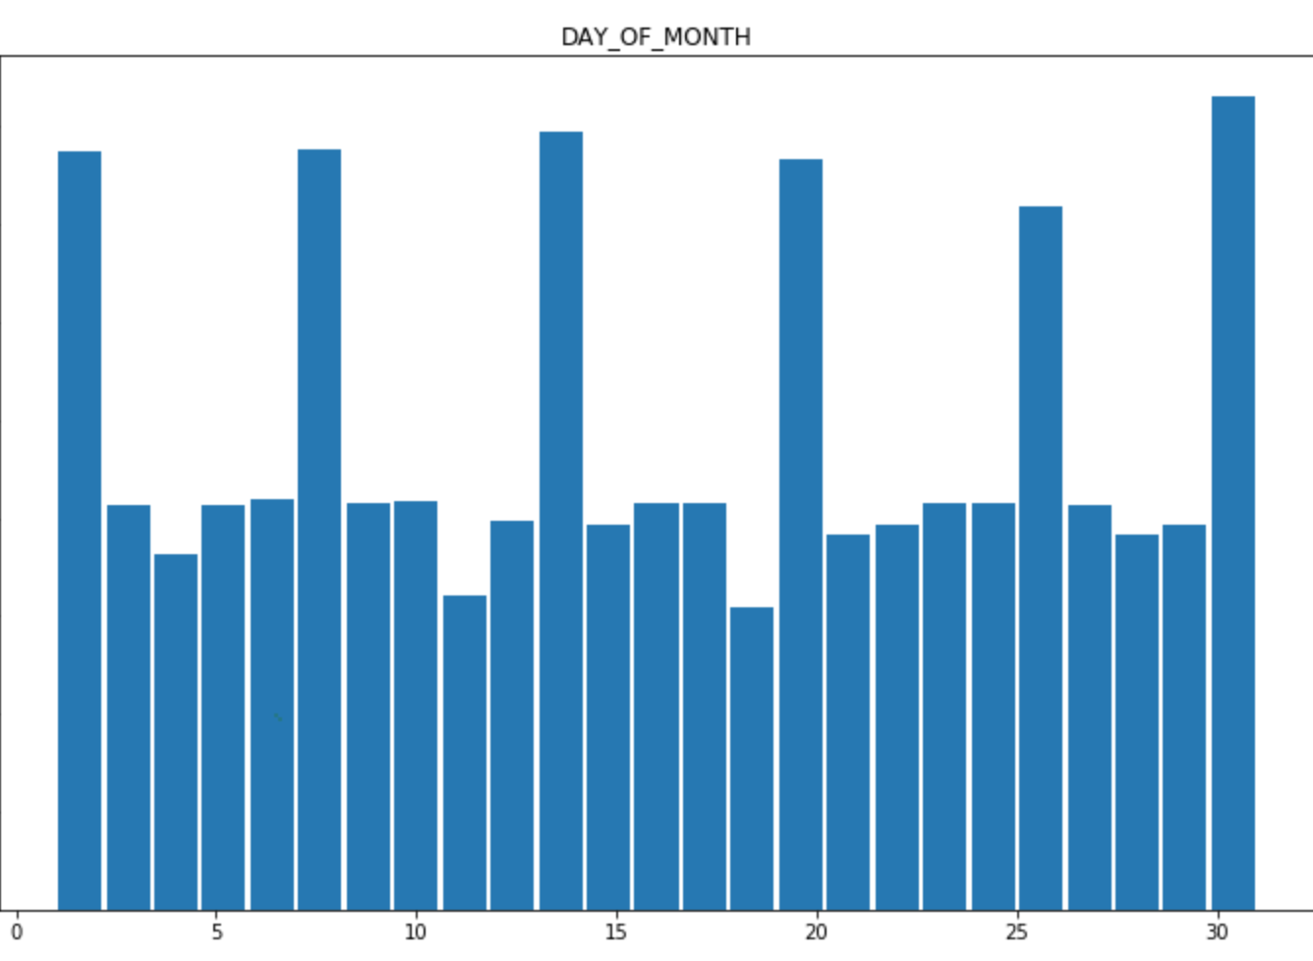
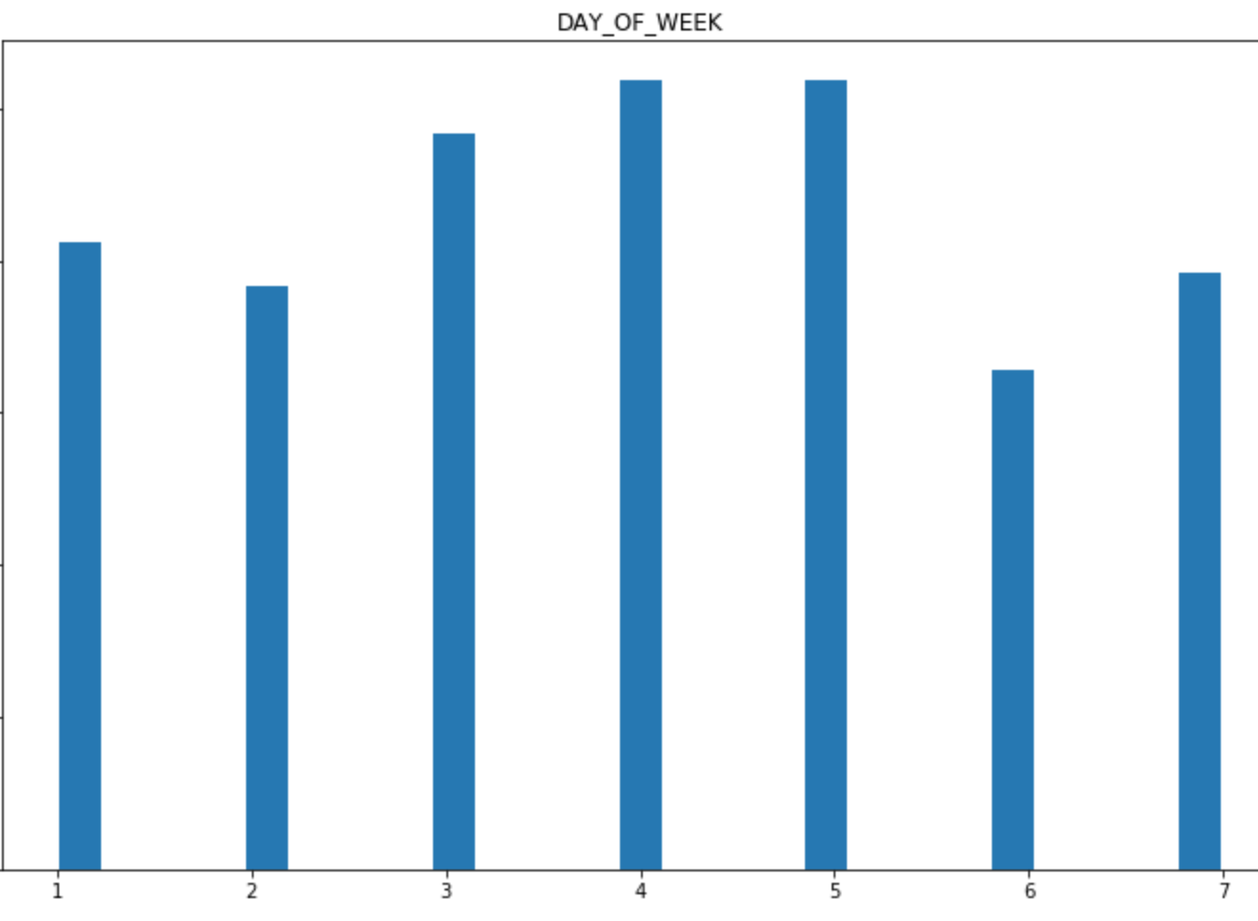
Histograms
Notes:
All days of the month and all days of the week should be examined. There are no really big outliers and both of these variables could possibly be more related to one another than what we initially see.

Slide 5
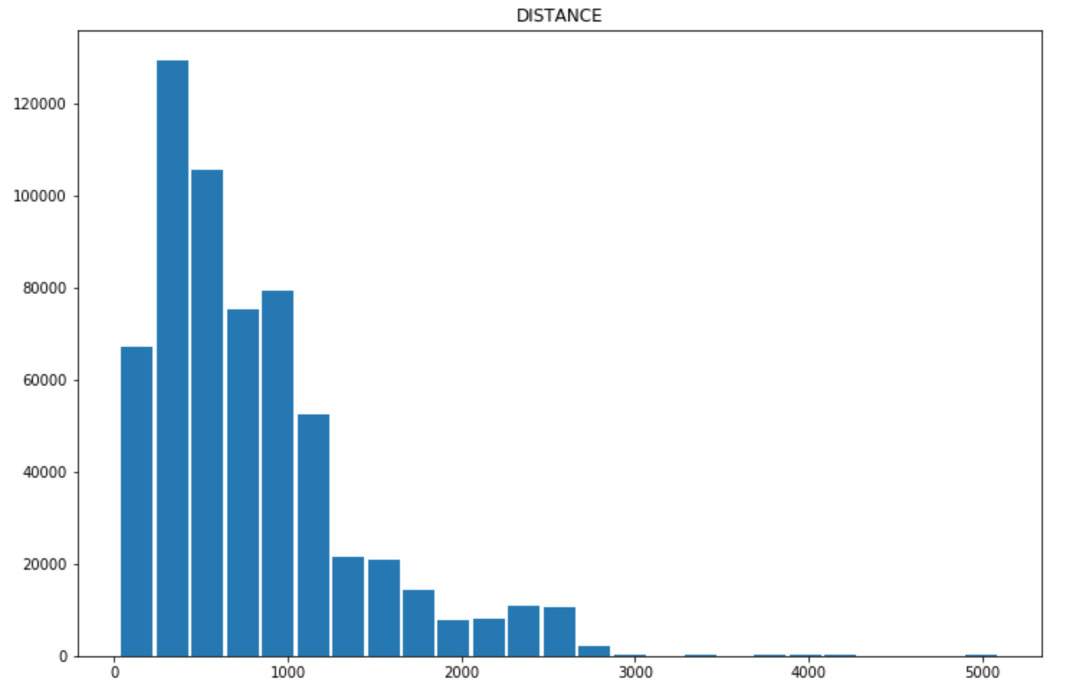
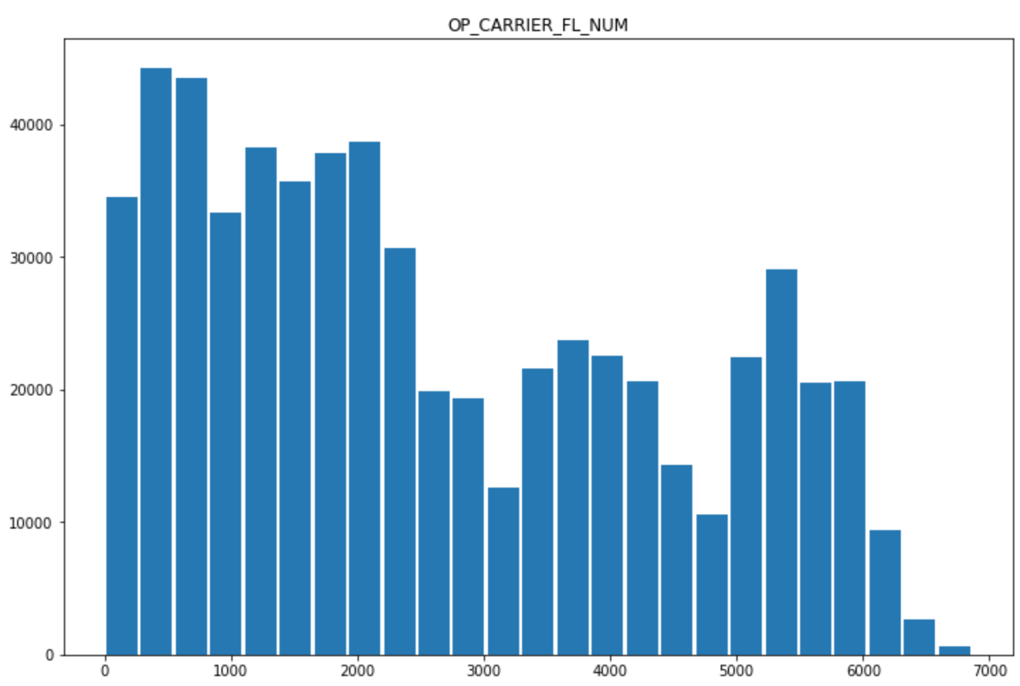
Histograms
Notes:
Though the distance does not have many flights that are more that 2500 miles, they should be kept in as analysis can be done to see what airlines do fly further than others. All flight numbers should be kept into analysis as they belong more with the aircraft and tell more of where the plane is going.

Slide 6
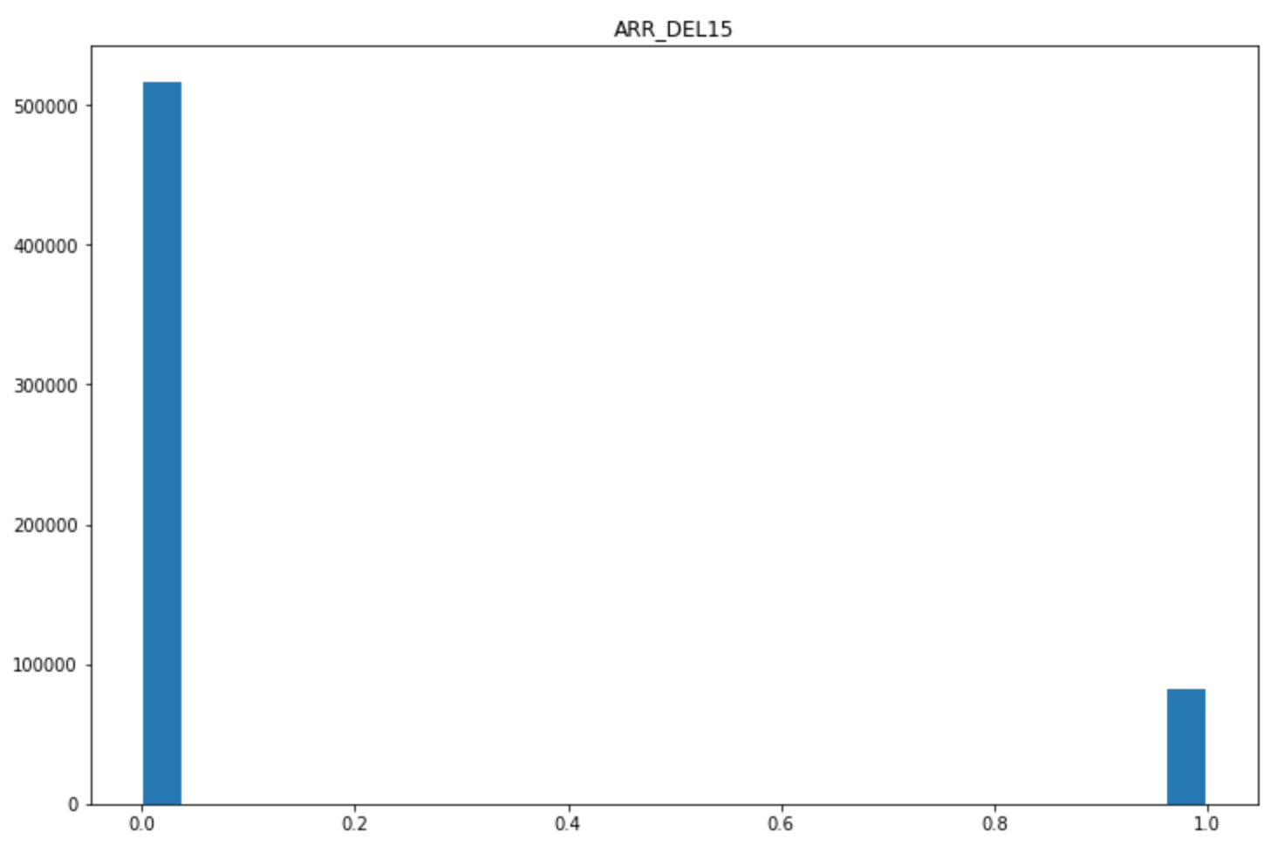
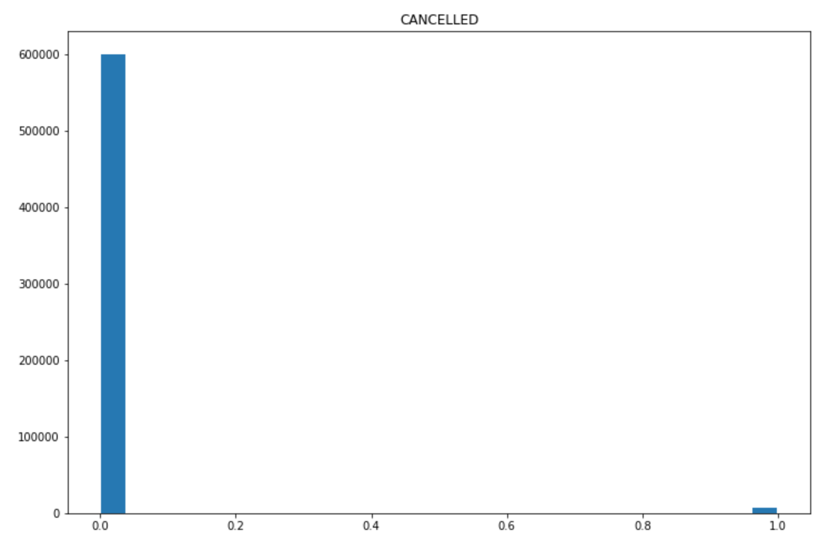
Histograms
Notes:
Though there is not many cancelled flights and the delayed flights are very low, they should still be included as they can help see what airlines have the most cancelled or delayed flights as well as if there is a specific day of these types of flights.

Slide 7
Descriptive Characteristics
DAY_OF_MONTH
Mean | 16.01
Mode | 6
Standard Deviation | 8.99
Variance | 80.83
DAY_OF_WEEK
Mean | 3.96
Mode | 5
Standard Deviation | 1.91
Variance | 3.65
DISTANCE
Mean | 798.02
Mode | 337
Standard Deviation | 587.28
Variance | 344900.90
OP_CARRIER_FL_NUM
Mean | 2622.37
Mode | 416
Standard Deviation | 1822.55
Variance | 3321671.4

Slide 8
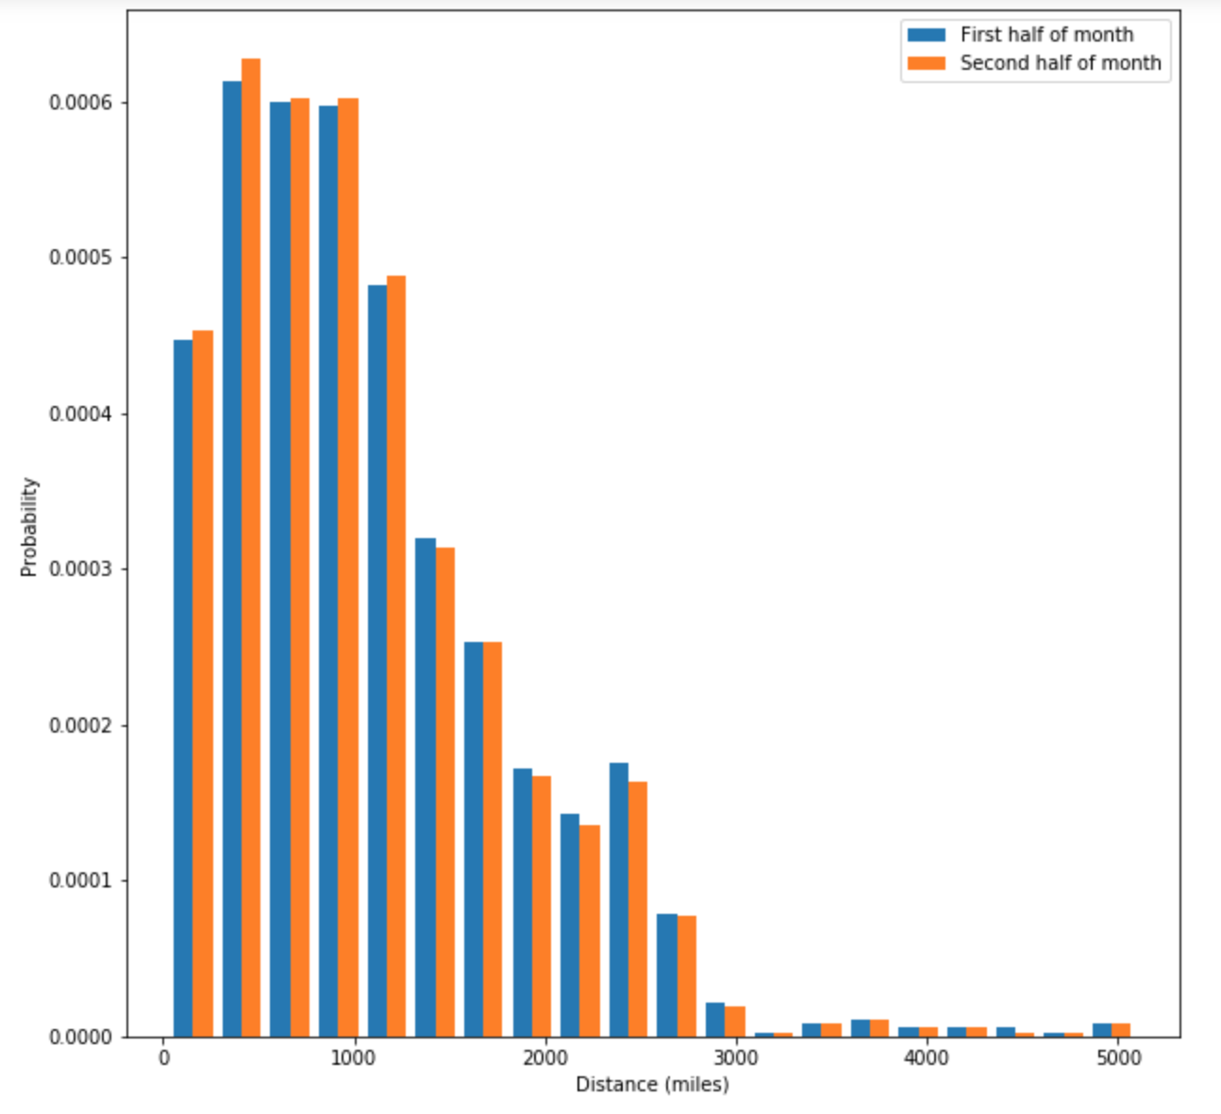
PMF Scenario #1
Notes:
There is not much of a difference in probability between how many miles are flown at the beginning of the month versus the end of the month.

Slide 9
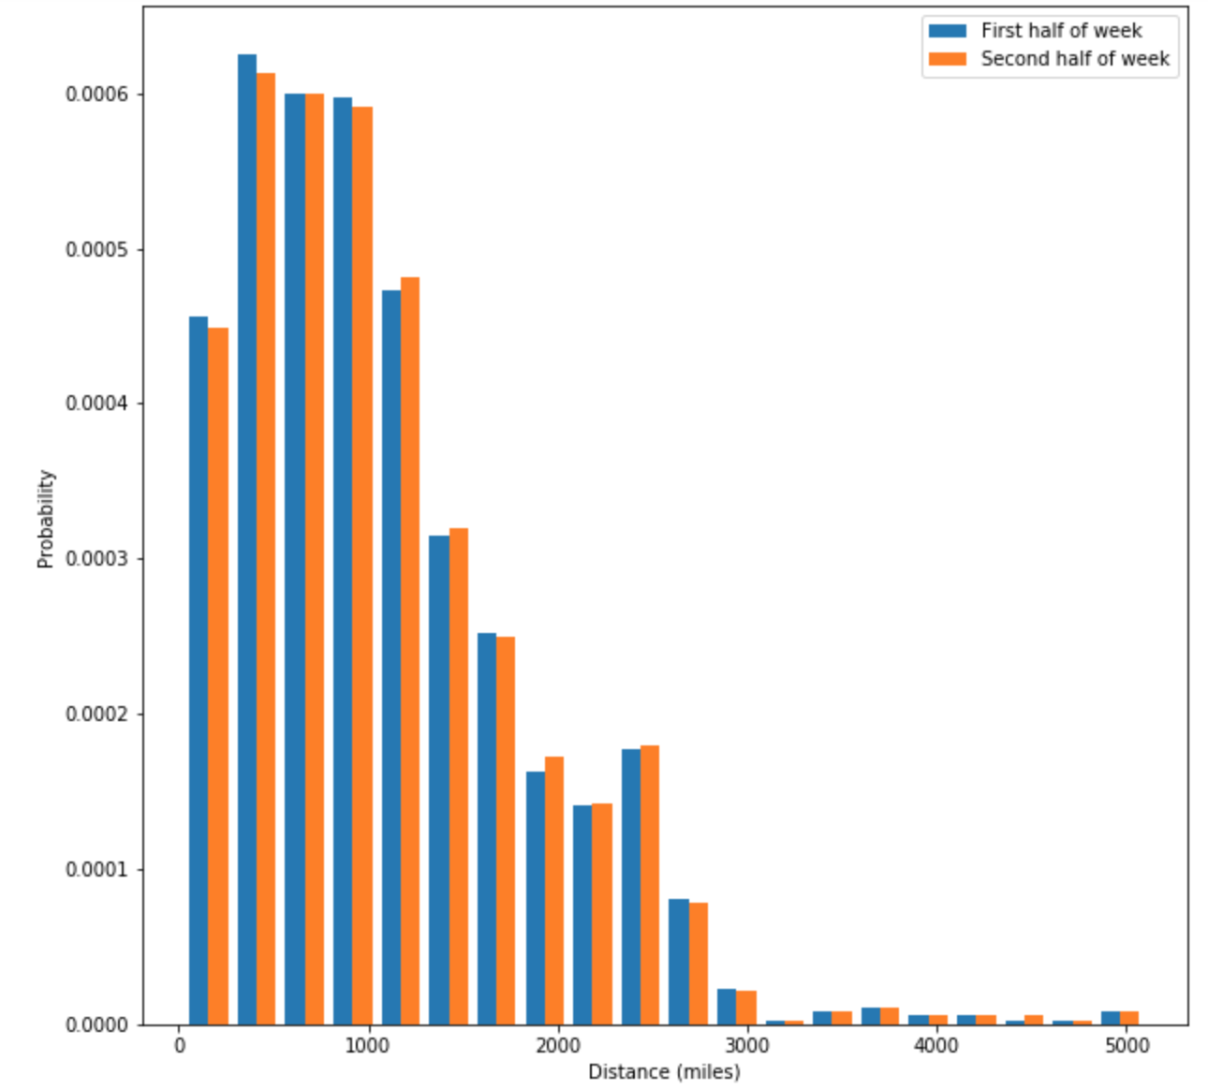
PMF Scenario #2
Notes:
Again, there is not much of a difference in probability between how many miles are flown at the beginning of the week versus the end of the week.

Slide 10
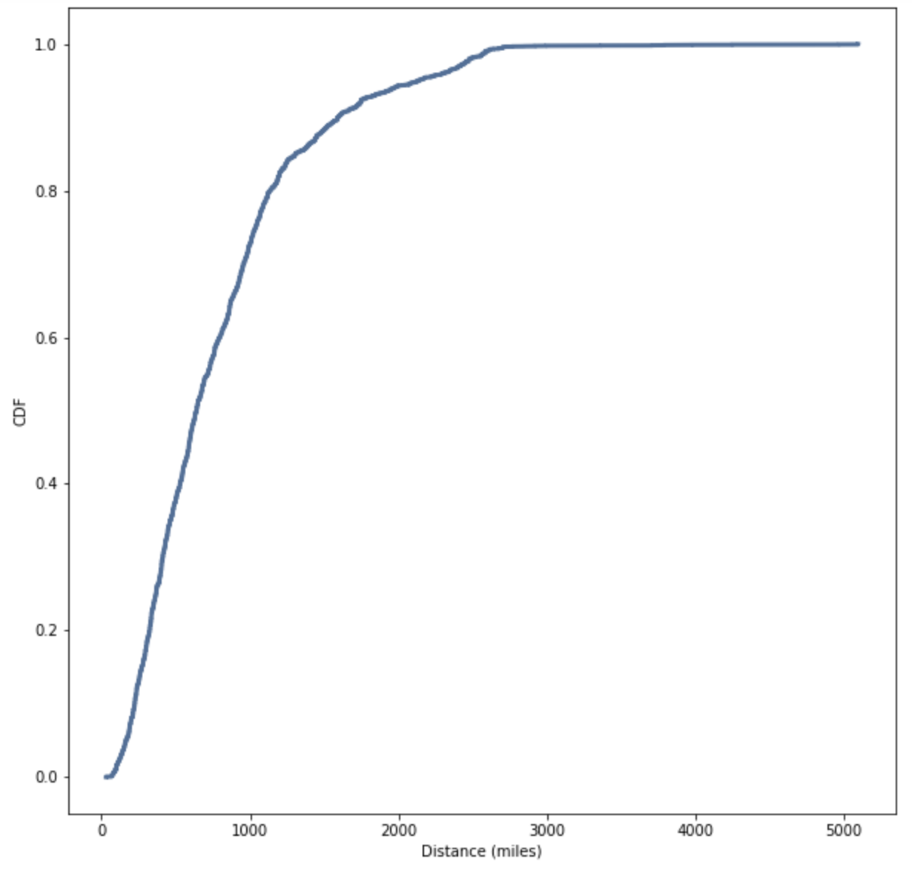
CDF - Distance
Notes:
From the CDF, it looks about 80% of flights are shorter than 1000 miles. There are not many flights that go above 3000 as the line starts to flatten out past 3000.

Slide 11
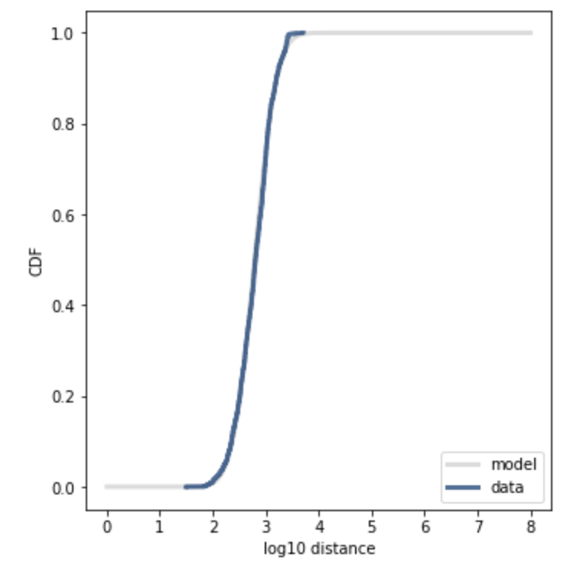
Analytical Distribution Lognormal Distribution
Notes:
The distance is approximately lognormal as it was a better fit than on a linear scale. The distribution is normally distributed.

Slide 12
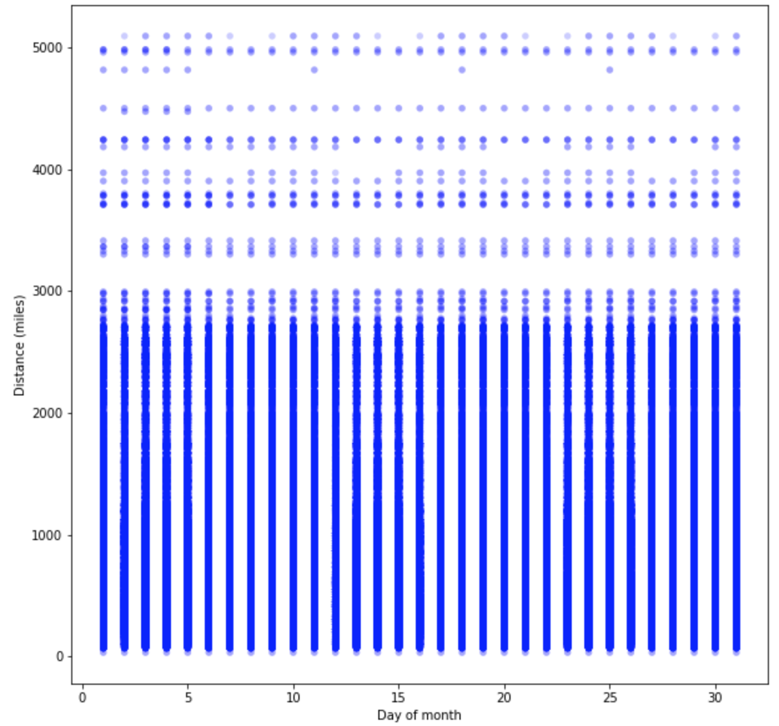
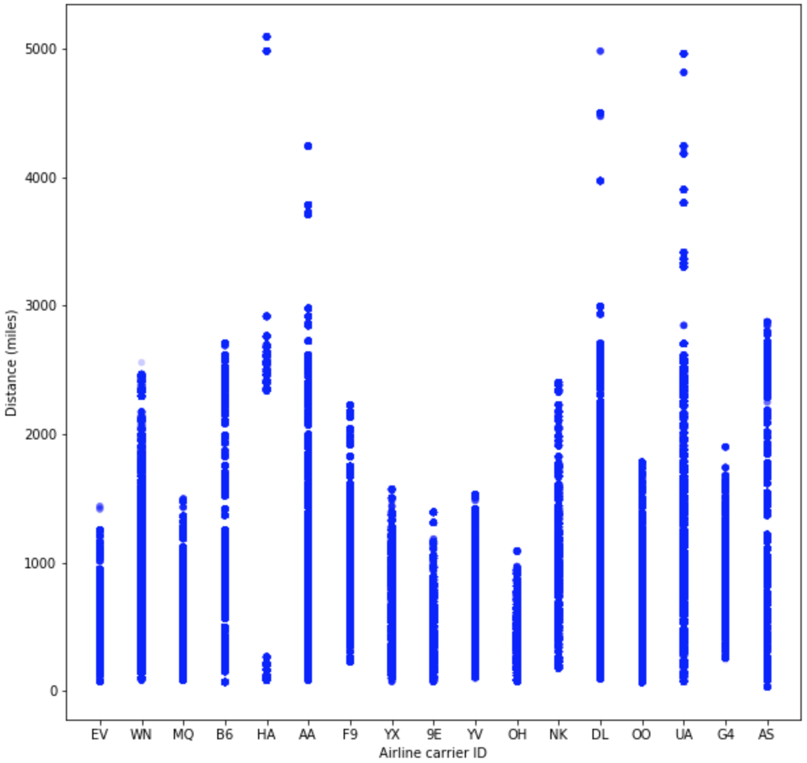
Scatter Plots
Notes:
As shown before, there are more flights that run continuously that are less than 3000 miles. For day of the month, it seems that they no matter the distance there is a flight in every range every day. For the airlines, only a select few airlines go over 3000 miles.

Slide 13
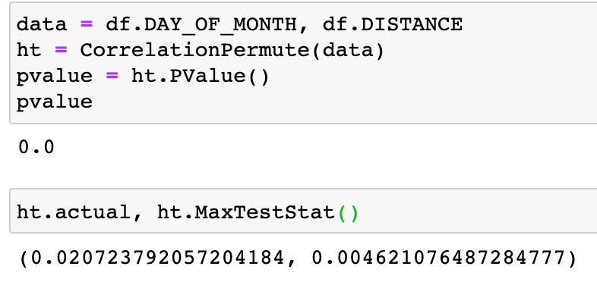
Hypothesis Test - Correlation
Notes:
The p-value is reported as 0, with the actual correlation is .02. That means that there really is no correlation between the day of the month and the distance flown.

Slide 14
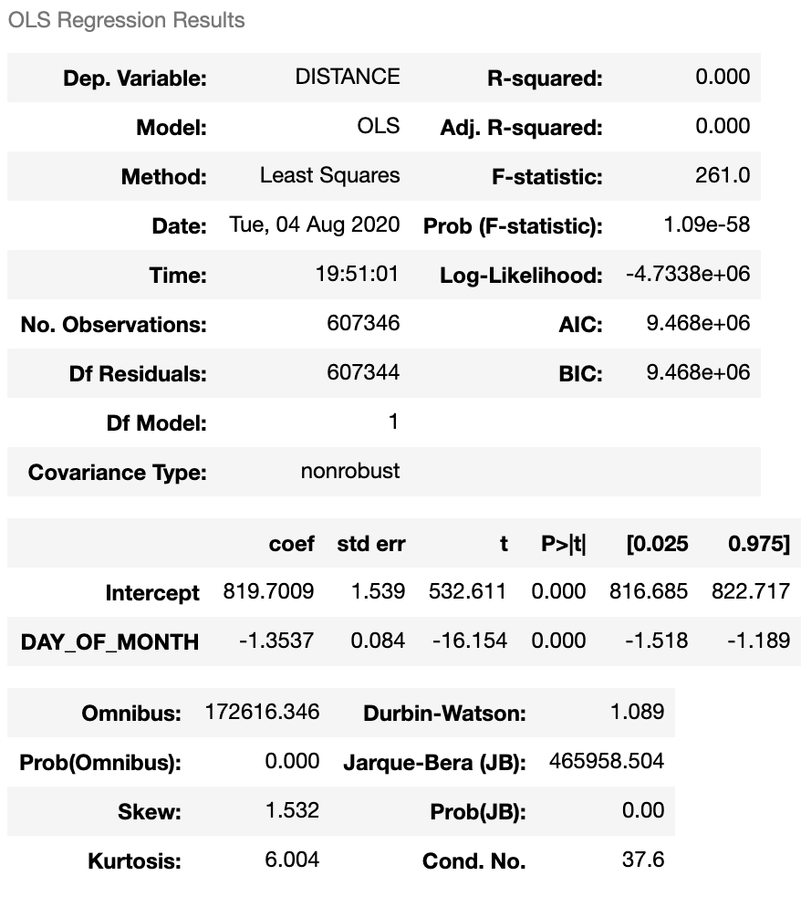
Regression Analysis
Notes:
Due to R-squared and adjusted R-square being 0, there is no dependency on the variables distance and day of the month. The F-statistic is quite high and since it is further away from 0, the probability of null hypothesis is false. The Prob(Omnibus) checks if the errors are normally distributed, due to the result being 0, this assumption is not satisfied. However, the Durbin-Watson tells that the variance of errors is constant.

