Slide 1
Grabbing Data with Dyalog
FinnAPL Autumn Seminaari
10 December 2020
Brian Becker – Dyalog, LTD

Slide 2
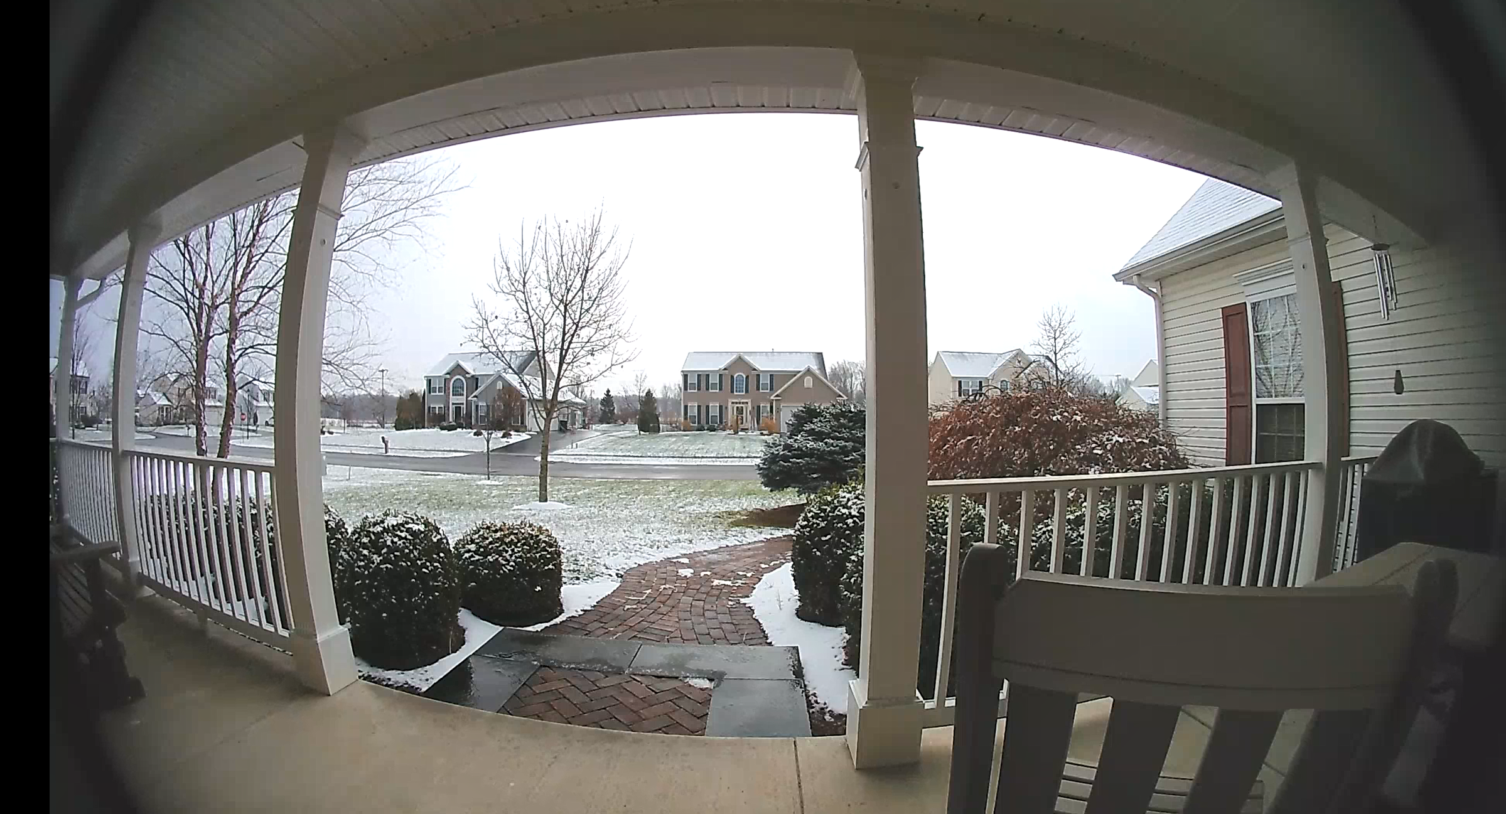
Goals/Agenda
Context
What, Why, When, How
Discuss techniques
Web scraping
Downloading files
Retrieve data from web services
Present some tools
curl
HttpCommand
.NET
This is a read-only presentation ☺
We will not cover how to send or update data on the net though some of the tools presented today could be used to do so

Slide 3
Context
What/Why?
Grabbing data from the net and converting it to a usable form in Dyalog.
"Web Scraping" – copying/extracting from a web page
Download/copy files
Accessing Web Services
When?
Ad hoc/One-off - You see something of interest and want to grab it
Routine/Repeatable
Check if a website is up
Interact with a web service
Retrieve periodic data
How?
Your browser
curl
HttpCommand
.NET WebBrowser (Windows only)

Slide 4
curl
Command line tool to transfer data from or to a server
Supports many protocols - DICT, FILE, FTP, FTPS, GOPHER, HTTP, HTTPS, IMAP, IMAPS, LDAP, LDAPS, MQTT, POP3, POP3S, RTMP, RTMPS, RTSP, SCP, SFTP, SMB, SMBS, SMTP, SMTPS, TELNET and TFTP
For today, we'll stick to HTTP and HTTPS
Designed to work without interaction
Comprehensive with many options to accomplish a wide variety of tasks
Available on all Dyalog platforms
Installation may be necessary
≢∊⎕SH 'curl https://www.dyalog.com'
19494

Slide 5
HttpCommand
APL utility intended to make it easy for an APLer to transfer data to and from a server using HTTP/HTTPS
Installed at [DYALOG]/Library/Conga/HttpCommand.dyalog
]load HttpCommand
r ← HttpCommand.Do command URL [parameters] [headers]
HttpCommand.Get url ⍝ shortcut for the HTTP GET command
HttpCommand.Documentation ⍝ display the documentation
HttpCommand.Upgrade ⍝ upgrade to latest version from GitHub
HttpCommand.Get 'dyalog.com'
[rc: 0 | msg: "" | HTTP Status: 200 "OK" | ⍴Data: 20428]
Note – there are 2 "return codes"
r.rc – is an "internal" return code (0 means success processing your request)
r.HttpStatus – is the HTTP status code (200 means OK)
0 200≡r.(rc HttpStatus) is a common test for success

Slide 6
curl or HttpCommand?
curl
+ may be able to address use cases not supported by HttpCommand
+ does not require anything additional to be loaded into the workspace
+ has no dependency on Conga
- may need to be installed
- arguments need to be formatted into a string to be passed via ⎕SH
- results will likely need further parsing
HttpCommand
+ written with an APL perspective in mind; arguments and results are more natural for use by the APLer
+ actively improved and extended
+ nothing addition to install
? requires Conga to be available in the workspace (it's copied in if not there already)
- is not as comprehensive as curl
There's no reason you can't use both if necessary

Slide 7
Web Scraping
Download and parse the content of a web page to extract information
Ad hoc
Navigate to the content of interest
Right-click and select "Inspect Element" (this opens the browser's developer tools)
Right click in the element in devtools and select Copy > Outer HTML
In APL, paste the clipboard into a variable
Use ⎕XML (or the tool of your choice) to parse into a form more usable in APL
Programmatic
Use curl or HttpCommand or to grab the content of the web page
Use ⎕XML (or the tool of your choice) to parse into a form more usable in APL
Alternatively use .NET WebBrowser
Note: ⎕XML alone may not be work
HTML is not always parseable using ⎕XML or regex
Tools exist to convert HTML into XHTML which ⎕XML can then parse
It helps to have some understanding of HTML
Notes:
Country Code demo
Dyalog home page demo

Slide 8
Downloading Content
Use curl or HttpCommand to download the content of some resource
Use ⎕XML, ⎕JSON, ⎕CSV, or other utilities to convert to usable form

Slide 9
Web Services
Many web services publish APIs to access their content
Some web services require you to register and possibly obtain a key and/or token for access
Some web services provide a free tier of service that is possibly limited in function or by the number of operations you can perform in a given period of time
Use curl or HttpCommand
Use ⎕XML, ⎕JSON, ⎕CSV, or other utilities to convert to usable form
RESTful? Web services
Operations correspond to HTTP commands GET (Read), POST (Create), PUT (Update), DELETE (Delete)
Endpoints are URLs – GET https://someurl.com/customers/23/orders DELETE https://someurl.com/customers/23/orders/65353
Having a basic knowledge of HTTP is very useful

Slide 10
Twitter Example
Read Getting Started
Apply for developer account
Create project for your app
Generate tokens/keys
Consumer Keys (API Key and Secret) for your app
Access token and secret (to authenticate for your personal account)
Bearer token (to track usage against your app)
Edit permissions for your app
Decide what endpoints you want to use
Depending on which endpoints, you'll use either the latest v2 API or the Standard or Premium v1.1 API
Endpoints may have different usage limits based on which API

Slide 11
Thank you!
Demo code will be available from 14 December 2020 at
https://github.com/bpbecker/GrabbingData
(after I remove personal keys and annotate it)

