Slide 1
Theories and Concepts
Week 2 Lecture II
Becoming a Political Researcher (POL2017)

Slide 2
What we will cover
What are models?
What is a theory?
Different types of theories
What are concepts?
How do these apply to political research?
Inductive and deductive research

Slide 3
What is a model?
Simplified representation of a real world process
Highlights, or omits certain aspects
Aids understanding of underlying processes
‘All models are wrong, but some models are useful’
Parsimony

Slide 4

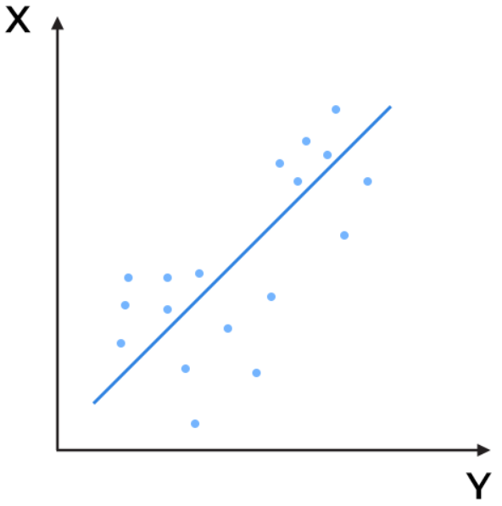
What is a model?

Slide 5
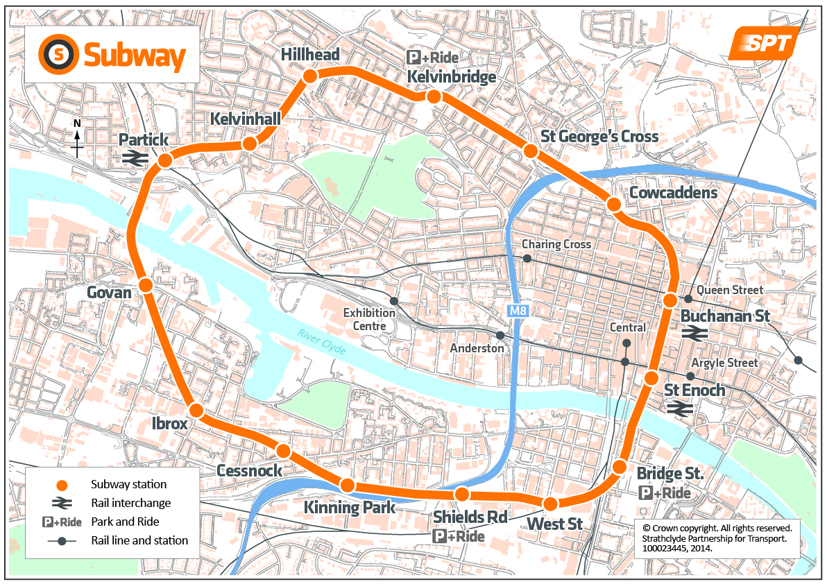
What is a model?

Slide 6
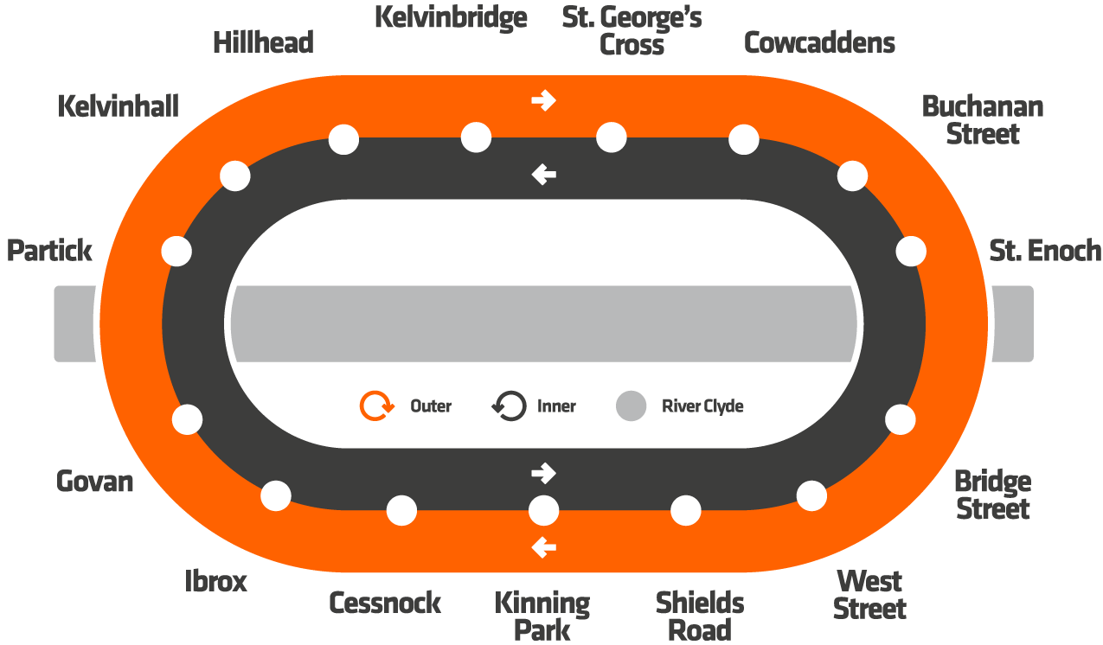
What is a model?

Slide 7

What is a theory?
Ways to make sense of, and explain the social world
‘How’ and ‘why’ questions
Relationship between different concepts

Slide 8
Types of theory
Can vary in scope, generalisability, level of abstraction
Grand theories
- e.g. marxism, feminism
Middle-range theories
- e.g. democratic peace theory, rational voter theory

Slide 9
The role of theory in research
Theories can offer potential answers to our research questions
Research can be used for:
-theory testing
-theory building
Linking relevant concepts

Slide 10
What are concepts?
Way of labelling things that share common features
Building blocks of theories
Often have contested meanings
Conceptualisation
What do we mean, or not mean by our chosen term?
e.g. liberty, equality, representation, nationalism, globalisation, the state

Slide 11


What are concepts?
Example: ‘Democracy’
Discussion Questions
What do we mean by ‘democracy’?
What are the key features of a democracy?

Slide 12
What are concepts?
Potential features
Democracy
Direct
Representative
Multi-party elections
Free press
Right to protest
Rule of law
Universal suffrage
Protection of human rights
Free and fair elections

Slide 13
What are concepts?
Conceptualisation
What do we mean, or not mean by our chosen term?
Operationalisation
How would we know it when we see it?
Which indicators can be used to measure it?

Slide 14
Theories to concepts
Abstract
Concrete
Latent
Manifest
Theory
⬇
Conceptualisation
⬇
Operationalisation

Slide 15
Example 1 – Explaining protest
Research question:
Why do some countries experience greater levels of protest than others?
Political
protest
Key concept = Protest
Level of analysis = Country level

Slide 16
Inductive and deductive research
Inductive
Starts with data, then theory
Theory generation
Deductive
Starts with theory, then data
Theory testing

Slide 17
Inductive Approach
Deductive Approach
Research Question
Research Question
Data Collection & Analysis
Theory
Theory
Hypotheses
Hypotheses
Data Collection & Analysis

Slide 18
Example 1 – Explaining protest
Research question:
Why do some countries experience greater levels of protest than others?
Political
protest
Key concept = Protest
Level of analysis = Country level

Slide 19
Why do some countries experience greater levels of political protest than others?
Theory 1: Resource theory
Resources
Political
protest
- Developed economy
- Mass education
- Mass media

Slide 20
Why do some countries experience greater levels of political protest than others?
Theory 2: Grievance theory
Deprivation
Political
protest
- Poverty
- Economic inequality

Slide 21
Hypotheses
Expected relationship between our key concepts/variables
What patterns would we expect to find in our data if our theory was correct?
Should be clearly stated, falsifiable

Slide 22
Why do some countries experience greater levels of political protest than others?
Economic development
Political protest
Resource theory: Hypothesis 1
Development ↑ =
Protest ↑
Grievance theory: Hypothesis 2
Development ↑ =
Protest ↓

Slide 23
Summary
Models
- simplified representations of real world events/processes
- certain aspects emphasized
Theories
- Ways of explaining the social world
- Offer answers to our research questions
- Can vary in scope (grand/middle-range theory)
- Relationship between different concepts

Slide 24
Summary
Concepts
- Labelling of items that share common features
- Lets us generalize beyond individual cases
Conceptualisation
What do we mean by our chosen concept? (Definitions)
Operationalisation
How would we know our concept when we see it? (Measurement)

Slide 25
Summary
Hypotheses
Expected relationships between our concepts, based on our theoretical assumptions
What patterns would we expect to find in our data if our theory was correct?
Inductive research
- Theory generation, starts with data, then theory
Deductive research
- Theory testing, starts with theory, then data

Slide 26
Next steps
Essential Readings
Halperin & Heath (2020), Ch 4 pp.93-114, Ch 5 pp.123-134, 143-145
Video: ‘How to formulate research questions’
Blackstone (2012), Chapter 2, Section 2.3
Seminar questions
What makes a good research question?
What do we mean by ‘theory’, and ‘concepts’ in research?
What is the difference between inductive and deductive research designs?

Slide 27
Next steps
Next week
Qualitative and quantitative research

Slide 28
References
Dalton, R., Van Sickle, A., & Weldon, S. (2010). The Individual–Institutional Nexus of Protest Behaviour. British Journal of Political Science, 40(01), 51. https://doi.org/10.1017/S000712340999038X

