Slide 1
Quantitative Methods
Week 3
Becoming a Political Researcher (POL2017)

Slide 2
This week
Assigned course materials:
Bryman, Alan. (2012). “Chapter 26: Breaking down the quantitative/qualitative divide” in Social research methods. Oxford University Press
Yilmaz, K. (2013). Comparison of quantitative and qualitative research traditions: Epistemological, theoretical, and methodological differences. European journal of education, 48(2), 311-325. https://doi.org/10.1111/ejed.12014
Seminar questions:
What are the main differences between quantitative and qualitative approaches to research?
Are quantitative and qualitative research incompatible, or can these approaches be complementary?

Slide 3
What we will cover
What are quantitative methods?
Evaluating quantitative research
Advantages and limitations
Examples
Experiments
Large-N comparative research

Slide 4
What are quantitative methods?
Explore relationships by collecting and analysing numerical data
Counting stuff
Positivism
- external objective reality
- scientific method, systematic
- measurement
- hypothesis testing

Slide 5
What are quantitative methods?
Examples:
Surveys
Content analysis
Experiments
Large-N comparative research

Slide 6
Key features
Statistical analysis
Descriptive statistics
- summarise features of your data
- distributions, averages, variation
Inferential statistics
- using data from a sample, make inferences about wider population
- quantify uncertainty

Slide 7
Evaluating quantitative methods
Validity
- Internal validity
Are we actually measuring the concept we are interested in?
Have we chosen an appropriate method that can answer our research question?
- External validity
Is our measure generalisable to different contexts?
Reliability
Consistency: measure produces the same results on repeated occasions

Slide 8
Key features
Measurement
- How to measure and operationalise our concepts of interest
- From concepts to variables
Deductive reasoning
- Hypothesis testing

Slide 9
Hypothesis testing
X
Predictor
Independent variable
Y
Outcome
Dependent variable

Slide 10
Hypothesis testing
X
Age
Age ⬆
Y
Voting
Voting ⬆

Slide 11
Hypothesis testing
Hypothesis
H1: Older citizens are more likely to vote in elections compared to younger citizens.
Null Hypothesis
H0: Older citizens are equally as likely to vote in elections compared to younger citizens.
Age⬆ → Voting ⬆

Slide 12

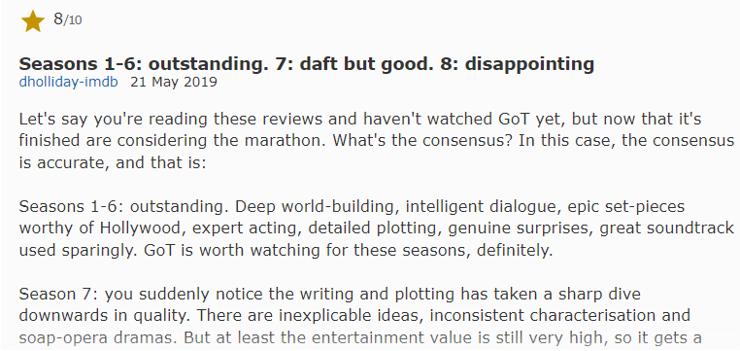

Slide 13
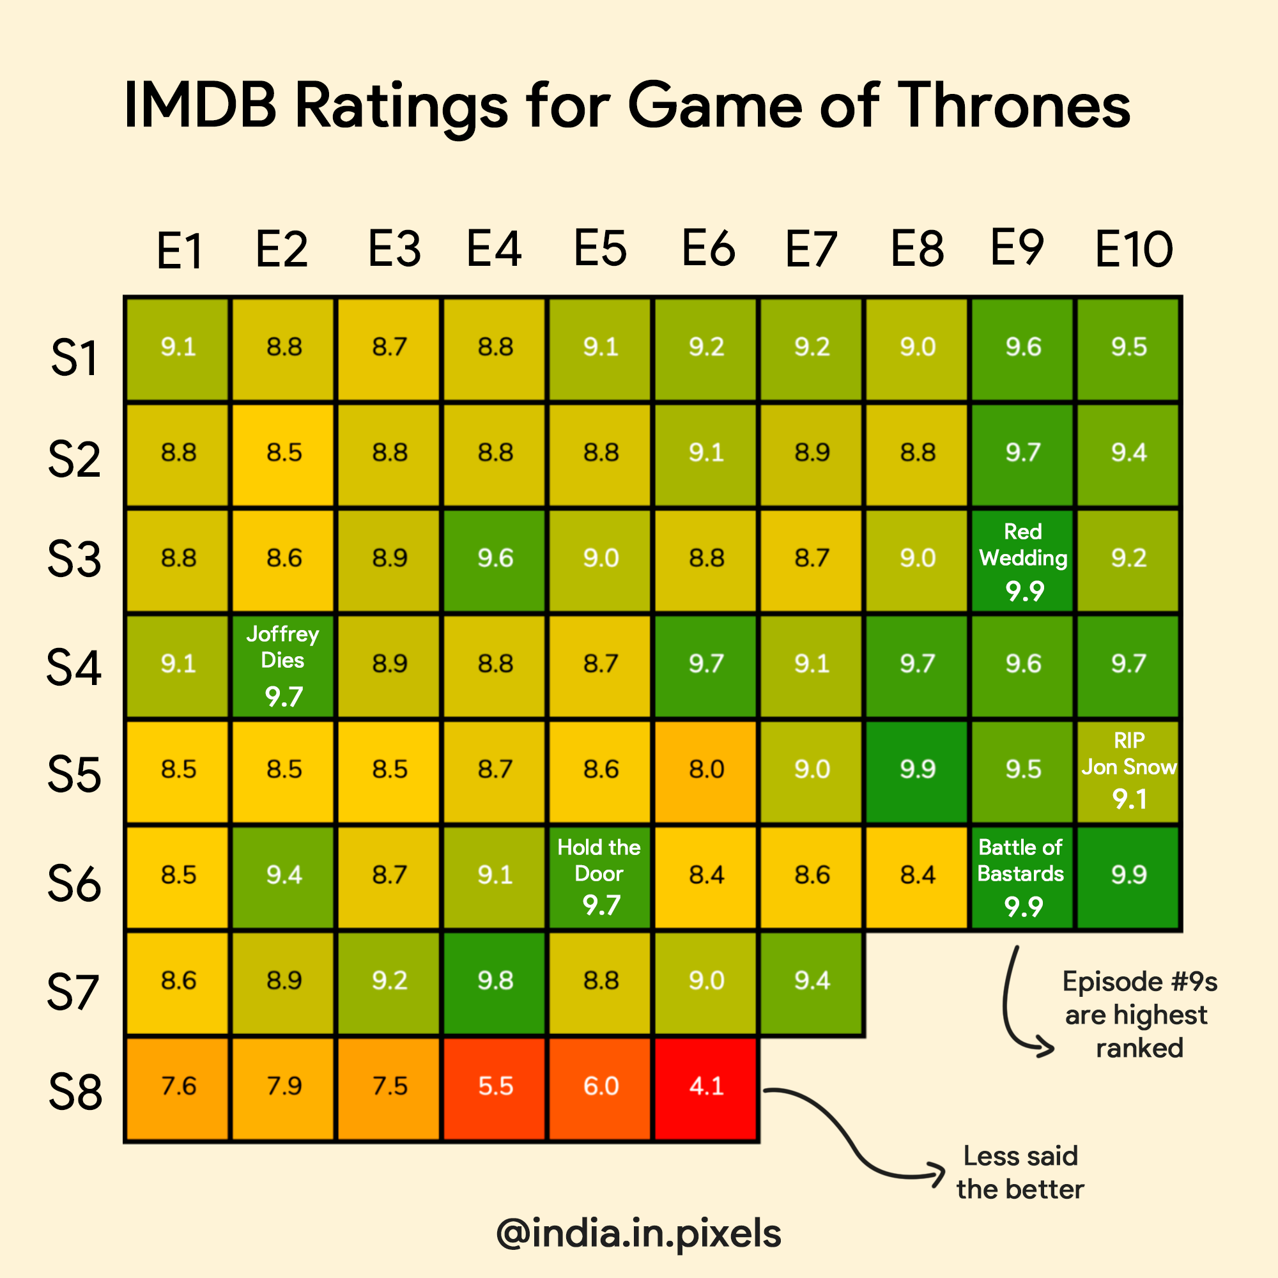

Slide 14
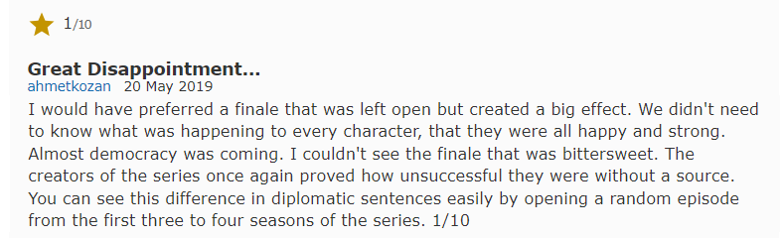
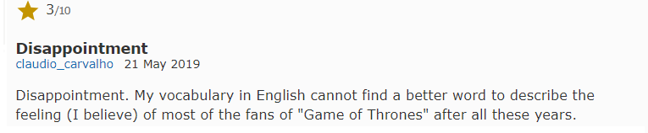
IMDB Episode Reviews for ‘Game of Thrones’ S8E6

Slide 15
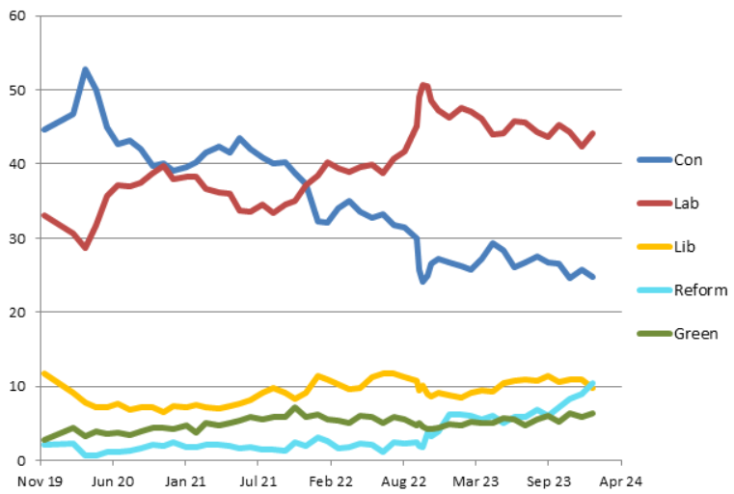
UK General Election Voting Intention (poll of polls)
Source: https://www.electoralcalculus.co.uk/polls.html

Slide 16
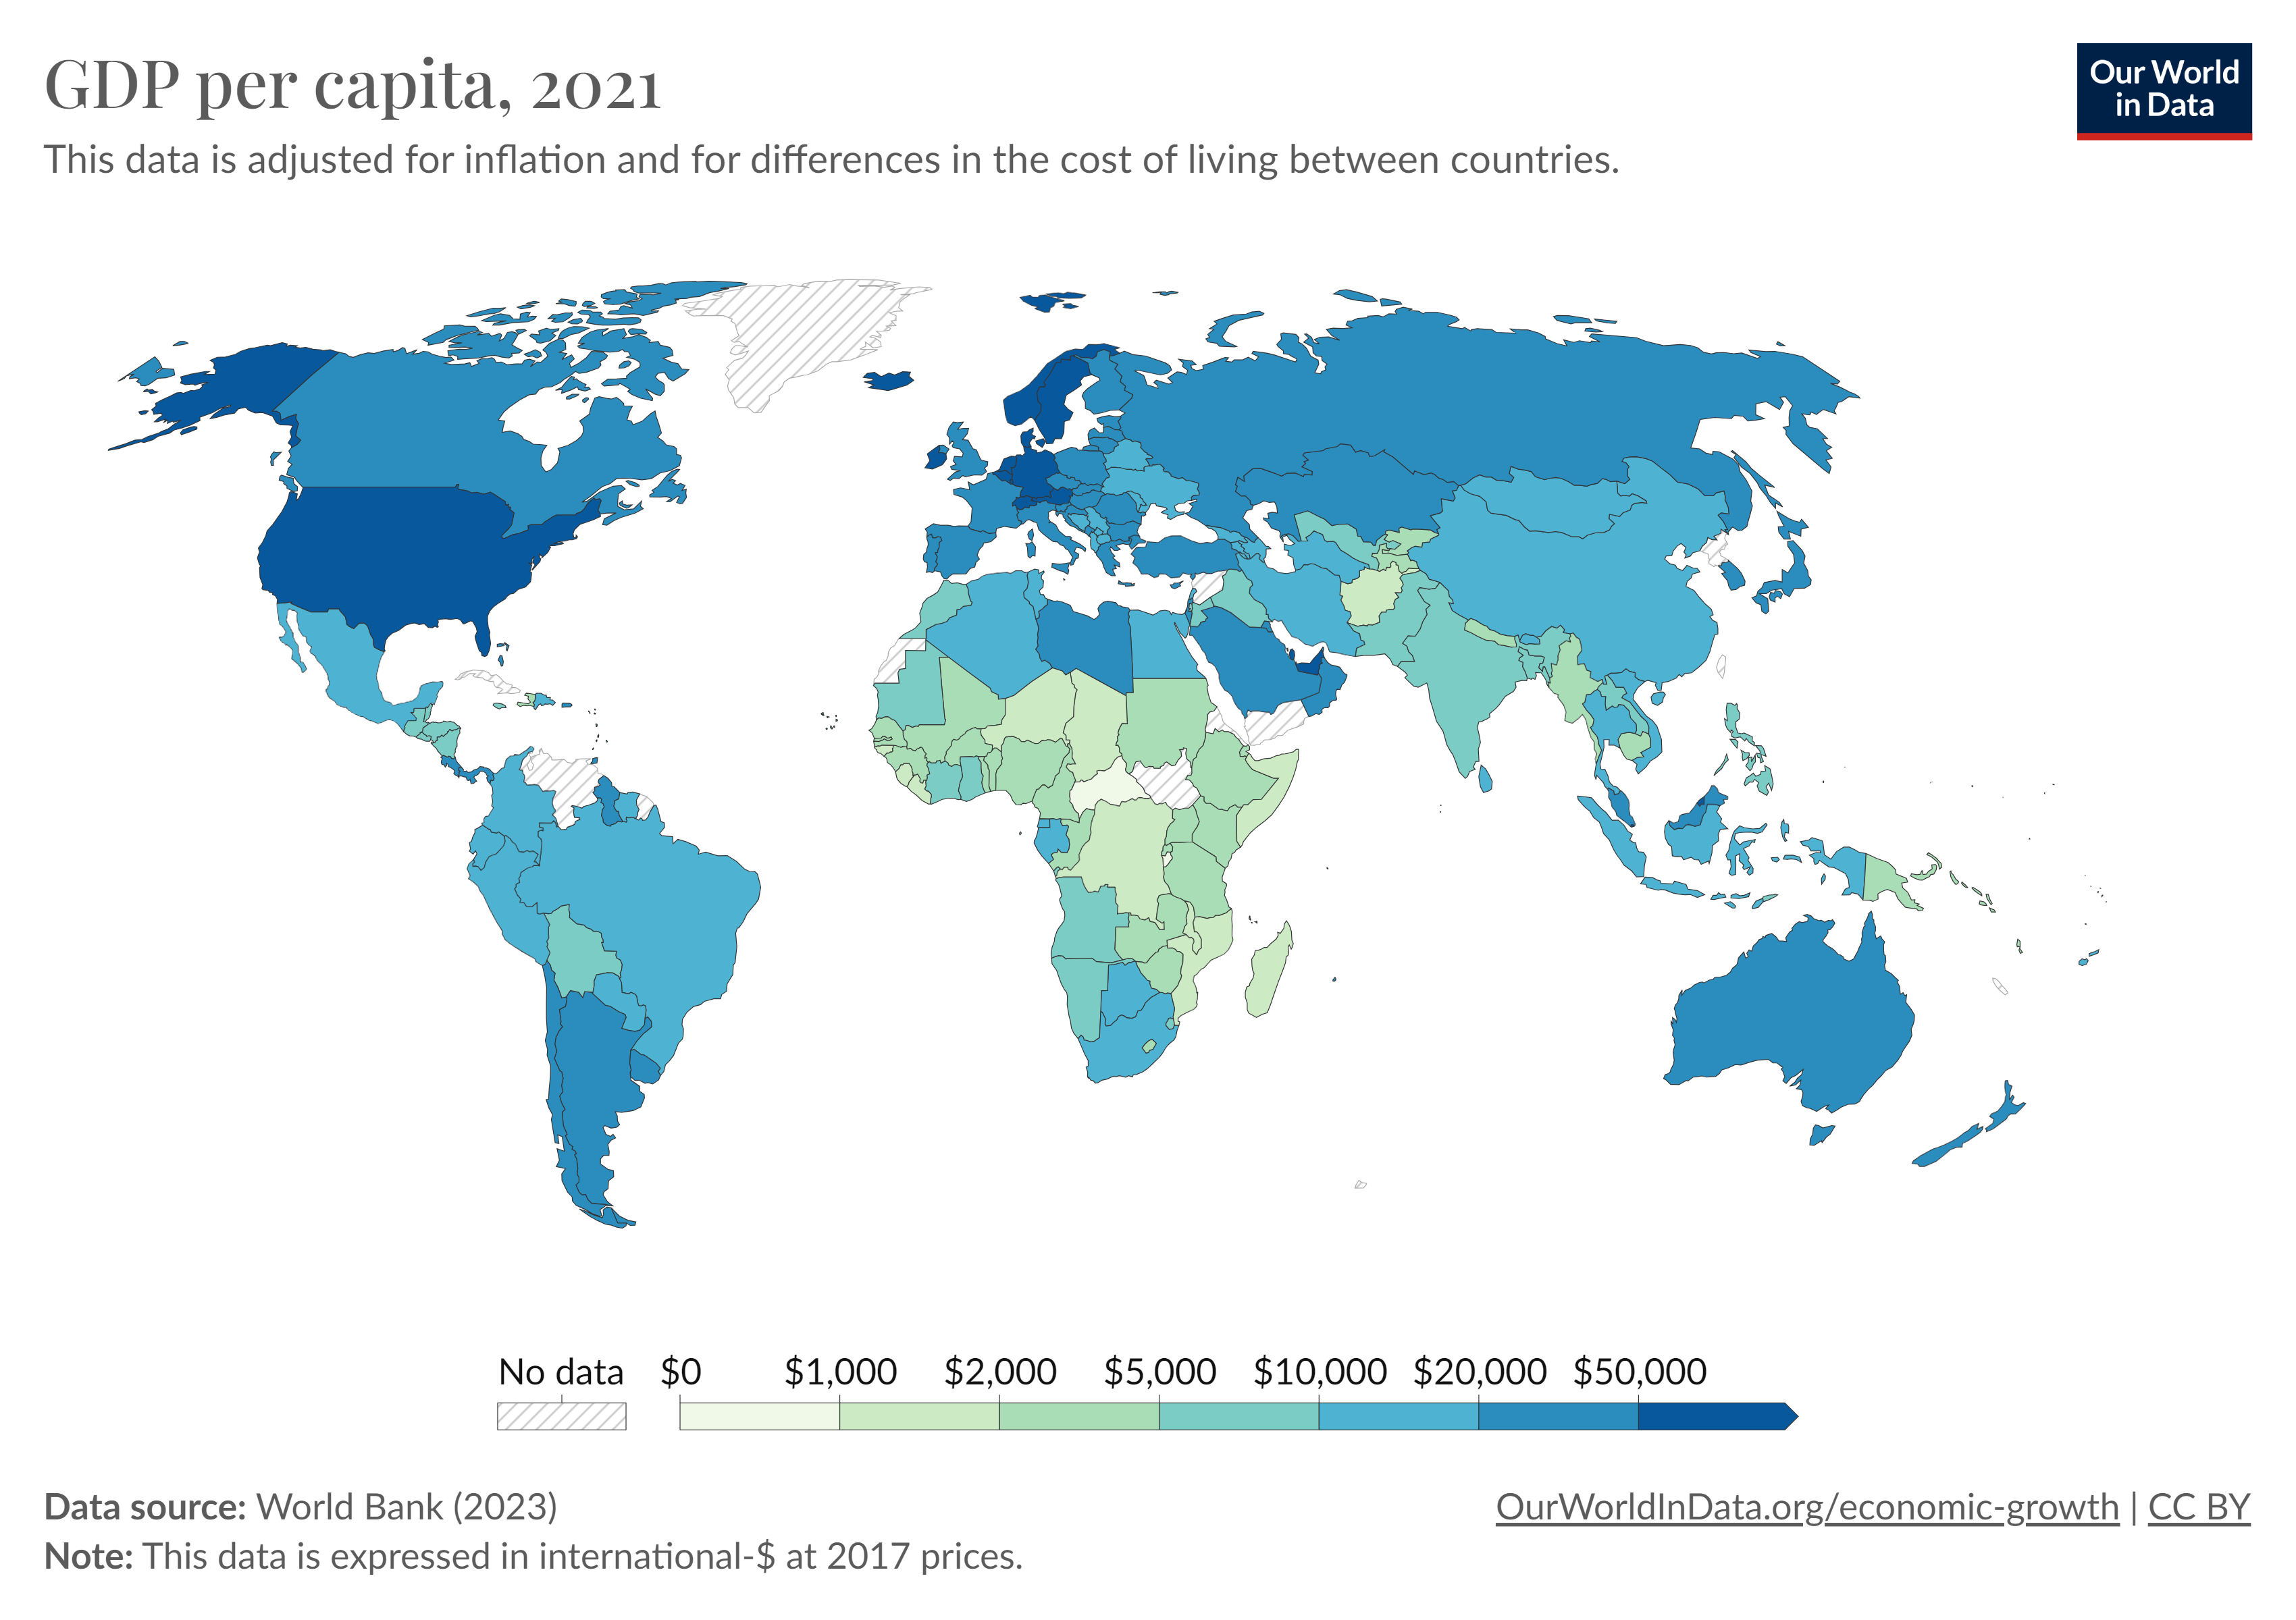

Slide 17
Evaluating quantitative methods
Advantages
Limitations
Large samples
Comparison
Hypothesis testing
Replication
Lack of context
Narrow focus, lacks depth
Structural biases

Slide 18
Examples
Experiments
- Lab experiments
- Field experiments
- Natural experiments
Large-N comparative research

Slide 19

Experiments
Control and treatment groups
Random assignment
Experiment Types
Lab experiments
Field experiments
Natural experiments

Slide 20
Lab experiments
Strong control over experimental environment
Strong control over treatment
Good internal validity
Limited external validity

Slide 21
Reher (2021) How Do Voters Perceive Disabled Candidates?
Example 1:
Lab Experiment
Research question
How do voters perceive disabled candidates?
Survey experiment (1,000 UK respondents)
Compare two fictional candidates standing for election
Given information on:
- gender, ethnicity, age, profession, children, experience

Slide 22
Reher (2021) How Do Voters Perceive Disabled Candidates?
Example 1:
Lab Experiment
IV: Disability
Treatment: mobility impairment, visual impairment, hearing impairment
- key barriers and adjustments
Control: no disability mentioned
DV: Candidate evaluations
Perceived traits, issue concerns, left-right position, issue competency

Slide 23
Reher (2021) How Do Voters Perceive Disabled Candidates?
Example 1:
Lab Experiment
Comparison 1
Please read the descriptions of these two candidates carefully.
Candidate A
<NAME> is <AGE> years old and has <CHILDREN>. <PRONOUN> <JOB>. <PRONOUN><DISABILITY>. <NAME> has been politically active in your constituency for <EXPERIENCE> years. <PRONOUN> <OFFICE>.
Candidate B
<NAME> is <AGE> years old and has <CHILDREN>. <PRONOUN> <JOB>. <PRONOUN><DISABILITY>. <NAME> has been politically active in your constituency for <EXPERIENCE> years. <PRONOUN> <OFFICE>.

Slide 24
Reher (2021) How Do Voters Perceive Disabled Candidates?
Example 1:
Lab Experiment
Comparison 1
Please read the descriptions of these two candidates carefully.
Candidate A
Anna Smith is 54 years old and has one child. She works as a lawyer for a large international firm. Anna has been politically active in your constituency for 5 years. She has previously served as a local councillor.
Candidate B
Tom Williams is 62 years old and has three children. He works as a primary school teacher. He is paralysed below the waist and uses a wheelchair to get around. Tom has been politically active in your constituency for 3 years. He has not yet held elected office.

Slide 25
Reher (2021) How Do Voters Perceive Disabled Candidates?
Example 1:
Lab Experiment
Results
Disabled candidates were perceived as being more:
compassionate, honest, and hard-working than nondisabled candidates
ideologically left-wing
concerned about and competent in dealing with policy on healthcare, minority rights, and social welfare

Slide 26
Field experiments
Limited control over experimental environment
Limited control over treatment (compared to lab)
Limited internal validity
Strong external validity

Slide 27
Yan & Bernhard (2024) Gendered Experiences of Political Participation
Example 2:
Field Experiment
RQ: Are women more likely than men to receive hostile messages when they participate in politics?
Field experiment (US in 2018)
SMS messages encouraging participation (135, 587 texts)
Randomised the names of the message sender
Measured types of response

Slide 28
Yan & Bernhard (2024) Gendered Experiences of Political Participation
Example 2:
Field Experiment
Hi [VOTER’S NAME], I’m [EXPERIMENTAL TREATMENT NAME], a volunteer with NextGen America. This Saturday, March 24, young people have organized a march to spread awareness and demand gun safety legislation from our elected officials. Find a local March For Our Lives here: http://nxtgn.us/dkh - Can we count on you to join us at the march?
Random assignment:
Jessica (treatment)
Michael (treatment)
Taylor (control)
No name

Slide 29
Yan & Bernhard (2024) Gendered Experiences of Political Participation
Example 2:
Field Experiment
Independent variable:
Name of sender (perceived gender)
Dependent variable:
Type of response
1) Offensiveness
- volunteer-reported measure, threatening or offensive language
2) Silencing
- respondent intimidates or harasses the volunteer into ceasing contact.
3) Withdrawal
- polite or inoffensive requests not to be contacted again

Slide 30
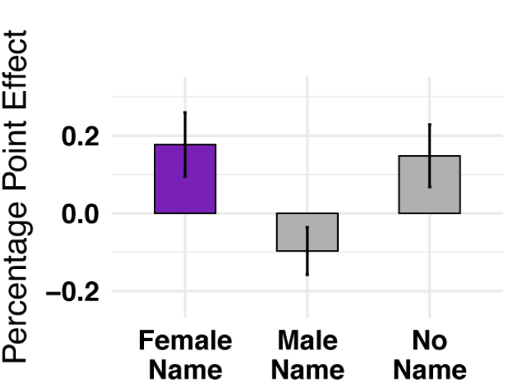
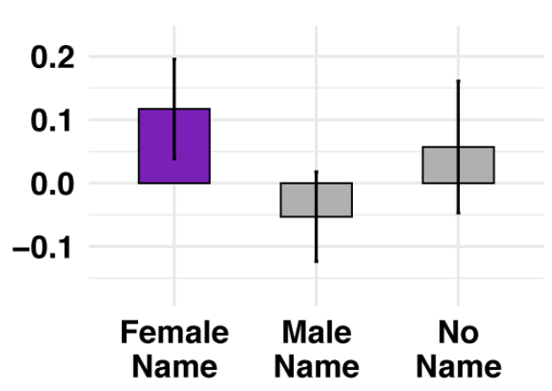
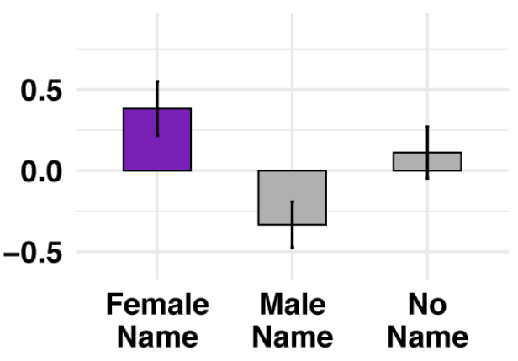
Yan & Bernhard (2024) Gendered Experiences of Political Participation
Example 2:
Field Experiment
Offensiveness
Silencing
Withdrawal

Slide 31
Yan & Bernhard (2024) Gendered Experiences of Political Participation
Example 2:
Field Experiment
Results
Volunteers assigned with a feminine name:
Received more offensive, silencing, and withdrawal responses than any other name condition
But also had higher response rates and supporter commitments to call their representatives
Both men and women were more hostile to female-named volunteers
Context of a “friendly audience”

Slide 32
Natural experiments
Least Control over experimental environment
Least Control over treatment
Limited internal validity
Strongest external validity

Slide 33
Jaitman (2013) Causal effect of compulsory voting laws on turnout
Example 3:
Natural Experiment
RQs:
Do compulsory voting laws have a causal effect on voter turnout rates?
Do the impact of these laws vary across different occupational groups?
Natural experiment
Argentina 2009, compulsory voting for citizens age 18-70
Compares citizens pre-post age 70 cut-off
Sample: male citizens aged 65–74 years (10,134)

Slide 34
Jaitman (2013) Causal effect of compulsory voting laws on turnout
Example 3:
Natural Experiment
Treatment: Legally required to vote (ages 65-69)
Control group: Not legally required to vote (ages 70-74)
DV: Voted in election
IV: Occupation
Skilled: profession requires more than high-school education
Unskilled: Profession requires high-school or a lower degree

Slide 35
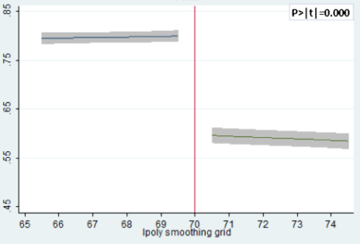
Jaitman (2013) Causal effect of compulsory voting laws on turnout
Example 3:
Natural Experiment
Fig 2. Voter turnout by age
-18pp

Slide 36
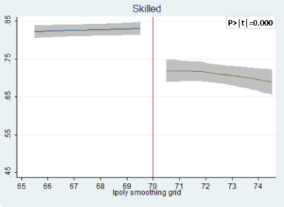
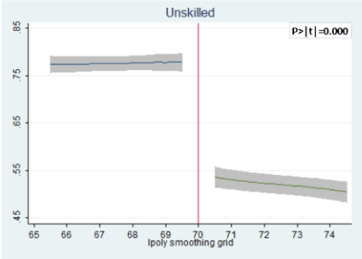
Jaitman (2013) Causal effect of compulsory voting laws on turnout
Example 3:
Natural Experiment
Fig 2. Voter turnout by age and occupation category
-12pp
-22pp

Slide 37
Jaitman (2013) Causal effect of compulsory voting laws on turnout
Example 3:
Natural Experiment
Results
Compulsory voting has strong causal effect on voter turnout
Effect even stronger for ‘unskilled’ occupational group
Compulsory voting reduces turnout inequalities across occupational/educational groups

Slide 38
Trade-offs
Lab
Field
Natural
Internal Validity
External Validity
Appropriate for all research questions?
Ethical considerations?

Slide 39
Large-N comparative research
Large number of cases & observations
Strong external validity
Secondary data (can combine multiple sources)
Sacrifices depth for coverage

Slide 40
Koga-Suddith, (2011) Where Do Third Parties Intervene?
Example 4:
Large-n Comparison
RQ: Do democracies and autocracies intervene militarily in different types of civil conflict?
Data on civil conflict and military interventions
All civil conflicts 1945-1999
147,933 observations

Slide 41
Koga-Suddith, (2011) Where Do Third Parties Intervene?
Example 4:
Large-n Comparison
DV: Did country intervene?
IVs
Regime type
Rebel group strength
Ethnic tie with government
Resources (non/lootable)
Controls: alliance, military, distance

Slide 42
Koga-Suddith, (2011) Where Do Third Parties Intervene?
Example 4:
Large-n Comparison
Results
When opposition groups are stronger
- democracies more likely to intervene
Ethnic tie between 3-rd party state and opposition
- democracies more likely to intervene
Presence of lootable natural resources
- autocracies more likely to intervene

Slide 43
Summary
Quantitative methods
Explore relationships by collecting and analysing numerical data
Typical features: positivist, scientific method, deductive, hypothesis testing

Slide 44
Summary
Validity
- Internal validity
Are we actually measuring the concept we are interested in?
- External validity
Is our measure generalisable to different contexts?
Reliability
Consistency: measure produces the same results on repeated occasions

Slide 45
Summary
Advantages
Limitations
Large samples
Comparison
Hypothesis testing
Replication
Lack of context
Lack of depth
Narrow focus
Structural biases

Slide 46
Next week
Lecture and interactive Library Skills Session
Bring along your laptop to the lecture if possible
Before the seminar:
Attend lecture (will find a journal article to bring to the seminar)
Watch canvas video on ‘Critical Reading and note taking’

Slide 47
Next week
Before the seminar:
Attend lecture (will find a journal article to bring to the seminar)
Watch canvas video on ‘Critical Reading and note taking’
Assigned course materials:
Halperin & Heath, 2020, Chapter 4: Asking Questions, pp.114-120
Video: How do I write a literature review? (11:04)
Seminar questions:
Why do we conduct literature reviews?
What different types of sources should we include in a literature review?
What resources can we use to search for relevant literature?

Slide 48
References
Jaitman, L. (2013). The causal effect of compulsory voting laws on turnout: Does skill matter? Journal of Economic Behavior and Organization, 92, 79–93. https://doi.org/10.1016/j.jebo.2013.05.008
Koga-Suddith, J. (2011). Where Do Third Parties Intervene? Third Parties’ Domestic Institutions and Military Interventions in Civil Conflicts1: Where Do Third Parties Intervene? International Studies Quarterly, 55(4), 1143–1166. https://doi.org/10.1111/j.1468-2478.2011.00684.x
Reher, S. (2021). How Do Voters Perceive Disabled Candidates? Frontiers in Political Science, 2, 634432. https://doi.org/10.3389/fpos.2020.634432
Yan, A. N., & Bernhard, R. (2024). The Silenced Text: Field Experiments on Gendered Experiences of Political Participation. American Political Science Review, 118(1), 481–487. https://doi.org/10.1017/S0003055423000217

