Slide 1
Part 2: Ontology, Epistemology, Methodology and Method
Week 1 – Introduction to method and methodology
POL 2017

Slide 2
Part 2: Overview
Ontology – what is?
Epistemology – what is knowable?
Methodology – the underlying assumptions to our research
The three methodologies of POL 2017
Method – the practical strategies we use to collect and analyse data
What is data?
*This lecture serves as the foundation for your mid-semester essay*

Slide 3
Mid-semester Concept Essay
Details found in your module guide, under 9c:
In 1000 words, please respond to the following two prompts –
Prompt 1: In roughly 500 words, drawing on the relevant literature, provide definitions of the following four concepts – Ontology, Epistemology, Methodology and Method – and highlight the relationships between them. (Week 1)
Prompt 2: Select quantitative OR qualitative methods. In the next approximately 500 words, explain what types of research questions are best suited to your chosen approach. (Week 3)
Remember to utilise teaching from weeks 1-4 in your essay response, including the lectures, weekly guided reading and seminar discussions to help guide your response.

Slide 4
Ontology
What is? What exists?
Nature of the social world
Does an objective reality exist independently of us? Or is our reality socially created?

Slide 5
Epistemology
What is knowable?
What can we know about the social world?
How can we know this?
What type(s) of knowledge should we pursue? What types of knowledge are legitimate?

Slide 6
Methodology
The ontological and epistemological assumptions we make when we obtain knowledge.
Three central methodologies in POL 2017:
Positivism
Interpretivism
Poststructuralism

Slide 7
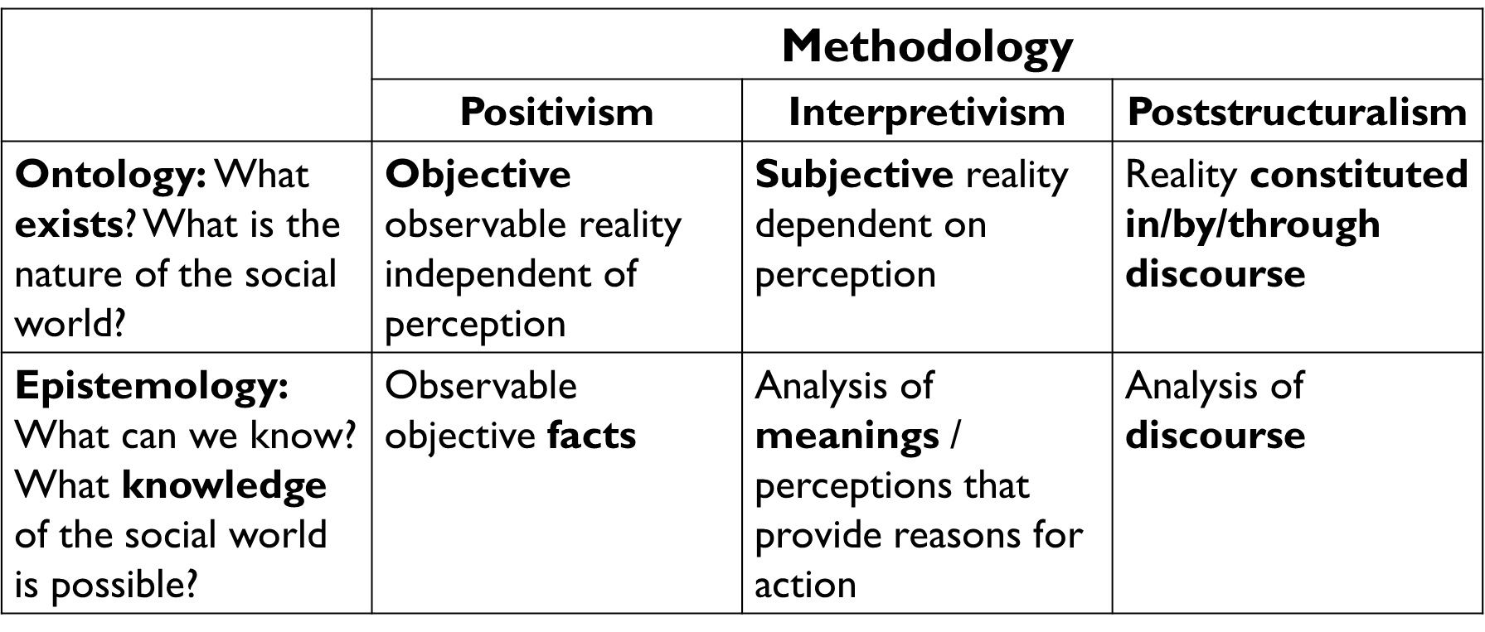
The Three Methodologies in POL 2017

Slide 8
Methodology 1: Positivism
Ontology: Objective observable reality independent of perception
Epistemology: Objectively observable facts
Distinction between facts and values:
Facts = falsifiable knowledge claims (Popper)
Social Sciences = Value Free
Hypothetico deductive model – laws (Hempel)
Positivism’s central aims: objectivity – reliability – generalizability
Positivist research primarily asks: “What is the effect of X on Y?”

Slide 9
Methodology 1: The Problem of Positivism?
Are the aims of positivist methodology possible, or even desirable?
Can the social sciences really be ‘value free’?
Critique of Positivism: “White logic, white methods: Racism and methodology” by Zuberi and Bonilla-Silva (2008)
Argues against the belief that by using scientific method, we can generate objective knowledge about the social world. Offers a critique of positivism’s insistence that our understanding, frameworks and assumptions are not structured by our individual identities or the dominance of certain identities within the academy.
Reviews and critiques the use of “white methods”: argues that the historical use of positivist methods problematically produced so called ‘objective knowledge’ about ‘race’ and the reasons for differences between racialized groups.

Slide 10
Methodology 2: Interpretivism
Ontology: Subjective reality
Epistemology: Subjective meanings
No distinction between facts and values
Knowledge claims = subjective + context dependent
Social sciences = value laden
Interpretivism’s central aims: reflexivity, specificity, context, centring of marginalized voices
Interpretivist research primarily asks: “How does X experience Y?” and “What are the effects of this experience of X?”

Slide 11
Methodology 3: Poststructuralism
Ontology: Reality constructed through discourse
Epistemology: Analysis of discourse
Also, no distinction between facts and values
Facts = constructed in discourse
Social Sciences = Value Laden
Poststructuralism’s central aims: also reflexivity – intertextuality – transparency
Poststructuralist research primarily asks: “How is X constructed?” and “What are the effects of the construction of X?”

Slide 12
 | Methodology
 | Positivism | Interpretivism | Poststructuralism
Ontology: What exists? What is the nature of the social world? | Objective observable reality independent of perception | Subjective reality dependent on perception | Reality constituted in/by/through discourse
Epistemology: What can we know? What knowledge of the social world is possible? | Observable objective facts (falsifiable knowledge claims) | Analysis of subjective meanings / perceptions that provide reasons for action | Analysis of discourse
Facts & Values | Separate | Intertwined | Intertwined
Social Sciences | Value free | Value laden | Value laden
Aims/Evaluation | Objective Valid Reliable Generalizable | Reflexive Specific Context Marginalized voices | Reflexive Transparent Systematic Intertextuality

Slide 13
Methodology and Method
So – if methodology is the ontological and epistemological assumptions we make when we obtain knowledge…
…then methods are the practical strategies we use to collect and analyse data.

Slide 14
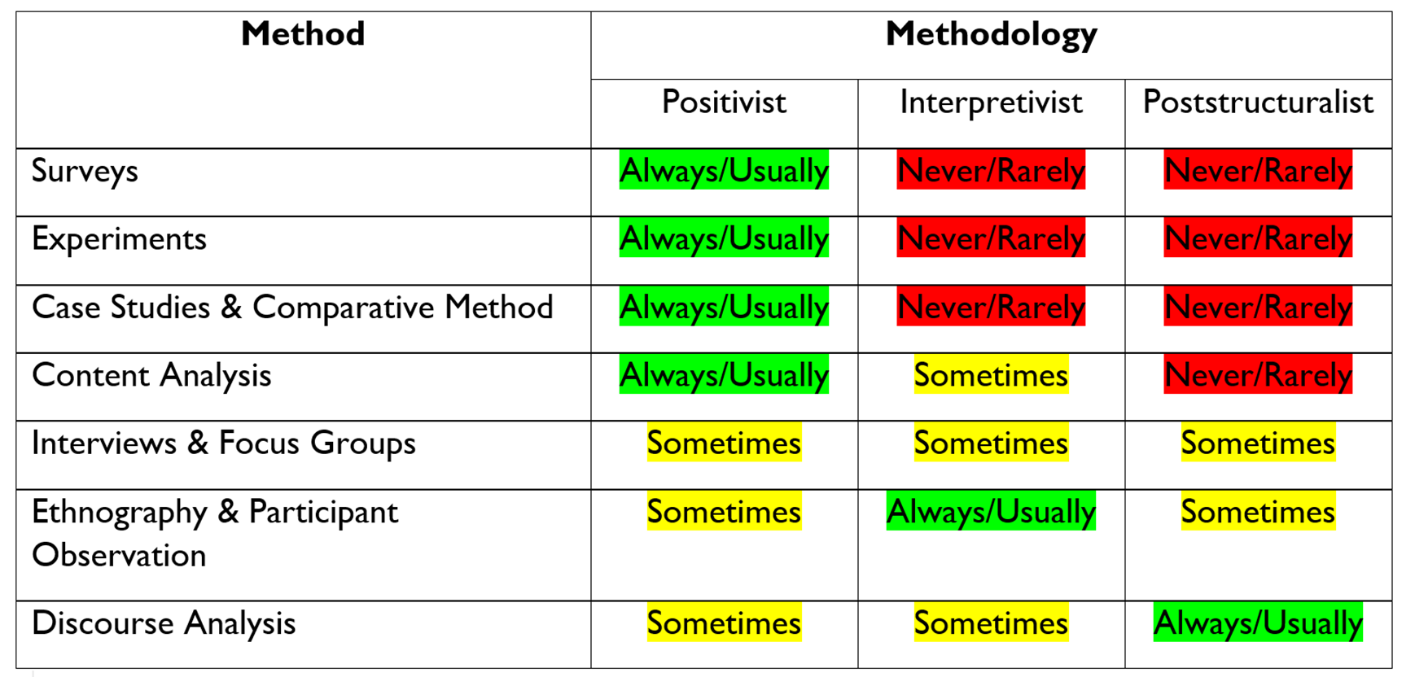
Method

Slide 15
What is data?
Because politics is everywhere, we can study politics everywhere.
Data, then, is the information we gather on political phenomena through the employment of our chosen research methods.
We can collect and study data using different methodologies and methods.

Slide 16

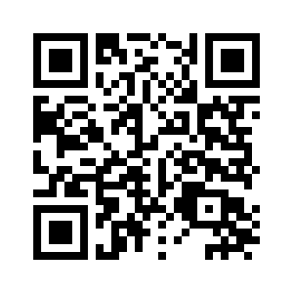

Academic Skills Kit
Need Support…?
For academic support, please use GPS staff’s consultation, guidance and feedback hours (“office hours”): times are on Canvas and posters in the Henry Daysh. The library’s Academic Skills Kit provides further study skills guidance – see the upper QR code
For well-being support follow the lower QR code. GPS students can contact the GPS Well-Being Adviser (gpswellbeing@ncl.ac.uk) for guidance
Unsure of where to go? You can email your personal tutor, or visit the GPS office on level 2 of the Henry Daysh (M-F 09:00-16:00) for help with finding services
Well-Being Support
Notes:
BLANK SLIDE
To duplicate slide, select copy on tool bar and then duplicate on drop down menu.

