Slide 1
Literature Reviews
Week 3 Lecture
Becoming a Political Researcher (POL2017)

Slide 2

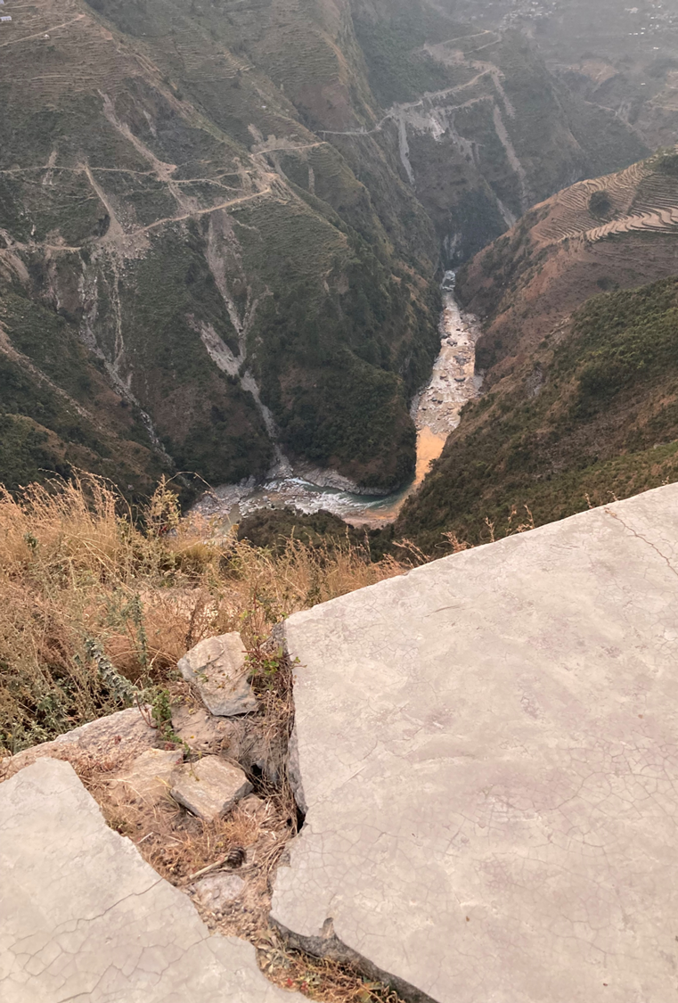
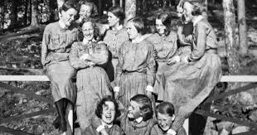
NEWCASTLE POLITICS DEPARTMENT PRESENTS:
FOOD FOR THOUGHT
‘Women at War and Why Familial Ties Matter’ with DR HANNA KETOLA
FREE FOOD & FREE THINKING – A CONVERSATION ABOUT GLOBAL EVENTS
SANDWICHES, COFFEE, CAKE & EXPERT ANALYSIS OF THE WEEK’S BIGGEST NEWS STORIES
A DIFFERENT THEME EACH TIME
WHEN AND WHERE: WEDNESDAY 12th of Feb, 4TH FLOOR HDB, 12.15-12:45

Slide 3
Updates
Food for thought
Assessment 1
Office hours

Slide 4
Plan for this week
Before this week’s seminar:
Assigned readings & seminar questions
Attend lecture (pick an academic source)
Watch canvas critical reading video
At the seminar:
Bring along article from lecture
Bring notes for seminar questions

Slide 5
What we will cover
What is a literature review?
Why do we conduct literature reviews?
Role of literature reviews in political research
What do we mean by the ‘literature’?
How do we conduct a literature review?
Interactive Library Skills Session

Slide 6
Recap
Research questions
- What you want to find out
- Relevance (societal, academic)
Theories and concepts
- Ways to make sense of and explain the social world
- Relationship between concepts
- Potential answers to our research questions

Slide 7
Example stages of a research project
Research Questions
Literature Review
Theory
Data Collection & Analysis
Report Results

Slide 8
What is a literature review?
A piece of academic writing that addresses:
What research has already been conducted on your topic?
What answers have been offered regarding your research question?
How does your project fit into what has already been discovered?
Not an essay!
Identifying relevant studies; summarising and critically evaluating sources; arguing how we can build on this existing work

Slide 9
Why do we conduct lit reviews?
Contextualise our work within broader academic knowledge of the field
Identify understudied areas within the field
Help focus our research questions
Get familiar with relevant theory/methods

Slide 10
Example:
Stages of a research project
Questions to ask yourself
What type of research questions have been examined by researchers in your field?
What are the main theoretical approaches that have been offered as answers to your question?
How are your key concepts defined in the academic literature?
What type of methods and data have researchers used when studying your topic?
What kinds of cases do they examine?
Research Questions
Literature Review
Theory
Data Collection & Analysis
Report Results

Slide 11
What makes up the ‘literature’
Academic research
- Journal articles, review articles, research notes
- Books, book chapters, edited books, monographs
Non-academic sources
Policy reports, media articles, official statistics, legislation, blogposts, websites, videos, parliamentary speeches, manifestos

Slide 12
How to conduct a lit review
Reading the literature
Summarising the literature
What still needs to be done?

Slide 13
How to conduct a lit review
Reading the literature
- identify relevant sources
- summarise each text
- take notes, ask questions
- what are their strengths and weaknesses?

Slide 14
How to conduct a lit review
2. Summarising the literature
- organise the sources you examined in step 1
- identify major themes, issues, arguments
- not everything, just what’s relevant to your question

Slide 15
How to conduct a lit review
3. What still needs to be done?
- based on steps 1 and 2 how does your research build
upon, and improve on what we already know?
- What still needs to be done to be able to effectively
answer your research question?

Slide 16
Next steps
Lecture
How do we find information for a literature review?
What tools can we use for finding literature?
What types of resources and support are available to us?
Canvas video
How do we read critically?
How can we take notes effectively?

