Slide 1
Introduction & Module Overview
Week 1 – Lecture I
Becoming a Political Researcher (POL2017)

Slide 2
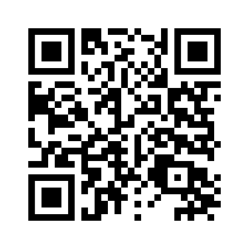

Geography, Politics and Sociology – Student Support Slide
Academic Skills Kit
Need Support…?
For academic support, please use GPS staff’s consultation, guidance and feedback hours (“office hours”): times are on Canvas and posters in the Henry Daysh. The library’s Academic Skills Kit provides further study skills guidance – see the upper QR code
For well-being support follow the lower QR code. GPS students can contact the GPS Well-Being Adviser (gpswellbeing@ncl.ac.uk) for guidance
Unsure of where to go? You can email your personal tutor, or visit the GPS office on level 2 of the Henry Daysh (M-F 09:00-16:00) for help with finding services
Well-Being Support
Notes:
BLANK SLIDE
To duplicate slide, select copy on tool bar and then duplicate on drop down menu.

Slide 3


Slide 4
Who we are
Module Leaders
Dr Brian Boyle
Email: brian.boyle@ncl.ac.uk
Office Hours: Henry Daysh 4.42
Tuesdays 11.30am-1pm
Wednesdays 10.30am-12pm
Dr Skyler Hawkins
Email: skyler.hawkins@ncl.ac.uk
Office: Henry Daysh 4.30
Tuesdays 10am-12pm (in person)
Thursdays 2-3pm (online)
Seminar Leaders
Jennifer Cooke
Email: J.Cooke1@newcastle.ac.uk
Divyali Mehrotra
Email: D.Mehrotra2@newcastle.ac.uk

Slide 5
What we will cover today
Why become a political researcher?
What will we learn?
How will we learn?
What resources are available?
How will we be assessed?

Slide 6
Why become a political researcher?
This module
Other modules & courses
Dissertation
Employability
Day to day life

Slide 7
What will we learn?
Principles of research design
Quantitative and Qualitative research
Focus on 3 specific methods

Slide 8
What will we learn?
Week | Lecture Topics | Notes
1 | Introduction; Ontology/Epistemology/Method/ology
2 | Research Questions; Theories and Concepts
3 | Literature Reviews; Library Skills Session | *Bring along laptop*
4 | Quantitative and Qualitative Research | *Formative Assessment Due*
5 | Surveys I
6 | Interviews I
7 | Content analysis I
8 | Surveys II
 | *Easter Break*
9 | Interviews II | *Proposal Due*
10 | Content analysis II
11 | Module Overview and Exam Preparation

Slide 9
How will we learn?
Introduce key concepts and debates
Make readings more accessible
Course admin
Lectures
Detailed reading of key texts (essential/further reading)
Build on lecture knowledge and prepare for seminar
Note down any questions you might have
Readings
Discuss questions based on assigned texts and lectures
Share ideas and learn from peers and seminar leaders
Put concepts into practice with applied tasks
Seminars
Discuss any aspect of the week’s material
Discuss individual questions relevant to assessments
General questions about the course
Office Hours

Slide 10
Participation and Engagement
Expected to attend all sessions
Catch up on content if you miss any sessions
Any SSP questions or issues, please email module leader
Get out what you put in, ask questions & talk with peers!
Seminar groups at capacity
If absolutely necessary to swap groups, email: politicsadmin@ncl.ac.uk

Slide 11
Module AI Policy
Please see canvas and module guide for full details:
Use of generative AI not permitted for assessments
Please do not use AI tools during seminars, or lecture discussion questions
Please do not use generative AI in your communications with module or seminar leaders

Slide 12
Module AI Policy
Why?
Develop foundational skills and area knowledge
Which remain core for employability
Changing AI landscape
Learning

Slide 13
What resources are available?
Canvas
  Module guide
    Essential and further readings
    Seminar questions
  Assessment information
  Class announcements

Slide 14


Discussion Question
What issues or topics are you most interested in researching?

Slide 15
Join the Vevox session
Go to vevox.app
Enter the session ID: 196-472-727
Or scan the QR code

Slide 16
What issues or topics are you most interested in researching?
##/##
Join at: vevox.app
ID: 196-472-727
Question slide

Slide 17
What issues or topics are you most interested in researching?
##/##
Join at: vevox.app
ID: 196-472-727
Preparing Results
RESULTS SLIDE

Slide 18
How will we be assessed?
Research proposal (40%)
Inspera digital exam (60%)
Formative assessment (0%)

Slide 19
How will we be assessed?
Research Proposal (40%)
  Take home assignment (1,500 words), due week 9
  Covers content from weeks 1-8
  1) Picking your own research question
  2) Finding relevant academic literature
  3) Selecting appropriate methods

Slide 20
How will we be assessed?
Digital exam (60%)
  90 minute essay style exam, held in May exam period
  3 prompts, select 2 to answer
  For a given research question, how you would apply one of the methods covered in class
  Open book – can bring limited set of notes

Slide 21
How will we be assessed?
Formative Assessment
  300 words, due week 4
  Submit your chosen research topic/question for your proposal, to get written feedback beforehand
  Not compulsory to complete module

Slide 22
Assessment Preparation
We will spend time in class covering how to prepare for each assessment
Assessment guides will also be posted to canvas
Please make use of office hours if you have any questions about assessment

Slide 23
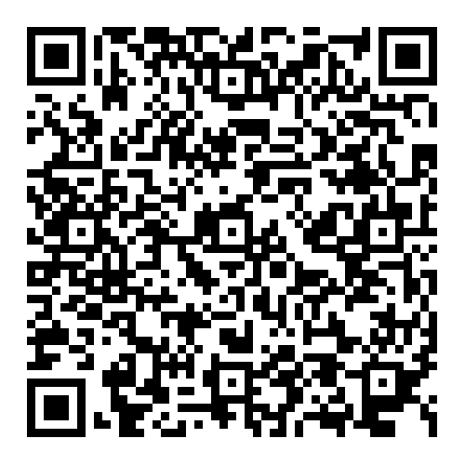
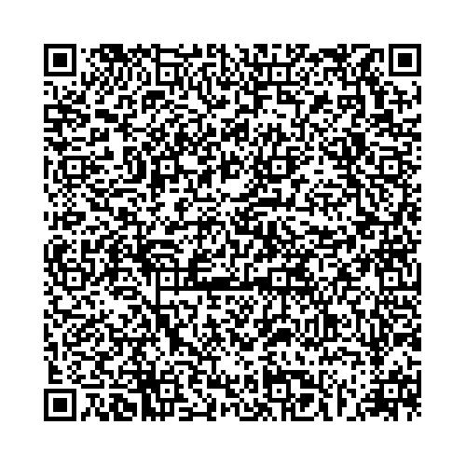
Types of Feedback available to you in Politics
Coursework
Summary feedback will highlight the strengths, weaknesses, and provide direction to improve your work.
In-text annotations for written assessments will provide comments specific to your text.
Exams
Generic/cohort feedback covering common strengths, mistakes, and misconceptions across the module.
Need More help?
You can contact the module leader for additional in-person feedback.
Approach your personal tutor for additional support if you struggle to understand the comments/feedback on your work.
Scan this QR code to learn how to access your feedback for Canvas assignments
Scan this code to learn how to use the feedback for your assessment.

Slide 24
Questions?

Slide 25
Break

