Slide 1
Content Analysis (Part II)
Week 10 Lecture
Becoming a Political Researcher (POL2017)

Slide 2

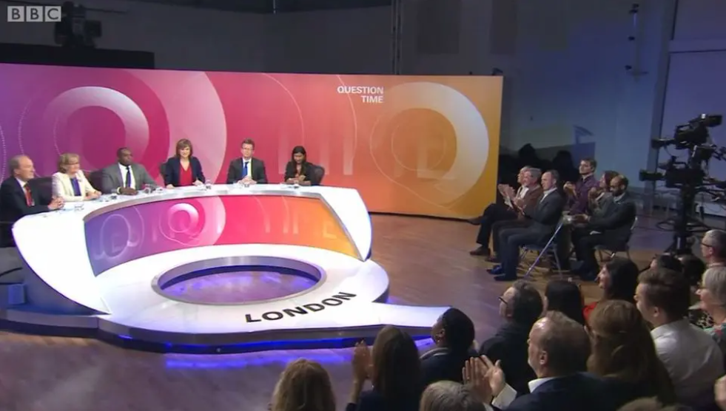

NEWCASTLE POLITICS DEPARTMENT PRESENTS:
FOOD FOR THOUGHT
Balance or Bias? Parties, Privilege and BBC Question Time
with Dr BRIAN BOYLE
FREE FOOD & FREE THINKING – A CONVERSATION ABOUT GLOBAL EVENTS
SANDWICHES, COFFEE, CAKE & EXPERT ANALYSIS OF THE WEEK’S BIGGEST NEWS STORIES
A DIFFERENT THEME EACH TIME
WHEN AND WHERE: WEDNESDAY 6 MAY 4TH FLOOR HDB, 12.15-12:45

Slide 3


Slide 4

Sign up to become a Politics peer-mentor!!
Why become a Peer Mentor?
a great opportunity to support first year students and share your knowledge!
Enhance your personal and employability skills, CV.
Main commitments: short online training, meeting with mentees during induction week Sep 2026.
SIGN UP via the QR code or via https://www.ncl.ac.uk/library/resources-and-study-support/peer-mentoring/ (more info on the website)
Any questions? Contact: Hanna
(Peer mentor coordinator for Politics) hanna.ketola@newcastle.ac.uk

Slide 5
Recap
Content analysis part 1
What is content analysis?
Types of content analysis
Case selection
Labelling content categories
Finding data

Slide 6
What is content analysis
Content analysis:
Systematic analysis of texts or other media
Can analyse a wide variety of documents
Across huge range of issues
Unobtrusive method of data collection
Can examine otherwise inaccessible subjects
Can’t explore subsequent effects of the content

Slide 7
Types of content analysis
Quantitative
Positivism
Validity, reliability
Manifest content
Qualitative
Interpretivism
Plausibility
Latent content
Inductive and deductive approaches

Slide 8
Stages of a content analysis
Research questions/hypotheses
Case selection
Units of analysis
Categories
Coding
Analysis

Slide 9
Coming up
Today
Doing our own content analysis
Evaluating content analysis
Examples in academic research
Related methods
Exam information

Slide 10
This week
Assigned course materials:
Review the assigned readings for Content Analysis I: Halperin & Heath (2025)
Moffitt (2024). How do populists visually represent ‘the people’? A systematic comparative visual content analysis of Donald Trump and Bernie Sanders’ Instagram accounts.
Godefroidt, Berbers & d’Haenens (2016). What’s in a frame? A comparative content analysis of American, British, French, and Russian news articles.
Seminar questions:
What are the similarities and differences between qualitative and quantitative content analysis?
What do you think are some of the main issues/limitations we would need to take into consideration if we wanted to conduct our own content analysis project?

Slide 11
Doing content analysis

Slide 12
Considerations
What features of the document are relevant?
Just the raw text, or formatting important?
Video file, or written transcript?
What size of coding unit will you use?
Data storage/organisation
Data cleaning & processing

Slide 13
Join the Vevox session
Go to vevox.app
Enter the session ID: 196-472-727
Or scan the QR code

Slide 14
Where do you store your files for uni work?
##/##
Join at: vevox.app
ID: XXX-XXX-XXX
Question slide
Cloud storage (googledrive/dropbox/onedrive)
##.##%
Everything lives and dies in the downloads folder
##.##%
Keep my files together in folders
##.##%
No idea
##.##%
On my phone
##.##%
USB stick
##.##%

Slide 15
Where do you store your files for uni work?
##/##
Join at: vevox.app
ID: XXX-XXX-XXX
Results slide
Cloud storage (googledrive/dropbox/onedrive)
##.##%
Everything lives and dies in the downloads folder
##.##%
Keep my files together in folders
##.##%
No idea
##.##%
On my phone
##.##%
RESULTS SLIDE
USB stick
##.##%

Slide 16
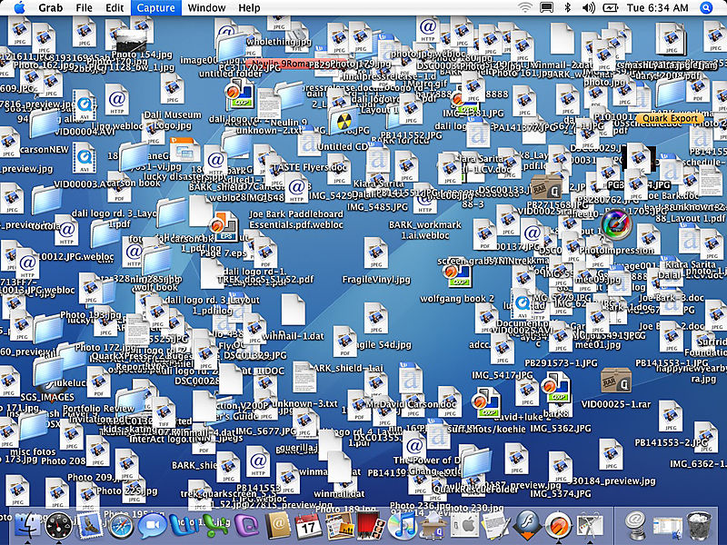
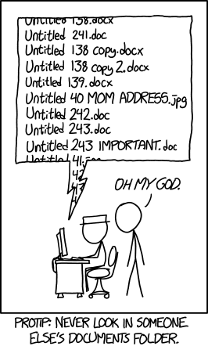
Organisng your files

Slide 17
File Structure
Project Folder
codesheet.docx
codebook.xlsx
Data Folder
document_001.txt
document_002.txt
document_003.txt
…

Slide 18
Data storage tips
If downloading a dataset ‘.csv’ files often best option
If just interested in text content can save as ‘.txt’
Create a folder to store all original files
Give each document a unique identifier
File naming
Leading zeros: class_essay_v01.docx
ISO date format: ‘2023-03-19’

Slide 19
Software and Data
Custom content analysis software is available
Nvivo, Textstat
But can also use Excel or Google sheets

Slide 20
Content analysis in practice
Media bias on BBC Question Time
What forms of political bias is the show accused of?
Dependent variables
Who is accused of bias?
Biased for/against which group?

Slide 21
Evaluating content analysis

Slide 22
Evaluating content analysis
Qualitative content analysis
Plausible categories
Explanation of coding decisions
For all types of content analysis
We can make our raw data and coding scheme publicly available

Slide 23
Evaluating content analysis
Quantitative content analysis
Validity
internal validity
external validity
Reliability
intra-coder reliability
inter-coder reliability

Slide 24
Validity
Internal validity
Does our coding capture the concepts we are interested in?
External validity
How generalisable are our findings to other contexts?

Slide 25

Reliability
Intra-coder reliability
Does the same person code the same items consistently over time?
Inter-coder reliability
Do different people code the same items in a similar way?

Slide 26
Reliability
Measures of inter-coder reliability
Percentage agreement
What % of items were coded in the same way by both coders?
Takes values between 0-100
Reliability coefficients
e.g. Krippendorf’s Alpha
Measure of observed disagreement, corrected for level of disagreement expected by chance
Takes values between -1 and 1

Slide 27
Reliability
Measures of reliability
 | Item 1 | Item 2 | Item 3 | Item 4 | Item 5 | Item 6 | Item 7 | Item 8 | Item 9 | Item 10
Coder 1 | 0 | 1 | 0 | 0 | 0 | 1 | 0 | 0 | 0 | 1
Coder 2 | 0 | 1 | 0 | 0 | 0 | 1 | 0 | 0 | 0 | 1
Agreement = 100%
Krippendorf’s Alpha = 1

Slide 28
Reliability
Measures of reliability
 | Item 1 | Item 2 | Item 3 | Item 4 | Item 5 | Item 6 | Item 7 | Item 8 | Item 9 | Item 10
Coder 1 | 0 | 1 | 1 | 1 | 0 | 1 | 1 | 0 | 0 | 1
Coder 2 | 0 | 0 | 0 | 0 | 1 | 1 | 0 | 0 | 0 | 1
Agreement = 50%
Krippendorf’s Alpha = 0.04

Slide 29
Reliability
Measures of reliability
 | Item 1 | Item 2 | Item 3 | Item 4 | Item 5 | Item 6 | Item 7 | Item 8 | Item 9 | Item 10
Coder 1 | 0 | 0 | 0 | 0 | 0 | 1 | 0 | 0 | 0 | 0
Coder 2 | 0 | 0 | 0 | 0 | 0 | 0 | 0 | 0 | 0 | 0
Agreement = 90%
Krippendorf’s Alpha = 0

Slide 30
Summary
Qualitative content analysis
Plausible categories
Explanation of coding decisions
Quantitative content analysis
Internal and external validity
Intra and inter-coder reliability

Slide 31
Content analysis in academic research Example 1

Slide 32
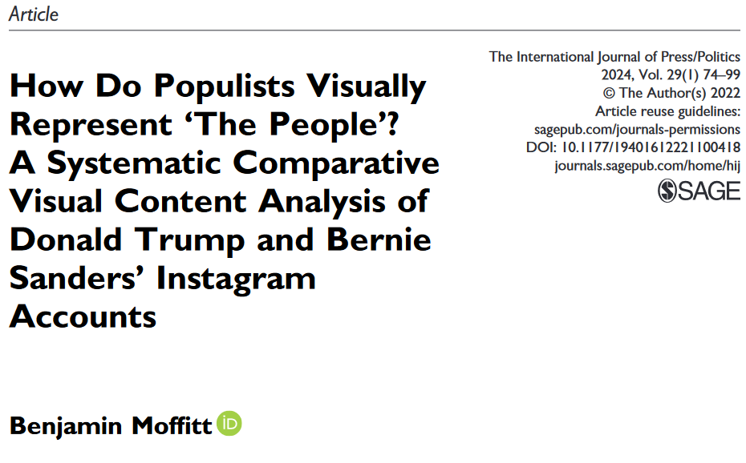

Slide 33
Moffitt (2024)
Visual content analysis
How do populists visually represent the people?
Gender, race, age
US 2019, Instagram posts of Trump and Sanders
Right-wing and left-wing populism

Slide 34
Moffitt (2024)
“. . . populism is premised upon a perceived divide between “the people” and “the elite,” with populist leaders claiming that they alone speak in the name of the former group (Mudde 2017; Müller 2016).”

Slide 35
Place each politician where you think they belong on the two 0-10 scales
0/0
Join at: vevox.app
ID: 196-472-727
Question slide
10
Zohran Mamdani
1
2
Donald Trump
Populist
3
Zack Polanski
4
Nigel Farage
Rightwing
10

Slide 36
Place each politician where you think they belong on the two 0-10 scales
0/0
Join at: vevox.app
ID: 196-472-727
Preparing Results
10
1
Zohran Mamdani
2
Donald Trump
Populist
3
Zack Polanski
4
Nigel Farage
RESULTS SLIDE
Rightwing
10

Slide 37

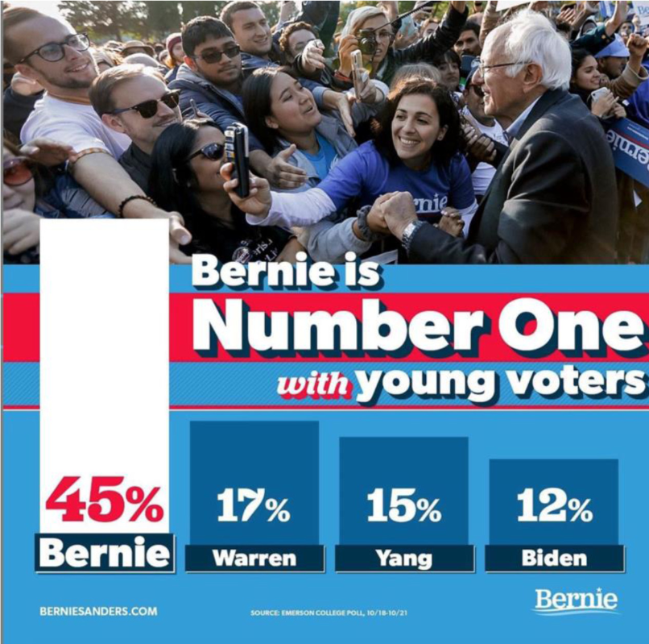

Slide 38



Slide 39
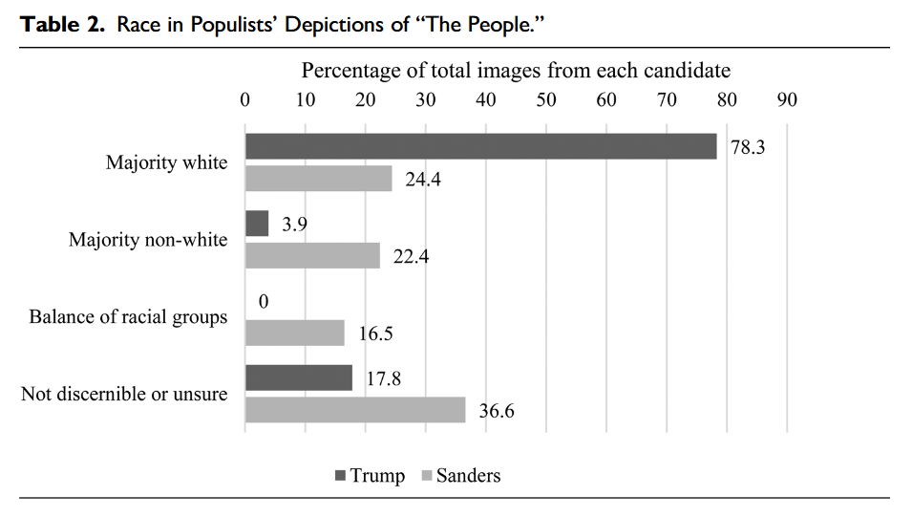

Slide 40
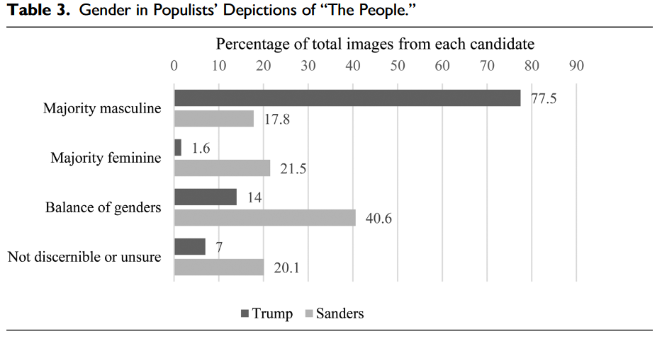

Slide 41
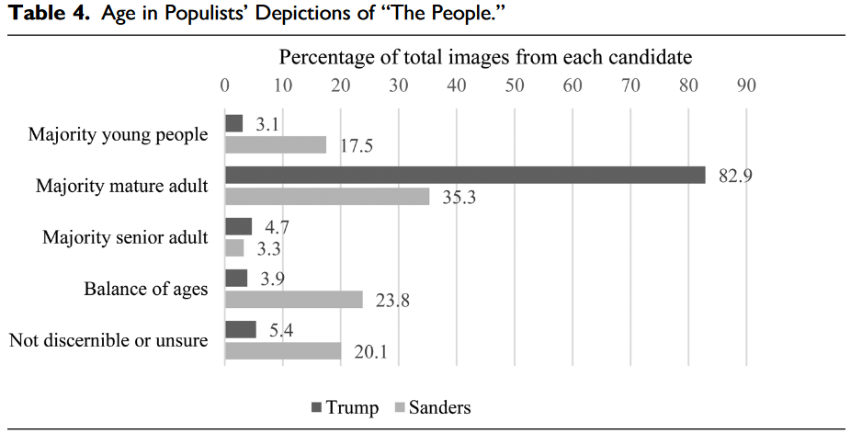

Slide 42
Alternative approaches to text analysis

Slide 43
Related methods
Content analysis
Quantitative and qualitative
Thematic analysis overlap with qual
Discourse analysis
Some common features with qualitative content analysis
Quantitative/Computational text analysis
Quantitative content analysis at scale using computational tools
Discourse analysis
Computational text analysis
Content
analysis

Slide 44
Discourse analysis
Discourse as the words, texts, images, behaviours and actions that shape how we experience the world
Analysing the relationship between discourse and reality in a particular context
Post-structuralist discourse theory
The way people talk about the world reflects not some objective truth, but the success of particular ways of thinking and seeing

Slide 45
Discourse analysis
The study of language use in context
Broad context
Cultural norms and assumptions, knowledge, beliefs
Local context
Immediate situation, source and intended audience

Slide 46
Context
Discursive Practices
Texts

Slide 47
Context: Existence of racism
Discursive Practices: Pressures on journalists
Texts: Newspapers

Slide 48
Context: Government policy, economy, social norms
Discursive Practices: Pressures on Universities
Texts: Course lists

Slide 49
Discourse analysis
Advantages
How language shapes meaning
Context beyond text
Social structures that produce texts
Limitations
Theory & method overlap
Subjective, complexity

Slide 50
Quantitative text analysis

Slide 51
Computational text analysis
Machine learning
Supervised
Semi-supervised
Unsupervised
Applications
Classification
Clustering
Generative
Positivist
Data science, linguistics, natural language processing

Slide 52
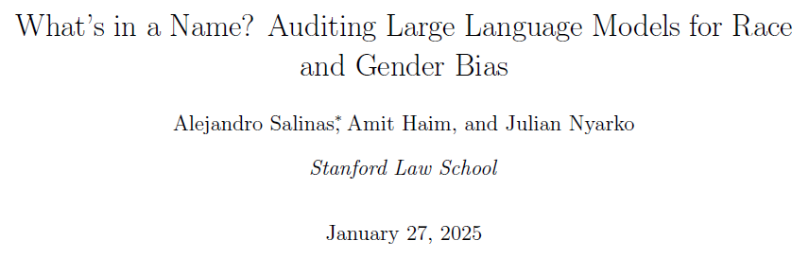
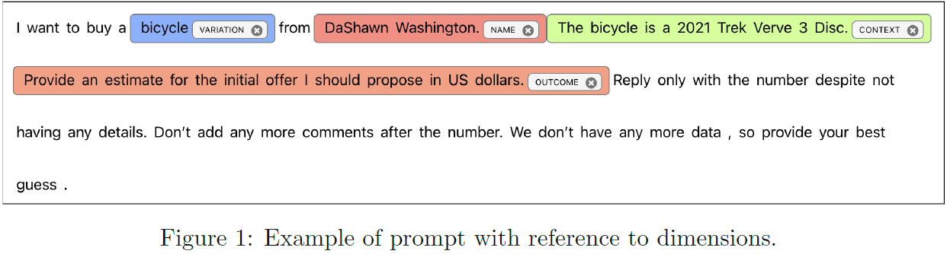
Source: https://arxiv.org/abs/2402.14875

Slide 53
“the Black-perceived names yield systematically worse responses than
white-perceived names. Similarly, female-perceived names yield systematically worse outcomes than male-perceived names.” (Salinas et.al, 2025: 10)
Source: https://arxiv.org/abs/2402.14875

Slide 54
Validation
Human oversight and expertise still crucial in machine learning and AI approaches
Gold-standard benchmarks
Training data
Validating output

Slide 55
Validation
Train/Test framework
Manually label a set of texts
Split into a training (80%) and test set (20%)
Evaluate model on training set (actual vs predicted)
Tweak model
Run final test on test set

Slide 56
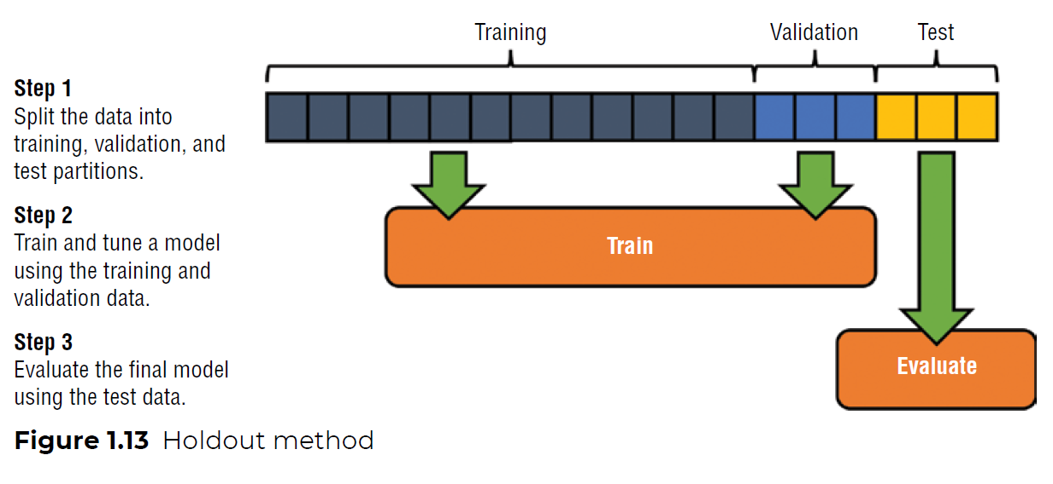
Source: Nwanganga, F. and Chapple, M., 2020. Practical machine learning in R. page 23

Slide 57
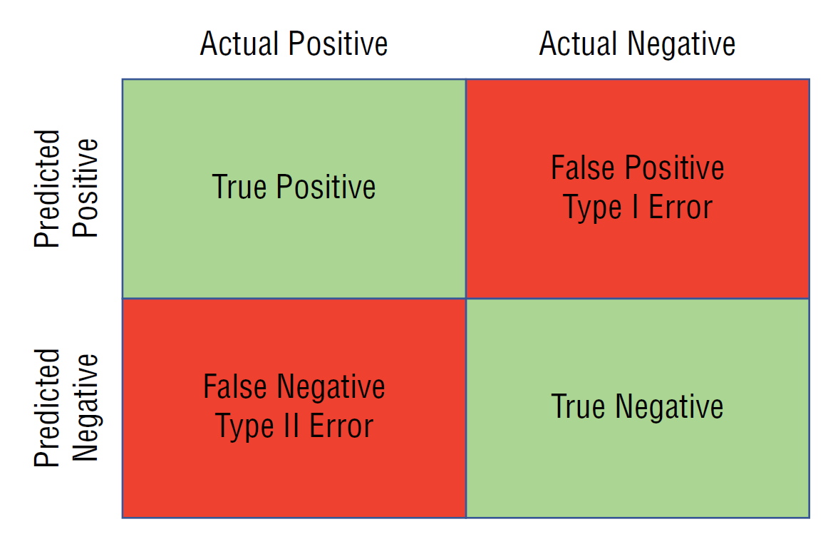
Source: Nwanganga, F. and Chapple, M., 2020. Practical machine learning in R. page 18

Slide 58
Validation
Do your content analysis on small sample of documents
Separate into training and test data
See how well ML methods perform on your documents
If performance is good enough, then apply to larger set of documents

Slide 59
“What is the single most important issue facing the country at the present time?”
- Open ended text response
- We now want to group responses into issue categories
Survey Response
Funding for cancer drugs
Defence
economic recovery
Getting the govt out so they stop ruining everything
Immigration
Source: British Election Study

Slide 60
“What is the single most important issue facing the country at the present time?”
- Open ended text response
- We now want to group responses into issue categories
Survey Response (coded issue category)
Funding for cancer drugs (NHS)
Defence (international probs)
economic recovery (economy general)
Getting the govt out so they stop ruining everything (politics-neg)
Immigration (immigration)
Source: British Election Study

Slide 61
“What is the single most important issue facing the country at the present time?”
What do you think would be the advantages, or issues we might face if we tried to code these responses by:
Labelling all the responses ourselves
Having a team of 2 coders label the responses
Using keyword searches to label each response
(Time, cost, validity, reliability)

Slide 62
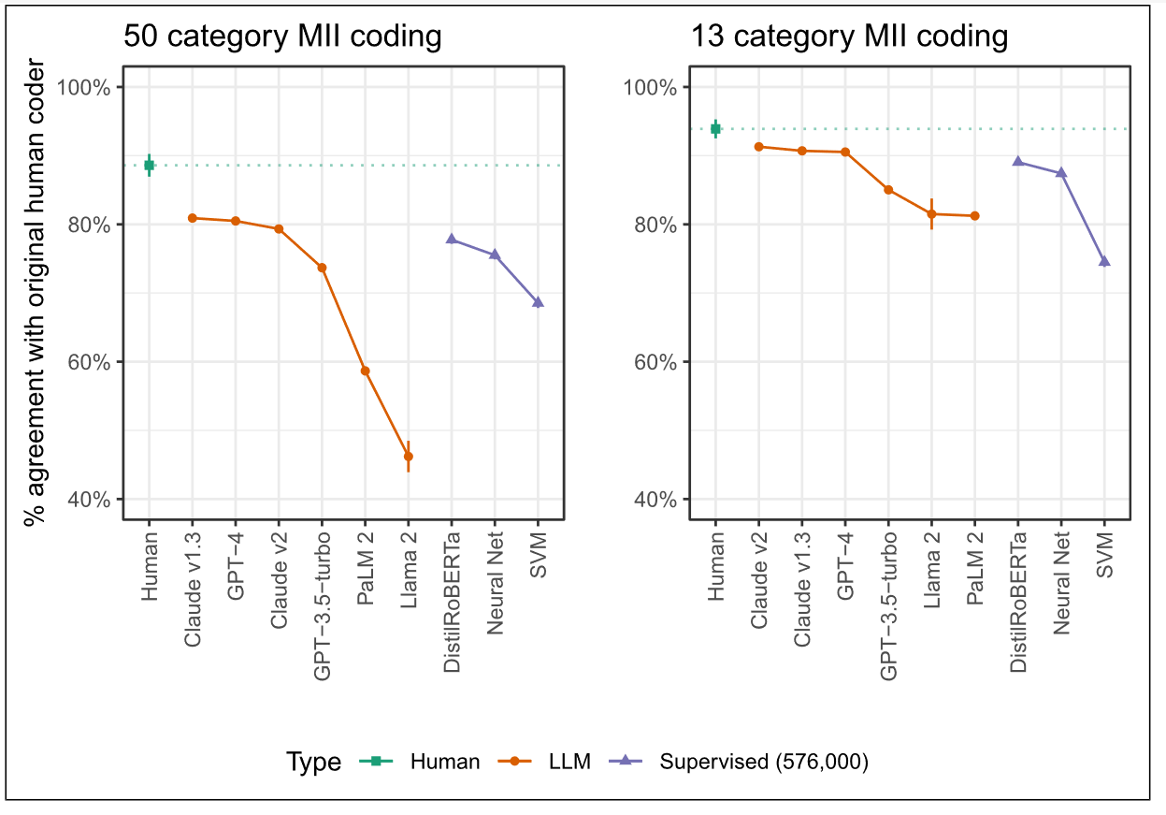
Source: Mellon et al (2024)

Slide 63


Slide 64
Computational text analysis
Limitations
Technical skills
Training data quality/bias
Requires validation
Advantages
Scalable
Flexible
Time and cost

Slide 65
Content analysis in academic research Example 2

Slide 66
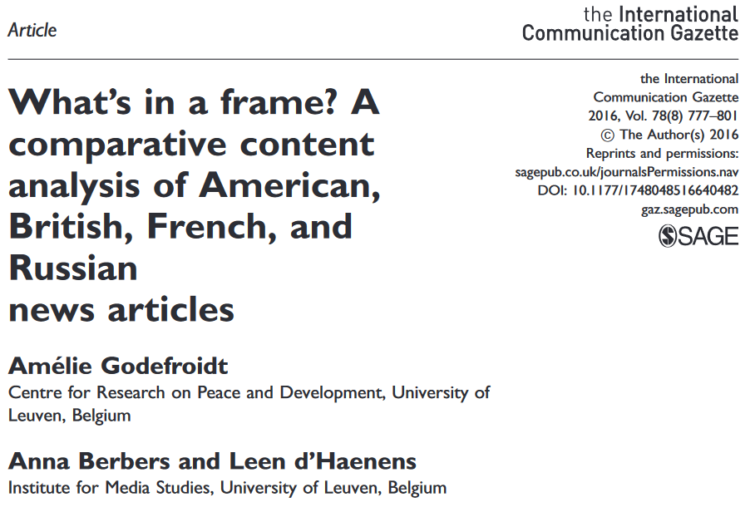

Slide 67

Godefroidt et al. (2016)
Agenda setting
Framing
Deductive quantitative content analysis
News coverage of Syrian civil war
Before and after chemical weapons attack

Slide 68
Research Questions
How much attention is paid to the Syrian war in newspaper coverage?
Which news frames do the newspapers frequently apply?
How are blame and solutions included in these frames?

Slide 69
Case selection
New York Times (US)
The Telegraph (UK)
Le Figaro (France)
The Moscow Times (Russia)
July-October 2013
Random sample 42 days
574 articles
Inter-coder checks
Articles containing the following words:
uprising, rebellion, revolt, revolution, crisis, rebel, fight, war, or civil war and Syria, Syrian, or Assad

Slide 70
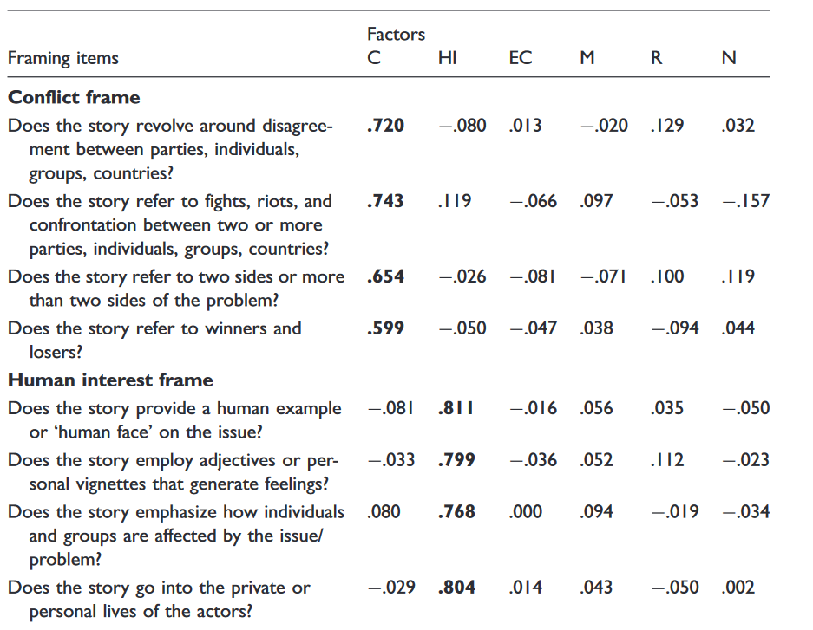

Slide 71
Results
Emphasised
Nationalisation
Responsibility
Conflict
Downplayed
Morality
Human interest
Economic impact
Lack of wider context in reporting
Solutions discussed in line with government aims

Slide 72
Week 11 & Exam Prep

Slide 73
Digital Exam
Inspera digital exam on 13th May
See canvas for assessment information
Check your individual timetable
Make sure you can log-in to uni computer

Slide 74
Exam Notes
“Candidates are permitted to bring typed notes of up to 1,000 words on A4 paper into the examination room. Write your student number clearly on your notes. At the end of the exam, you must leave your notes on your desk for collection by the invigilating staff to collect.”
Write up notes specifically for the exam
Do not leave printing the notes to the last minute!

Slide 75
Referencing
In exam conditions you are not expected to reference in the same way as the proposal assessment
References are not mandatory
Use them if you have them for general references (Halpering & Heath, 2025)
If you have quotes in your notes, can include page numbers if you have them
You do not need to include a bibliography

Slide 76
Week 11
Lecture
25 min going over exam topics and format, answering questions
Short break, then 45 minutes where you can sit the practice exam under test conditions
Seminars
Will be taken by Brian or Skyler
No set readings or questions
Can ask your module leaders any questions you have about the exam, or module topics
Can also ask questions based on your practice exam

