Slide 1
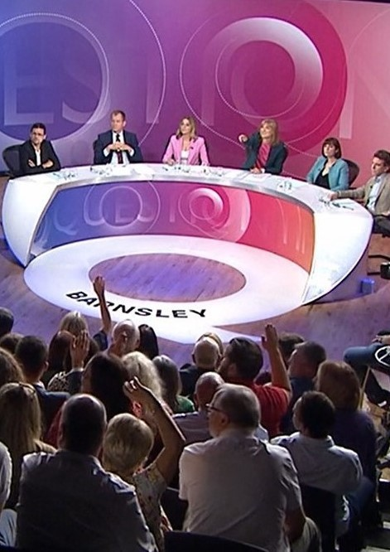
Party Representation & Responsiveness in Public Participation Broadcasting: BBC Question Time (1979-2019)
Brian Boyle, Heinz Brandenburg, & Yulia Lemesheva
Newcastle University
University of Strathclyde
September 13, 2024

Slide 2
Background : BBC Question Time
Pioneering format in Public Election Broadcasting(1979-)
Weekly panel of politicians, journalists & commentators
Political elites questioned directly by the public
Accusations of bias in its:
Audience, location, and panel selection
Issues, ideology, party representation

Slide 3
Background : BBC Question Time
Labour MP Rupa Huq:
“One barometer people have of
impartiality is the panels that you see on
Question Time”.
BBC Director of Editorial Policy:
“...trying to make sure that its panels are
gender representative, are ethnically
diverse, are geographically disparate, are
socioeconomically representative, are
politically representative of all of the
different political parties in the country...”

Slide 4
How does the BBC decide which political parties are represented on Question Time? (from BBCQT FAQ)
Aims to achieve fair and appropriate representation from the various political parties across the UK.
Will nearly always be a representative from the UK government and the official opposition
‘The panel will also feature representatives from other political parties across the series, taking as our guide the level of electoral support at national level which each party enjoys
Sometimes parties may be represented by politicians who conspicuously do not support their party leadership – this too will be on a consistent basis.

Slide 5
Party support in the UK political landscape
What does “electoral support at national level” mean and how does the BBC implement this?
Seats or votes in national elections?
Opinion polls in-between elections?
Results from second order elections?
Due impartiality
Responsiveness vs platforming groups

Slide 6
The stated BBC approach
Interviewed the Executive editor of BBC Question Time 2000-2006, now Chief Advisor, Politics at the BBC
Guaranteed slots for Gov and official Opposition
Initial contact can be from parties, politicians, or the show
Other parties get slots allocated on a roughly annual basis
Not algorithm based, but by editorial decision
Can also taking polling into account (e.g. when a party like Reform in 2024 consistently polls in double figures)

Slide 7
Initial Research Aims
To what extent do party appearances reflect levels of party support in terms of: vote/seat shares; national/devolved/European elections
Trace over-time variation in the composition of representatives from major parties (cabinet, loyal backbenchers, rebels)

Slide 8
Data
Collected panellist information for all appearances between 1979-2019 (6300 apps, 1400 eps)
Combination of web-scraping and hand coding
Variables
Party affiliation, cabinet/shadow cabinet membership, voting records
Party Support
Election results (General, Devolved, European)

Slide 9
UK General Elections

Slide 10
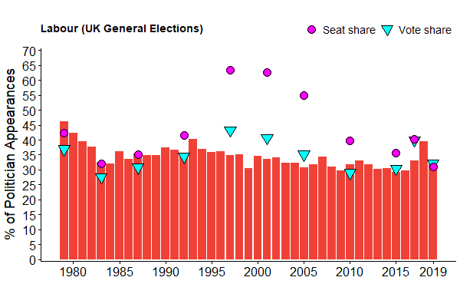

Slide 11
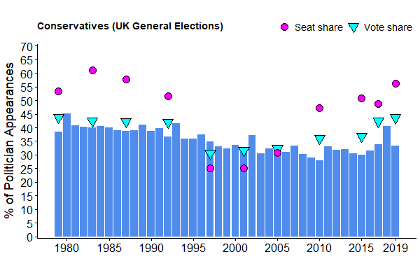

Slide 12
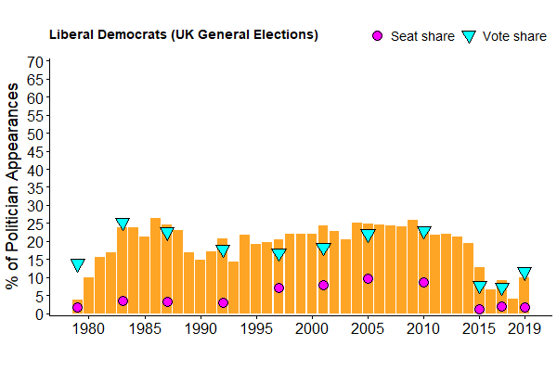

Slide 13
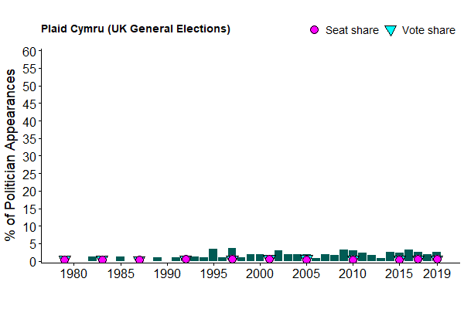

Slide 14
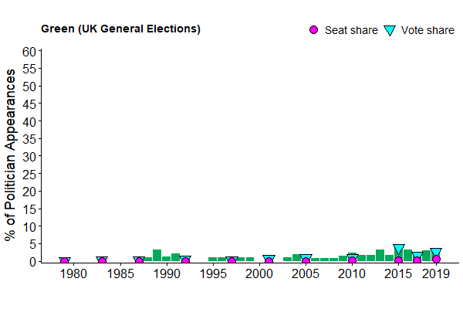

Slide 15
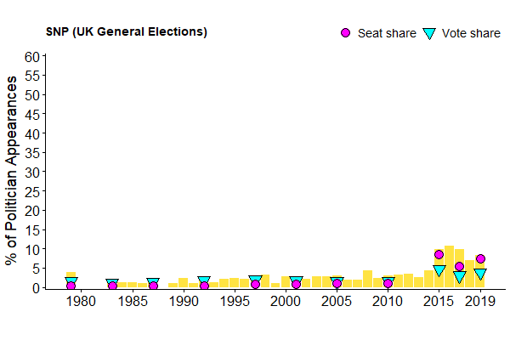

Slide 16
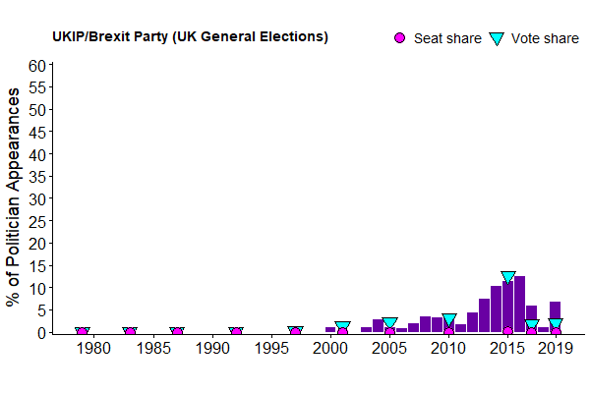

Slide 17
Devolved Elections

Slide 18
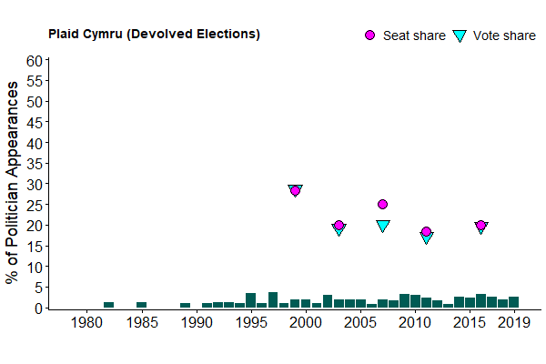

Slide 19
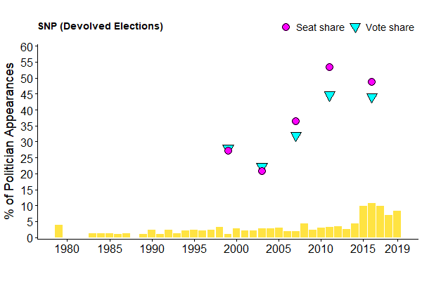

Slide 20
European Parliament
Elections

Slide 21
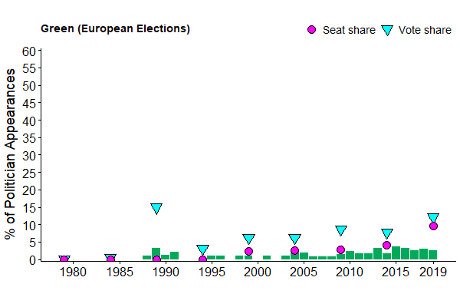

Slide 22
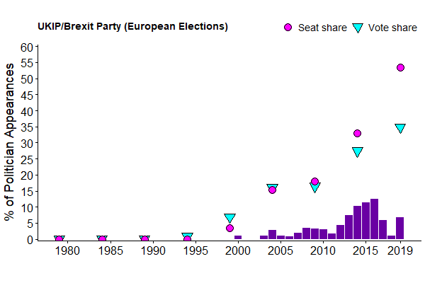

Slide 23
Cabinet and Party Rebel Appearances

Slide 24
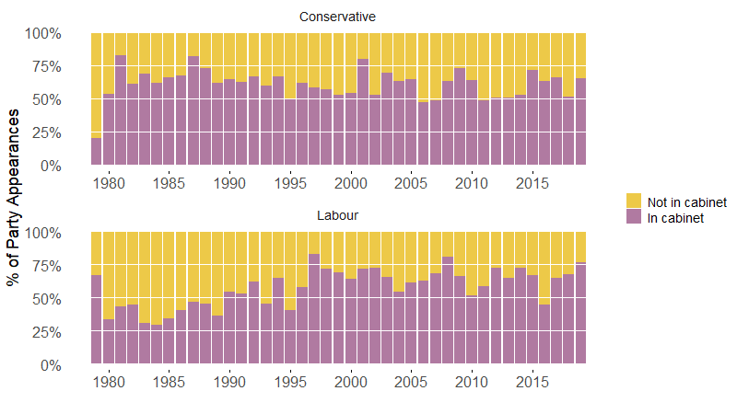

Slide 26
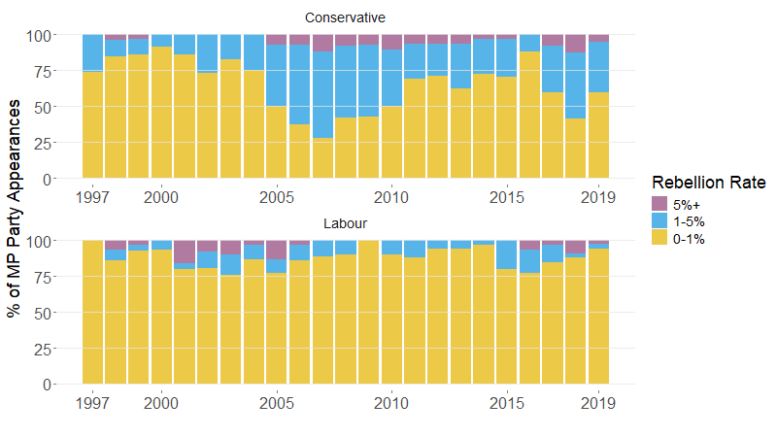

Slide 27
Summary
Party appearances largely reflective of general election vote share
Exceptions of: SNP 2015, UKIP 2015
Next steps:
Examine pre-post election periods
Periods where main parties are divided (Brexit, Iraq War)
Cabinet position coding
Responsiveness to results versus tracking polls

