Slide 1
Data warehousing Methodology
Notes:
Topic should be data warehousing methodology
Remove the “some guidelines” section and put in your name and project over there…
Change the template

Slide 2
Agenda
Data Modeling and its types
Dimensional Modeling
Basic concepts of OLTP Vs OLAP
What is a Data Warehouse
Components of Data Warehouse
ETL
Datamart
Report
Tools
Notes:
Looks good, change report analysis to reporting

Slide 3
Data Modeling
Data modeling is used to communicate the way data flows from one stage to the next, on its way from source system to user.
ER Model - When designing an OLTP system, Entity Relationship Modeling is the modeling technique used.
Dimensional Model - However, Dimensional Modeling, is the modeling technique used to design the data warehouse and associated data marts.

Slide 4
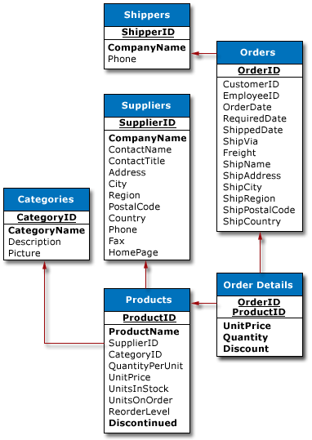
ER-Model (Relational Data Modeling)
In the ER model , a database is a collection of relational tables
Entities – the principal data object about which information is to be collected
Relationships – represents an association between two or more entities
Attributes - describe the entity of which they are associated
Normalized
Notes:
Normalization: what is normalization? Basically, it's the process of efficiently organizing data in a database.
There are two goals of the normalization process: eliminate redundant data (for example, storing the same data in more than one table) and ensure data dependencies make sense (only storing related data in a table
Primary key
Foreign Key
In the relational model, a database is a collection of relational tables
Entities are the principal data object about which information is to be collected
Relationship represents an association between two or more entities

Slide 5
Dimensional Modeling
Models the data around two basic concepts: Facts & Dimensions.
Facts
  Facts are numeric measurements (values) that represent a specific business aspect or activity.
  Facts can be computed or derived at run-time (metrics).
  Examples : Unit Cost, Sale Amount, Quantity Sold
Dimensions
  Dimensions are qualifying characteristics that provide additional perspectives to a given fact.
  Examples: Date (Day, Month, Qtr, Year), Product (Type, Category)

Slide 6
Dimensional Modeling
Dimensional Model Schema
- Star Schema
- Snowflake schema
The dimensional model is partially de-normalized.
Why is Normalized data not preferred?
- Normalized data models are too complex for the query tools to navigate – they need to be simplified.
- With a normalized database, many standard reports and analyses will require large, multi-table joins. This will affect the performance tremendously.

Slide 7
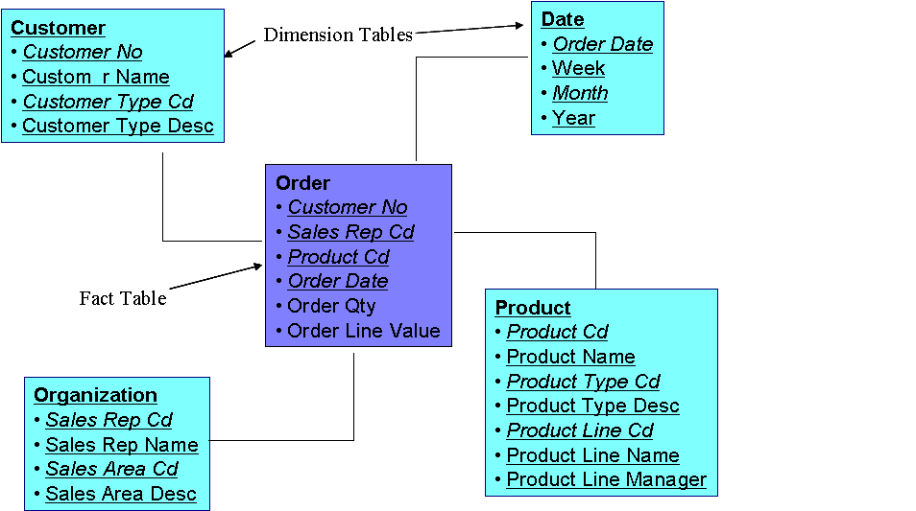
Star Schema
Fact – the central table is called the fact table
Dimension – the surrounding tables are called the dimensions
Notes:
Put in supporting text
Fact & Dimension
- In the dimensional model, the central table is called the fact table
- The surrounding tables are called the dimensions

Slide 8
SnowFlake Schema
Snowflaking is a method of “Normalizing” the dimensions in a star schema
When all dimensions are completely normalized, the resultant structure is called a snowflake schema
Removing low-cardinality columns from dimension tables and making separate tables
May result in space saving
Sometimes certain dimensional attributes can be further elaborated by creating a sub-dimension

Slide 9
Snowflake Schema
Month
Product
Year
Month
Year
ProductNo
ProdName
ProdDesc
Category
QOH
Year
Date
Date
Month
Sales Fact Table
Date
Product
Store
Store
StoreID
City
Customer
unit_sales
City
Cust
dollar_sales
City
State
CustId
CustName
CustCity
CustCountry
Country
schilling_sales
State
Country
Region
State
Country
Measurements
Notes:
Really good; format the diagram to a smaller size and have it compact

Slide 10
Disadvantage - Snowflake
Brings in the complexity of ER / Normalized Model
That too in a less structured manner
Ability to browse through contents is difficult
More tables = More Joins

Slide 11
Basic Concepts – OLTP and OLAP
There are two basic data processing models:
OLTP - On-Line Transaction Processing
  Captures and updates large amounts of transactions.
  Works on a normalized, relational database.
  Used for a company's day-to-day operational needs.
  E.g., order entry, invoicing, general ledger, etc.
OLAP - On-Line Analytical Processing
  Works on multidimensional data.
  Used for collecting, processing and presenting multidimensional data for analysis.
  E.g., sales forecasting, market trends analysis, etc.
Notes:
Why don’t we have this in the previous slide? – looks like duplication of data
OLTP - On-Line Transaction Processing.
OLTP - On-Line Transaction Processing. It focuses on capturing and updating large amounts of transactions efficiently and it works best on a normalized, relational database.
It is used for a company's day-to-day operational processing and data needs, E.g. order entry, invoicing, general ledger, etc.
OLAP - On-Line Analytical Processing OLAP - On-Line Analytical Processing.
It is the technology used for collecting, managing, processing and presenting multidimensional data for analysis .
It used mostly to analyze the business, E.g. sales forecasting, market trends analysis, etc.

Slide 12
Decision Support system
  DSS: Information technology to help knowledge workers (executives, managers, analysts) make faster and better decisions:
      what were the sales volumes by region and by product category in the last year?
      how did the share price of computer manufacturers correlate with quarterly profits over the past 10 years?
      will a 10% discount increase sales volume sufficiently?
  OLAP is an element of decision support system
Notes:
Explain the relevance of OLAP wrt DSS, they are not separate entities one helps the other – explain how

Slide 13
Differences – OLTP and OLAP
DIFFERENCES | OLTP | OLAP
Function | Day to day operations | Decision support
Users | Clerical | Knowledge worker
Data | Current, up-to-date, flat relational, isolated | Historical, summarized, multidimensional, integrated, consolidated
Unit of work | Short, simple query | Complex query
User Access | Read/write | Lots of scans
Usage | Repetitive | Ad-hoc
# Records accessed | Tens | Millions
#Users | Thousands | Hundreds
DB size | 100MB-GB | 100GB-TB
Notes:
Looks great

Slide 14

Why do we need a data warehouse?
Converts large amounts of corporate data into useful strategic information.
Integrates data from multiple, diverse sources.
Provides analysis capabilities to decision makers
Notes:
Put in this slide before you explain the definition of dw
In most organizations there is lots and lots of data about every possible operation. However, there may not be the right information available.

Slide 15

What is a Data Warehouse
“A data warehouse is a subject-oriented, integrated, time-variant, and nonvolatile collection of data in support of management’s decision-making process.” --- W. H. Inmon
Collection of data that is used primarily in organizational decision making
Notes:
good

Slide 16
Data Warehouse…
Subject-oriented - Data that gives information about a particular subject instead of about a company's ongoing operations.
Integrated - Data that is gathered into the data warehouse from a variety of sources and merged into a coherent whole.
Time-variant - All data in the data warehouse is identified with a particular time period. The key structure of the data warehouse always contains some element of time
Non-volatile - Data is stable in a data warehouse. More data is added, but data is never removed. This enables management to gain a consistent picture of the business

Slide 17

Operational data store
It is subject oriented, integrated like a data warehouse.
Its data is volatile or updatable.
The ODS is most often designed to contain the transaction level data, that is, the lowest level of detail for the subject area.
DW is not always efficient for providing up-to-date analysis. This is where ODS, Operational Data Stores, come in.
ODS are used to hold recent data before migration to the Data Warehouse.
ODS are used to hold data that have a deeper history than OLTPs.

Slide 18
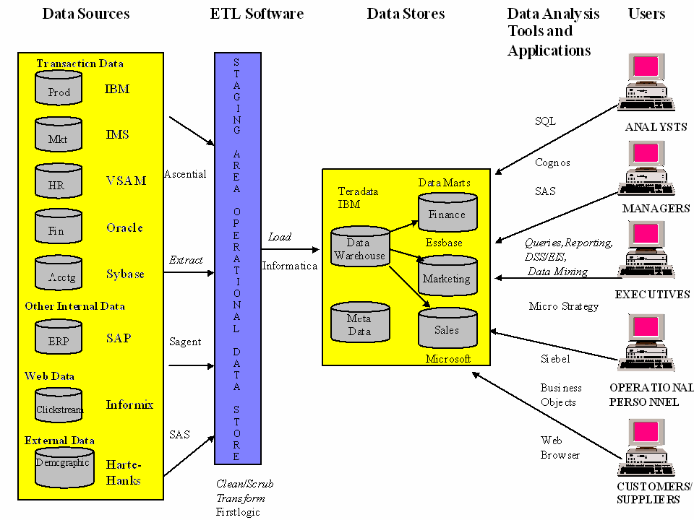

Slide 19
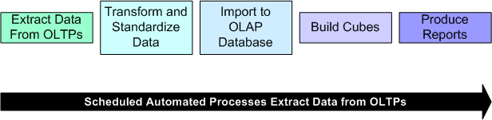
Simplified Form…
Notes:
Put in supporting text

Slide 20

Extraction
Extraction
Identify Data - During extraction, the desired data is identified and extracted from many different sources, including database systems and applications. Data may be removed from the source system or a copy is made and the original data retained in the source system.
Extraction Processes - Data extraction processes can be implemented using SQL* plus, COBOL, Data Transformation Services (DTS) tasks, or custom applications developed in programming or scripting languages.
Size - The size of the extracted data varies from hundreds of kilobytes up to gigabytes, depending on the source system and the business situation.
Notes:
Looks good, remove DTS and t-SQL related text. Put in some generic data. You can even get it from google.

Slide 21
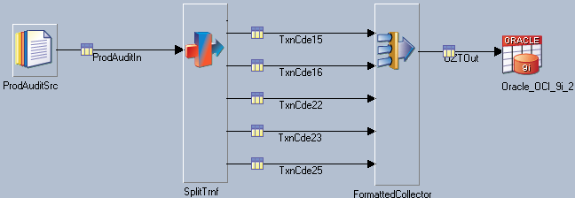
Transformation
Transformation
The ETL transformation element is responsible for
data validation –
data accuracy -
data type conversion, and
business rule application.
Transformation is the most complicated of the ETL elements.
Notes:
Put in supporting text for the figure
Data Validation
Check that all rows in the fact table match rows in dimension tables to enforce data integrity.
Data Accuracy
Ensure that fields contain appropriate values, such as only "off" or "on" in a status field.
Data Type Conversion
Ensure that all values for a specified field are stored the same way in the data warehouse regardless of how they were stored in the source system. For example, if one source system stores "off" or "on" in its status field and another source system stores "0" or "1" in its status field, then a data type conversion transformation converts the content of one or both of the fields to a specified common value such as "off" or "on".
Business Rule Application
Ensure that the rules of the business are enforced on the data stored in the warehouse. For example, check that all customer records contain values for both FirstName and LastName fields.

Slide 22
Loading
Loading - The ETL loading element is responsible for loading transformed data into the data warehouse database.
Update Data - Data warehouses are usually updated periodically rather than continuously. Large numbers of records are often loaded to multiple tables in a single data load.
Notes:
Looks good, say about the batch loading processes also

Slide 23

Meta Data
Data about data
Describe the structure of information and the systems uses to manage that information
Example:
Name Null? Type
--------------------------- ------------ ----------------
EMPLOYEE_ID NOT NULL NUMBER(6)
FIRST_NAME VARCHAR2(20)
LAST_NAME NOT NULL VARCHAR2(25)
EMAIL NOT NULL VARCHAR2(25)
PHONE_NUMBER VARCHAR2(20)
HIRE_DATE NOT NULL DATE
Notes:
Looks good, give the types of metadata available

Slide 24
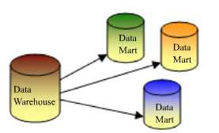
Data Mart
A database, or collection of databases, designed to focus on a particular subject or department used for specific applications
High level of granularity
Star Schema structure
Notes:
Give real time examples

Slide 25
Slowly Changing Dimensions
Dimensions that change over time are called Slowly Changing Dimensions
Example:
For instance, a product price changes over time; People change their names for some reason; Country and State names may change over time

Slide 26
Types of SCD’s
There are 3 types of SCDs that can be used
  Type 1: Overwrite the dimension record
  Type 2: Add a new dimension record
  Type 3: Create new fields in the dimension record

Slide 27
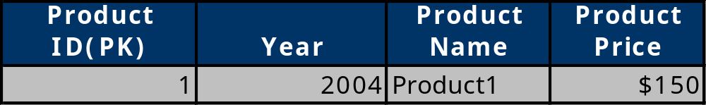

SCD Type 1
Type 1: Overwrite the dimension record
The new information simply overwrites the original information. In other words, no history is kept

Slide 28
Pros and Cons of Type1
Advantages:
This is the easiest way to handle the Slowly Changing Dimension problem, since there is no need to keep track of the old information.
Disadvantages:
All history is lost. By applying this methodology, it is not possible to trace back in history.
When to use Type 1:
Type 1 slowly changing dimension should be used when it is not necessary for the data warehouse to keep track of historical changes.

Slide 29
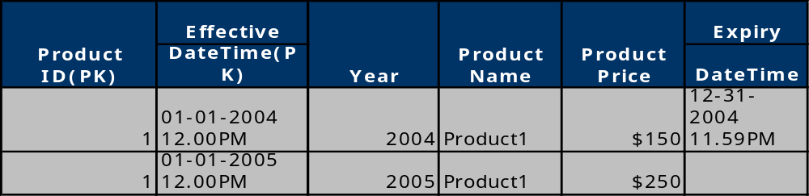
Type 2 SCD:
In Type 2 Slowly Changing Dimension, a new record is added to the table to represent the new information. Therefore, both the original and the new record will be present. The new record gets its own primary key.

Slide 30
Pros and Cons of SCD 2
Advantages
This allows us to accurately keep all historical information.
Disadvantages
This will cause the size of the table to grow fast. In cases where the number of rows for the table is very high to start with, storage and performance can become a concern.
This necessarily complicates the ETL process.
When to use Type 2:
Type 2 slowly changing dimension should be used when it is necessary for the data warehouse to track historical changes.

Slide 31
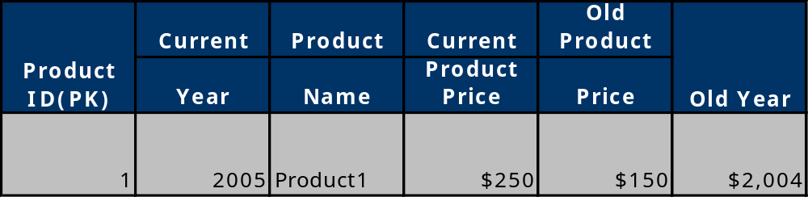
SCD Type 3
In Type 3 Slowly Changing Dimension, there will be two columns to indicate the particular attribute of interest, one indicating the original value, and one indicating the current value. There will also be a column that indicates when the current value becomes active

Slide 32
Pros and cons of Type 3
Advantages:
This does not increase the size of the table, since new information is updated.
This allows us to keep some part of history.
Disadvantages:
Type 3 will not be able to keep all history when an attribute is changed more than once.
When to use Type 3:
Type III slowly changing dimension should only be used when it is necessary for the data warehouse to track historical changes, and when such changes will only occur for a finite number of time.

Slide 33
Factless Fact
Think of facts as values that arise when a particular combination of dimension instances occur
  e.g. SALE AMOUNT fact arise when a particular CUSTOMER buys a particular PRODUCT on a particular DATE.
In some situations, a combination of dimension instance occur without any fact

Slide 34
Types of Facts
Additive Nature
Additive:
Facts that can be summed up/aggregated across all of the dimensions in the fact table (e.g., discrete numerical measures of activity, i.e., quantity sold, dollars sold)
Semi-Additive:
Facts that can be summed up for some of the dimensions in the fact table, but not the others (e.g., account balances, inventory
level, distinct counts)
Non-Additive:
Facts that cannot be summed up for any of the dimensions present in the fact table (e.g., measurement of room temperature)

Slide 35
Factless Fact Table
A particular STUDENT attending a particular COURSE on a particular DATE by a particular FACULTY MEMBER
What are the facts in this attendance scenario?
Hard to think of any!
TIME
……………
FACT-LESS
COURSE_ID
STUDENT_ID
TIME_ID
FACULTY_ID
COURSE
……………
FACULTY
……………
STUDENT
……………

Slide 36
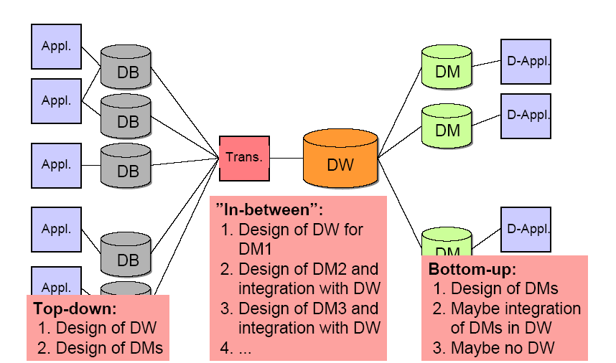
Top-down vs. Bottom-up

Slide 37
Physical Structure of Data Warehouse
There are three basic architectures for constructing a data warehouse:
  Centralized
  Distributed
  Federated
  Tiered
The data warehouse is distributed for: load balancing, scalability and higher availability

Slide 38
Physical Structure of Data Warehouse
Client
Client
Client
Central
Data
Warehouse
Source
Source
Centralized architecture

Slide 39
Physical Structure of Data Warehouse
End
Users
Marketing
Financial
Distribution
Local
Data Marts
Logical
Data
Warehouse
Source
Source
Federated architecture

Slide 40
Physical Structure of Data Warehouse
Workstations
(higly summarized
data)
Local
Data Marts
Physical
Data
Warehouse
Tiered architecture
Source
Source

Slide 41
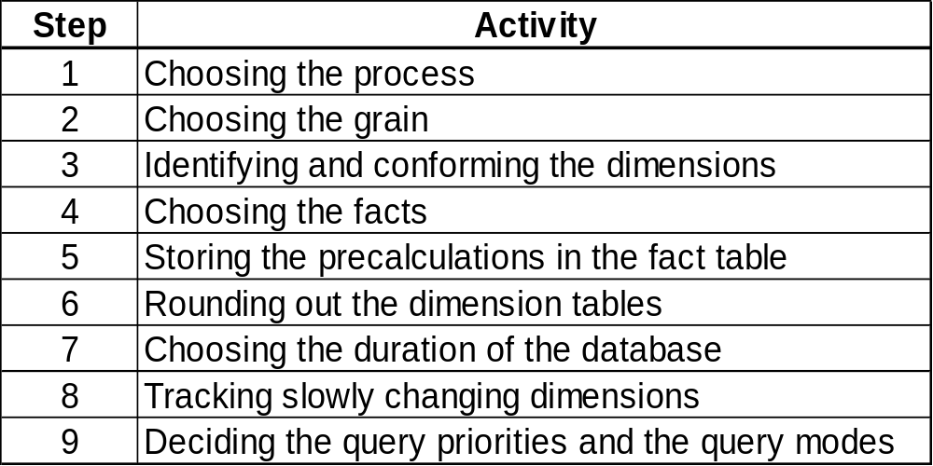
Data base design methodology for data warehouses (1)
Nine-step methodology – proposed by Kimball

Slide 42
Step 1: Choosing the process
The process (function) refers to the subject matter of a particular data marts. The first data mart to be built should be the one that is most likely to be delivered on time, within budget, and to answer the most commercially important business questions.
The best choice for the first data mart tends to be the one that is related to ‘sales’

Slide 43
Step 2: Choosing the grain
Choosing the grain means deciding exactly what a fact table record represents. For example, the entity ‘Sales’ may represent the facts about each property sale. Therefore, the grain of the ‘Property_Sales’ fact table is individual property sale.
Only when the grain for the fact table is chosen we can identify the dimensions of the fact table.
The grain decision for the fact table also determines the grain of each of the dimension tables. For example, if the grain for the ‘Property_Sales’ is an individual property sale, then the grain of the ‘Client’ dimension is the detail of the client who bought a particular property.

Slide 44
Step 3: Identifying and conforming the dimensions
Dimensions set the context for formulating queries about the facts in the fact table.
We identify dimensions in sufficient detail to describe things such as clients and properties at the correct grain.
If any dimension occurs in two data marts, they must be exactly the same dimension, or or one must be a subset of the other (this is the only way that two DM share one or more dimensions in the same application).
When a dimension is used in more than one DM, the dimension is referred to as being conformed.

Slide 45
Step 4: Choosing the facts
The grain of the fact table determines which facts can be used in the data mart – all facts must be expressed at the level implied by the grain.
In other words, if the grain of the fact table is an individual property sale, then all the numerical facts must refer to this particular sale (the facts should be numeric and additive).

Slide 46
Step 5: Storing pre-calculations in the fact table
Once the facts have been selected each should be re-examined to determine whether there are opportunities to use pre-calculations.
Common example: a profit or loss statement
These types of facts are useful since they are additive quantities, from which we can derive valuable information.
This is particularly true for a value that is fundamental to an enterprise, or if there is any chance of a user calculating the value incorrectly.

Slide 47
Step 6: Rounding out the dimension tables
In this step we return to the dimension tables and add as many text descriptions to the dimensions as possible.
The text descriptions should be as intuitive and understandable to the users as possible

Slide 48
Step 7: Choosing the duration of the data warehouse
The duration measures how far back in time the fact table goes.
For some companies (e.g. insurance companies) there may be a legal requirement to retain data extending back five or more years.
Very large fact tables raise at least two very significant data warehouse design issues:
  The older data, the more likely there will be problems in reading and interpreting the old files
  It is mandatory that the old versions of the important dimensions be used, not the most current versions (we will discuss this issue later on)

Slide 49
Step 8: Tracking slowly changing dimensions
The changing dimension problem means that the proper description of the old client and the old branch must be used with the old data warehouse schema
Usually, the data warehouse must assign a generalized key to these important dimensions in order to distinguish multiple snapshots of clients and branches over a period of time
There are different types of changes in dimensions:
  A dimension attribute is overwritten
  A dimension attribute causes a new dimension record to be created
  etc.

Slide 50
Step 9: Deciding the query priorities and the query modes
In this step we consider physical design issues.
  The presence of pre-stored summaries and aggregates
  Indices
  Materialized views
  Security issue
  Backup issue
  Archive issue

Slide 51

A Sample Data Cube
Date
camera
1Q
2Q
3Q
4Q
sum
C
o
u
n
t
r
y
Product
video
USA
CD
sum
Canada
Mexico
sum
All, All, All

Slide 52
MOLAP
The multidimensional online analytical processing (MOLAP) engine takes the data from the warehouse or from the operational sources
MOLAP engine stores then the data in proprietary data structures (multi-dimensional cubes) and pre-calculates as many outcomes as possible
The database is organized to allow rapid retrieval of related data across multiple dimensions.
Generally, separate multidimensional server (containing a relatively small amount of highly indexed data) is used.

Slide 53
MOLAP
Data can be offloaded from the server onto the client for local access reducing the network traffic (however, it can take time to form the cubes)
The calculation engine can create new information from existing data through formulas and transformation.
The complexity of underlying data is transparent to the MOLAP tool user
Pre-aggregated summary data and pre-calculated measures enable quick and easy analysis of complex data relationships

Slide 54
ROLAP
Relational online analytical processing (ROLAP) engine takes data from the relational data warehouse.
Data and metadata is stored as records in the relational database.
Users supplied with a multidimensional viewing tool to view relational data.
Complex SQL code generated by the ROLAP tools.
No limitations on the size of the database or the kind of analysis that may be performed (however, if the user joins several complex tables or performs complex computations, performance may be severely affected)

Slide 55
HOLAP
MOLAP vs. ROLAP
Performance vs. Storage
Hybrid online analytical processing (HOLAP) combines MOLAP and ROLAP approaches and takes advantage of the strengths of both methods
In a hybrid solution, for example, the relational database can be used to store the bulk of the detail data and the multidimensional model can be used to store summary data.

Slide 56

Reporting
To produce attractive, meaningful reports and publish them throughout the enterprise
To query the data in your database without needing specialized programming knowledge.
Access up-to-the minute information.
Notes:
Give sample figures

Slide 57
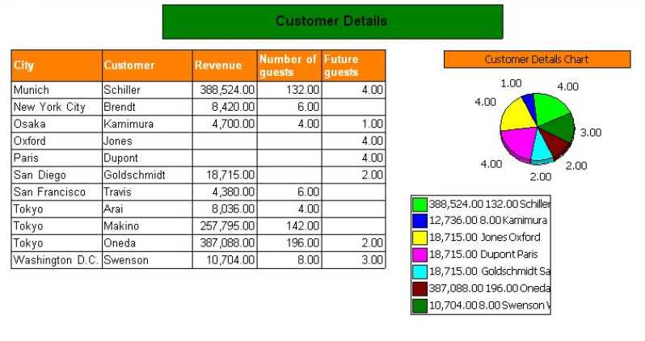
Report Analysis
Notes:
Give supporting text

Slide 58

Data warehousing Tools
Popular Relational Databases
Oracle
Microsoft SQL Server
IBM DB2
Teradata
Sybase
MySQL
Popular OS Platforms
Linux
FreeBSD
Microsoft Windows
Popular ETL Tools
Data Junction
Ascential DataStage
Ab Initio
Informatica
Popular OLAP and Reporting Tools
Business Objects
Cognos
Hyperion
Microsoft Analysis Services
MicroStrategy

Slide 59
Summary
Data warehouse - it is an important information processing system architecture for decision making!
Data Modelling facts and Dimensions
OLAP provides powerful and fast tools for reporting on data
OLTP provides online application
ETL , tool where data is cleansed, rules applied and loaded
Datamart – subject oriented, specific applications
Report Analysis
Notes:
Looks good

Slide 60

USA INDIA SRILANKA UK
www.virtusa.com
"Virtusa" is a trademark of the company and a registered trademark in the EU and In India.
"Productization" is a service mark of the company and a registered service mark in the United States.
"vRule" is a service mark of the company.
For more information please contact SalesInquiries@virtusa.com
© V I r t u s a C o r p o r a t i o n

