Slide 1
Vaadin

Slide 2
What And Why ?
Create web content
AJAX
GWT features can be used
Server driven
No Java Script knowledge
Themes
JSON is used and not XML

Slide 3
Environment Setup
TOMCAT
ECLIPSE
VAADIN
VAADIN PLUGIN FOR ECLIPSE

Slide 4
Vaadin Application
Themes
Vaadin Application
UI
Components
Listeners
Resources
Data

Slide 5
Features
Component Errors
Notifications
UI Components
Layouts
Data Model
Portal compatible
GUI for mobiles

Slide 6
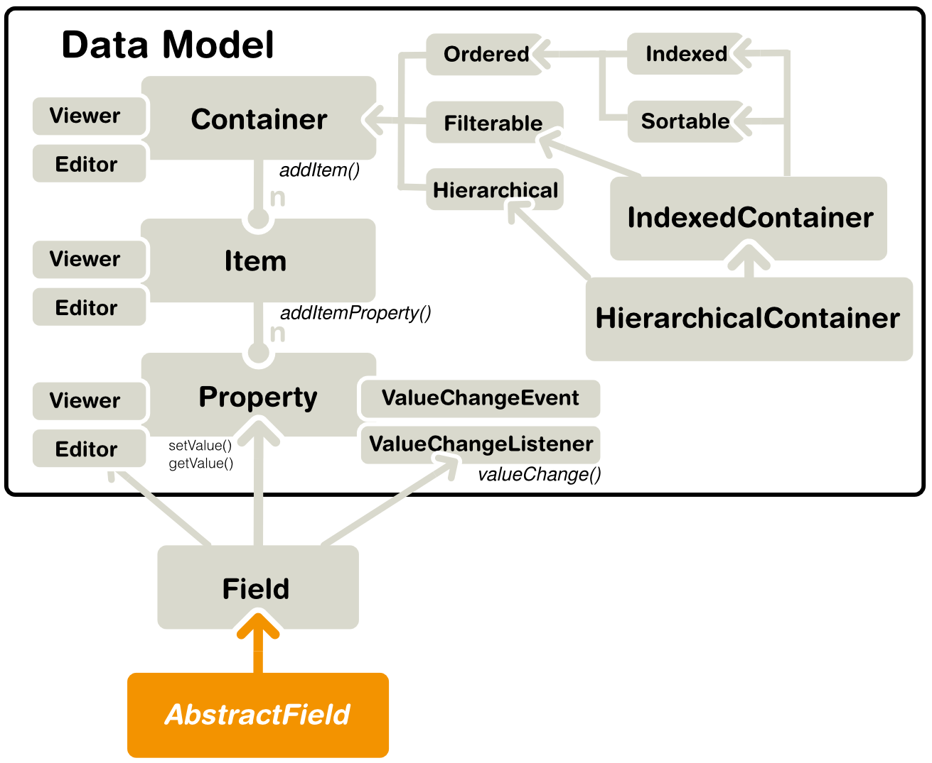
Data Model

Slide 7
Create Vaadin Application
public class MyApp extends com.vaadin.Application {
public void init()
}
Extend Application and implement init method will create an application
Every application has <>-----------→ Main window
Deploy- use eclipse ->File -> export as war and deploy in web server
Restart application : add ?restartApplication to url
Debug application using ? Debug

Slide 8
Simple Form
Create a bean with setters and getters
Create a form
Set the form data source as bean
And run the app

Slide 9
Links
http://vaadin.com/eclipse plugin for eclipse and how to use
Demo http://vaadin.com/demo
Add ons http://vaadin.com/add-ons
http://vaadin.com/learn

