Slide 1

Student parking system presentation
Sam V, Benjamin Pedrin, Mersadeys Mysliwiec

Slide 2
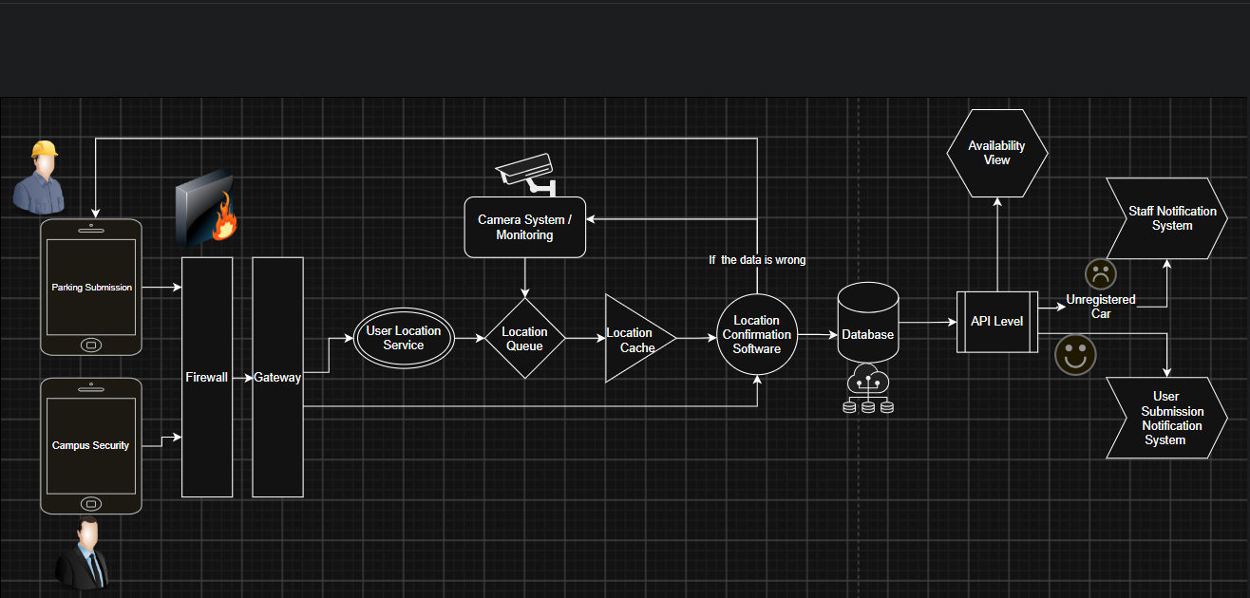

Western parking program design

Slide 3



Problem or purpose of the system
Prevents drivers circling the lots looking for open spaces
Cuts down on dangers to pedestrian students
Provides live count of parking availability
Assists in parking accountability
Intended users
Students and staff who use campus parking
Campus security
System Administrators
Data the system collects
User information – User ID, Location Data, Timestamps, Coming or Going
Camera data – Availability, Timestamps, Lot Location
License Info and permit information

Slide 4
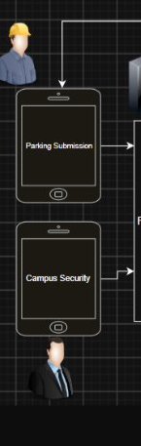
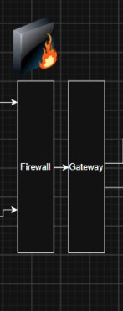
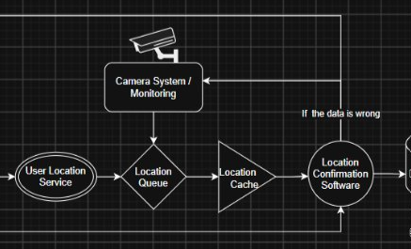
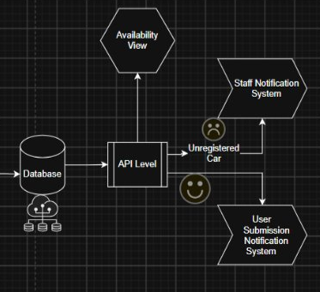

The Firewall Confirms that the User is Authorized to Move Into the System
The Gateway verifies which path the User's Data will take.
User Path:
Location Services where data is verified as plausible.
Enters Queue along with Camera data and timestamps
Enters Cache – Volatile memory
Confirmation Software – compares all data for discrepancies
Data Enters Database:
API pulls requested data from Map View software and sends to Availability View
API also pushes notifications to security and users dependent on the outcomes
Students & staff opens APP and logs in

Slide 5
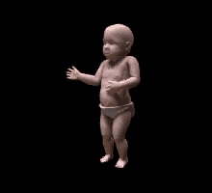


Important IT ROLES
IT Support Technician: Work with computers that monitor the system.
Network Administrator: Work with network between cameras and system.
Cloud / Systems Administrator: Work with and monitor database
Software Developer: Work with the software affecting the system.
Data Analyst: Work with the data collected by the database.
IoT: Work with other devices (cameras and sensors)

Slide 6


Design decision
An important decision we made was to add cameras into our design. These cameras do come with expenses and may break down, but they also add another layer of security and protection to the system design.

Slide 7

Tradeoff
We make our design user-focused. This is to ensure that our system isn’t solely based on cameras and sensors. It will be prone to user error. Our system is not fully trustworthy, but it will work efficiently 24/7 at a cheap cost.

Slide 8


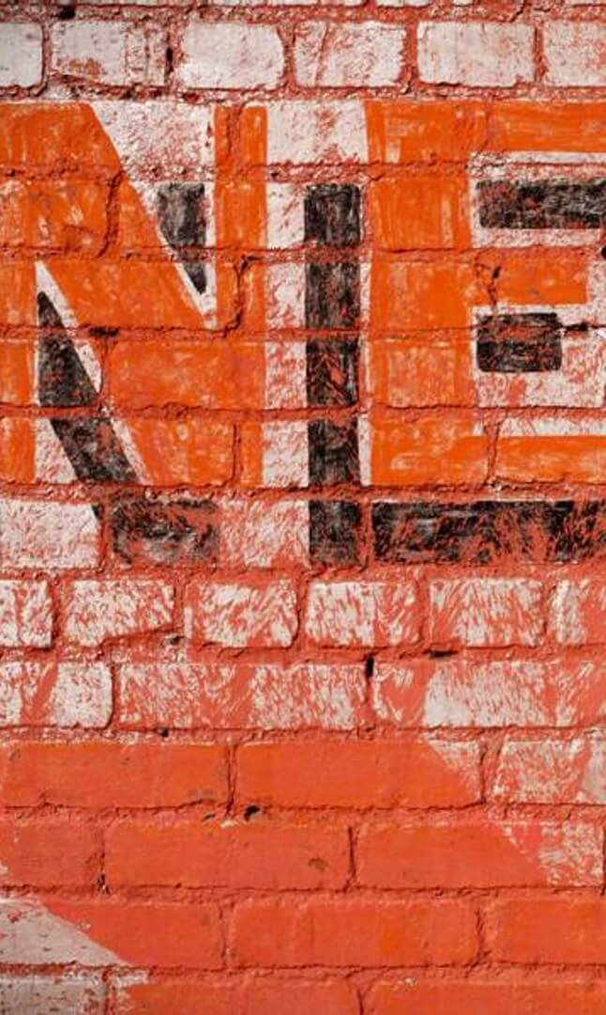
RISK
As stated in the Tradeoff section, our system is very dependent on the user. This means we are prone to user error, such as forgetting to submit your data or submitting incorrect data. We also risk software failure and other small errors (people taking multiple spots, etc.)

Slide 9
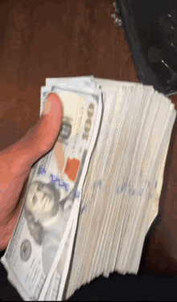

COSTS
Category | Estimated Cost
Hardware & Installation | 0-53k
Software | 0-90k
Mobile APP | 20k - 100k
One Time Total: | 165k - 243k

Slide 10





Thanks for your time we hope you enjoyed it!

