Slide 1
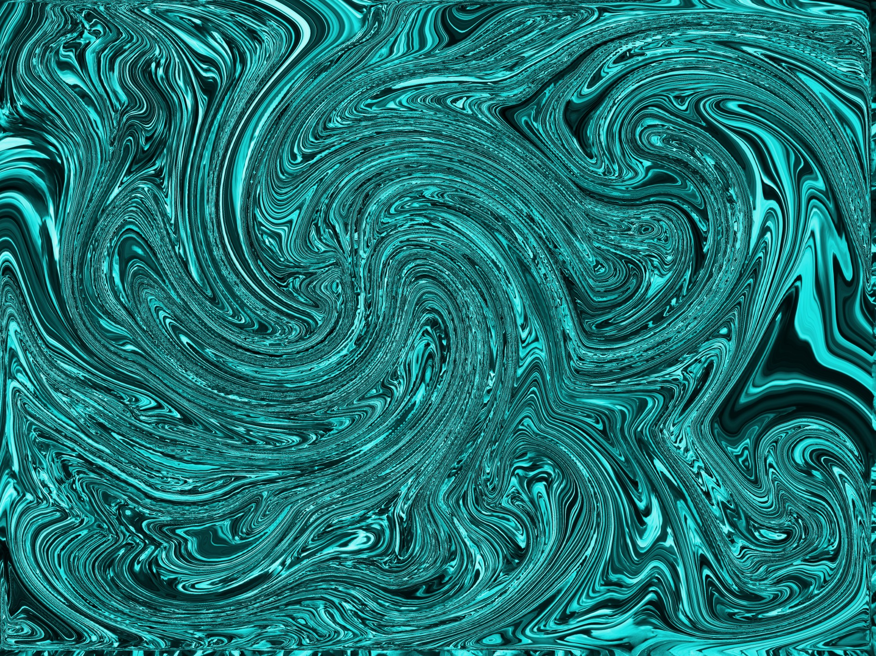
AlternationTissue Integrity
Pathophysiologic Basis for Antimicrobial Medications & Mechanisms of Infectious Disease
Osano Bw’Osano

Slide 2
Medical Terminology
Suffix –itis indicates inflammation of an anatomic location
appendicitis, bronchitis, endocarditis
Suffix –emia designates the presence of an infectious agent in the blood
bacteremia, viremia, fungemia
Febrile neutropenia : life-threathening complication on ca Pts
The term septicemia or sepsis is the confirmed presence of an infectious agent in the blood combined with a systemic inflammatory response

Slide 3
Key Terms
Pathogenicity => the ability of an organism to cause infection
Pururent exudate : white-green drainage
Serosanguineous : bllod serum and serous fluid exudate
Leukopenia : too few WBCs = risk of infections
Virulence => disease producing potential
Host => organism capable of supporting the nutritional and growth requirements of another organism
Infection => the presence and multiplication of one organism within another that eventually causes damage to the host
Colonization => the presence of establishing a presence
Microflora => the normal and beneficial microbial life living on/in the human body
Notes:
Opportunistic Infection => all microbes are capable of creating infection given the right circumstances. For example, immunocompromise (HIV, transplant)
Superinfection occur when too many host flora are killed by an antibiotic​ (c. dif)

Slide 4
Infection entry
The cell is the functional unit of life and the site of action for infection
Damage to the cell from infection
Invasion
Toxins
Dysregulated immune response
The skin is the most important infection first line of defence
Pathogens : bacteria, viruses, fungus, protozoa and worms
Notes:
Most start big and go small
We will start small and go big

Slide 5
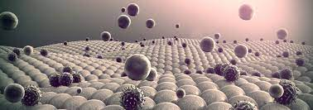
Inflammation
A response to tissue injury meant to minimize the effects of infection or injury, remove damaged tissue, create new tissue, and facilitate healing

Slide 6

Diagnosis of inflammation
C-reactive protein ( CRP) elavation
Erythrocyte sedimentary rate (ESR)
White blood cell with differential ( WBC) = indicates infection and inflammation
Notes:
Theme

Slide 7
Cells Involved in Inflammation
Many cells are involved
Principal Cells include:
Endothelial Cells
Platelets
Leukocytes
Neutrophils
Macrophages, lymphocytes, eosinophils, and mast cells more associated with chronic inflammation

Slide 8
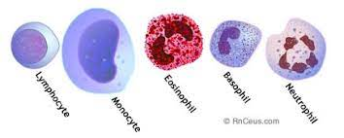
White Blood Cells => leukocytes are the major cellular components of the inflammatory response. Normal = 4000 -10,000

Slide 9
Acute Inflammation
The classic signs of acute inflammation
Erythema
Swelling
Heat
Pain
Loss of function
Fever is a systemic symptom of inflammation
Two stages: vascular and cellular

Slide 10
Disease Production
Infectious Agents cause infection and damage tissues by:
Entering host cells and directly causing their death
Overwhelming the host’s immune system through multiplication
Triggering host responses that, although meant to destroy the infectious agent, cause additional tissue damage
By releasing substances or products that increase the microbe's ability to cause disease

Slide 11
Virulence Factors
Bacterial Endotoxin
Bacterial Exotoxins
Lipopolysaccharides found in gram negative cell walls
Trigger immune response at low levels
High levels cause septic shock, DIC, and ARDS
Released from bacteria during cell growth
Affect the structure and function of host cells and help bacteria invade tissues
For example, botulism exotoxin decreases cholinergic neurotransmitters causing paralysis
Endotoxins that cause vomiting and diarrhea are called enterotoxins

Slide 12
Disease Production
To cause infection, microbes must
Invasion Factors
Chain of infection
Motility, entry enzymes
Adherence Factors
Slime (glycocalyx) layer, adhesins
Evasion Factors
Entry enzymes, Capsules, Excreting leucocidin C, Urease enzymes, Coagulase, Altered antigenic presentation
Additional Virulence Factors
Notes:
leukocidin is a type of cytotoxin designed to kill leukocytes, urease changes stomach acid to ammonia
Adhesins are cell surface components and appendages which help bacteria to adhere

Slide 13
Infection Progression
SIRS ( Systemic inflammatory response syndrome)
Sepsis
The body’s response to an infectious agent that is exaggerated and contributes to cellular damage
Cytokine storm causes activates poorly regulated inflammatory cascade
T > 100.4; HR > 90; RR > 20 or ETCO2 <32; WBC >14,000 or <4,000 or left shift
escalation of SIRS with suspected or confirmed infectious cause;
Includes circulatory, cellular, and metabolic dysfunction
Lactic acidosis (lactate > 2)
Severe sepsis: SBP < 90 mmHg
Septic shock: hypotension despite adequate fluid resuscitation
MOD Syndrome: ≥ 2 organs failing

Slide 14
Sepsis Treatment
Fluid Resuscitation is priority
Obtain STAT blood cultures. DO NOT DELAY
Start broad-spectrum antibiotic within 1 HR
IFNarrow treatment in response to culture results
VS MONITORING
Notes:
Zosyn because anti-pseudomonal beta-lactam
Vanc is highly effect against pseudomonas
Levaquin has broad activity for multiple strains of community acquired pneumonia

Slide 15
Viruses
Viruses are the smallest intracellular pathogens
They consist of a protein capsid surrounding a DNR or RNA genome
No organelles or biomechanical structures
Virus must insert into a host cell and take over the cell’s biomechanical machinery to produce progeny
Categorized by type of genome (DNA or RNA), single or double stranded, size, presence of a membrane or lipoprotein envelope, mode of transmission (arthropod, enterovirus), target tissue, and mode of replication (retrovirus)
Viral diseases examples: Influenza, chicken pox, measles, hepatitis, coronavirus, pneumonia, ebola, respiratory syncytial virus ( RSV), HIV, polio, mumps, herpes, human papillomavirus

Slide 16
Virus
The virus inserts into a cell
The cell’s bio-machinery is used to replicate the virus
The cell dies and the progeny are released to repeat the process
Some viruses insert their genome into the host cell’s chromosome where it lies latent for long periods
Herpes Virus
HIV

Slide 17
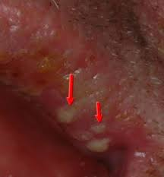
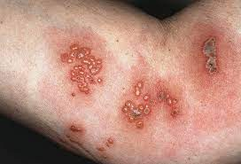
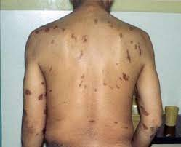
Herpes Group Viruses
Varicella-Zoster
Herpes Simplex I
Herpes Simplex II
Cytomegalovirus
Epstein-Barr
Kaposi's Sarcoma
Remains latent in the nerve ganglia until stimulated
Undergoes active replication

Slide 18
Classes of Antiretrovirals
Nucleoside/Nucleotide reverse transcriptase inhibitors
Non-nucleotide reverse transcriptase inhibitors
Protease inhibitors
Entry inhibitors
Integrase inhibitors
Patients infected with HIV will need combination therapy
For example, Dolutegravir (integrase inh.) + abacavir (NRTI) + lamivudine (NRTI)
Notes:
Nucleoside/Nucleotide analogs mimic nucleoside/nucleotide building blocks which impair the synthesis of reverse transcriptase (ex zidovudine) Nucleoside reverse transcriptase inhibitors (NRTIs)
Monoclonal antibodies – hybridomas – antibody producing B cells harvested from an immunized animal are fused with immortal b-cancer cells. The hybridoma produces large quantities of antibodies specific to a single antigen

Slide 19
Nursing actions with HIV Antiviral therapy
Establish baseline CBC, BMP, CD4, viral load, liver and kidney studies
Monitor for concurrent infections
Regularly monitor for hepatic, renal, and neuro toxicity
Monitor for pancreatitis
Monitor glucose and lipid levels
Emphasize importance of compliance with drug regimen
Assess for body image disturbance
psychosocial councelling
Enhanced nutrition

Slide 20
Bacteria - Classification
Shape — spherical (cocci); helical (spirilla); elongate (bacilli)
Motility & Adhesion— some bacteria will have flagella; pili
Reproduction — dividing in chains (streptococci); pairs (diplococci); clusters (staphylococci)
Gram Staining — stain purple with basic dye (+) due to their thick cell walls, for example, Streptococcus pyogenes; not stained with basic purple but counterstain red (-), for example, Legionella pneumophila
Acid Fast — resistant to acid staining, for example, mycobacteria like M. tuberculosis
Aerobic vs. Anaerobic

Slide 21
Bacterial pathogens
Rickettsia rickettsii -> RMSF -> Doxycycline
Chlamydiaceae -> Chlamydial infections like Chlamydophila trachomatis
Salmonella
E. coli
Pseudomonas aeruginosa
Streptococcus
campylobacter
Staphylococcus
Some Bacterial Infections: UTI, URI, pneumonia, bacteremia, cellulitis. TB, Gonorrhea, Tetanus, Chlamydia, Lyme disease, whooping cough.
Notes:
RMSF fever, stomach pain, muscle pain, rash -> meningitis

Slide 22
Fungi
Mycoses
Free living, eukaryotic saprophytes
Yeasts and molds
Produce cells walls but chemically unrelated to peptidoglycan
Fungi cell walls contain ergosterol while human cells contain cholesterol
Most cannot grow at body temperature and are superficial (Epidermophyton floccosum → tinea pedis [​athlete’s foot])
Systemic fungal infections are opportunistic and usually serious
Aspergillus fumigatus → Aspergillosis: opportunistic; mainly affects the lung → variconazole
Candida albicans → Candidiasis: most common opportunistic fungal infection; may affect nearly any organ​ → fluconazole
May be systemic or superficial (infection of the oral mucosa is called thrush → Nystatin S/S)
Histoplasma capsulatum → Histoplasmosis: begins in the lungs and spreads to other organs​ → itraconazole
Notes:
Most serious fungal infections happen in immunocompromised people
Protozoal infections are often related to poor sanitation BUT also open abdominal surgery

Slide 23
Parasites
Protozoa: malaria, dysentery, giardiasis
Malaria is a serious disease worldwide causing significant morbidity and mortality
Atovaquone-proguanil
Helminths: wormlike creatures like tapeworms and roundworms. Ex. Enterobius vermicularis (pinworm)
Pinworm is most common helminthic infection in the US
Pyrantel pamoate (available OTC)
Arthropods: ticks and ectoparasites like lice (pediculosis [capitus, corporus, pubis], mites (scabies)
Ectoparasites may be vectors for more serious diseases (bubonic plague)
Notes:
Quinine is no longer rcmmd re: drugs that are equally effective with fewer side effects

Slide 24
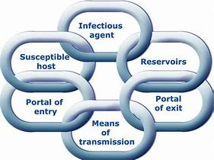
Transmission
Microbes must breach host defenses to be live and reproduce
The portal of entry does not necessarily define the location of infection
Chain of Infection
Transmission is directly related to the number of infectious agents that penetrate the body’s defensive barriers
Direct Contact
Ingestion
Inhalation
Notes:
Infectious Agent
Reservoirs
Portal of Exit
Modes of Transmission
Portal of Entry
Susceptible Host
Neutralize a link in the chain and infection will not occur

Slide 25
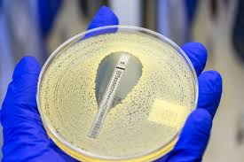
Treatment
The goal of antimicrobial treatment is usually the eradication of the infectious agent from the host.

Slide 26
Antibiotics
Bactericidal
Bacteriostatic
Some antibiotics are effective against gram + bacteria
Some antibiotics are effective against gram – bacteria
Some antibiotics are “broad spectrum” => effective against gram+ and gram- bacteria
No antibiotic is effective against viruses
IX ABX: more effective
Loading dose may be used

Slide 27
Four Basic Mechanisms of Antibiotic Action
Interference with a specific step in bacteria cell wall synthesis (penicillins, cephalosporins)
Inhibition of bacterial protein synthesis (aminoglycosides, tetracyclines)
Interruption of nucleic acid synthesis (fluroquinolones)
Interference with bacterial metabolism (sulfonamides, trimethoprim)

Slide 28
Acquired Resistance
Occurs when pathogen develops gene that survives longer or grows faster
Through maturation;
Antibiotics destroy sensitive bacteria
Insensitive (mutated) bacteria remain
Mutated bacteria multiply with less competition
Mutations are random
May harm or help bacteria
Bacteria may pass mutations to other bacteria

Slide 29
Use of Antibiotics
Antibiotics do not create mutations
Resistance not caused by, but is worsened by, over-prescription of antibiotics
Results in loss of antibiotic effectiveness
Only prescribe when necessary
Long-time use increases resistant strains
Healthcare associated infections (HAIs) often resistant
Prophylactic use appropriate in some cases to prevent infection (e.g., dental procedure for individual with prosthetic heart valve)
Nurse should instruct patient to take full dose
Nurse should teach patient to not stop taking antibiotic because they start to feel better.

Slide 30
Host Factors Influence Choice of Antibiotics
Immune system status
Local condition at infection site
Allergic reactions
Age
Pregnancy
Genetics
Severity of illness
Psychosocial Aspects of Care
sensitivities
Notes:
cytochrome P450 enzyme helps process medication
Old/young elimination and nephrotoxicity

Slide 31
wound healing/union
Primary intention: healing of clean surgical lacerations
Secondary Intention : myofibroblasts cause contraction of wound edges to close the tissue gap
Tertiary intention : wound missing large amount of deep tissue and is contaminated. may have much drainage and may need packing.
Determinants of wound healing
Nutrition, circulation, immune strength
contamination, dehiscence ( opening of wound sature line)
Wound Evisceration = internal organs and tissues extrude from open wound
age, DM

Slide 32
Risk factors of pressure injury
Bedsores/ pressure ulcers/ decubitus ulcers
lack of pressure redistribution by supportive surfaces and T&R
Poor nutrition
incontinence
dehydration
Advanced age
Shearing: forces are applied to body tissues thta causetissue to move in opposite direction
Friction: mechanical force exerted when skin is dragged across a course surface causing laceration / superficail laceration

Slide 33
Wound stages
Stage 1: just erythema of the skin.
Stage 2: erythema with the loss of partial thickness of the skin including epidermis and part of the superficial dermis. Painful
Stage 3: full thickness ulcer that might involve the subcutaneous fat.
Stage 4: full thickness ulcer with the involvement of the muscle or bone
Unstageable" is when you can’t see the bottom of the sore, so you don’t know how deep it is.
Deep tissue injury : : 'purple or maroon localized area of discolored intact skin or blood‐filled blister due to damage of underlying soft tissue from pressure and/or shear'

Slide 34
End –of- life
Determination of death: cerebral angiography. uses a special dye (contrast material) and x-rays to see how blood flows through the brain
Determining death: persistent coma, absence of brain stem reflexes, lack of ability to breath
Mimics of brain death: antiepileptic overdose, baclofen or organ phosphate toxicity, hypothermia, high spinal code injury
Lock-in-syndrome= nervous system disorder which leads to paralyzed body except muscles controlling eye movements. Pt remains conscious but cannot move or talk
Assessing brain death: use cranial nerves and apnea tests
Ice-cold water test: placed into ears to see if any eye movement exists
Thin tubes are placed down wind pipe to see if gagging occurs
Disconnect ventilator for a short time to see if breathing occurs.
*** pt cannot survive without oxygen to the brain for more than an hour

Slide 35
End-of- life
Will likely die within 12 months
Has incurable disease
My need palliative/ hospice services. Comfort dictates any nursing care
Death rattle : gurgling sound heard in a dying pt d/t throat buildup of fluids
Cheyne-stokes respiration: abnormal breathing oscillating between hyperventilation and apnea
Cardiovascular changes in the dying : bradycardia, hypotension
Musculoskeletal changes : loss of muscle tone, weakness
Skin changes: Skin of the knees, feet, and hands may become purplish, pale, grey, and blotchy or mottled. These changes usually signal that death will occur within days to hours.

Slide 36
Nursing role in end of life
Involve other parties: hospice, family , funeral homes, palliative care
Timely assess and intervene for pain, anxiety and agitation
Vital signs, feeding, T&R, Labs, might not be necessary
Optimize comfort
Offer spiritual care
In hospital settings a doctor will declare death. Follow facility policies in declaring death and removing of body
Contact organ donor upon death if applicable
The dead must be treated with absolute dignity and with reference to the family, cultural, or advanced directives

