Slide 1
Neuro-ODE
2025.01.30

Slide 2
Recap
First step: Model the change of variants over time based on data.
Exploratory visualization for variants
Data collection for factors (e.g. climate, mobility, hospitalization/ED…)
Variable selection

Slide 3
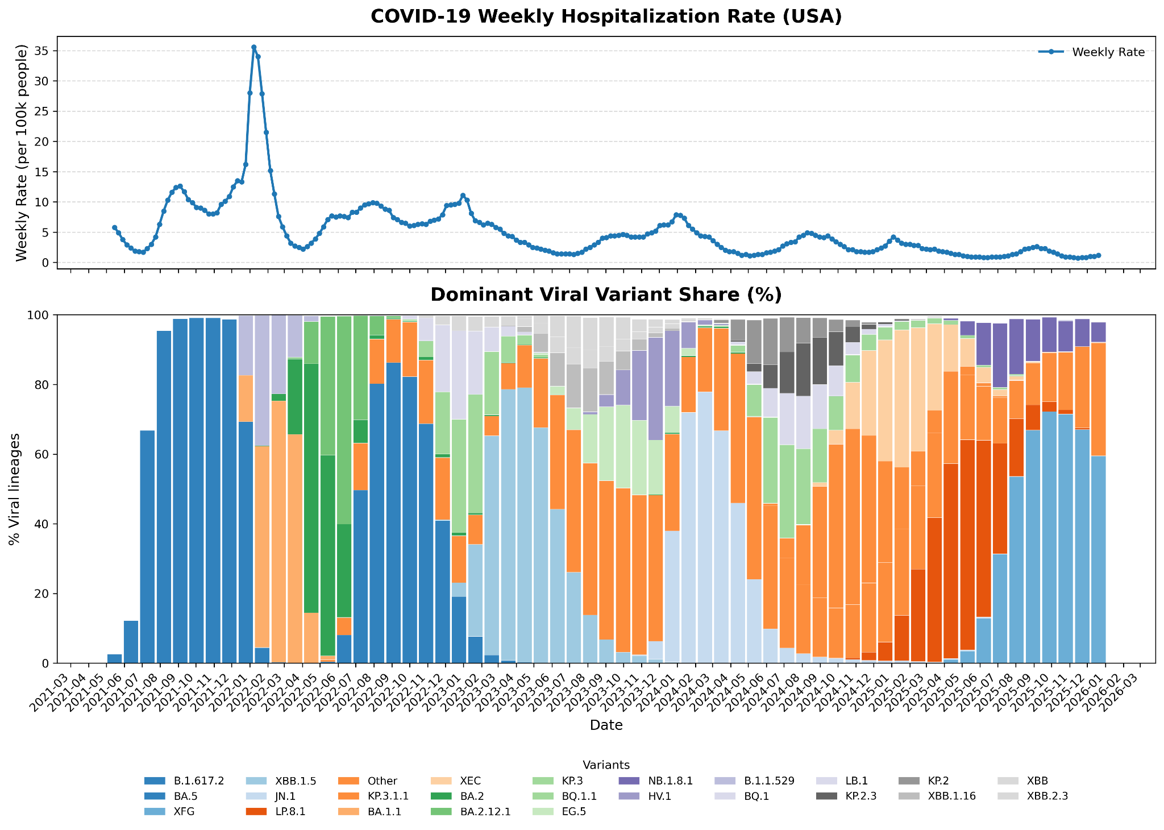
Delta
Omicron
BA.1/2/5
Omicron
XBB
Omicron
JN.1
Late Omicron

Slide 4
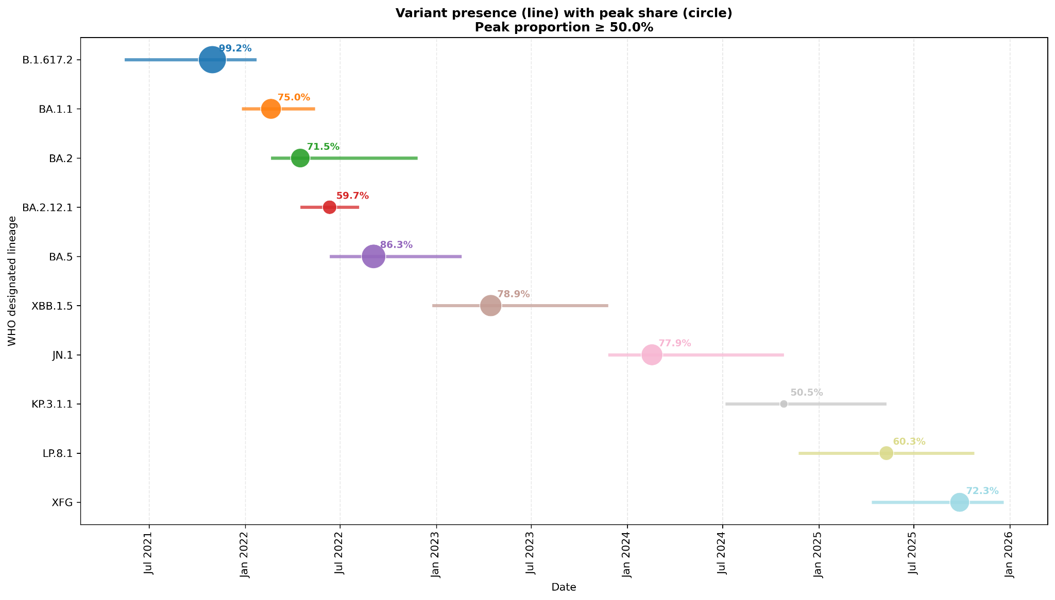

Slide 5
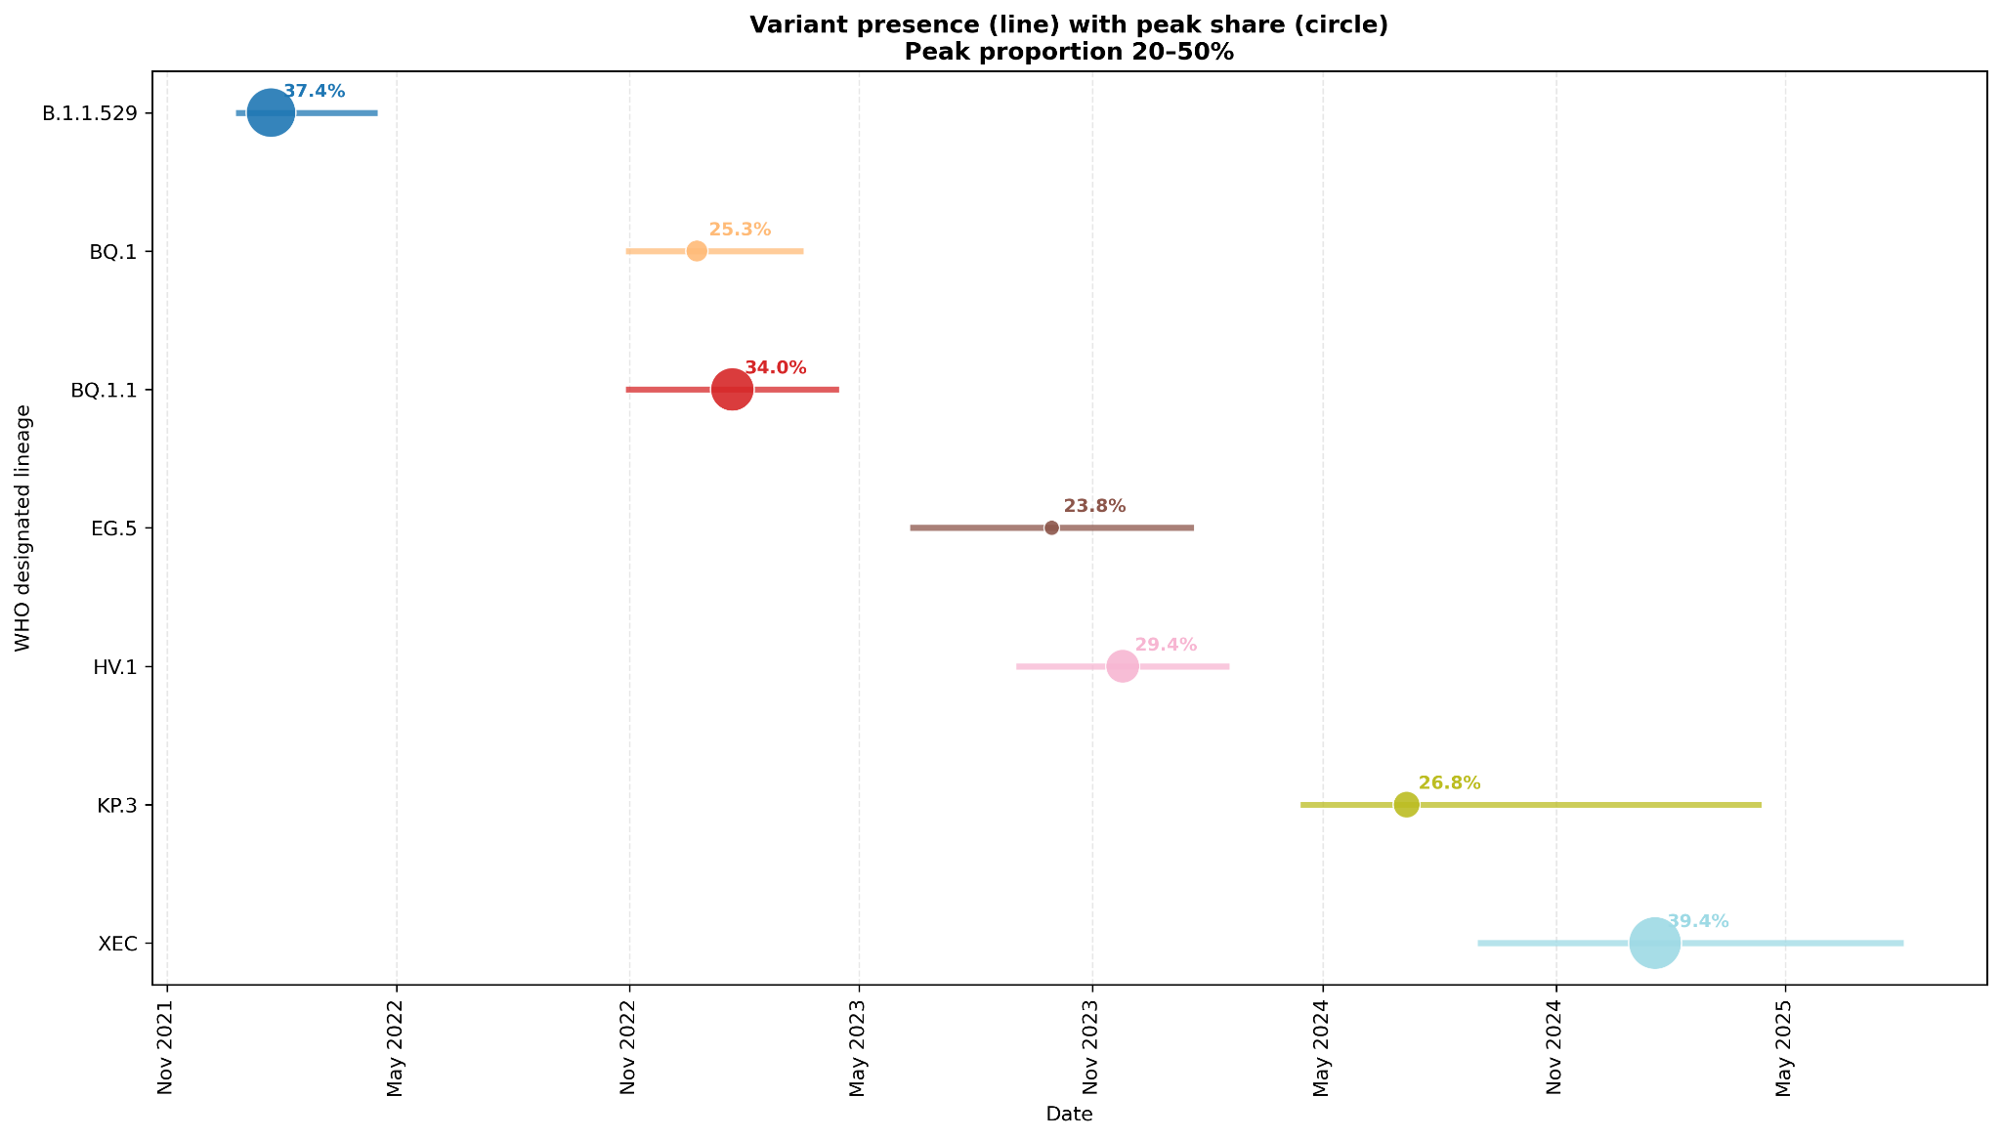

Slide 6
