Slide 1
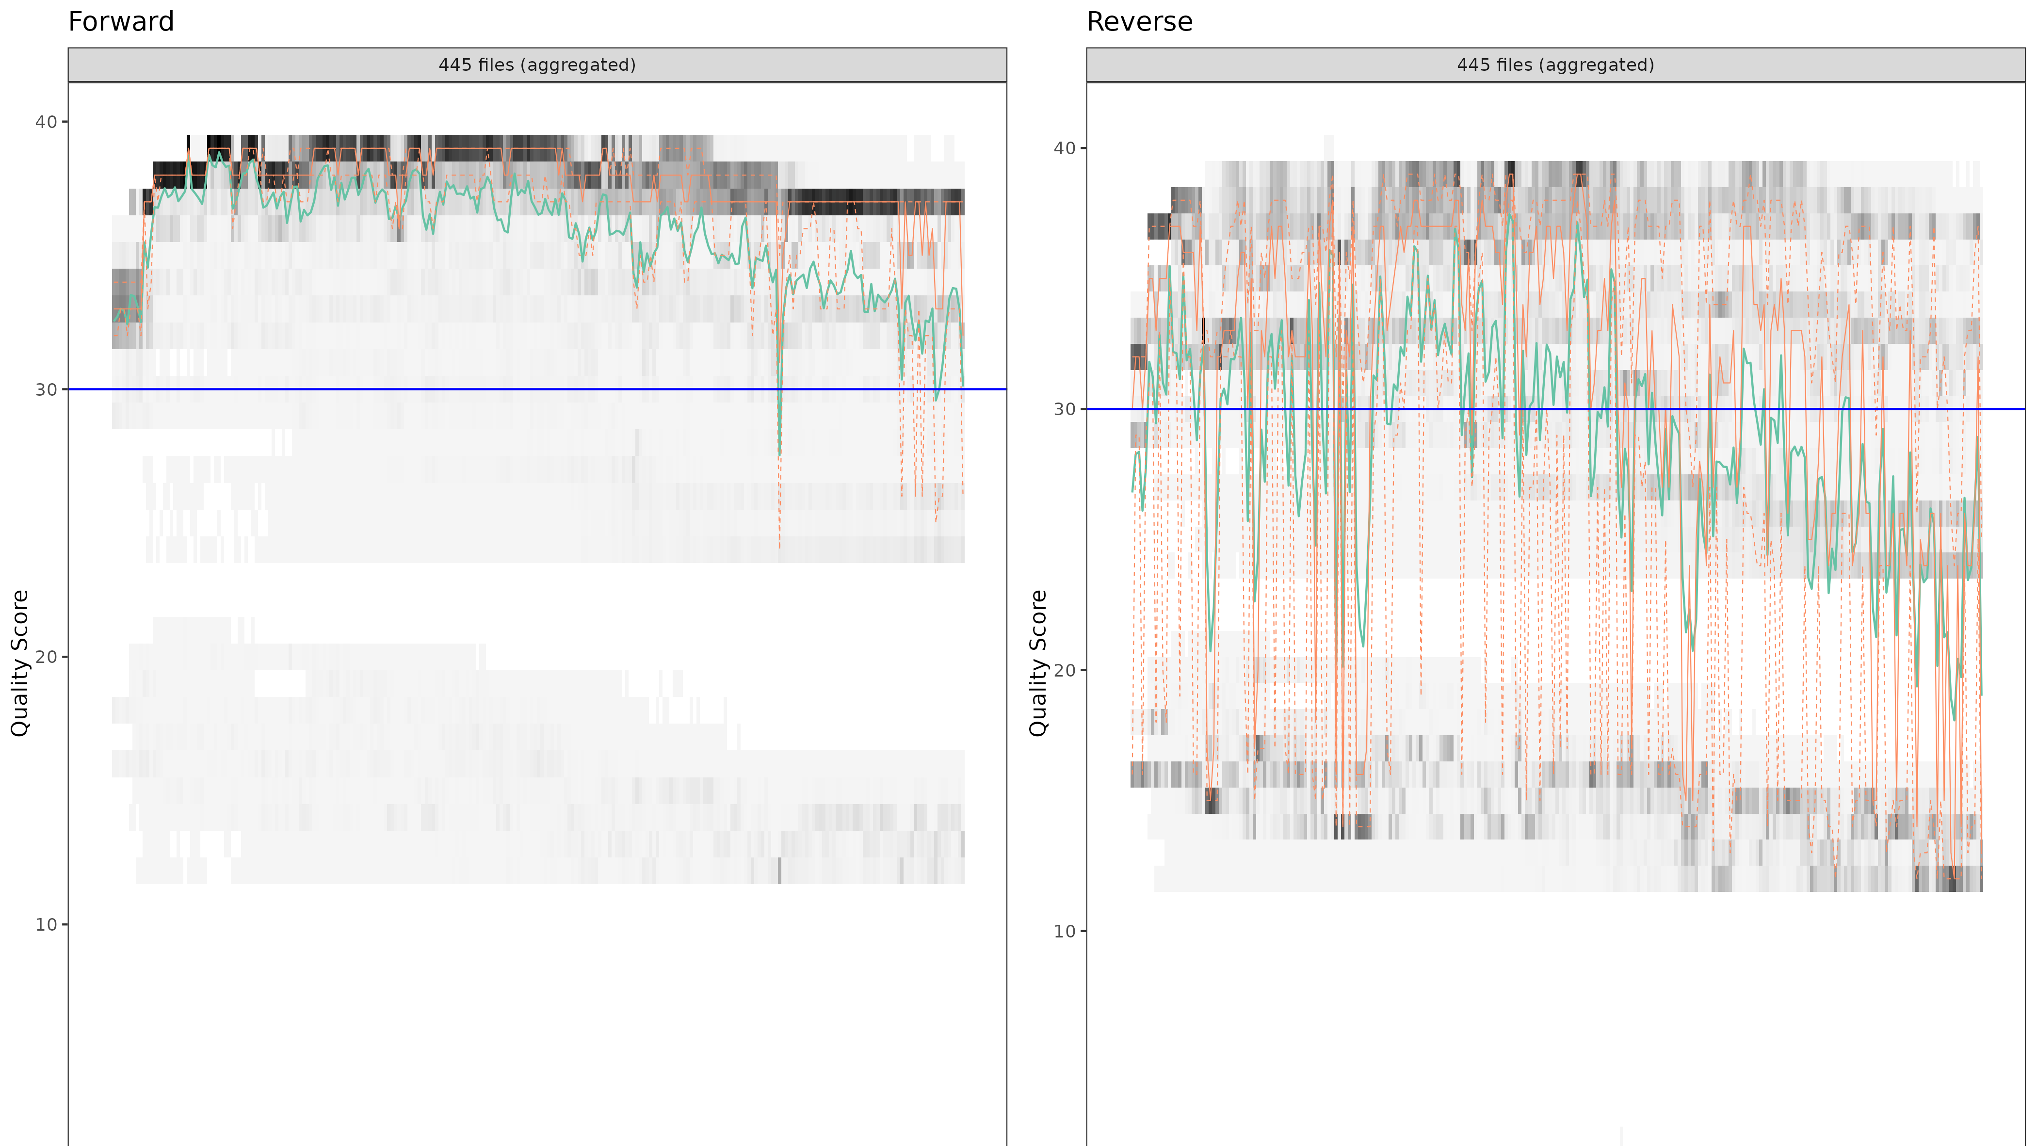

Slide 2
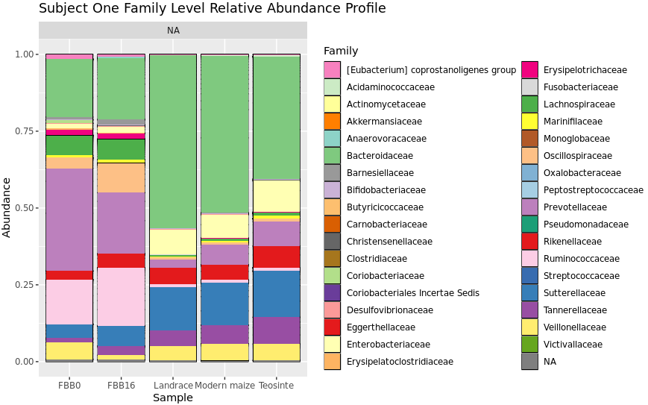
Significantly different taxa: Bacteroidaceae, Prevotellaceae, Tannerellaceae

Slide 3
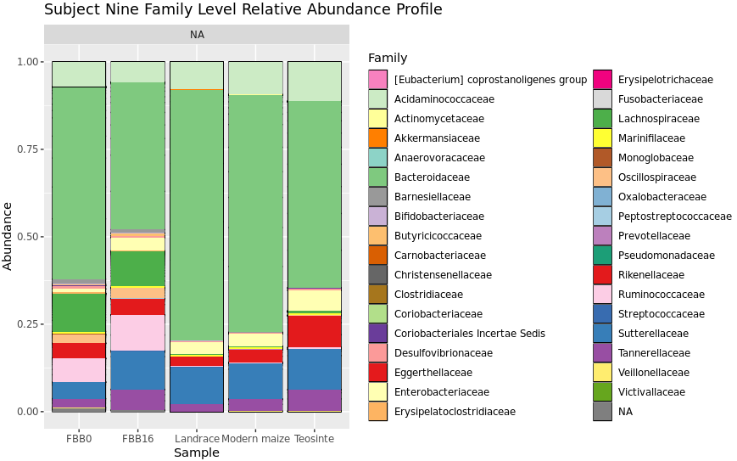
Significantly different taxa: Bacteroidaceae, Acidaminococcaceae, Rikenellaceae, Tannerellaceae

Slide 4
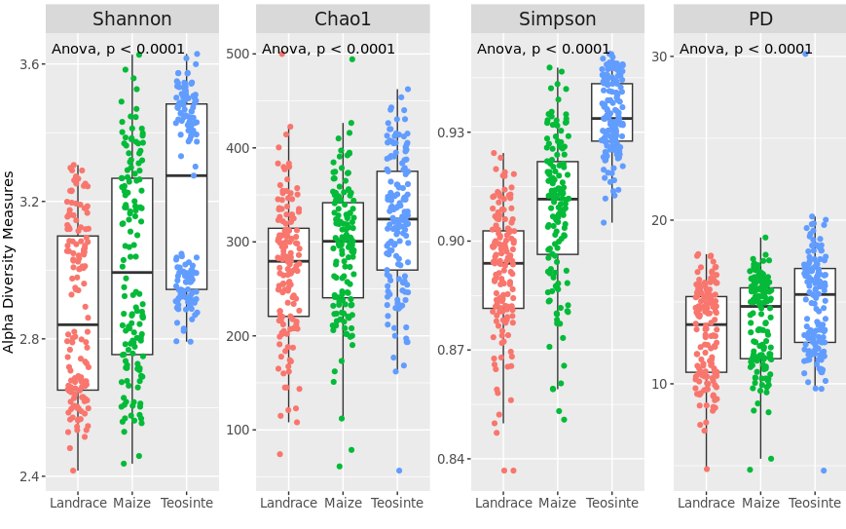
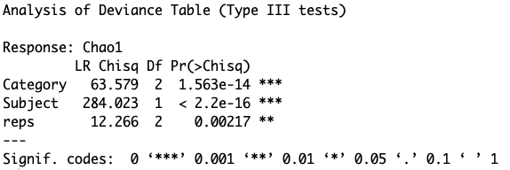

Slide 5
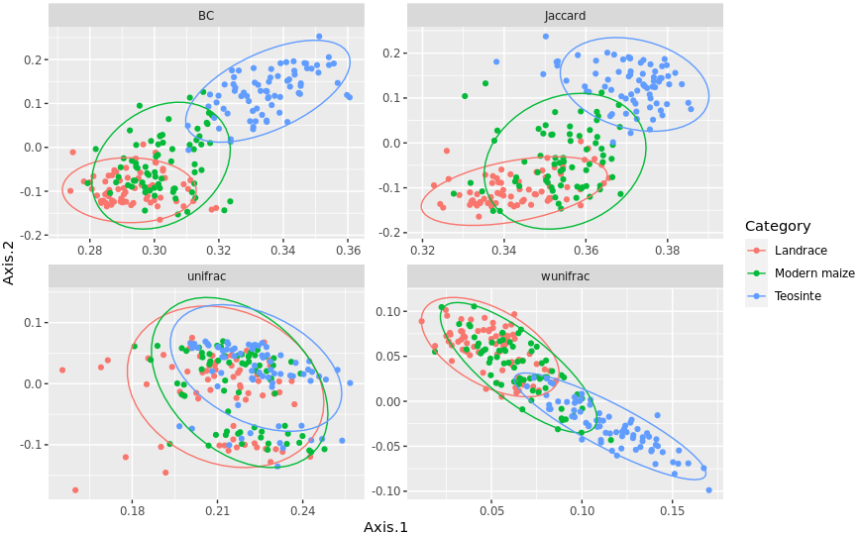
S1

Slide 6
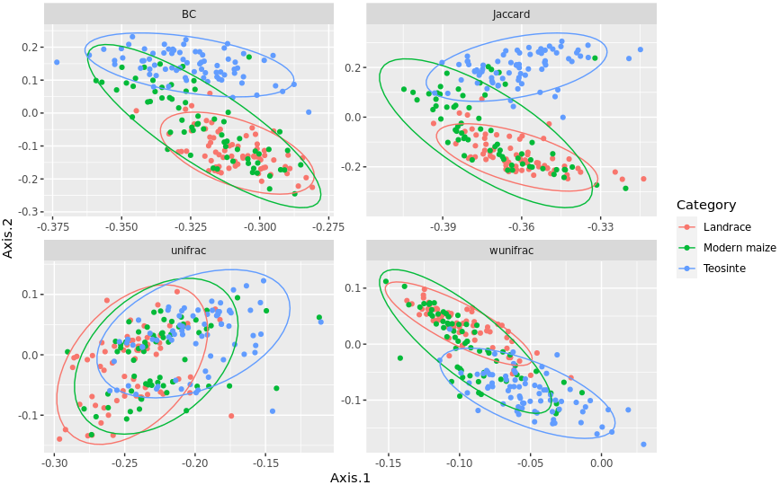
S9

Slide 7
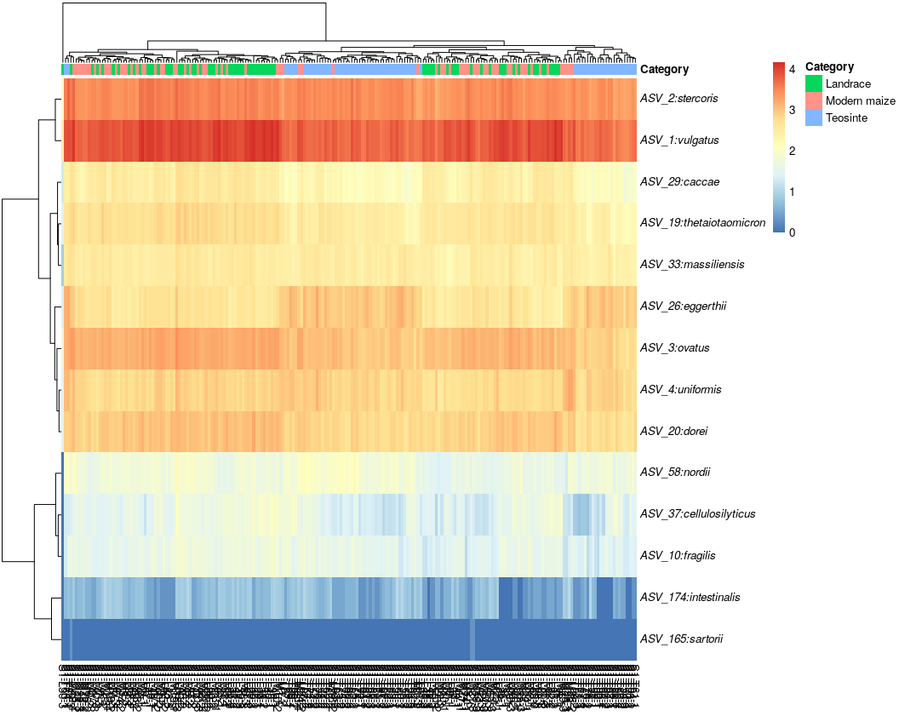
Subject 1 Bacteroidaceae_Bacteroides species in log10 abundance
B.vulgatus is less abundant in teosinte, while B.eggerthii and B.uniformis are more abundant in teosinte.

Slide 8
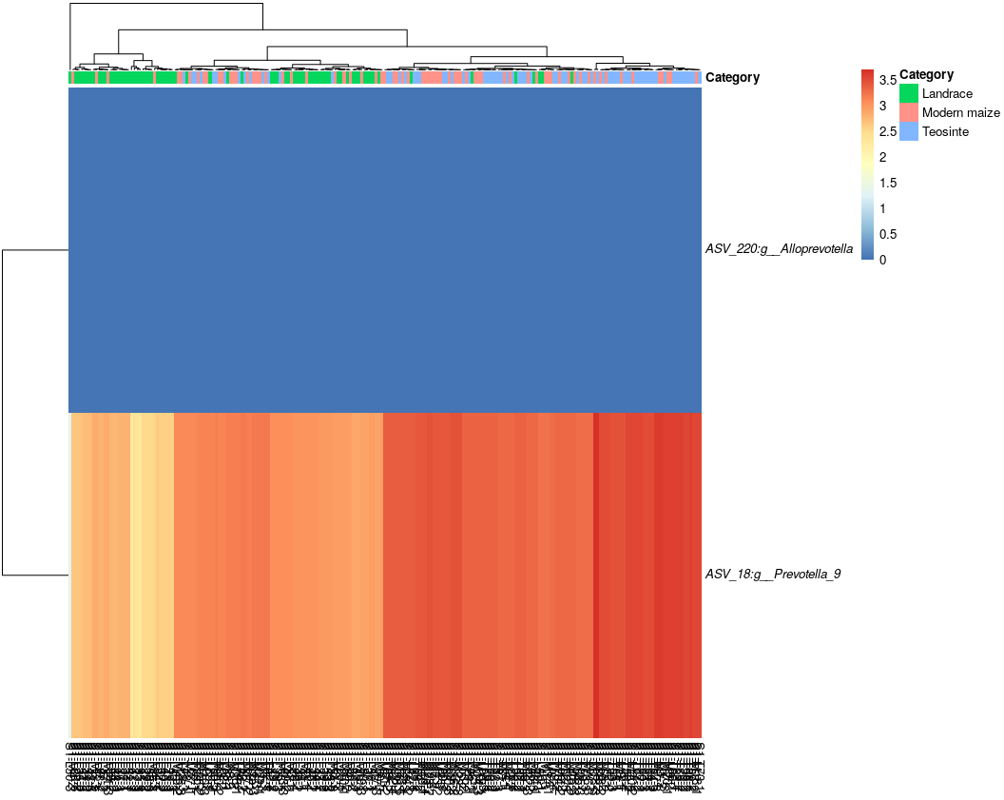
Subject 1 Prevotellaceae genus in log10 abundance
Prevotella has higher relative abundance in teosinte compared to landrance.

Slide 9
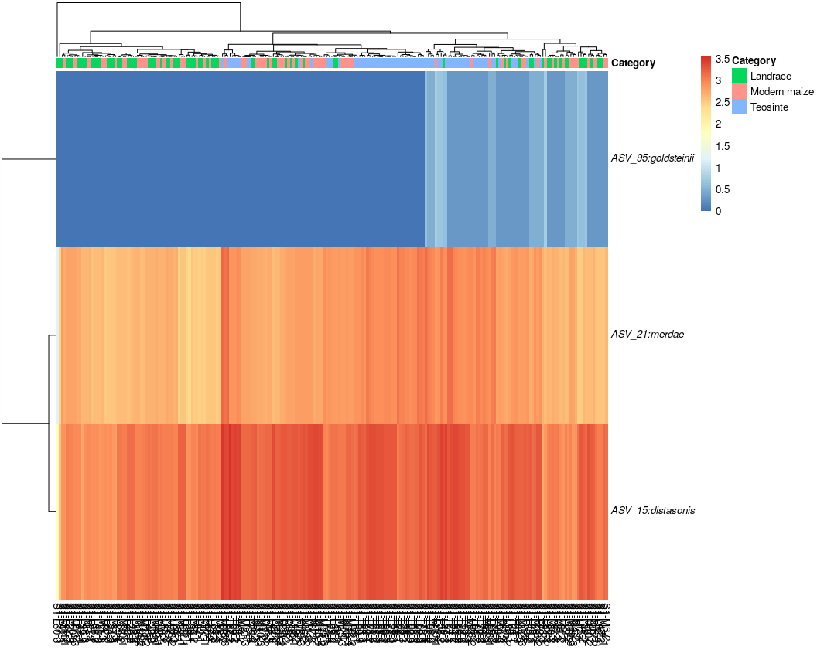
Subject 1 Tannerellaceae genus in log10 abundance

Slide 10
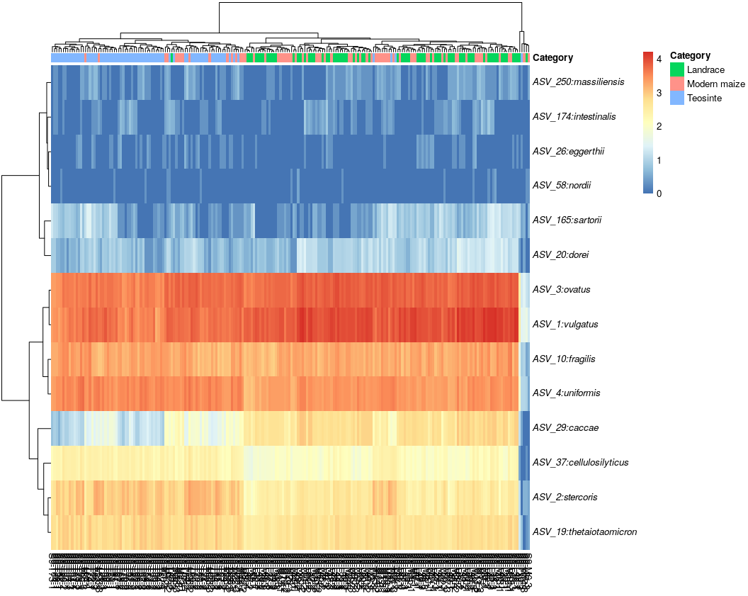
Subject 9 Bacteroidaceae_Bacteroides species in log10 abundance
B. caccae is less abundant in teosinte, while B. stercoris and B.thetaiotaomicron are more abundant in teosinte.

Slide 11
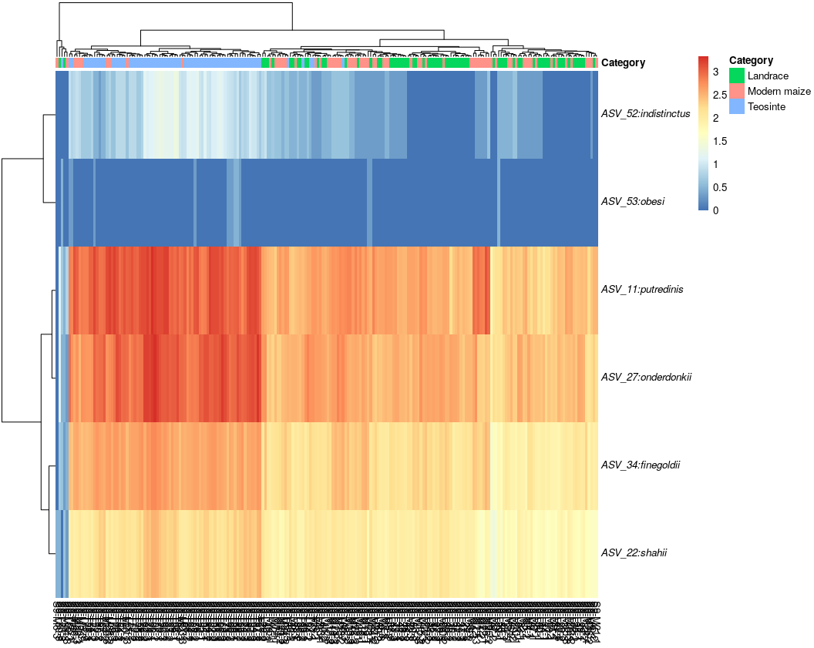
Subject 9 Rikenellaceae genus in log10 abundance
R. Putredinis, R. onderdonkii, R. finegoldii, R. shahii are more abundant in teosinte treatment compared to modern maize and landrace

Slide 12
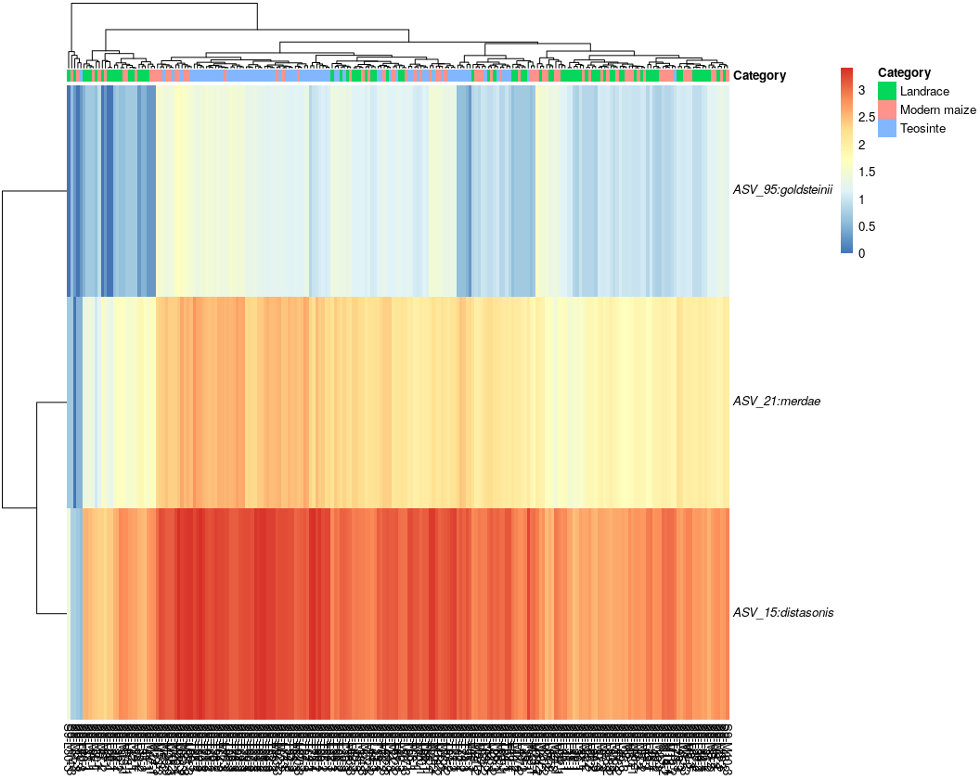
Subject 9 Tannerellaceae genus in log10 abundance
T. merdae, T.distasonis are more abundant in teosinte treatment compared to landrace and modern maize.

Slide 13
Conclusions
Modern maize and landrace have more similar effects on gut microbiome compared to teosinte.
Both B.vulgatus and B. uniforms indicates the digestion of polysaccharides, but show different trends. While B. eggerthii is under researched. I also cannot explain why B.caccae is significantly decreased in teosinte

Slide 14

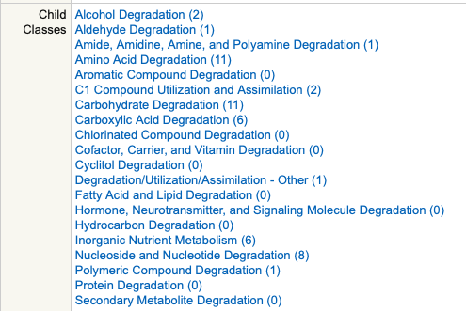
Tools Used:
Bacteroides stercoris is enriched in amono acid degradation genes and carbohydrate degradation genes
Source: https://www.biocyc.org/GCF_000154525/new-image?object=Degradation

Slide 15
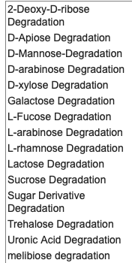
caccae
stercoris

Slide 16
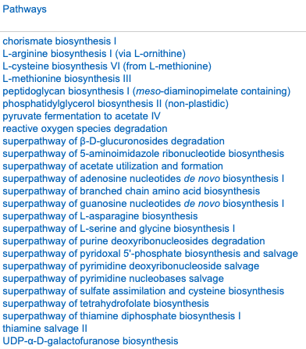
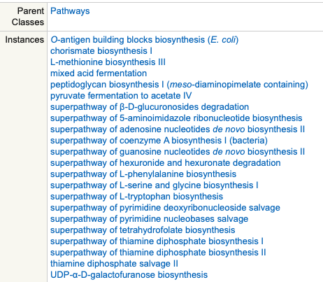
Bacteroides stercoris ATCC 43183
Bacteroides caccae ATCC 43185

Slide 17
Problem Met
I expect B.caccae has less protein and carbonhydrate metaboliz genes compared to B. stercori and B. eggerthii. However, it is not what I saw.
Next step: Dig into hemicellose degradation

