Slide 1
MOVIE DATABASE COLLECTION
By Baudelio Perez and Juan Rosales
CSE 111 – 06L

Slide 2
PROJECT DESCRIPTION
The main purpose behind the project is the development of a movie-related database capable of performing these functions:
Store a massive repository of existing films with basic information (i.e., title, genre, year released, actors, etc.)
Ability to add new films that were previously considered “lost” to the repository
Purchase or rent films and have a list that keeps track of all transactions
Give your own personal score (i.e., 3/5 stars) for any film and integrate your results with the scores set by rating score databases like Rotten Tomatoes or IMBD.
Keep a list of movies you have either watched or owned.

Slide 3
REQUIRED PROGRAMS
Some of the programs that will be required for the project are:
SQLite
JSON
Potentially Use
HTML
CSS
JavaScript

Slide 4
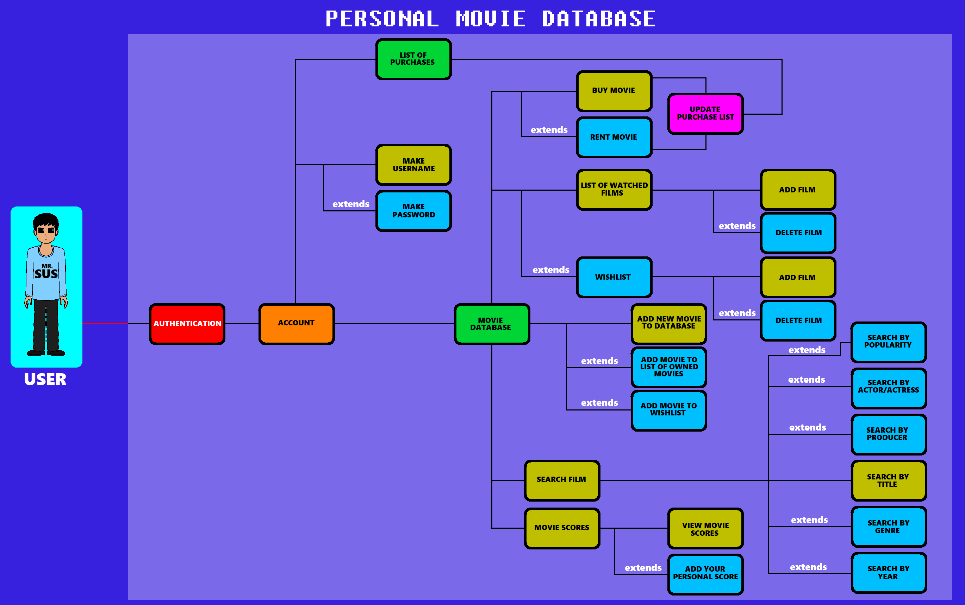
UML USE-CASE DIAGRAM

Slide 5
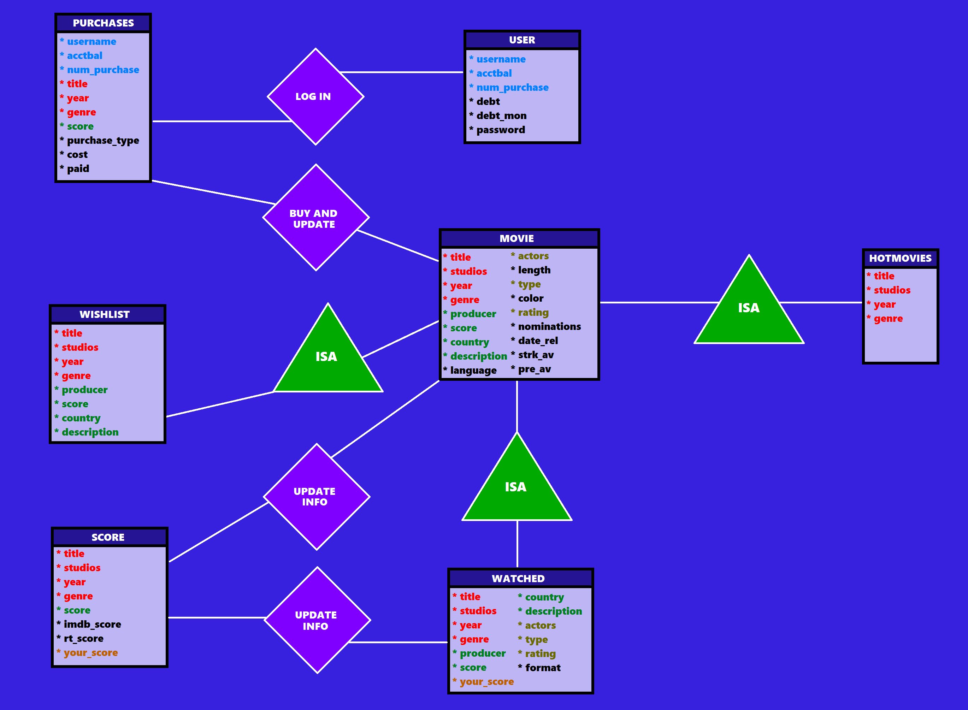
E/R DIAGRAM AND SCHEMA

Slide 6
DEFINITIONS
User – essentially the account of the user for authentication purposes
Movies – the massive repository containing information of the many films that have been brought out into existence. You can add new or rediscovered films to the database as well.
Purchases – interface area to buy/rent films as well as keep track of your transactions
Wishlist – personalized list of films you haven’t seen but wish to see.
Score – repository containing film titles and the scores they have received through score reception databases like Rotten Tomatoes or IMBD
Watched – personalized list of films you have already watched and/or own.
Hotlist – sub list of Movies repository containing only the movies that are trending.

Slide 7
ANY QUESTIONS…??
For Mr. SuS…???

