Slide 1
MOVIE DATABASE COLLECTION
By Baudelio Perez
CSE 111 – 06L

Slide 2
SYSTEM DESCRIPTION
This application is known simply as the “Movie Database Collection”, but it can also be referred to as the “S.U.S Movie Database Collection.”
Users can log into this online application to purchase any film that is stored within the database. However, this database isn’t just set solely for film purchasing. It includes the other following features:
Create user account and operate within specific account only
Manage purchases and view list of purchases
Create, edit, and update lists of films that help with following:
To keep track of which films you have seen registered in the database.
To keep track of which films you wish to watch or own, but have not yet seen
Explore list of all actors and their basic information.
Give films your own personal rating and integrate it within the database.
Add films that were once deemed lost in a previous point in time.
Add any film to database that was not previously present.

Slide 3
IMPLEMENTATION
The only program used for this project was Visual Studio Code. Languages that were utilized during development were SQLite, Java, and the Java JDBC system which allows connectivity between SQLite and Java.
The entire database was developed from scratch with every table being filled in manually combined with the task of perusing information details about specific films included in the database. However, the choice of attributes for each table in the database has taken inspiration from other tables that I have explored on websites such as Kaggle.
In the Java file, I programmed most functions to have connections with only one specific table of the database (i.e., Scores function in Java is only tied to the Scores table from the SQLite database used). Although two or three of these functions have connection with at least one other table from the database only for purposes of updating information across multiple tables. This is due to specific tuples having the exact same set of information across more than one table.

Slide 4
USER-CASE DIAGRAM INTERACTIONS
The most important interactions between the interface and the user would be:
User being able to purchase movies from database.
Modifying and updating information pertinent to their account:
Information present in their list of purchases.
Information present in films that have already been watched
Information present in films that have been set on a “Wish List”
Aggregating lost or new films to the database. Though it is highly preferred that films be added that they be films that were considered “lost” at some point in time.

Slide 5
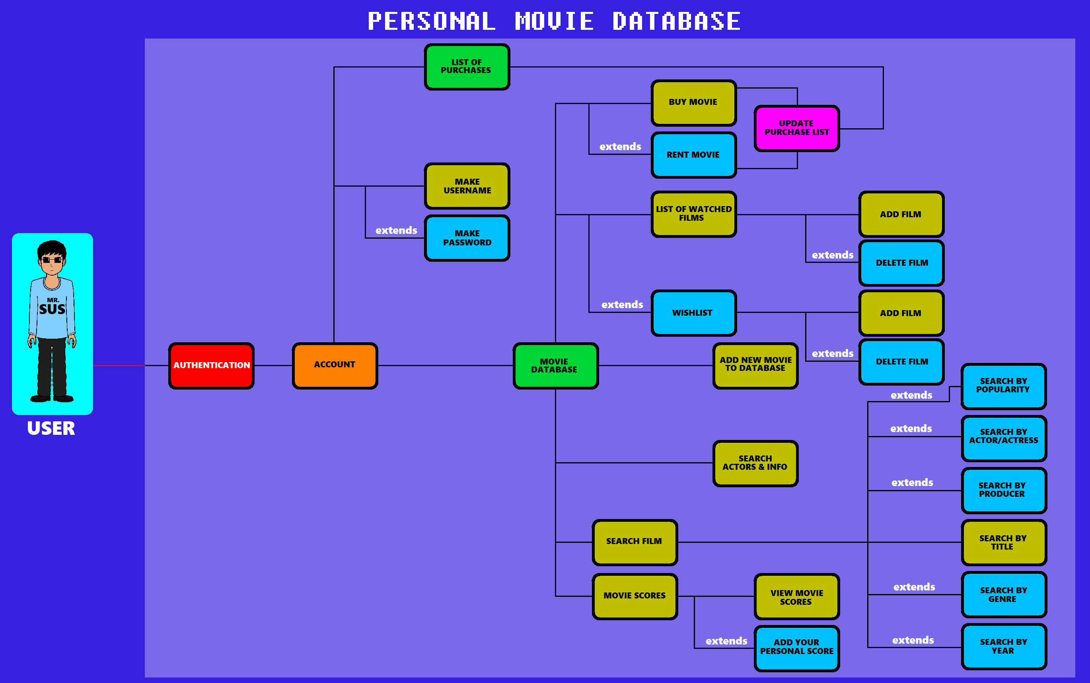
UML USE-CASE DIAGRAM
The “buy/rent” option has been reduced to just “buy” or “purchase” for a film.

Slide 6
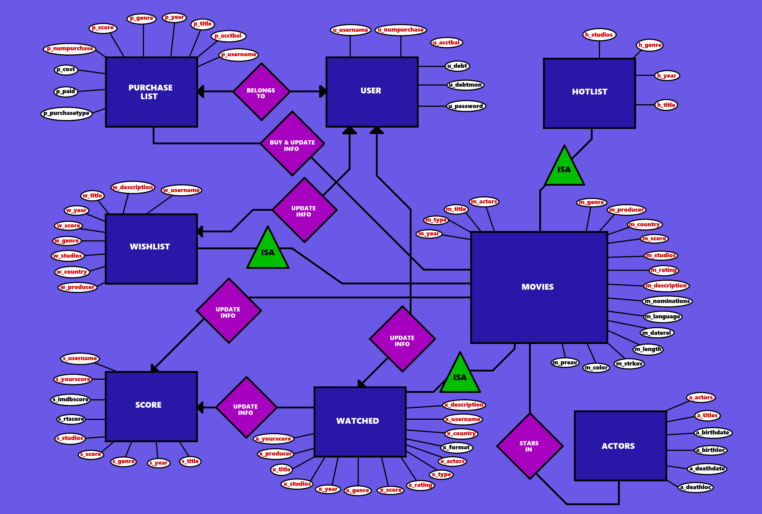
E/R DIAGRAM
NOTE:
x_country has been eliminated from “WATCHED” table. Deemed unnecessarily included…

Slide 7
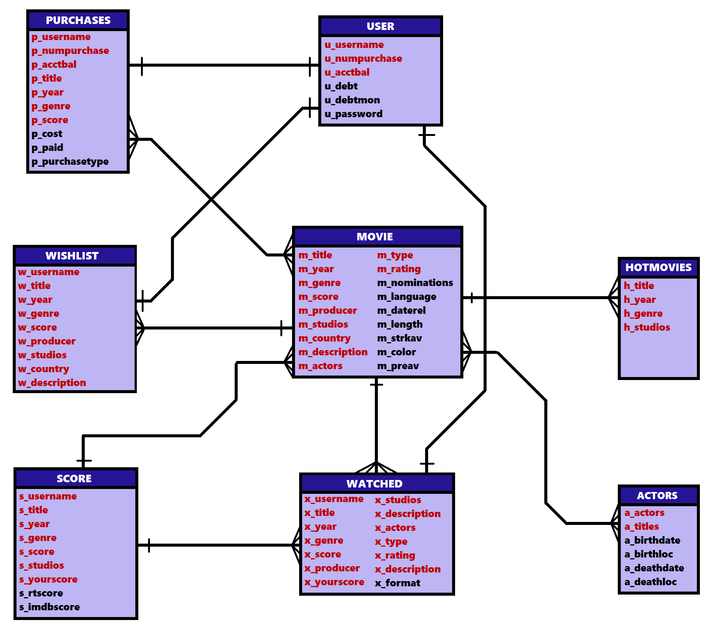

RELATIONAL SCHEMA
x_description is
the same variable…

Slide 8
RELATIONAL SCHEMA (Continued)
USER
u_username, u_numpurchase, u_acctbal, u_debt, u_debtmon, u_password
PURCHASES
p_username, p_numpurchase, p_acctbal, p_title, p_year, p_genre, p_score, p_cost, p_paid, p_purchasetype
MOVIE
m_title, m_year, m_genre, m_score, m_producer, m_studios, m_country, m_description, m_actors, m_type, m_rating, m_nominations, m_language, m_daterel, m_length, m_strkav, m_color, m_prevav
WISHLIST
w_username, w_title, w_year, w_genre, w_score, w_producer, w_studios, w_country, w_description
WATCHED
x_username, x_title, x_year, x_genre, x_score, x_producer, x_yourscore, x_studios, x_actors, x_type, x_rating, x_description, x_format
SCORE
s_username, s_title, s_year, s_genre, s_score, s_studios, s_yourscore, s_rtscore, s_imdbscore
HOTMOVIES
h_title, h_year, h_genre, h_studios
ACTORS
a_actors, a_titles, a_birthdate, a_birthloc, a_death, a_deathloc

Slide 9
DEFINITIONS
User – essentially the account of the user for authentication purposes.
Movies – the massive repository containing information of the many films that have been brought out into existence. You can add new or rediscovered films to the database as well.
Purchases – option to view purchases that have been made on your account. Also includes feature to purchase a film.
Wishlist – personalized list of films you haven’t seen but wish to see.
Score – repository containing film titles and the scores they have received through score reception databases like Rotten Tomatoes or IMBD. You can also add your own personalized score.
Watched – personalized list of films you have already watched and/or own.
Hotlist – sub list of Movies repository containing only the movies that are trending.
Actors – list of actors who participated in movies listed in the database and includes small facts about their life (i.e., birth and death).

Slide 10
ANY QUESTIONS…??
For Mr. SuS…???

