Slide 1
Blob Detection
Brandon Perez - Devon White - Yiyi Zhang

Slide 2
Outline
Problem Statement
Motivation
Algorithm Implemented
Findings
Limitations and Weaknesses

Slide 3
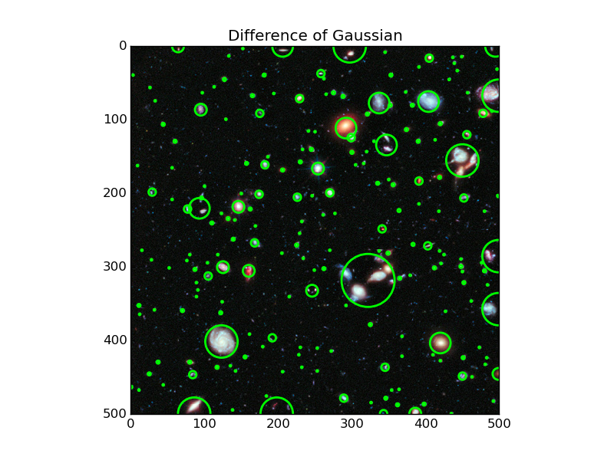
Problem Statement
Goal of project: Multi-scale blob detector
The blob detector finds bright, circular regions in an image.

Slide 4
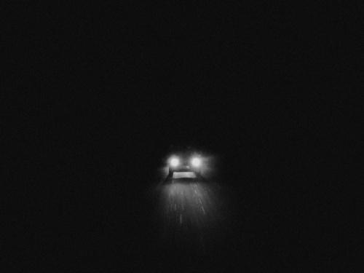
Motivation
Has a variety of applications, but we are specifically interested in detecting the headlights of a car
Headlight detections can be used with SMART headlights, to prevent headlights from shining in the opposing driver’s face (AKA “anti-glare”)

Slide 5
Implementation Overview
HLS - C++
Use wide variety of C++ features
Use pragmas to optimize speed and size for Zedboard
Heavily weighted towards inlining for functions, pipelining for pixel-level parallelism, and array partitioning for meeting initialization intervals.

Slide 6
Communication
FPGA-Processor communication done exclusively through AXI DMA IP.
Converts a memory region to a stream and vice-versa with caches and burst-mode transfers.
Skips central interconnect, and goes straight to DRAM.
Image streamed from DRAM into our design one pixel at a time through the AXIS protocol.
AXIS - Advanced eXtensible Interface Streaming (mode)

Slide 7
Blob Detection Overview
Image
Black and White
LoG
(Blob Detect)
Bounding Boxes
Downscale Level 1
Black and White
LoG
(Blob Detect)
Bounding Boxes
Merge Streams
Downscale Level 2
Black and White
LoG
(Blob Detect)
Bounding Boxes
Downscale Level (N-1)
Black and White
LoG
(Blob Detect)
Bounding Boxes
Pixel Level Pipeline

Slide 8
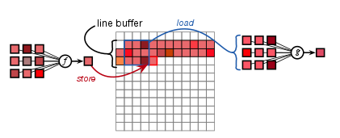
Window Operation
C++ Template for use with a general window function
Implements row buffer and “calls” generic window function.
Serial in, 1 pixel, delayed serial
Ideal: 1 pixel/cycle after initialization interval.
May be lower depending on the latency of the window function.

Slide 9
Downsampling
Streams in the grayscale pixels input from Grayscale kernel.
Streams out the grayscales pixels to more subsequent downsampling kernels or monochrome kernels
HLS kernel that implements window blocks(not sliding window) that downscale the pixels by applying a box (averaging) filter to the blocks.

Slide 10
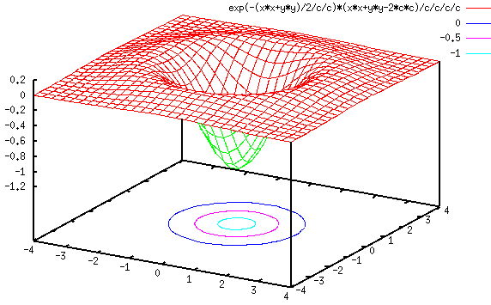

LoG Implementation
Use the window template
“Multiply” the window itemwise by the filter and sum them.
Check if the sum is greater than an empirically determined threshold.
5x5 kernel used, with 𝞂 = 1.
Kernel is negated so it detects bright blobs on black backgrounds.

Slide 11
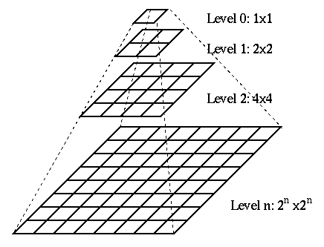
Multiscale
Pipelines (grayscale, monochrome, LoG, and downsampling) are combined to form the multiscale implementation.
5 scale levels used, with a scaling factor of 2 (4 times smaller).
All pipeline stages use AXIS protocol internally to handle back-pressure.
Review of the pipeline: Slide 5: Blob Detection Overview

Slide 12
Optimizations
Arbitrary precision (ap) types were used to specify exact bit widths, cutting down on BRAM usage.
Fixed-point used over floating point for efficiency and saving bits.
Design was able to be clocked at 200 MHz, twice the normal.
Image split into 4 horizontal sections, and processed in parallel among 4 independent multi-scale blob detection pipelines, to increase throughput.
Multiscale Blob Detector
Image
Multiscale Blob Detector

Slide 13
Application Implementation
Application was used for benchmarking the power and performance of the accelerator, and provide some verification.
Used a list of files on directory.
Ran multiscale blob detection on each image, then overlaid the detections and saved it to file.
Benchmarking the average time to process each image.

Slide 14
Reference Implementation
A reference multiscale blob detector was written in MATLAB.
Application written with as many MATLAB intrinsics as possible, relies only on scripting language for basic control flow.
Reference implementation was used to find and tune parameters for algorithms (e.g. downscale factor, sigma value for LoG, etc.)

Slide 15
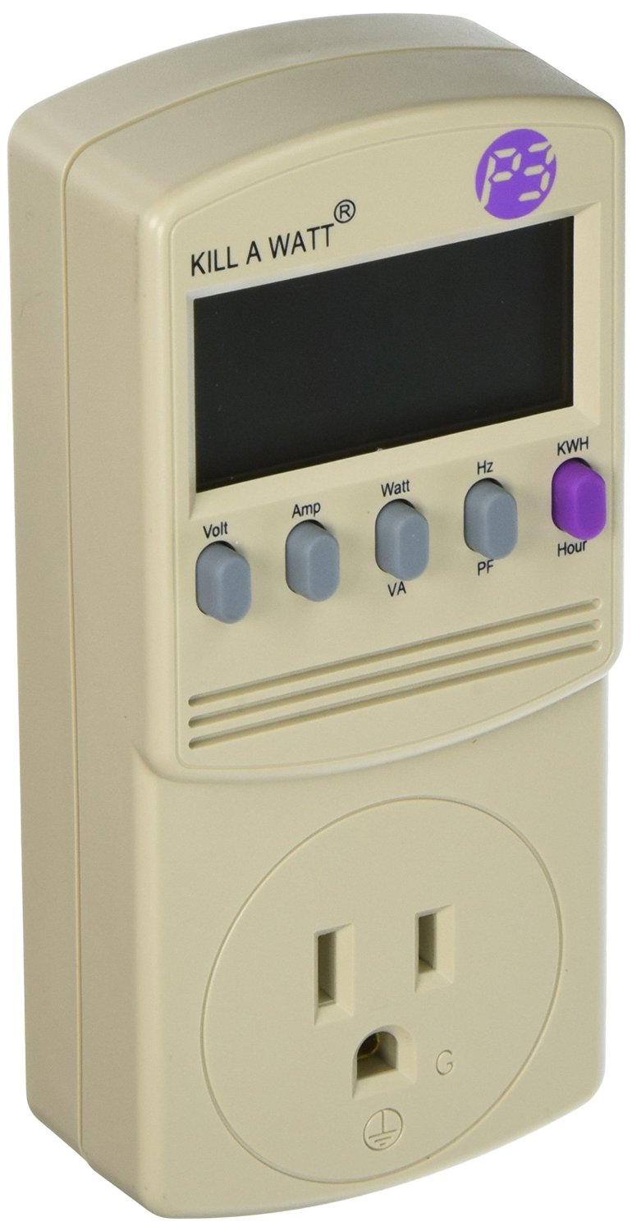
Results Setup
Reference implementation run on Intel Skylake i7-6700HQ processor:
Clocked at 2.60 GHz
34.1 GB/s memory bandwidth, 6 MB L3 cache
4 cores, 8 threads
Acceleration implementation run on Xilinx Zedboard:
Clocked at 200 MHz
1.56 GB/s memory bandwidth (based on AXI DMA IP specifications)
Execution is measured from after the image is loaded into memory to when the blob detection bounding boxes enter DRAM.
Power was measured using an electricity load meter (Kil A Watt).

Slide 16
Major Finding
FPGA implementation provides better performance per Watt than the CPU.
Provides sufficient performance at larger image sizes, and comparable or better performance at smaller image sizes.
FPGA is ultimately compute-bound, as only 4 instances of the blob detection pipeline can fit on the (due to limit on LUTs).

Slide 17
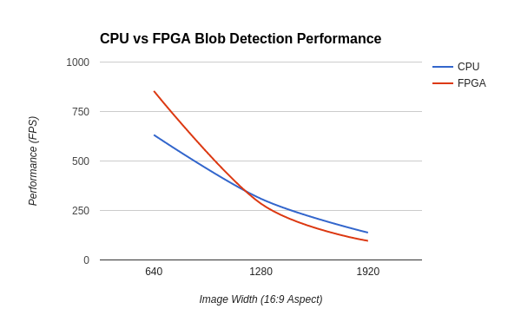
Result: Performance
 | Performance (FPS)
Image Size | CPU | FPGA
640x360 | 632.01 | 853.83
1280x720 | 309.26 | 284.61
1920x1080 | 138.21 | 96.45

Slide 18
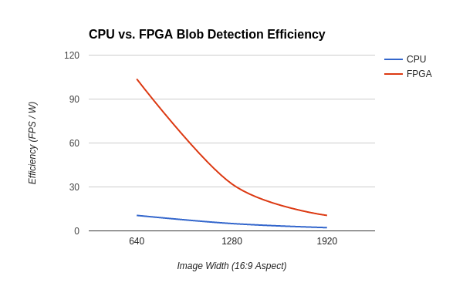
Result: Efficiency
 | Power (W) |  | Efficiency (FPS/W)
Image Size | CPU | FPGA | CPU | FPGA
640x360 | 59.8 | 8.23 | 10.57 | 103.75
1280x720 | 61.83 | 8.88 | 5.00 | 32.05
1920x1080 | 62.72 | 9.14 | 2.20 | 10.55

Slide 19
Result: Accuracy
Accuracy was more difficult to measure as it was tricky to find good headlight image data online.
Both algorithms closely mirror each other, so inaccuracies are minor at worst.
Only difference comes from floating-point versus fixed-point, but the algorithm doesn’t require that much precision, so this has little effect.
Accuracy of both algorithms matched.

Slide 20
Limitations, Weaknesses, Improvements
The FPGA has a hard memory wall around 1.5 GB/s. If a higher framerate was required, this could become an issue.
Neither the reference nor FPGA implementation separate headlights from other light sources (e.g. reflections); this would require machine learning.
To overcome the memory bound, the image could be streamed in an encoded/compressed format (e.g. JPEG) and decoded on the FPGA.
Adding an machine-learning component would require computation of additional features, and a pre-trained model.

Slide 21
Questions?

