Slide 1
Blob Detection
Brandon Perez - Devon White - Yiyi Zhang

Slide 2
Outline
Problem Statement
Motivation
Algorithm Overview
Parallelization Challenge
Metric of Comparison
Implementation Plan

Slide 3
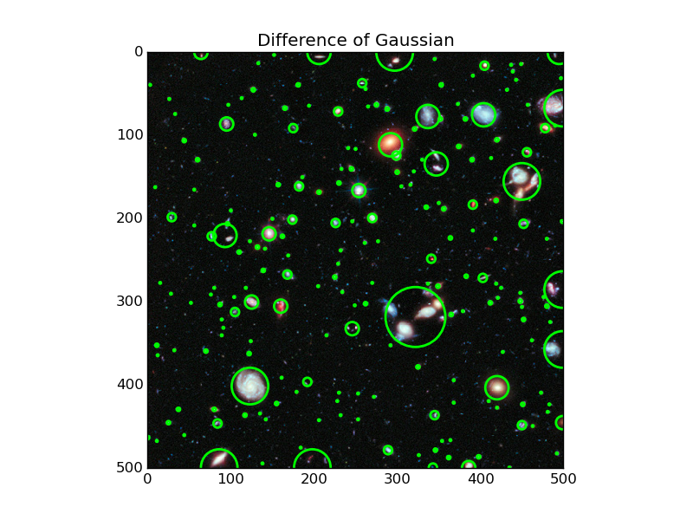
Problem Statement
Goal of project: Multi-scale blob detector
The blob detector finds bright, circular regions in an image

Slide 4
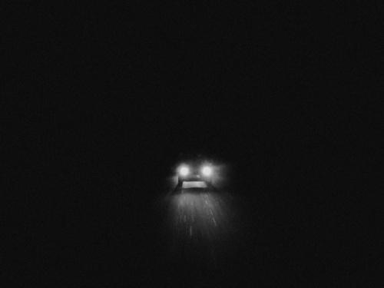
Motivation
Has a variety of applications, but we are specifically interested in detecting the headlights of a car
Headlight detections can be used with SMART headlights, to prevent headlights from shining in the opposing driver’s face (AKA “anti-glare”)

Slide 5
Blob Detection: Phase 1: Downsampling
Blob detection uses a Laplacian of Gaussian (LoG) filter to detect blobs.
The issue with this is that the filter is fixed size, so it will only detect fixed-size blobs, specifically blobs that are the same size as the kernel.
Naturally, we want blobs of all sizes to be detected.
To alleviate this issue, the image can be scaled down, through downsampling.
This scaled down images allow the same kernel to operate on larger sized windows in the image, allowing blobs of multiple sizes to be detected.
Downsampling is typically down through bilinear interpolation, which is linear interpolation in two dimensions.

Slide 6
Phase 2: Image Preprocessing
The next phase is to get the image into a format suitable for detecting blobs.
First the image is converted to a binary black and white image.
An empirically determined threshold on the intensity (grayscale) values of the pixels to convert the image.
A Gaussian filter is used to smooth the image, removing high-frequency noise from the image.

Slide 7
Phase 3: Blob Detection
The last phase is to actually detect the blobs at each scale of the image.
A Laplacian of Gaussian (LoG) filter is used to detect the centerpoint of blobs in the image.
Once we have the centerpoint of the blobs in the image, the next step is to perform image dilation.
Dilation expands the white regions of an image, so it will expand the centerpoints of the image back into blobs.

Slide 8
Blob Detection Overview
Image
Black and White
Gaussian
LoG (Blob Detect)
Dilation
Downsampling Scale 0
Black and White
Gaussian
LoG (Blob Detect)
Dilation
Downsampling Scale 1
Black and White
Gaussian
LoG (Blob Detect)
Dilation
Downsampling Scale 2
Black and White
Gaussian
LoG (Blob Detect)
Dilation
Downsampling Scale N
Black and White
Gaussian
LoG (Blob Detect)
Dilation

Slide 9
Parallelization Challenge
Blob detection is a data-parallel application, displaying very regular parallelism through the convolution operation.
However, the introduction of multiple scales introduces difficulties.
Each scaled down version of the image requires some form of intermediate storage, requiring more memory and reducing the overall AI.

Slide 10
Metric of Comparison
Many implementations exist in many different software languages.
It’s easy to find implementations in Python, C++, etc.
Compare the performance and performance per watt.
We will compare the these metrics on the same size image.
For the software implementation, the power and performance will be physically measured for the code.
Vivado will provide the power estimation for the design, and the time will be measured for execution.

Slide 11
Expected Perf of FPGA Blob Detector
Custom RTL will have less overhead than a general purpose processor, so implementing a blob detector on an FPGA can give us better performance
FPGA might not have as good performance as ASICs, but it’s too expensive to build custom blob detection ASICs, so an FPGA will be more economical.
A GPU will get better or comparable performance to an FPGA, but will do so at a significantly higher cost
FPGA is suitable to a pipelined implementation that gives high performance at comparatively lower power.

Slide 12
Implementation Plan
We plan on implementing all of the core algorithms in HLS.
The first design we’re going to target is a streaming design, pipelining each stage of the blob detection, and running the n scale pipelines in parallel.
This is essentially the design shown in the overview slide.
The images will be stored in DRAM and sent to the FPGA through DMA transfers.
A second design we will try is having multiple streams fetching in parallel

Slide 13
Weekly Milestones
Beginning implementation
Software version working, establish data set
Single stream implementation complete
Single stream comparison results, begin multi-stream
Multi-stream complete
Final results comparison

Slide 14
Risk Assessment
Synchronizing results at the end of each pipeline can be a tricky part
We have a pretty solid plan, so we shouldn’t have more issues

Slide 15
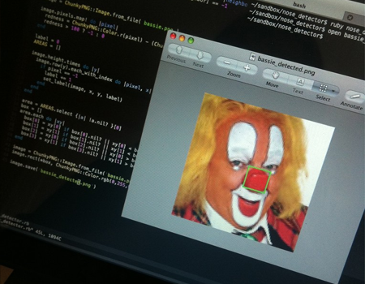
Q&A

