Slide 1
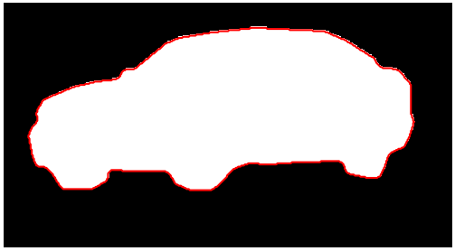
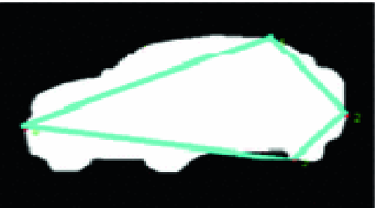
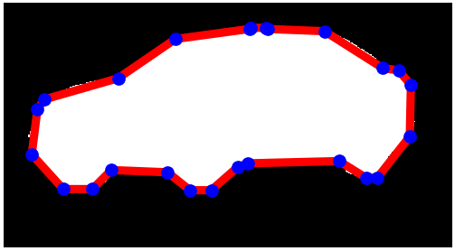

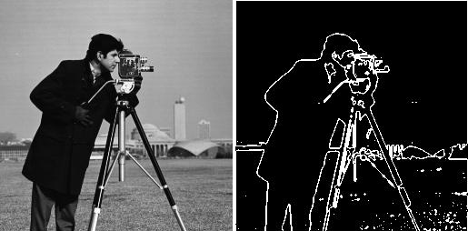
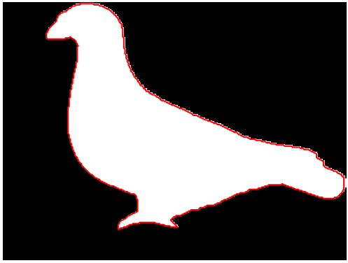
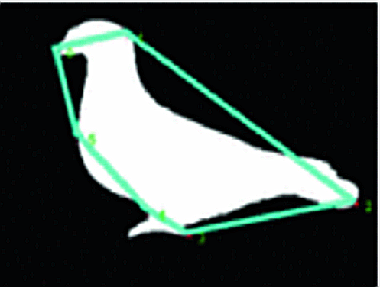
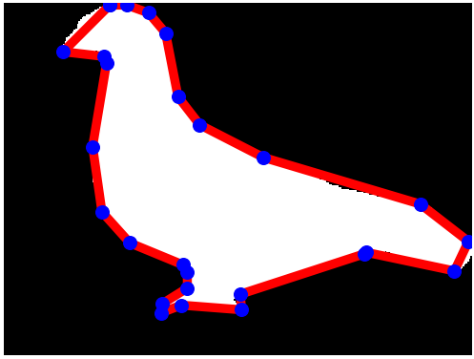
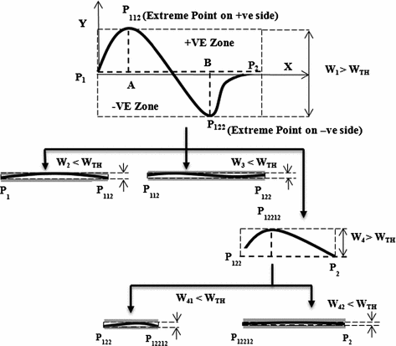
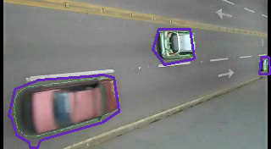
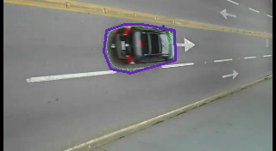
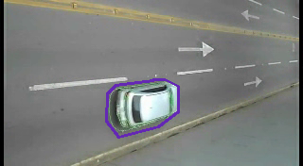
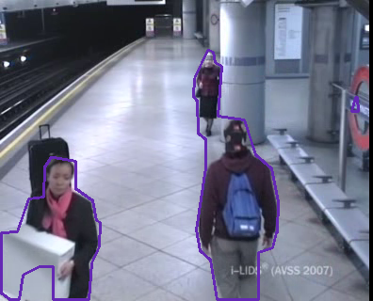
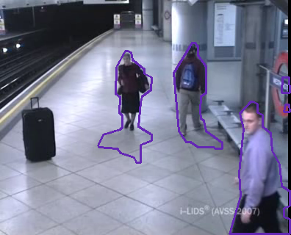
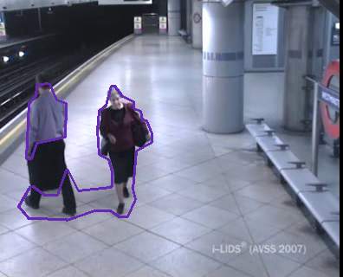
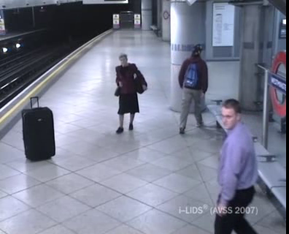
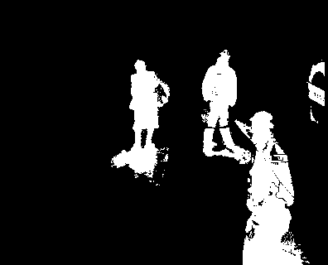
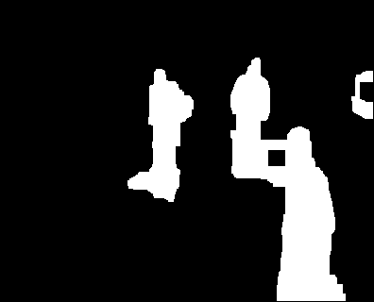
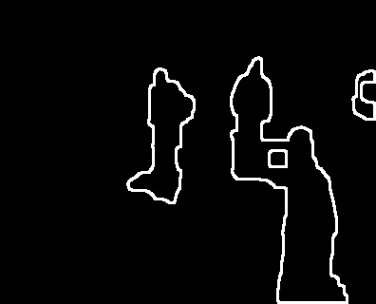
Thick Edge Polygon Approximation for Object Tracking
Brandon Perez Sohil Shah
bmperez@andrew.cmu.edu sohils@andrew.cmu.edu
Introduction
Results
The goal of this research is to simplify complex object contours into simpler polygons for use in object tracking using thick-edge polygon approximation. This is useful due to the lower computational cost and higher versatility of low-vertex polygons for tracking algorithms. It provides a good compromise between a complex contour and a simple rectangle.
Original Polygon
Ramer–Douglas–Peucker
Approximation
Thick Edge
Approximation
Figure 1: Instead of these complex contour representations, we would like a simple polygon to track.
Method
Figure 4: Comparison of polygon approximation methods. Left image is original, center is an older algorithm, and right is ours.
Figure 2: Algorithm Overview
Compute the line between the endpoints.
Partition points into those above and below the computed line.
Find the extremum of each point set.
Compute the thickness as the sum of the extrema’s distances from the line.
If the thickness is above the threshold, partition the points with the extrema, and repeat steps 1-5 on the partitions.
Otherwise, the two endpoints are dominant points, add them to the final list.
Figure 5: Example frames from two sequences: top is a car sequence, bottom is at a train station.
Discussion / Future Work / etc
The thick-edge polygon approximation performs much better than the Ramer-Douglas-Peucker approximation and keeps more information than just a bounding rectangle
Computational cost is low: entire preprocessing and approximation pipeline works in real time.
Next step is to integrate polygons into object tracking flow to improve tracking
Future work might examine different background subtraction algorithms for moving cameras: this work dealt only with fixed cameras
Figure 3: Pre-processing flow: first step is to perform background subtraction using a Gaussian Mixture model algorithm. Next step is to process the image to reduce noise via erosions and dilation. Finally we get closed edges using Canny edge detector and contour analysis. This complex contour polygon is then simplified via the thick edge polygon approximation.

