Slide 1
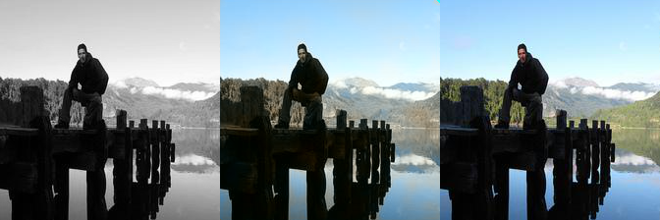
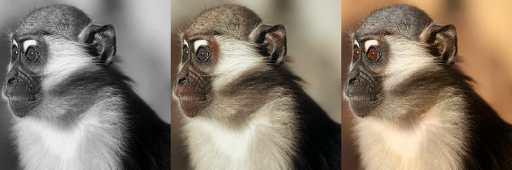
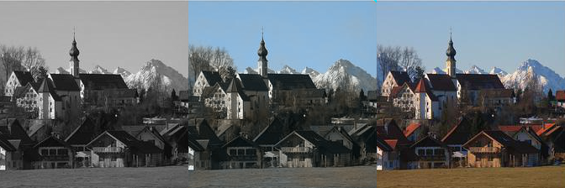
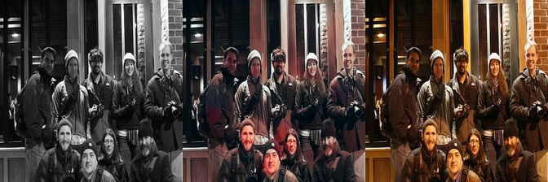
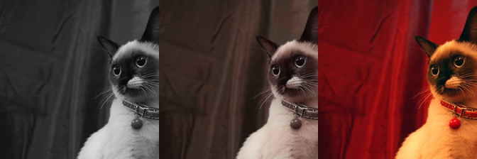
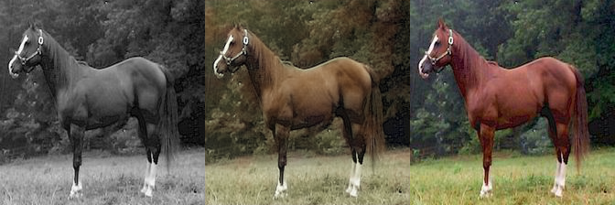
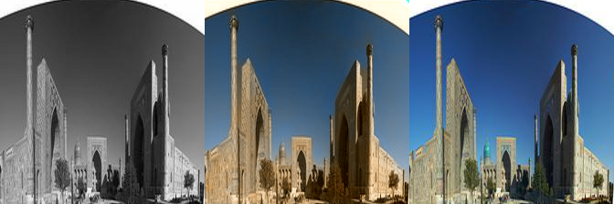

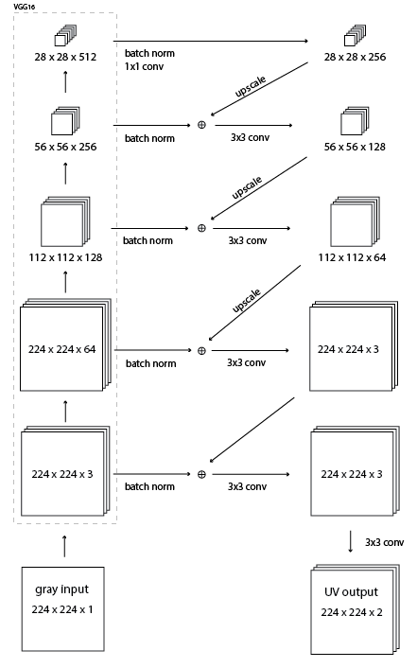
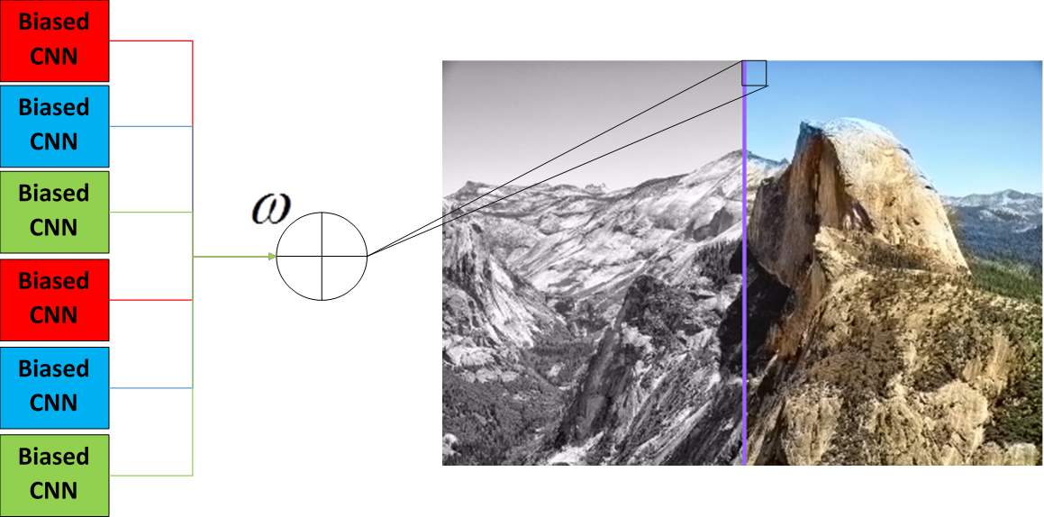
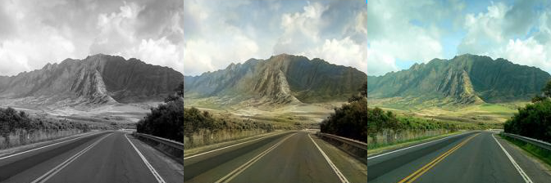
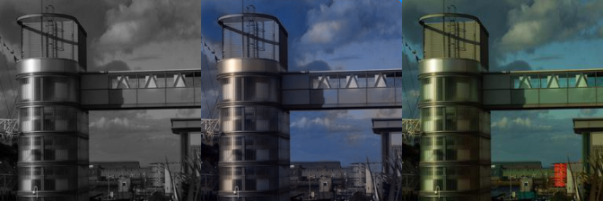
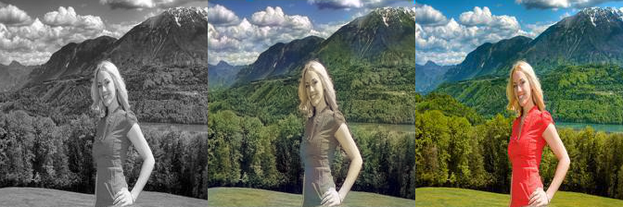
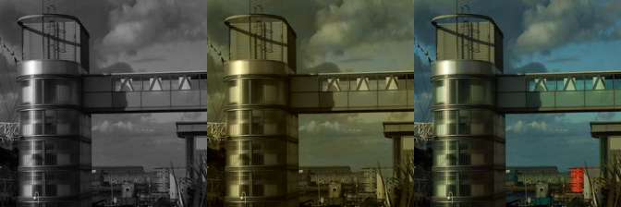
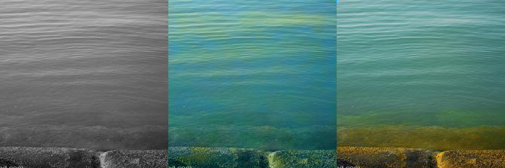
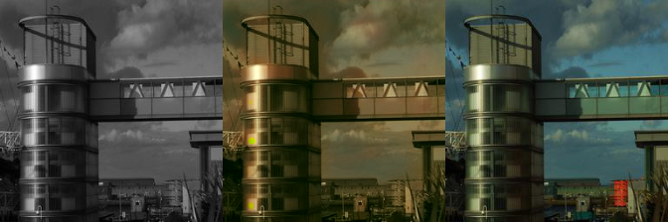
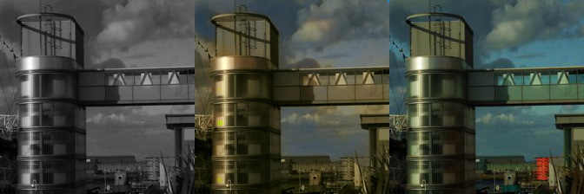
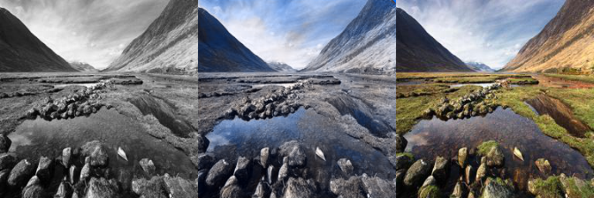
Image Colorization via Ensemble of Convolutional Neural Networks
Brandon Perez Sohil Shah Rohit Banerjee
bmperez@andrew.cmu.edu sohils@andrew.cmu.edu rohitban@andrew.cmu.edu
Introduction
Results
Convolutional Neural Network (CNNs) are commonly used to automatically generate plausible colored versions of grayscale image. However colorization CNNs tend to have their outputs biased towards desaturated colors such as light blues and beige that are relatively abundant in image backgrounds. As objects vary highly in color, these CNNs tend to average all colors into a sepia-like tone seen in examples from Colornet in Figure 1.
We propose a novel approach to the colorization problem by using an ensemble in which each CNN is trained on red, green, and blue biased partitions of the training set. We then perform a weighted recombination of these separate CNNs to boost color accuracy and visual appeal.
Grayscale Our Recolored Ground Truth
Grayscale Our Recolored Ground Truth
Grayscale Colornet Recolored Ground Truth
Grayscale Colornet Recolored Ground Truth
Figure 1: Images from colornet implementation. Notice the desaturated colors.
Figure 5: CNN Biased towards blue images: trained only on images that had strong blue components. Note that all the resulting images are strong in areas such as sky, water, and atmosphere effects, but are weak in houses, buildings, and human skin.
Figure 6: CNN Biased towards red images: trained only on images that had strong blue components. This CNN is strong in areas of humans and animals, clothes, faces, and common red objects with strong patterns such as brick.
Method
Grayscale Our Recolored Ground Truth
Figure 8:
From top to bottom: Biased towards blue, green, and red. Last is combined based on weighted saturation per pixel. Note that recombined version has best parts of all three images and does not lose saturation and get washed with sepia.
Figure 2: CNN ensemble architecture
Figure 3: Architecture of Individual CNN
Networks use 256x256 images as inputs and are trained on a subset of the ImageNet database, as well as a Flickr dataset.
There are around 250k images in total, split into red, green, and blue biased partitions
Training due to the size of the dataset was done on an NVIDIA 980Ti GPU with Tensorflow
Individual CNNs are modified instances of Colornet - an open source image colorization CNN based on VGG-16.
The ensemble consisted of 6 CNNs of which we had pairs trained on images with an abundance of red, blue and green dominant pixels
We combine the individual outputs of the CNNs on a per pixel basis where we augment the dominant color channel (RGB) and attenuate the rest (Figure 2).
Figure 7: CNN Biased towards green images: trained only on images that had strong blue components. This CNN is particularly good at landscapes and grass.
Future Work
Our method is designed for visual appeal, but more accurate should be able to generate images with low saturation as well as high saturation.
The recombination weights could be learned via another CNN or similar method
The CNN could be trained in another color space.
Combination weighting parameters could be adjusted for different kinds of appeal.
Due to time constraints, the network was only trained on 250k images over a few epochs. Greater performance is expected if trained over all of ImageNet and the Flickr dataset as well as over far more epochs. This training could take weeks on a single GPU system.
Figure 4: Weighting of the different CNNs occurs in the saturation domain. By doing this, we boost CNNs that are more confident about their result, as more confident CNNs generally output more highly saturated colors. This lets us preserve information from less important CNNs while boosting more important ones. The colorized image on the right shows saturated areas the CNN is confident with and desaturated areas where it is not.

