Slide 1
ANALYSIS OF RACIAL, SOCIOECONOMIC, & OTHER FACTORS IN BREAST CANCER INCIDENCE RATES
Bailey Perry
Advisor: Gary Oehlert

Slide 2
DATA COLLECTION
IL Department of Health (IDH) – incidence & zip codes (2010-14)
Manual via Google – mileage
US Census Bureau (USCB)
American Community Survey (ACS) Demographic & Housing Estimates (2012-16) – racial predictors & age
ACS Economic Characteristics – income, insurance, etc
Total: 218 zip codes

Slide 3
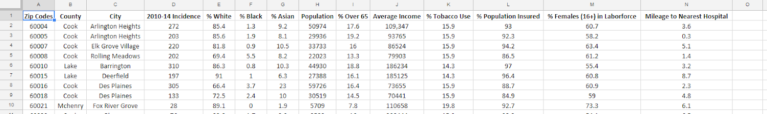
DATA
Notes:
Talk motivation for studying it here, but also then go in to data and how you compiled everything… show excel screenshot.

Slide 4
METHODS
Fit desired regression on all main effects & interactions
Use backwards elimination (using AIC) with k=4
Fit new regression with only the significant regressors above
Diagnostics
Consider outlier testing or transformations
Remove outliers & refit
Diagnostics
Interpretation
Notes:
Testing with k=4 is like testing with a critical value of 0.05 and increases selectivity of terms for the model.

Slide 5
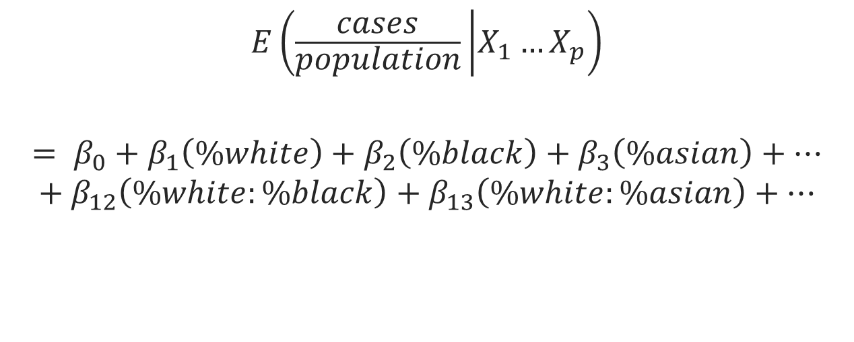
GENERIC MODELS: LINEAR RATE

Slide 6
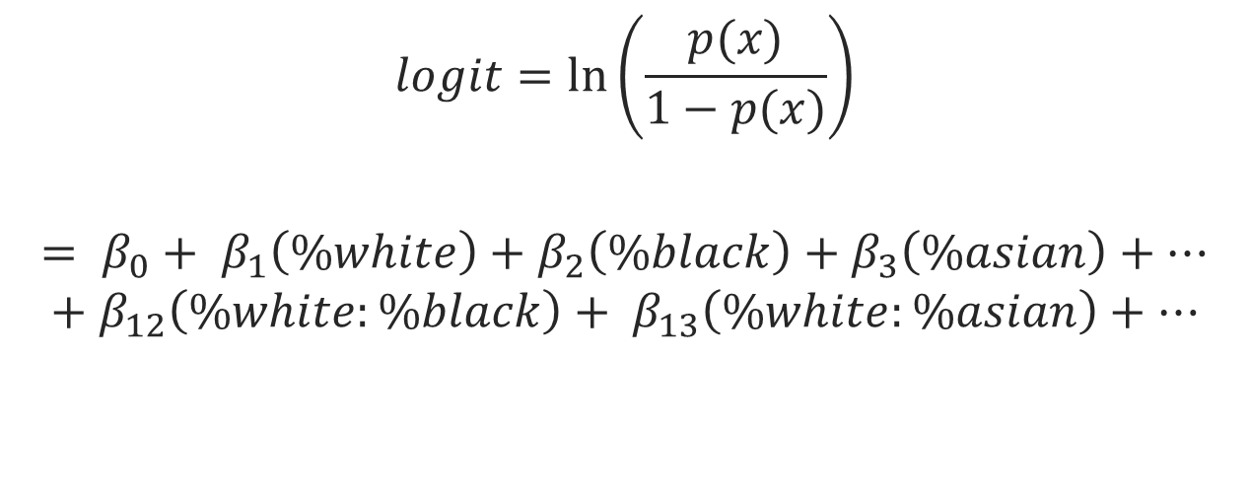
GENERIC MODELS; QUASIBINOMIAL

Slide 7
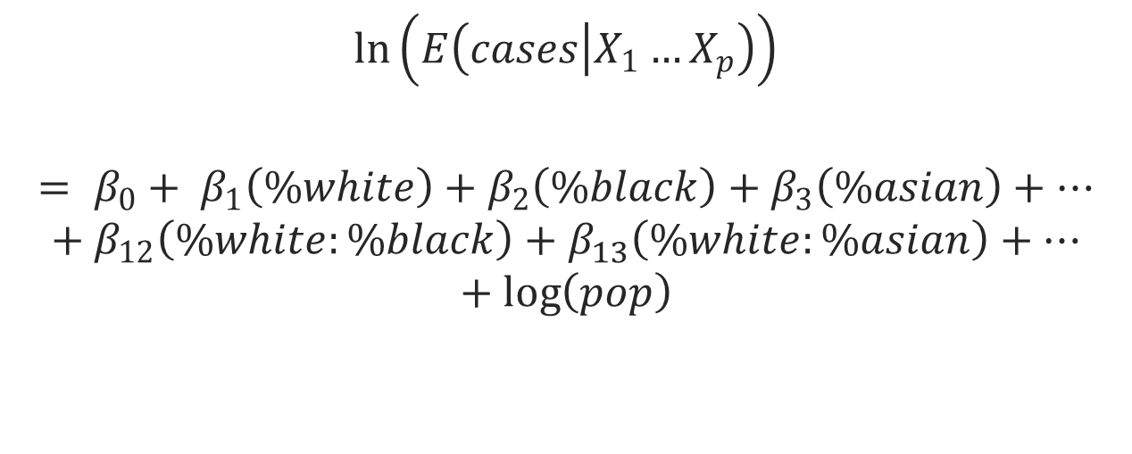
GENERIC MODELS: QUASIPOISSON

Slide 8
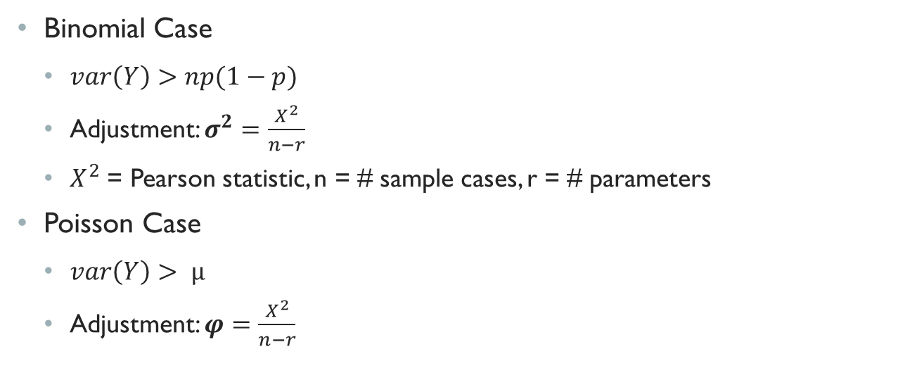
OVERDISPERSION
Notes:
This is done to address the excess variability that is not yet being explained; the reason why we use quasi models for binomial and poisson. Explain that the pearson statistic is the sum of (Obs – Exp)^2/Exp for all of the outcomes i=1 to n

Slide 9
RESULTS: LINEAR RATE
 | Estimate | Standard Error | Significant?
Intercept | -0.0026 | 0.00016 | .
Black | 0.000015 | 0.000003 | ***
Age | -0.000054 | 0.000084
Income | 0.000000014 | 0.000000003 | ***
Smoke | 0.00007 | 0.000028 | *
Insured | 0.000054 | 0.00002 | **
Work | -0.000051 | 0.00002 | *
Age:Work | 0.0000049 | 0.0000014 | ***
Significance codes : 0 ‘***”, 0.001 ‘**’, 0.01 ‘*’, 0.05 ‘.’, and 0.1 ‘ ’
Notes:
Black is the only racial predictor that was left from backwards elimination. Both percentage black and income have the highest levels of significance, along with the interaction term age:work. Speaking solely in terms of coefficient magnitude with no other shifts, % smokers is the largest magnitude predictor coefficient.

Slide 10
RESULTS: QUASIBINOMIAL
 | Estimate | Standard Error | Significant? |  |  | Estimate | Standard Error | Significant?
Intercept | -0.11 | 1 | *** |  | White:Asian | 0.0002 | 0.000096 | .
White | 0.018 | 0.007 | ** |  | White:Pop | -0.000000088 | 0.000000034 | **
Black | 0.019 | 0.007 | ** |  | White:Age | -0.014 | 0.00056 | *
Asian | 0.011 | 0.0086 |  |  | Black:Age | -0.014 | 0.0006 | *
Population | 0.000004 | 0.0000024 | . |  | Asian:Age | -0.017 | 0.0006 | **
Age | 0.1 | 0.059 | . |  | Age:Work | 0.0011 | 0.00027 | ***
Income | 0.000034 | 0.000012 | ** |  | Income:Insured | -0.00000034 | 0.00000012 | **
Smoke | 0.0094 | 0.0055 | .
Insured | 0.04 | 0.01 | ***
Work | -0.016 | 0.00046 | ***
Miles | 0.039 | 0.0014
Significance codes : 0 ‘***”, 0.001 ‘**’, 0.01 ‘*’, 0.05 ‘.’, and 0.1 ‘ ’
Overdispersion parameter = σ² = 4.59
Notes:
All terms except for percentage asian and miles to hospital are significant; of the three racial predictors, black has the largest magnitude without considering shifts or any other factors involved. Of all the terms, percentage over 65 has the largest overall magnitude, again not considering interactions or any shifts. 18 terms in this final model, with outliers removed. The terms with the highest level of significance include: % insured, % over 16 in workforce, and the interaction between %over65 and work. The overdispersion parameter is 4.59 which means we scale the standard errors by multiplying them by sqrt(4.59)=2.142 which inflates them by 114.2% to adjust for the extra variability.

Slide 11
RESULTS: QUASIPOISSON
 | Estimate | Standard Error | Significant? |  |  | Estimate | Standard Error | Significant?
Intercept | -0.1 | 1.009 | *** |  | Work | -0.016 | 0.0046 | ***
White | 0.019 | 0.066 | ** |  | White:Asian | 0.0002 | 0.000096 | *
Asian | 0.011 | 0.0086 |  |  | White:Pop | -0.000000092 | 0.000000034 | **
Pop | 0.0000046 | 0.0000024 | . |  | White:Age | -0.0014 | 0.00057 | *
Black | 0.02 | 0.0065 | ** |  | Black:Age | -0.0014 | 0.0006 | *
Age | 0.11 | 0.06 | . |  | Asian:Age | -0.0017 | 0.00064 | **
Income | 0.000035 | 0.000012 | ** |  | Age:Work | 0.0011 | 0.00028 | ***
Insured | 0.038 | 0.0099 | *** |  | Income:Insured | -0.00000035 | 0.00000013 | **
Significance codes : 0 ‘***”, 0.001 ‘**’, 0.01 ‘*’, 0.05 ‘.’, and 0.1 ‘ ’
Overdispersion parameter = φ = 4.704
Notes:
All terms except for percentage asian are significant; of the three racial predictors, black has the largest magnitude without considering shifts or any other factors involved. Of all the terms, percentage over 65 has the largest overall magnitude, again not considering interactions or any shifts. 16 terms in this final model, with outliers removed. The terms with the highest level of significance include: % insured, % over 16 in workforce, and the interaction between %over65 and work. All of this held true in the quasibinomial model as well. The overdispersion parameter is 4.70 which means we scale the standard errors by multiplying them by sqrt(4.70)=2.168 which inflates them by 116.8% to adjust for the extra variability.

Slide 12
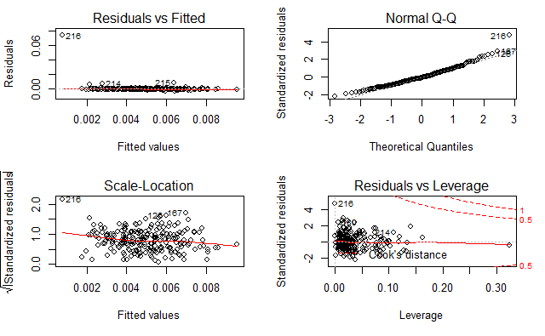
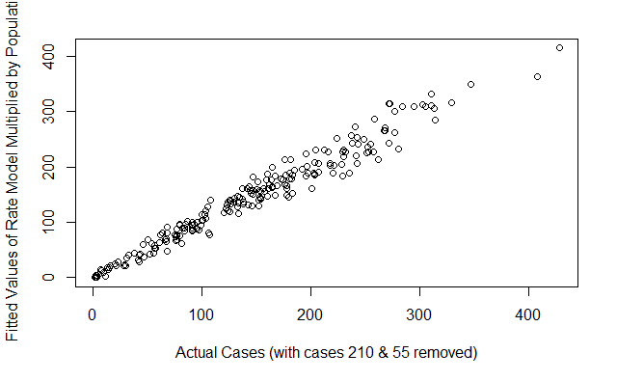
MODEL DIAGNOSTICS: LINEAR RATE
Notes:
Case 216 stand out, did arise as a new outlier, but stayed in due to the rest of the models not removing it. Wanted to keep removal standard across the three. Normality is an assumption for this, and it looks quite good with minimal deviations, we just see 216 highlighted again. This model has excellent actuals v fitted, will see it is best of all three models. Closest to a 45 degree angle with minor deviations.

Slide 13
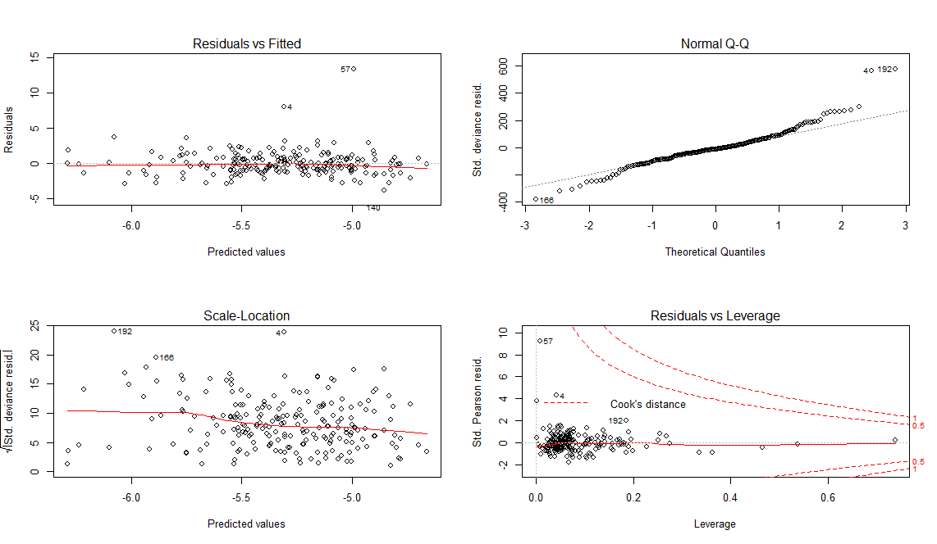
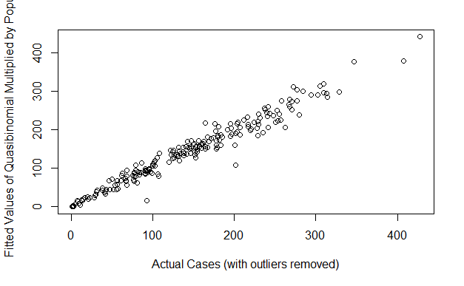
MODEL DIAGNOSTICS: QUASIBINOMIAL
Notes:
KEEP THIS BRIEF; no pattern in resid v fitted; we see some points showing in the tails of the normal qq but this is not an assumption for quasi, more of a check that with such a large N we see some normality. Actuals v fitted is very good 45 degree angle. The fitted values are multiplied by population since we looked at rate not just cases.

Slide 14
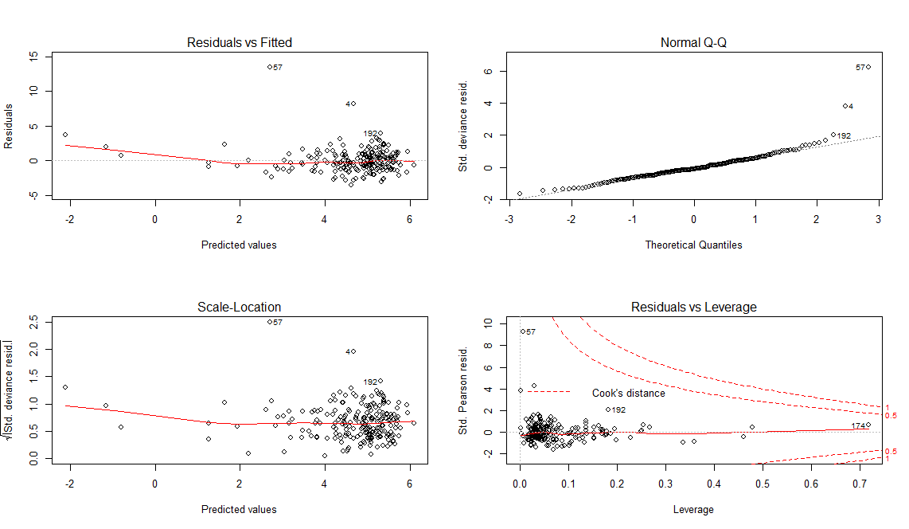
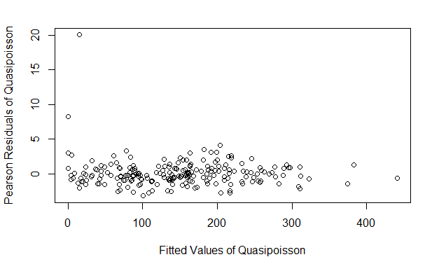
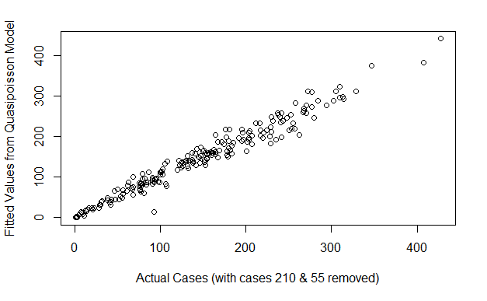
MODEL DIAGNOSTICS: QUASIPOISSON
Notes:
Resid v fitted clustered, not necessarily an issue. Pearson residuals standardize this by accounting for the variance function in the model. One stand out point near top, but overall no pattern, etc. Right tail deviation in quasipoisson but again not an assumption, just a check with large N.

Slide 15
RACIAL PERCENTAGE ADJUSTMENTS
 | White | Black | Asian | Other
Mean (%) | 70 | 12.4 | 8.4 | 9.2
White ↑ 1% | 71 | 11.99 | 8.12 | 8.89
Black ↑ 1% | 69.2 | 13.4 | 8.31 | 9.09
Asian ↑ 1% | 69.24 | 12.26 | 9.4 | 9.1
Notes:
This was done because the three racial categories did not add up to one, so there was a clear other category and the other three were not collinear. But we cannot just increase one percentage for interpreting the coefficients without seeing an effect on the other percentage points, so this table highlights those shifts. GO through example of first line shift of white and then removing portions based on that.

Slide 16
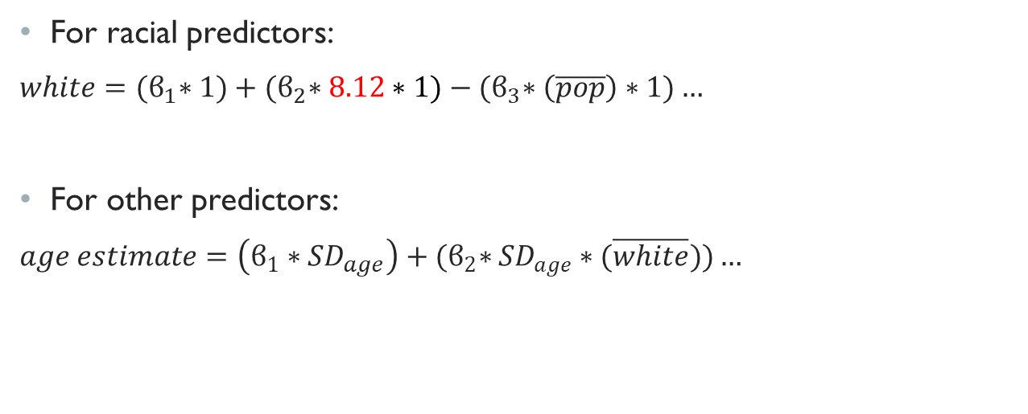
COEFFICIENT CALCULATIONS
Notes:
The coefficient tables are displayed on the next slide, but here is a precursor to how they were calculated. UNIT change for racial predictors, thought to make more sense than SD. Then an SD change for the other predictors. Just as a way to standardize. Maybe not best choice to not have all on same scale, so sorry for that, but moving on.

Slide 17
MODEL COMPARISON
Quasibinomial Coefficient Estimates
Quasipoisson Coefficient Estimates
Rate Coefficient Estimates
Predictor | Coefficient | Odds Factor
White* | -0.172 | 0.842
Black* | -0.17 | 0.844
Asian* | -0.20 | 0.819
Pop | -0.046 | 0.955
Age | -6.66 | 0.0013
Income | 0.145 | 1.156
Smoke | 0.023 | 1.023
Insured | 0.035 | 1.036
Work | -0.072 | 0.931
Miles | 0.409 | 1.505
Predictor | Coefficient | Incidence Rate ∆
White* | -0.12 | 0.887
Black* | 0.00113 | 1.001
Asian* | 0.0019 | 1.002
Pop | 4.284 | 72.53
Age | 0.283 | 1.327
Income | 0.149 | 1.161
Smoke | N/A | N/A
Insured | -1.846 | 0.158
Work | -0.01 | 0.990
Miles | N/A | N/A
Predictor | Coefficient
White* | N/A
Black* | 0.000016
Asian* | N/A
Pop | N/A
Age | 0.0014
Income | 0.00064
Smoke | 0.00015
Insured | 0.00031
Work | -0.00041
Miles | N/A
*unit change, not SD change
Notes:
TAKE YOUR TIME ON THIS SLIDE. Touch on how they have been calculated with the interaction terms… Either one unit or one SD and then multiplied by the mean for interactions, and then summed. Cannot be directly compared except between quasipoisson and rate, because binomial has different response. If we focus on each model independently first, the next slide will cover comparisons through the models. FIRST off, the quasibinomial interpretation is based on odds. So… is we increase any racial predictor by 1% then the odds decrease by the factor in column 3. If we increase any other predictor by one SD, the odds increase/decrease by the factor in column 3 again. NEXT, the quasipoisson is adjusted to having column three represent the expected incidence change. This means that AGAIN racial predictors by one percent, while others by one SD (apologize for not being able to compare directly there)… then the expected change is in column 3. Finally, rate doesn’t need transformations, so the terms directly affect the rate.

Slide 18
MODEL COMPARISON
Racial Predictors:
Asian in QB, White in QP, & Black in Rate
Other Predictors:
Age in QB & Rate, Pop in QP
Notes:
First: racial predictors – in each model, a different racial predictor has the most influence… asian then white then black when considering absolute magnitude and their respective effects in the models. Second: age is the biggest magnitude predictor outside of race for both quasibinomial AND rate models. Discuss that pop makes sense because of the offset term, but we also noticed that % insured was relatively large in the model. Go back to that slide if necessary.

Slide 19
MODEL SELECTION
DIFFICULTIES:
Actuals v Fitted
Null & Residual Deviance
Non-nested
DECISION:
Linear Model of Rate
Notes:
I would select the linear model of rate since it describes the relationship with cancer incidence cases very well as seen in the almost perfect Actuals v Fitted plot. It also does not require any transformation to understand the effects of each term on the response, and has the least amount of terms to consider in the model. Also the adjusted R squared was 0.723 for the linear model of rate. Therefore, the model not only fits well, but it is also relatively user friendly.

Slide 20
LITERATURE REVIEW
SUPPORT:
Percentage Black
Percentage Smokers
CONTRAST:
Income
Percentage Insured
Notes:
The study revealed complex relationships within predictors as well as with the response. %Black was found to have a positive association with expected cases for both linear rate and QP. Although smoking is more clearly associated with lung or other respiratory cancer in general, this habit also had positive association with expected cases which is agreed in both literature and intuition. One possible explanation is that diagnosis occurs for those with insurance and/or the ability to pay for doctors’ visits, but one could also assume that diagnosis occurs at some point; it just may be later when it is further developed or too late for those with less money or access to insurance.

Slide 21
SUMMARY
All 3 models fit similarly – statistician’s preference
Rate model had evidence for & against literature
Further investigation could include:
Genetic factors
“Proactive” risk analysis
Spatial predictors
Cross Validation
Notes:
Use of genomic profiles to consider survival analysis. Additional studies could take another more “proactive” approach by focusing on risk analysis, and exposures that lead to higher risk of development rather than the “reactive” approach of reviewing cases that have already occurred. Finally, it could be interesting to gain a larger geographical perspective and dive into more spatially related characteristics and comparing regions and their risk. Another method used by many statisticians is the process of cross-validation. In this case, that would involve splitting the data into training and testing sets before creating the model. This is done to see how the results of the model generalize to an independent dataset. In this project, splitting the data was not performed because cancer incidence rates are recorded at regular time intervals for these zip codes, and therefore cross-validation could be performed by using future data for the area.

Slide 22
QUESTIONS?

