Slide 1
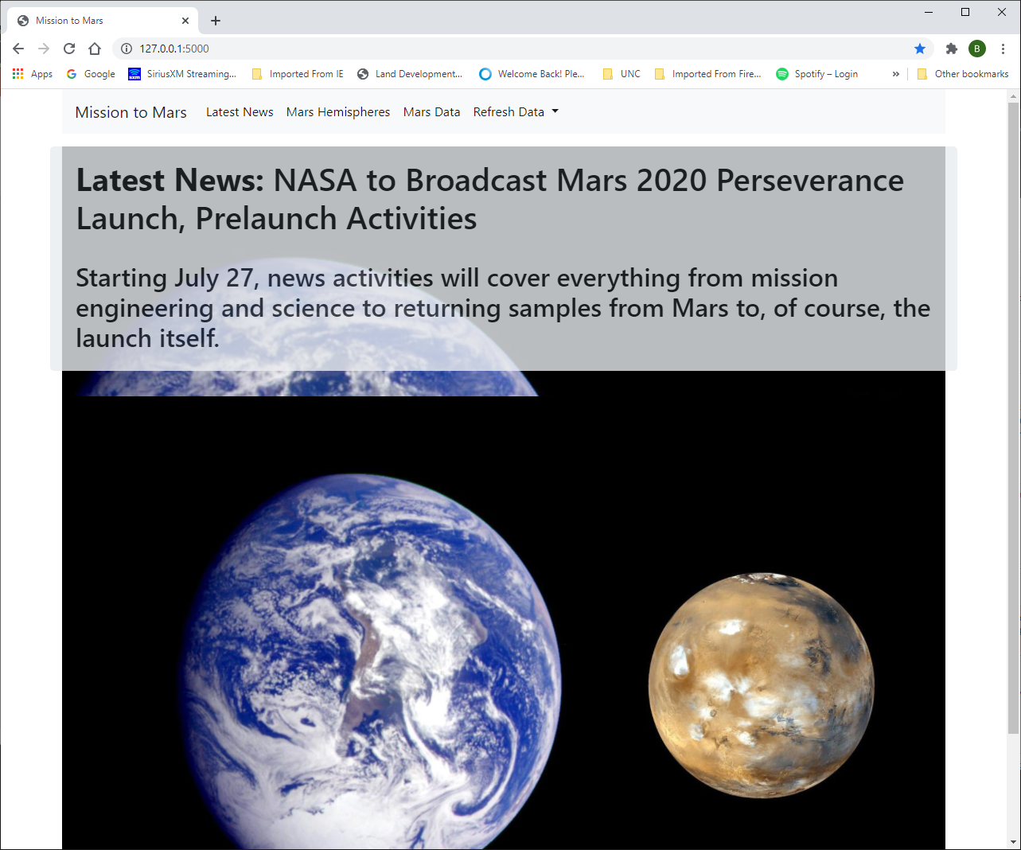
Initial page latest news with image in background and below. The navbar is adaptive and will shrink as the page gets smaller.

Slide 2
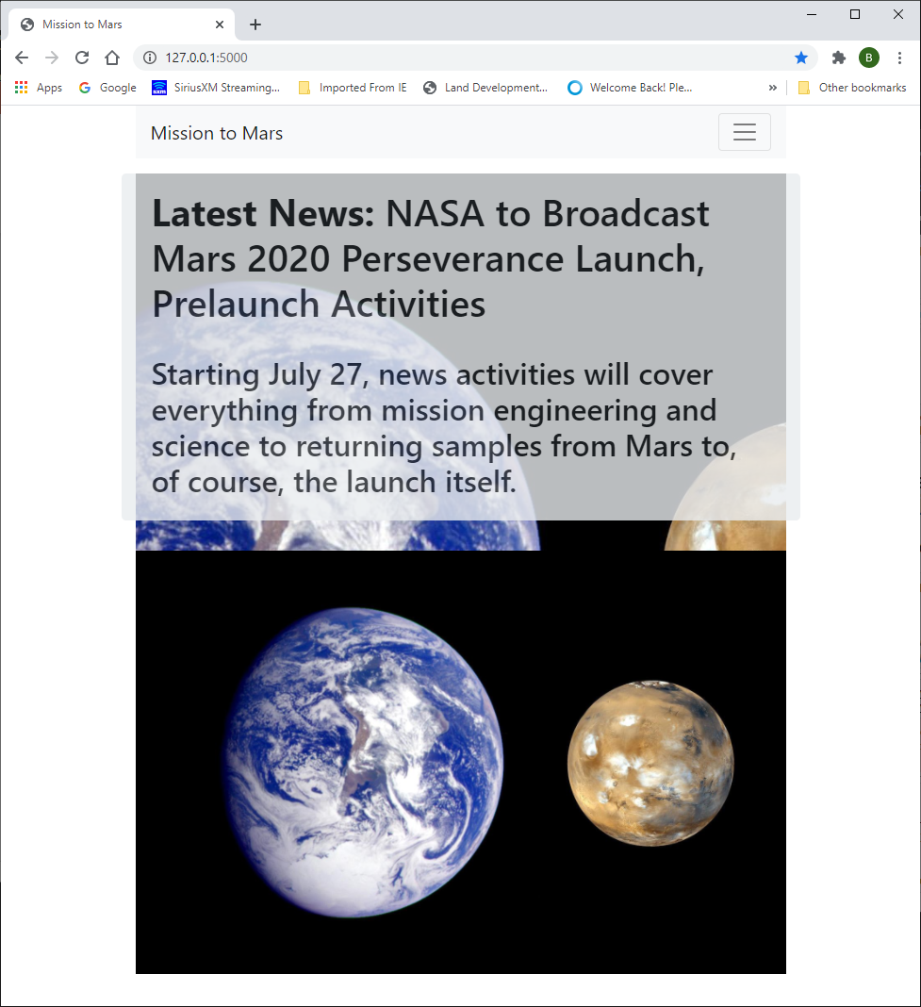
Initial page latest news with image in background and below. The navbar is adaptive and will expand if the screen is larger.

Slide 3
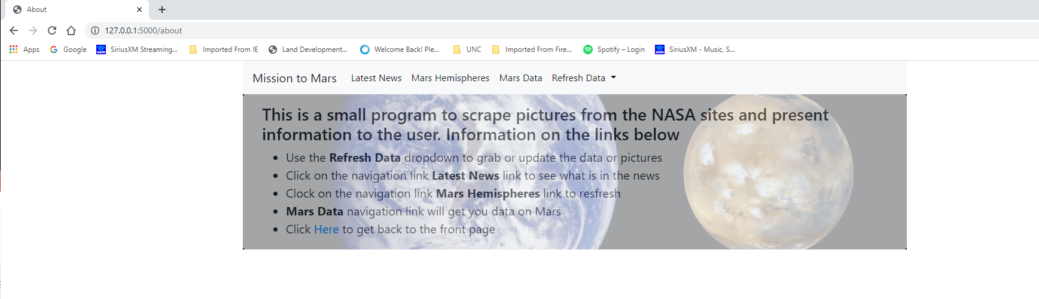
Additional About page if you click on Mission to Mars link. Explains the links in the navbar.

Slide 4
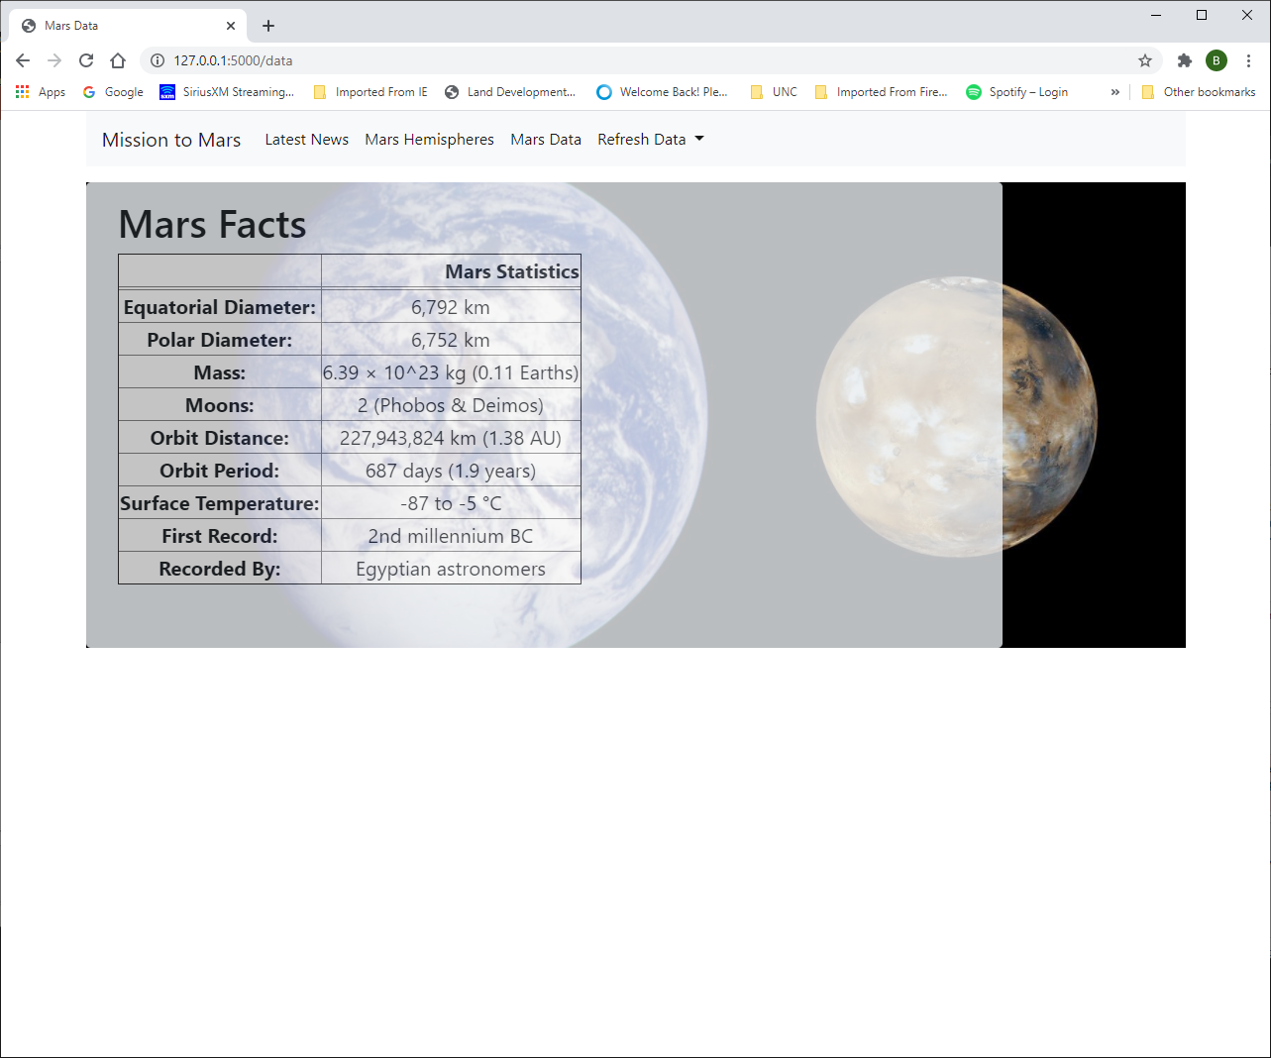
Mars Statistics page with image in background

Slide 5
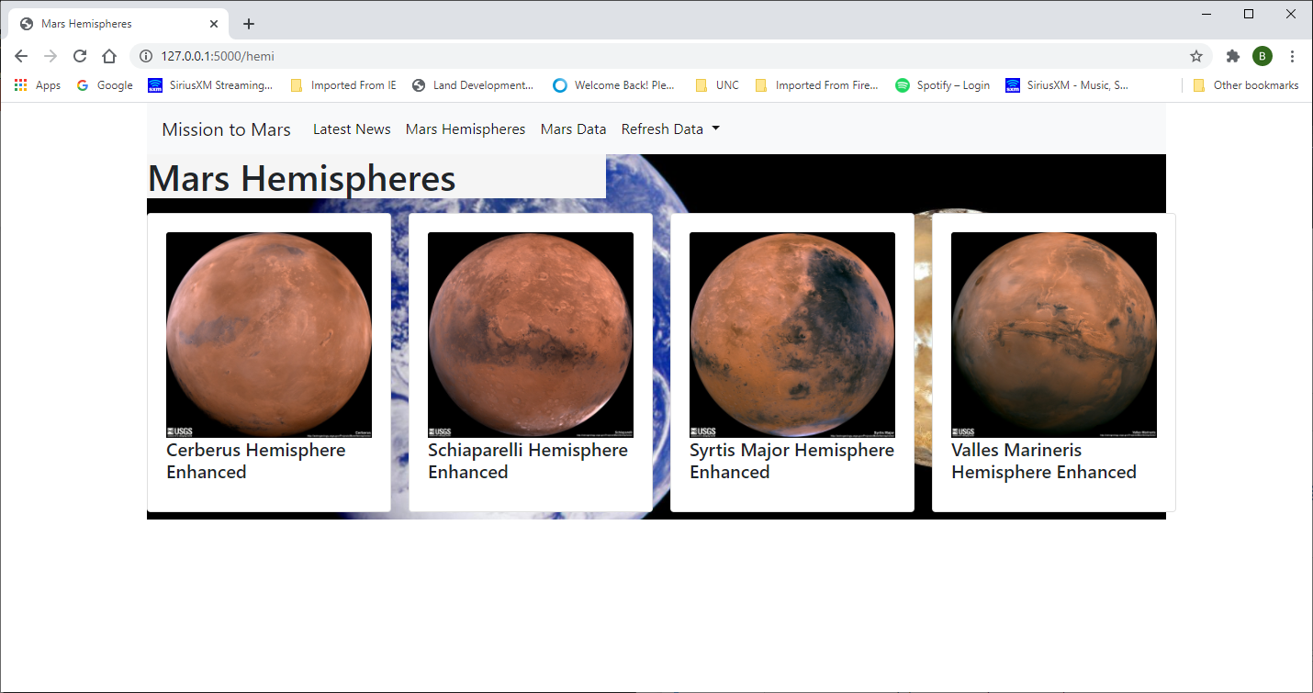
Hemispheres full web page with image in background

Slide 6
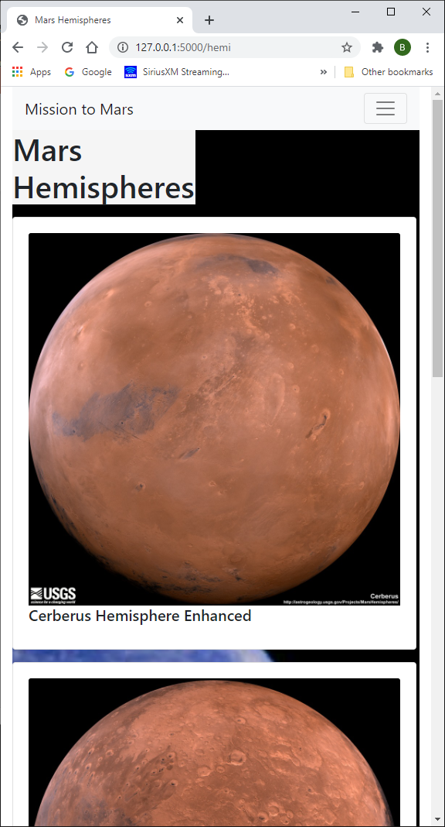
Hemispheres web page shrunk down

Slide 7
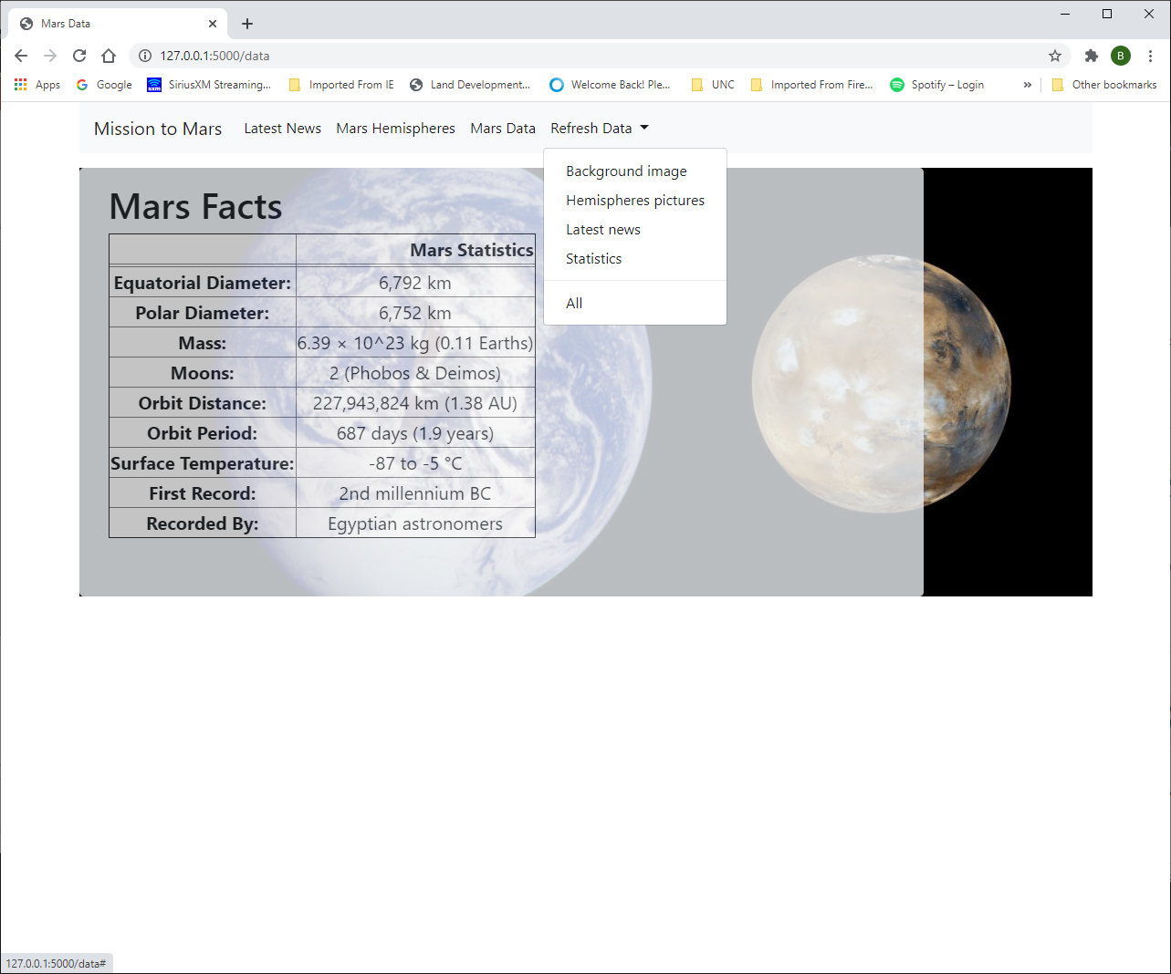
Image showing the dropdown link to refresh some or all data.

