Slide 1
How to Use OPM’s Approved PowerPoint Template

Slide 2
Contents
Fill out the properties
Template do’s and don’ts
Accessibility do’s and don’ts
Slide masters and layouts
Available layouts
How to add a slide
How to change the layout of an existing slide
How to remove the “draft” watermark
Blank slides of each layout with addition usage information

Slide 3
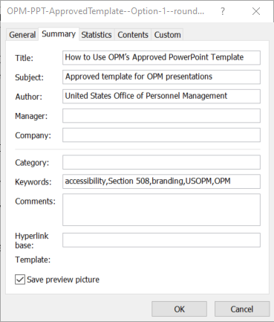
Fill Out the Properties
Under File > Info > Properties, give your presentation a:
Title: match the title on the title slide and the filename
Subject: elaborate on the title
Author: your name, your office’s name, or OPM spelled out, as appropriate
Keywords or phrases: prioritize synonyms of words in the other properties and other terms that are important but didn’t make it into the title or subject

Slide 4
Template Do’s and Don’ts
Do
Don’t
Choose only from the available layouts
Put your content in the boxes provided by the layouts
Email AskOC@opm.gov if you need a new layout
Adjust the font size in the body as needed, to no smaller than 18 points
Add, modify, or rearrange text boxes
Copy slides in from a different template; instead, copy the content, box by box, into the appropriate layout
Adjust how the heading text is displayed
Change text colors
Remove the page numbers from the footer

Slide 5
Accessibility Do’s and Don’ts
Do
Don’t
Add the word “draft” to your title until the file is approved
Give your presentation to participants ahead of time, only as an accessible PDF and only after approval
Visit PowerPoint and meetings
Use built-in features for lists and tables
Use accessible links and verify that all your links work
Provide captions and audio descriptions for videos
Use accessible colors and images
Visit Don’t… because… instead for other tips
Remove “draft” from your title until the file is approved
Spell out URLs
Tell people you’ll let them read your slide themselves—what if they can’t?
Use color, size, position, location, or shape as the only way of conveying meaning. Instead, also use labels or another sensory characteristic from this list
Use blinking or scrolling, which can cause seizures
Use spaces or special characters (except hyphens) in the filename

Slide 6
Slide Masters and Layouts
This template has four slide masters, each with its own set of layouts
Title (4 layouts)
Content (10 layouts)
Content – End (1 layout)
Content – Blank (1 layout)
Slide Masters and Layouts
Use
Title slide layouts only for the first slide and for Section Break slides
Content layouts for all other slides

Slide 7
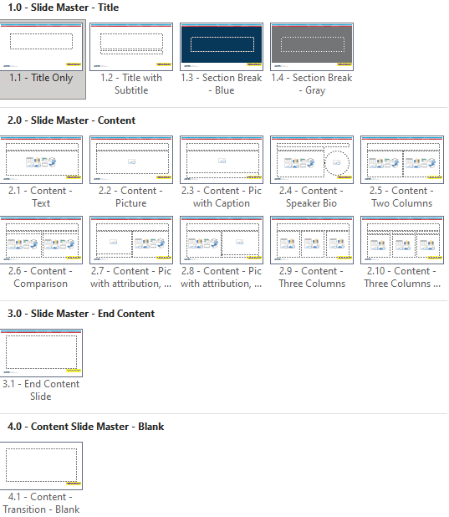
Available Content Layouts
Text
Picture
Pic with caption
Speaker bio
Two columns
Comparison
Pic with attribution (choose left or right)
Transition (different slide master from other content layouts)
Three columns

Slide 8
Other Available Layouts
Title
Title only
Title with subtitle
Section break – blue
Section break – gray
End content
Blank

Slide 9
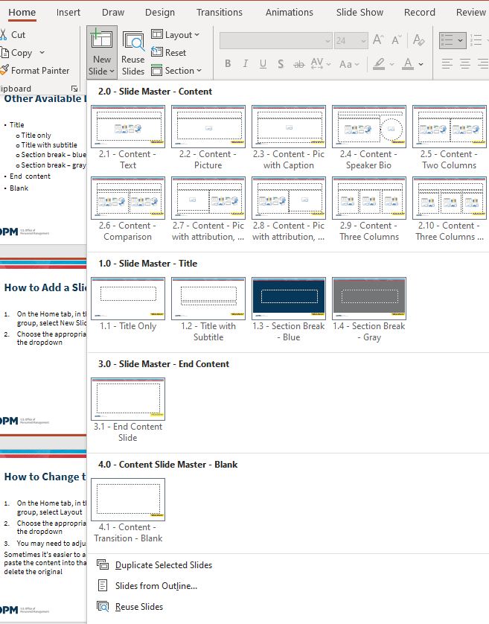
How to Add a Slide
On the Home tab, in the Slides group, select New Slide
Choose the appropriate layout from the dropdown

Slide 10
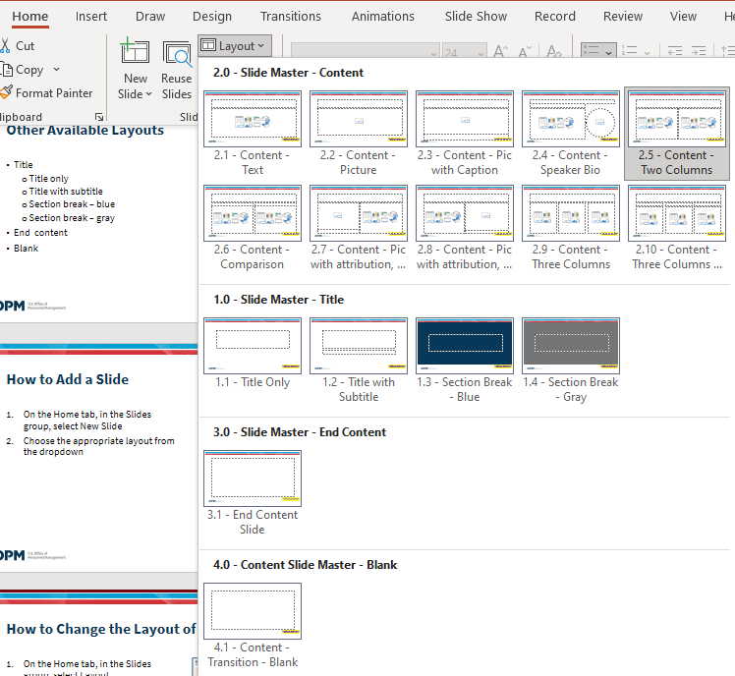
How to Change the Layout of an Existing Slide
On the Home tab, in the Slides group, select Layout
Choose the appropriate layout from the dropdown
You may need to adjust your content
Sometimes it’s easier to add a new slide, paste the content into that slide, and delete the original

Slide 11
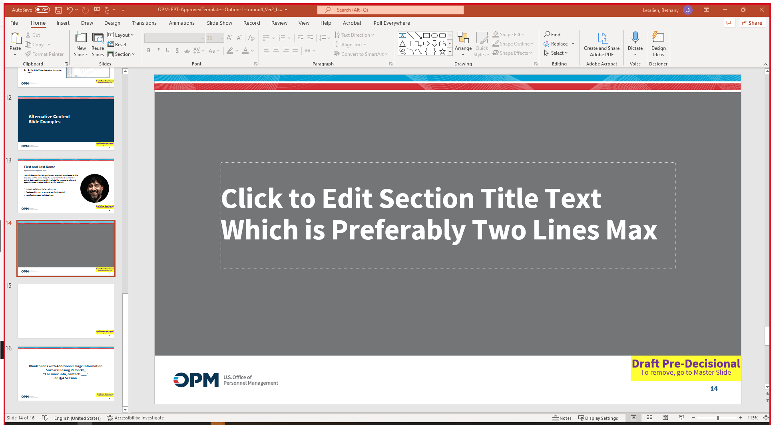
How to Remove the “Draft” Watermark
Once your presentation has been approved:
On the View tab, choose Slide Master
Select the Title Slide Master at the very top of the list of masters and layouts. It has a “1” next to it
Select the “Draft” text box and delete it
Repeat with the two other slide masters
On the Slide Master tab, close the master view

Slide 12
Alternative Content Slide Examples

Slide 13

First and Last Name
Speaker’s Title Appears Here
Include the speaker biography and relevant experience in this text box on the slide. Keep the statement short and to-the-point. But most importantly, include the speaker’s relevant experience as an expert about on the subject.
Include bullet points for relevance
Past speaking engagements can be included
Certifications can be listed here

Slide 16
Blank Slides with Additional Usage Information Such as Closing Remarks, “For more info, contact: ___” or Q/A Session

