Slide 1

Analysis of Women Safety in Indian Cities Using Machine Learning
BONAM VENKATA CHALAMAYYA ENGINNERING COLLEGE
(AUTONOMOUS)
DEPARTMENT OF COMPUTER SCIENCE AND ENGINEERING
SUBMITTED BY :- PROJECT GUIDE :-
TEAM MEMBERS Mrs. B.GANGA BHAVANI
B.VENKATA NAVEEN (18221A0520) M.Tech
B. PAVAN GANESH (18221A0516) ASSOCIATE PROFESSOR
B. SAI KIRAN (18221A0519)
K. BALA ADITYA (18221A0545)

Slide 2
ABSTRACT
Now a days women are experiencing lots of violence such as harassment in places in several cities. This starts from stalking which then leads to abusive harassment or also called abuse assault. In this paper we mainly focus on the role of social media which can be used to promote the safety of women in India, given the special reference to the participation of many social media websites or applications such as Twitter, Facebook and Instagram platforms. This project also focuses on developing the responsibilities among the common people on the various parts of Indian cities so that the safety of women around them is ensured. Tweet on the Twitter application contains the text messages, audio data, video data, images, smiley expressions and hash-tags. This tweet content can be used to read among the people and thus can educate them in order to take strict actions if tweets are abusive to women and hence can punish such people if the harassment is made. Applications which include hash-tags, such as Twitter and Instagram, can be used to spread the messages across the entire globe and make the women feel free to express their views and feelings. By this we can know the state of their mind when they go out for work or travel in a public transportation or surrounded by anonymous men and whether it feels they are secure or not.
Keywords: Women, Safety, Sexual Harassment, Hash tag, Sentimental Analysis.

Slide 3
INTRODUCTION
There are certain types of harassment and Violence that are very aggressive including staring and passing comments and these unacceptable practices are usually seen as a normal part of the urban life. There have been several studies that have been conducted in cities across India and women report similar type of sexual harassment and passing off comments by other unknown people. The study that was conducted across most popular Metropolitan cities of India including Delhi, Mumbai and Pune, it was shown that 60 % of the women feel unsafe while going out to work or while travelling in public transport.

Slide 4
EXISTING SYSTEM
Now-a-days almost all peoples are using social networking sites to express their feelings and if any women feel unsafe in any area then she will express negative words in her post/tweets/messages and by analysing those messages we can detect which area is more unsafe for women’s.

Slide 5
PROPOSED SYSTEM
This research paper basically focuses on the role of social media in promoting the safety of women in Indian cities with special reference to the role of social media websites and applications including Twitter platform Facebook and Instagram.
In propose work author using TWEEPY package from python to download tweets from twitter but every time INTERNET will not available to download tweets online so we downloaded MEETOO tweets on women safety and safe inside dataset folder. Application will read the tweets to detect women’s sentiments.
Author using NLTK (natural language tool kit) to remove special symbols and stop words from tweets and to make them clean

Slide 6
HARDWARE REQUIREMENTS:
System : Pentium i5.
Hard Disk : 500 GB.
Monitor : 14 inches
Input Devices : Keyboard, Mouse
RAM : 4 GB
SOFTWARE REQUIREMENTS:
Operating system : Windows 10.
Coding Language : Python 3.7.0

Slide 7
ADVANTAGES
Author using TEXTBLOB corpora package and dictionary to count positive, negative and neutral polarity and the tweets which has polarity value less than 0.2will consider as negative as and greater than 0.2 and less than or equal to 0.5 will consider as neutral and polarity greater than 0.5 will consider as positive.

Slide 8
DISADVANTAGES
In existing system there is no machine learning algorithm.
There is accuracy result.

Slide 9
Modules:
upload tweets dataset: using this module we will upload tweets dataset
Read tweets: using this module we will see all the tweets in dataset and we can see all tweets contains special symbols and stop words.
Tweets Cleaning: Using this module we will remove or clean the special symbols and stop words.
Run Machine Learning Algorithm: using this module we will see tweet text and then displaying tweets sentiments with polarity score
women safety graph: using this module we will see the result in graph
Genuine & Fake Tweet Graph: using this module we will see the result in graph

Slide 10
Packages
tkinter: tkinter is the standard GUI library for Python. tkinter module helps in creating GUI applications in a fast and easy way.
Matplotlib: Matplotlib is an amazing visualization library in Python for 2D plots of arrays. Matplotlib consists of several plots like line, bar, scatter etc.
Numpy: NumPy is a Python library used for working with arrays. It also has functions for working in domain of linear algebra, fourier transform, and matrices.

Slide 11
Packages
Pandas : Pandas is an open-source library that is made mainly for working with relational or labeled data both easily and intuitively it is used for Fast and efficient for manipulating and analyzing data.

Slide 12
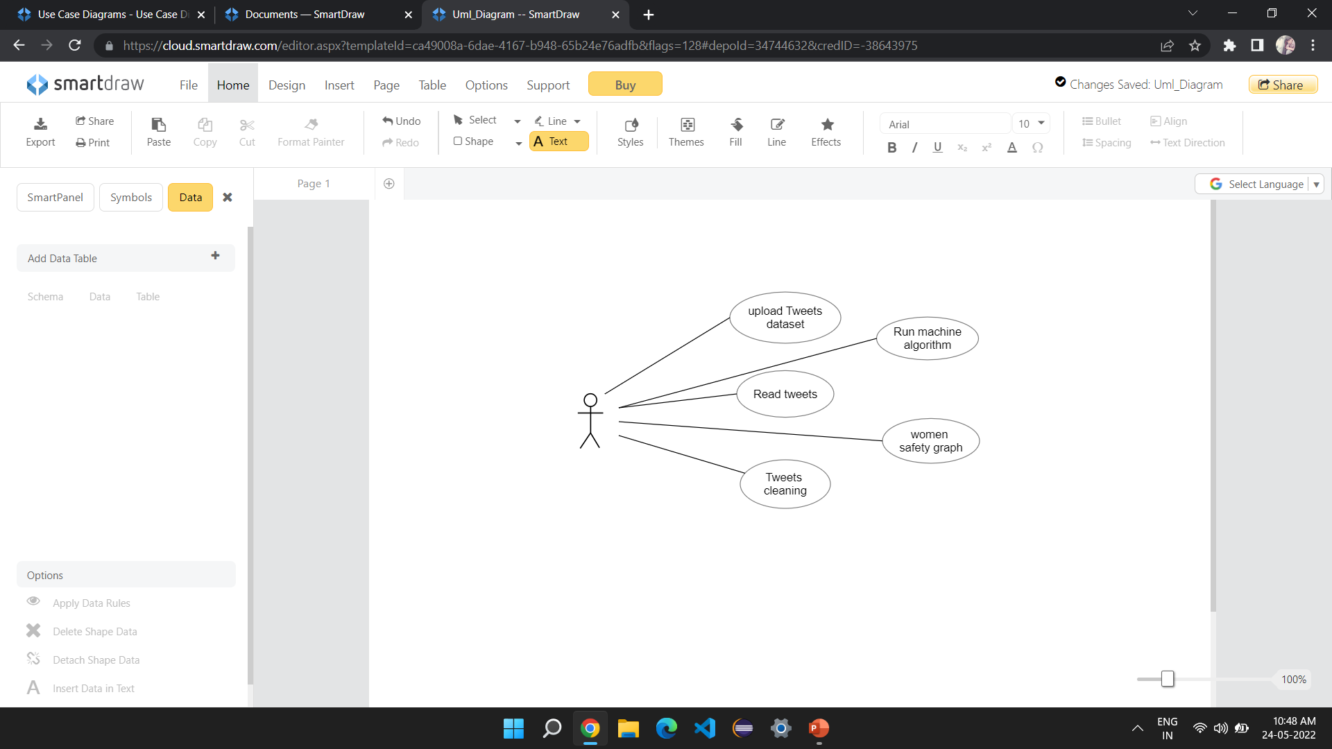
Design
Use case Diagram

Slide 13
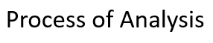
System Architecture:
Upload the data
Pre-processing the data
Algorithm
Selection of Attributes
Model Training
Test data

Slide 14
Algorithm
Sentimental analysis algorithm
Step 1: Start
Step 2: load the dataset
Step 3: Clean tweets by removing the stop words and noise like repetitive letters.
Step 4: For each word, compare it with positive sentiments and negative sentiments word dictionary and then increment positive count or negative count of the overall phrase.
Step 5: Finally, based on the positive count & negative count, we can get result percentage about sentiment to decide the polarity which is categorized in Positive, Negative and Neutral.

Slide 15
Dataset:
To implement this project we are using tweets dataset called MeeToo_tweets.csv dataset
The datasets is download from
https://www.kaggle.com

Slide 16
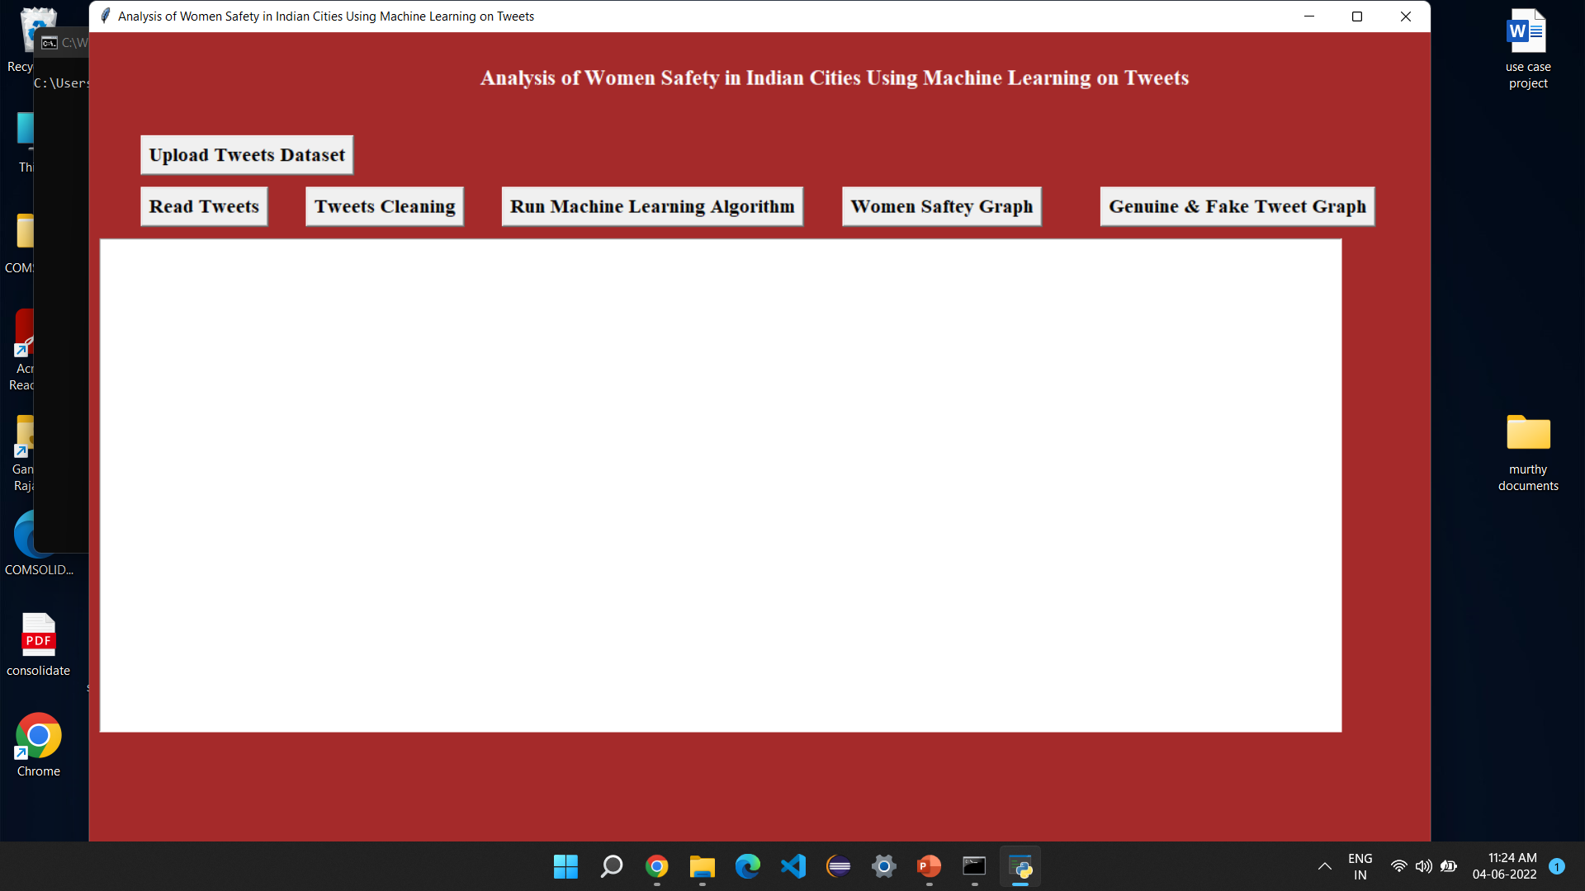
Result
After execute the project It shows like this
In above screen run all buttons

Slide 17
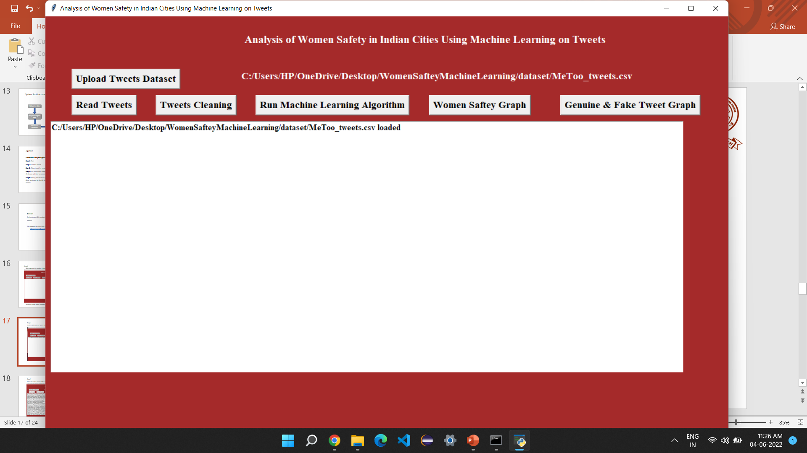
Step1:
First click the upload Tweets Dataset button .It show like this

Slide 18
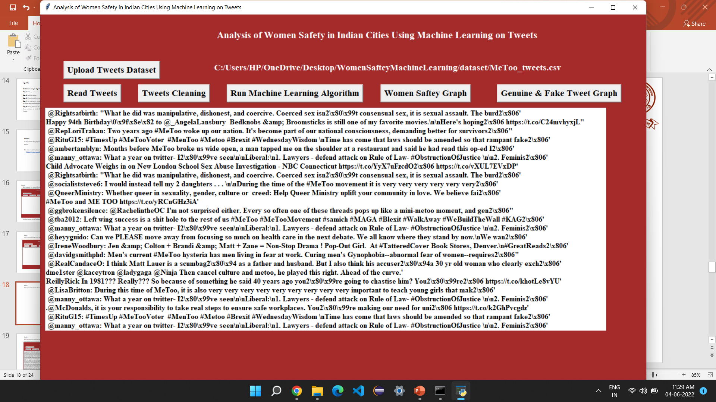
Step2:
After upload the dataset .After click the read Tweets Button to read the data

Slide 19
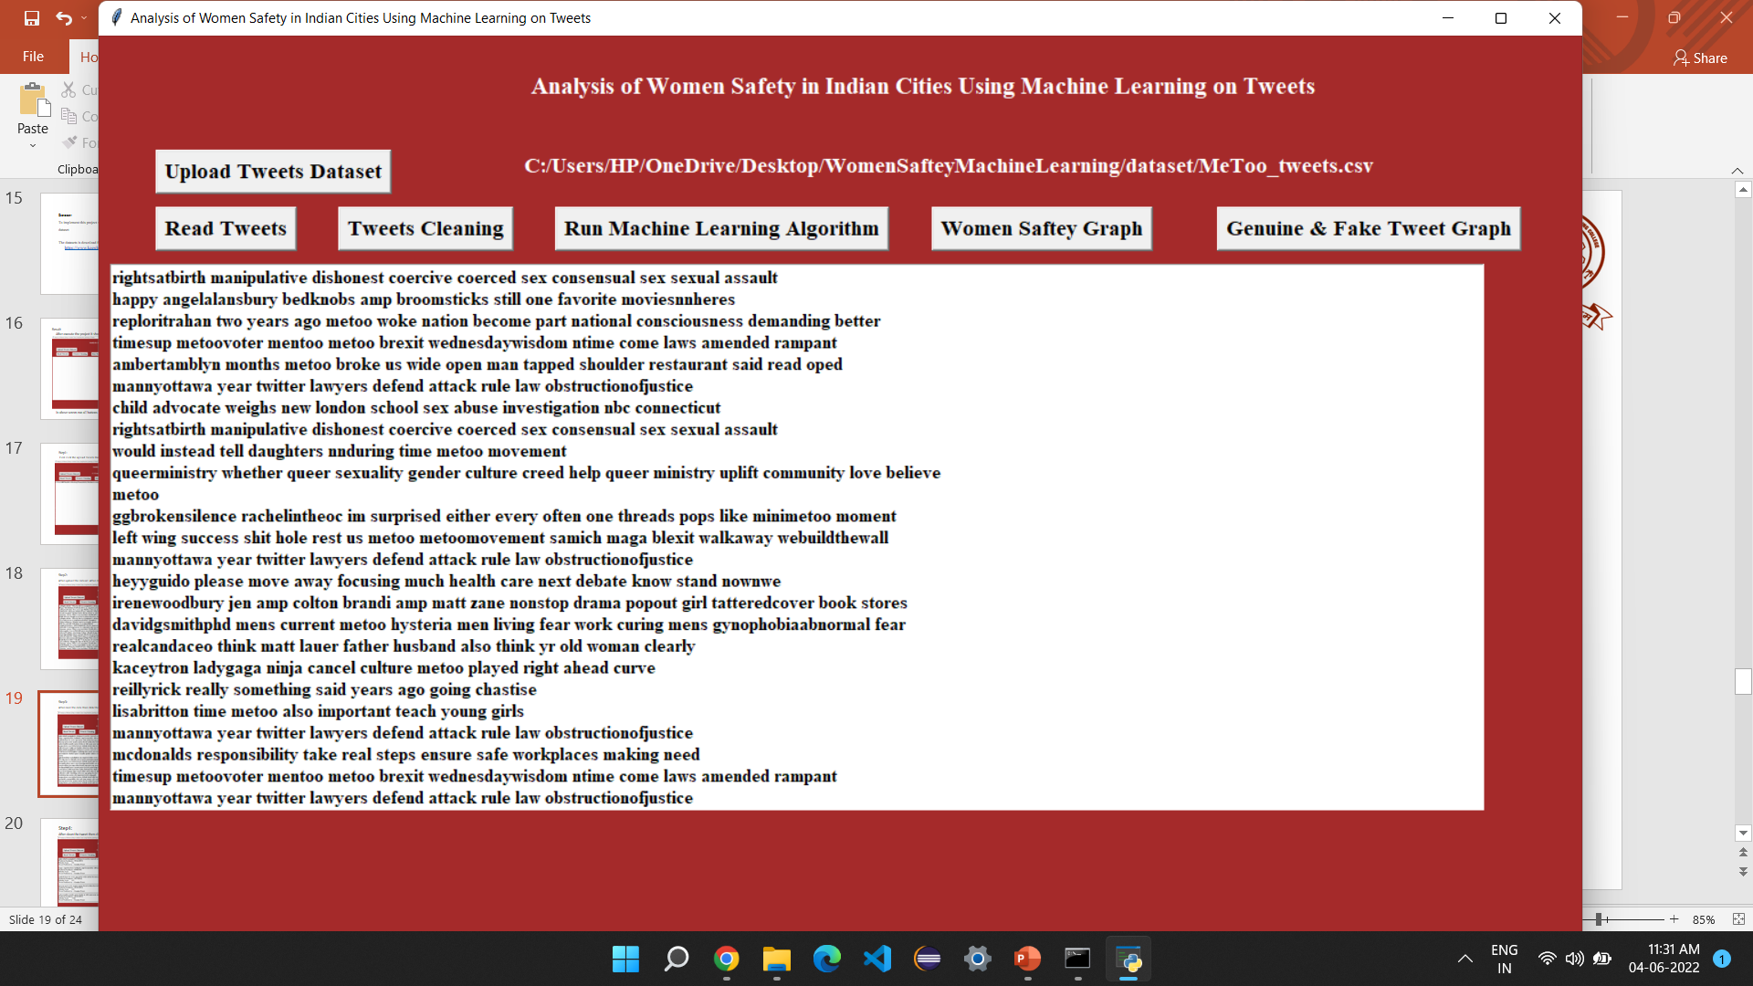
Step3:
After read the data then click the Tweets cleaning button

Slide 20
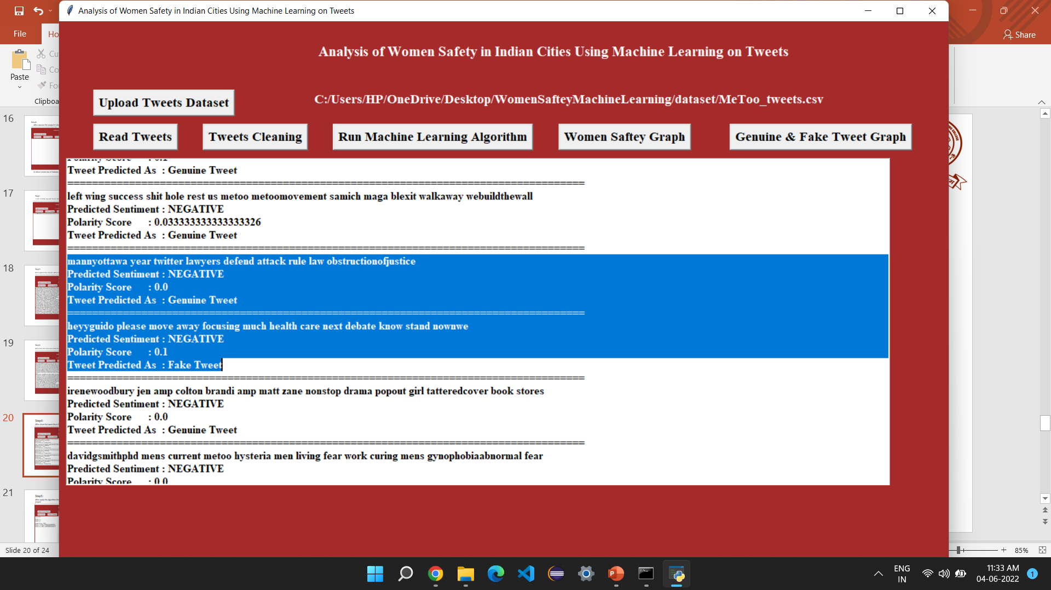
Step4:
After clean the tweet then click the run machine learning algorithm button

Slide 21
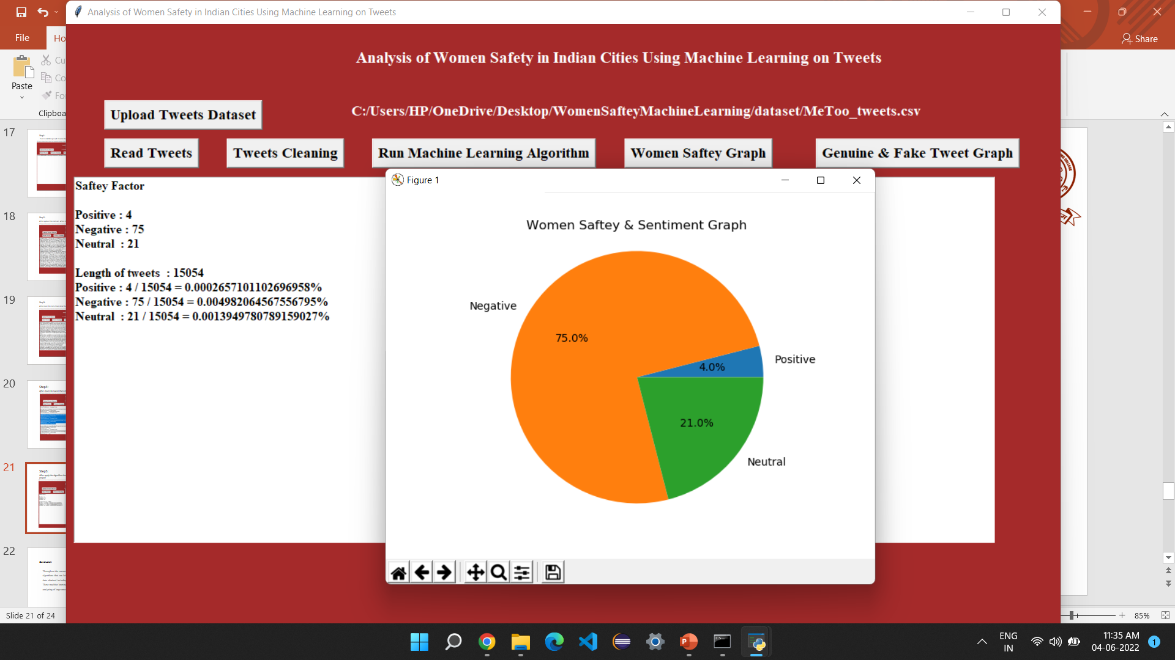
Step5:
After apply the algorithm then click the Women safety graph.

Slide 22
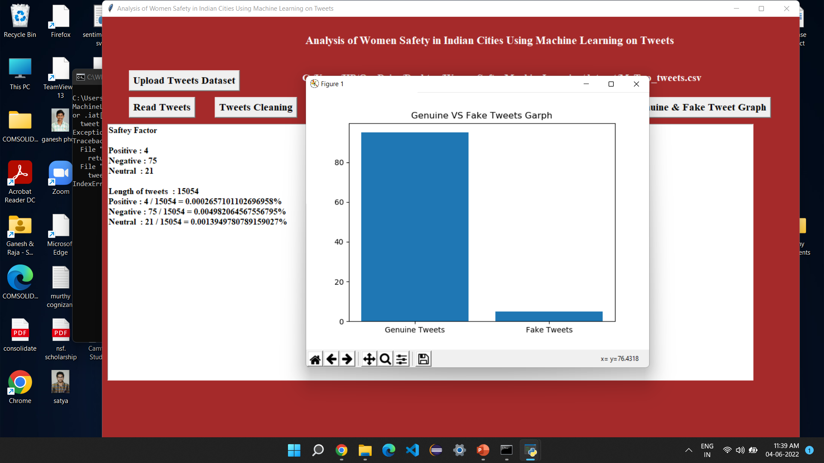
Step 6:
To click the Genuine & Fake Tweet Graph Button

Slide 23
Conclusion:
Throughout the research paper we have discussed about various machine learning algorithms that can help us to organize and analyze the huge amount of Twitter data obtained including millions of tweets and text messages shared every day. These machine learning algorithms are very effective and useful when it comes to analyzing of large amount of data including

Slide 24
References
Agarwal, Apoorv, Fadi Biadsy, and Kathleen R. Mckeown. "Contextual phrase-level polarity analysis using lexical affect scoring and syntactic n-grams." Proceedings of the 12th Conference of the European Chapter of the Association for Computational Linguistics. Association for Computational Linguistics, 2009.
Barbosa, Luciano, and Junlan Feng. "Robust sentiment detection on twitter from biased and noisy data." Proceedings of the 23rd international conference on computational linguistics: posters. Association for Computational Linguistics, 2010.
Bermingham, Adam, and Alan F. Smeaton. "Classifying sentiment in microblogs: is brevity an advantage?." Proceedings of the 19th ACM international conference on Information and knowledge management. ACM, 2010.
Sahayak, V. Shete, V., & Pathan, A. (2015). Sentiment analysis on twitter data. International Journal of Innovative Research in Advanced Engineering (IJIRAE), 2(1), 178-183.
Mamgain, N.Mehta, E. Mittal, A.Bhatt. (2016, March). Sentiment analysis of top colleges in India using Twitter data. In Computational Techniques in Information and Communication Technologies (ICCTICT), 2016 International Conference on (pp. 525-530). IEEE.

Slide 25
THANK YOU

