Slide 1
Lab 3: ARM
By: CS 382 CAs

Slide 2
Logistics
Reminder: Homework 1 is due Thursday, Sept 26
Attendance for this lab: Show your CA that you completed Task 1

Slide 3
ARM Review

Slide 4
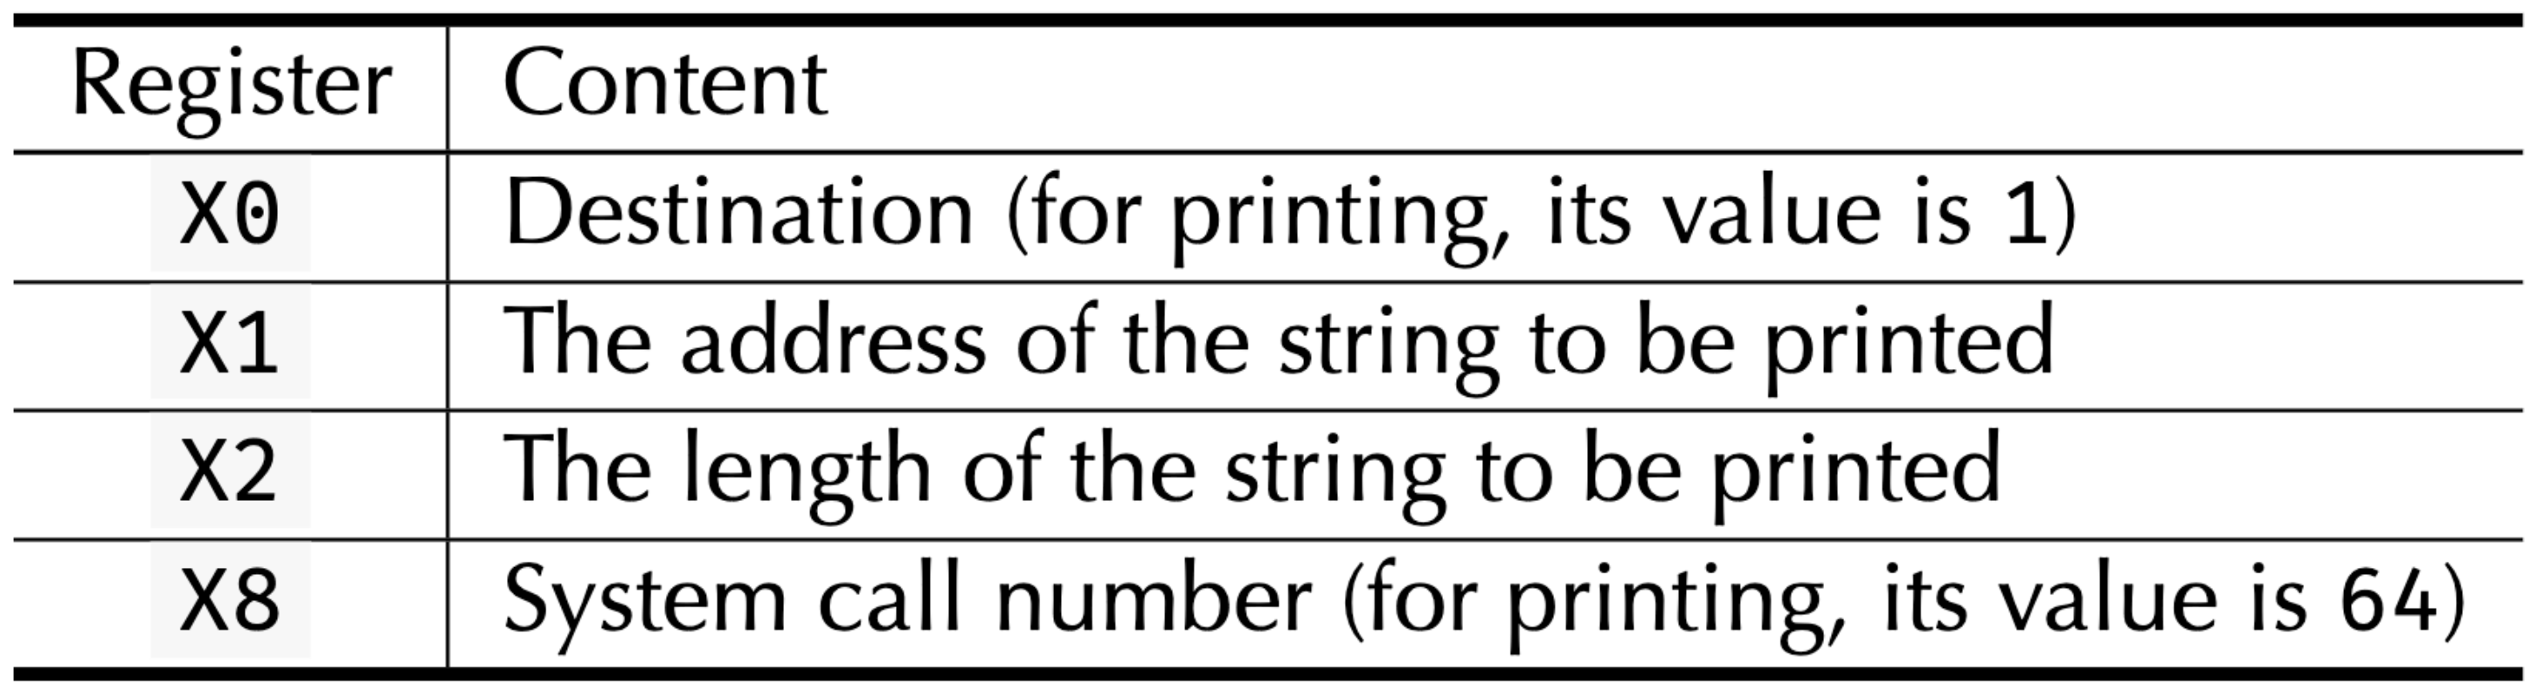
Basic ARM Instructions
MOV <destination>, <immediate/register>
Copies the value into the destination register
LDR <destination>, [<source address>, <immediate>]
SVC 0
Supervisor call (syscall), don't forget to load your arguments first!
Note: the ”[]” in the LDR are part of the instruction

Slide 5
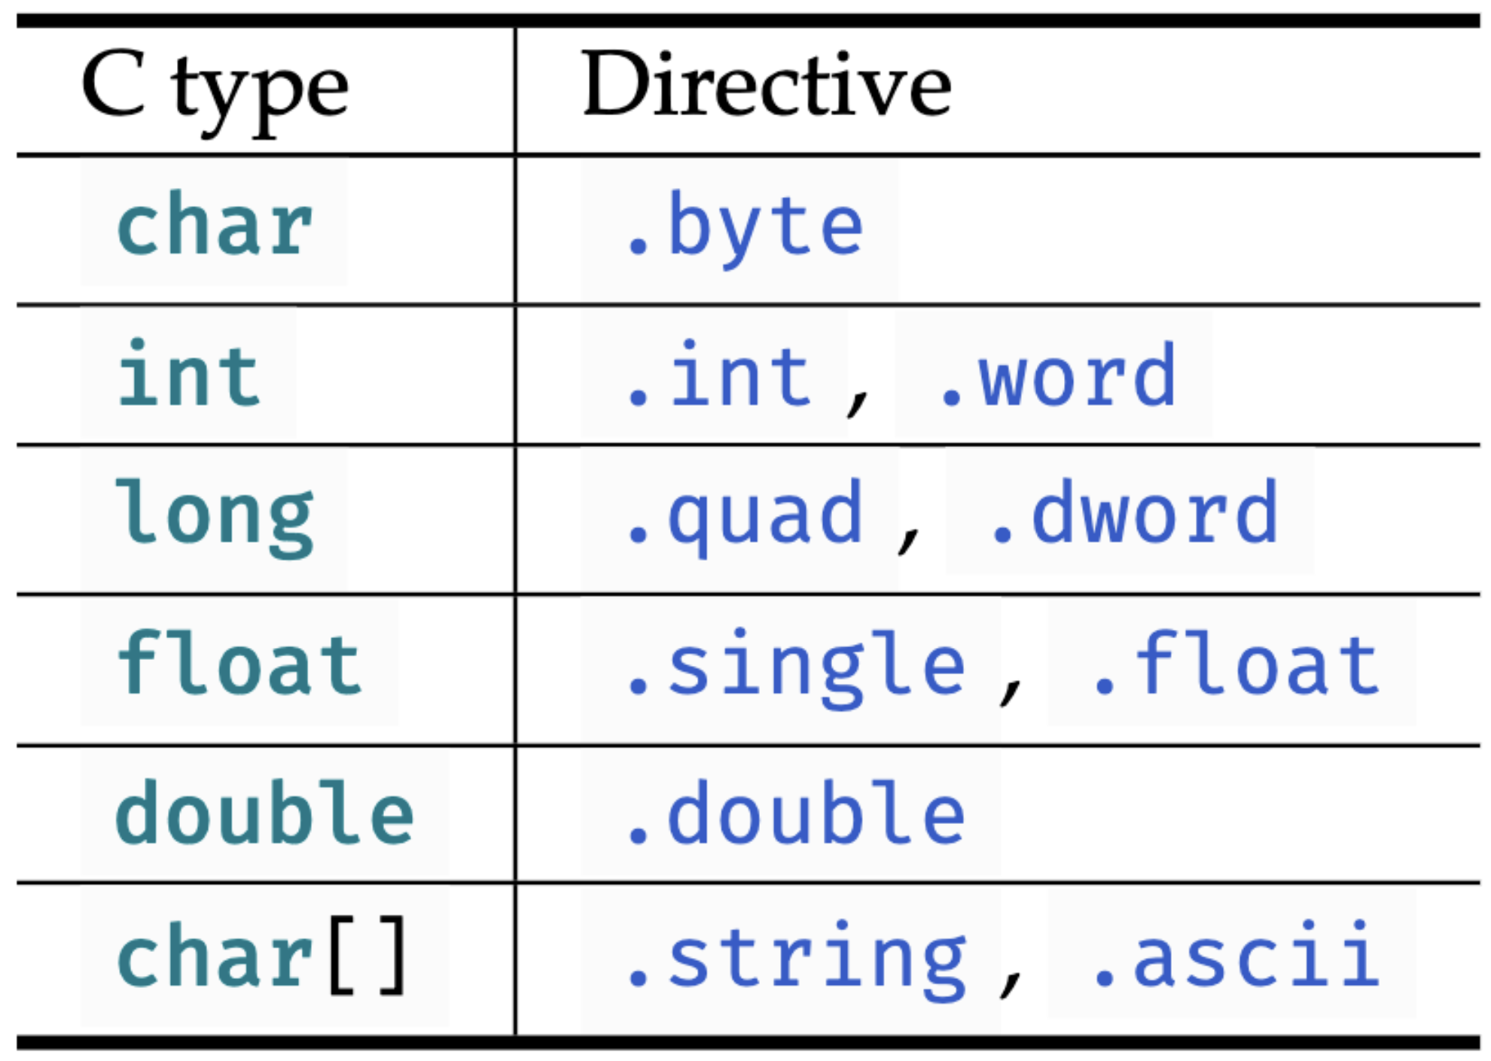
Segments!!!!!!
Segments are used to contain specific kinds of data for your assembly program. These segments live in memory.
Some basic segments you will need to complete this lab:
.text -> this is where your program lives (read only!)
.data -> this is where your variables live (you can read/write from this segment)
label: .directive data
message: .string "Hello, world!\n”
Other semantic things:
Use ".global _start" to declare the entry point for your program. ".global" specifies that the symbol _start is exposed to the linker as the entry point, so make sure you don't leave this out!

Slide 6
ADR: Getting Memory Addresses
With the .data segment, you can store variables in memory
However, to use these variables in your assembly code, you need the address
You use ADR <register>, <name of label> to store the address of a variable in a register
Once you load the address into a register, you use the LDR instruction to get the actual value at that address
.text .global _start _start: ADR X0, number // Moves the address of number into X0 LDR X1, [X0] // Loads the values at the address of number (28) into register X1 MOV X0, 0 // Set register X0 to 0 (return code) MOV X8, 93 // Set register X8 to 93 (syscall number for exit) SVC 0 // Invoke syscall to exit .data number: .quad 28

Slide 7
Assembling, Linking, and Executing
See B.2 in the textbook for detailed instructions
Assemble:
Generate an object file with the aarch64 assembler:
aarch64-linux-gnu-as demo.s -o demo.o
Link:
Link object files to generate an executable using the linker:
aarch64-linux-gnu-ld demo.o
Execute:
Run the executable with the QEMU emulator
qemu-aarch64 a.out

Slide 8
Lab 3 Assignment

Slide 9
Task Time
Starter Code (B.1.1)
Complete Task 1 in the Lab PDF​
Install qemu: sudo apt-get install qemu-user
Show us you installed QEMU and have assembled and linked the simplest ARM program.
Things to keep in mind:
Comment every line of your code explaining what it does. (Excluding labels or directives)
Don't hard-code the length in your code! Make sure you declare it as a .quad in the data segment!
Please read the textbook
.text .global _start
_start: MOV X0, 0 MOV X8, 93 SVC 0 .data

