Slide 1
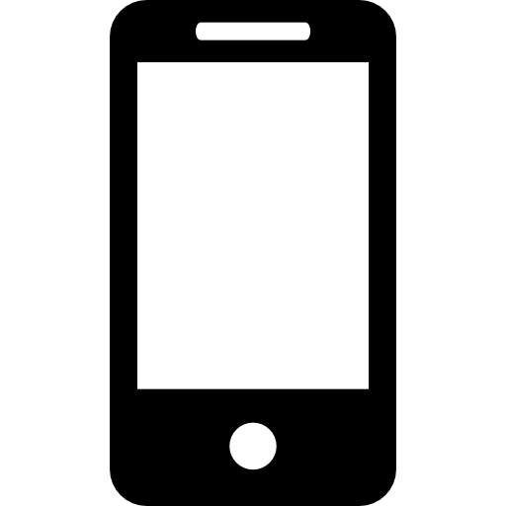


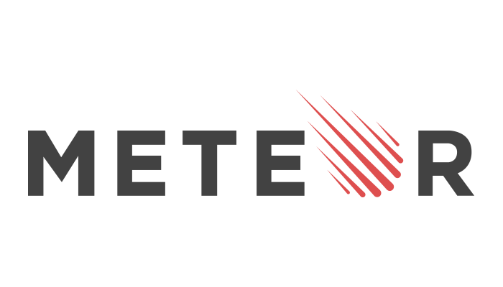






Inventory Management System
Bradley Griffee, Brian Sizemore, Mark Morrison
Problem Statement
Technologies
Process
Develop an inventory management system for non-traditional inventories with three core development principles:
User-Friendly
Use Modern Technologies
Built to be Scalable
Mobile and Desktop Application
Our system is simple enough to avoid confusion and robust enough to provide all the features you need to manage your non-traditional inventory.
We chose technologies that would allow our system to provide necessary tools and features for inventory management while simultaneously being robust and scalable.
mongoDB – NoSQL Database
Javascript - API and Core
MeteorJS - Mobile and Desktop Application
Meteor Kitchen – Templating tool for Meteor Apps
NFC – Tagging/tracking technology
1
Item arrives
Mobile app lets you
record relevant
Item details
2
background
Current systems rely on UPC codes. With all of modern systems using the existing barcode systems, the market for a more generalized system is prime.
Current systems have too many unnecessary features. By bombarding the end-user with confusing to use, ultimately fruitless features and tools the system becomes overly complicated and hard to manage
Current systems try to do it all. Even the most basic systems out there are trying to do everything at once: manage inventory, generate statistics, act as a point of sale service, and be the database.
3
Item is stored in DB
View items anywhere
4
Achievements
Results
Stop relying on old technology. We built our system with modern technologies that allow us to provide a simple user interface with necessary features to easily manage inventory.
Simplify the process. Our mobile and desktop applications make it fast and simple to add new items and lookup existing items.
Improve tagging/tracking technology. Instead of UPC codes we integrated NFC technology into our system for tagging and tracking items. This technology is similar to UPC codes but with additional benefit of being reusable.
The user is paramount. We built our system with the user in mind. To that end we tried to implement a simple, intuitive user interface.
Our final result is a functional prototype that allows users to add, modify, and remove items easily and quickly. We have a user interface that is easy to understand navigate. We have also integrated NFC technologies into our application by allowing users to write an items ID to an NFC tag. The user can then use their phone to read the tag and navigate directly to the item.

