Slide 1
Inventory Management System
Bradley Griffee
Brian Sizemore
Mark Morrison

Slide 2
Problem Statement
Inventory Management System
Aimed at tackling non-traditional inventories
Products that aren’t already easily tracked with UPC or similar product codes
User-friendly
Easily implemented by the less technically inclined
Builds on existing infrastructure
Using smartphones and lightweight databases
Notes:
Our group is building an inventory management system that will be aimed at non-traditional, typically “untrackable” inventory Two of our focus points are being as user friendly as possible, and building upon preexisting infrastructure. We want to do this so that we can gain the target audience of small business’ that don’t have a lot to invest in an inventory system.

Slide 3
Project Background
Current systems don’t fit all scenarios
Police tracking of cars, guns, laptops, etc.
Salvage company / junkyard
No current systems have efficient interoperability with eCommerce websites
Tracking inventory and selling products put together saves time and resources
Notes:
Current systems fall short. Products do not already come with preassigned UPC codes.
In the case of an organization such as a police department that wants to track all of the items that they have. It is unrealistic to do something like stamp the guns and cars they have with UPC codes, so we want a way to track the items by other distinguishing factors such as serial numbers and vin numbers.
Another target market is the salvage and junkyard industry. Most of the time salvage yards and junkyards will have very little if any inventory of what they have. However, we think we could improve the business they can conduct by allowing them a simple system to “check items in” to the yard and have some kind of inventory they can share online. This we will do by having our system be able to export inventory lists and product details to ecommerce sites. So we can take companies from not having any idea what they even have in stock to selling additional product online with one system.

Slide 4
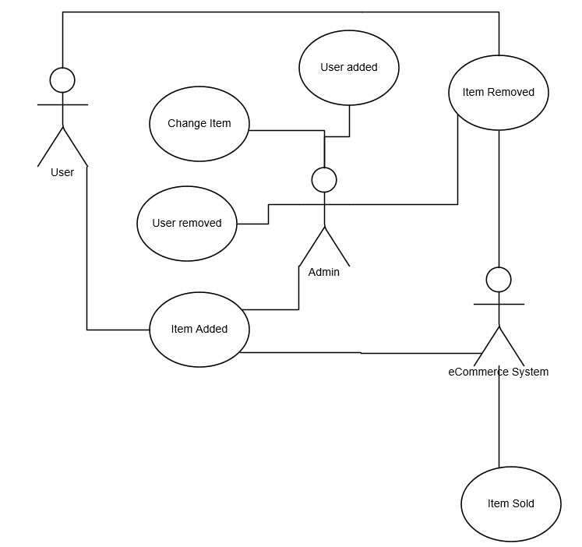
Use Cases

Slide 5
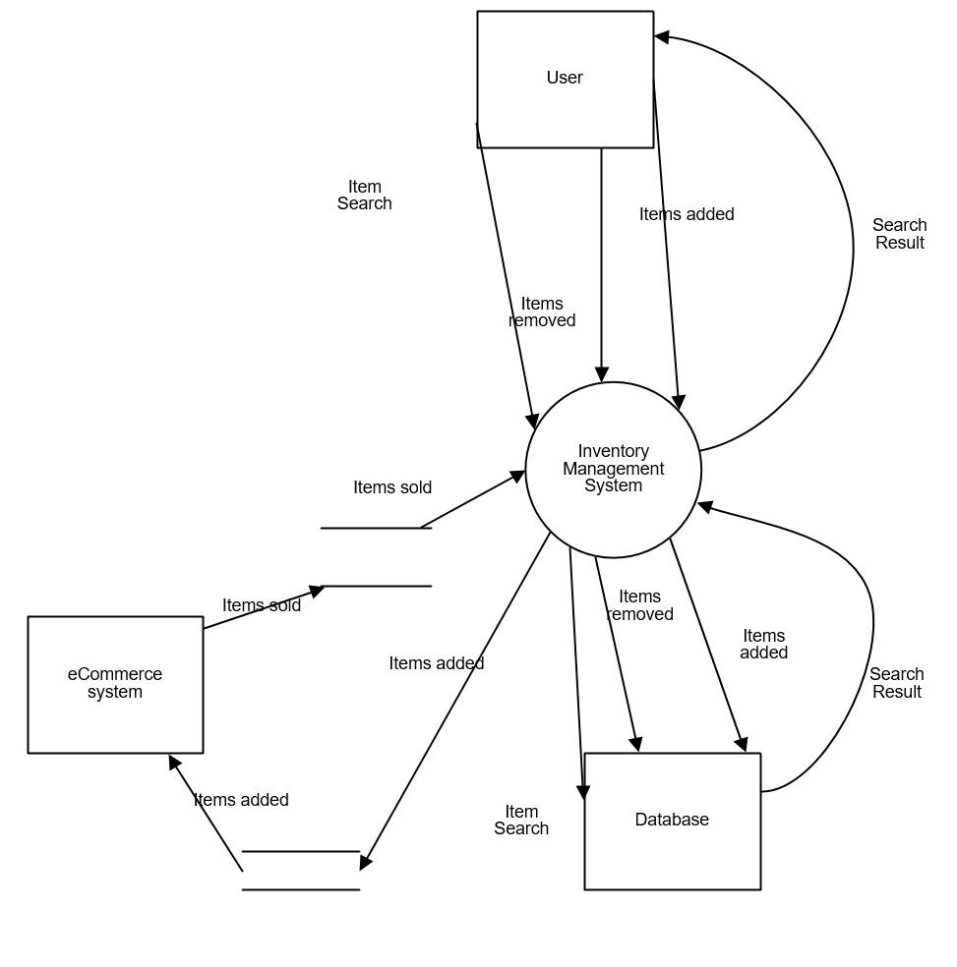
Dataflow

Slide 6




Technologies
Mysql
Database
Java
API and Core System
Android
Mobile Application
Material Design
Google’s standard design principles
Notes:
These are some of the major technologies we have chosen to use in our system.
We are using mysql and java to build the core of our system. These are common technologies that are commonly available for most
Users.
We chose to build an android application for our project. Android is open source and will integrate more easily with our java backend.
And finally, we will use Googles’ Material Design principles to develop all of the User interfaces both on our mobile app and our desktop app. Material Design is simply a list of rules and guidelines that define a “good” user interface.

Slide 7
Innovative and Creative Aspects of Our Solution
Easy to use system.
Uses existing and tested technology to ensure a robust platform.
Cloud based server.
Allows for fast and simple scalability.
Easily work together from multiple different locations.
Utilize existing technology to interface with our system.
Mobile application allows users to perform all necessary functions remotely.
Notes:
Our solution is meant to be easy to use and easy to implement for people who aren’t tech savvy. To this end we will focus
On building an easy to use product.
We will also use existing and tested technology to ensure that our product is robust and familiar.
We intend to use a cloud based server. This gives our product scalability as well as allowing it to work easily from multiple different locations and devices.
We will build an android app to utilize smartphones which users are already comfortable with. This means we can easily control the product remotely.

Slide 8
Challenges and Uncertainties
Finding freely available software.
Our primary goal is to use open source software.
This helps ensure that end users have simple setup and configuration.
Excessively large database
We are countering this by using industry standard tools that can scale with the database.
Notes:
There are two main challenges with our product:
Firstly, we want to use software that is free so that users don’t have to worry about hidden costs or fees.
Secondly, Databases have the ability to grow large enough that they cause lots of issues if they are not managed properly. By building our system with scalable technologies and that possible in mind we can counteract the negative effect this could have.

Slide 9
Component Procurement
Smartphones - Done
Server - Done
Designed to run on any spare computer
NFC Tags - Done
Already have some, cheap if we need more

Slide 10
Expected Outcomes
System based around three principles:
Easy to use
Scalable
Reliable
We want to simplify the logistics so business owners can get back to making money

Slide 11
Questions?

