Slide 1
Portable Grid Square LCD Bill Pence KI4US

Slide 2
Grid Square LCD Display
Simple, portable, stand alone low cost Grid Square LCD display hardware
Arduino of about any flavor
I2C LCD
GPS module
7 Arduino jumpers, or can be soldered with hook up wire as desired.
Can be powered in several ways
Battery connected to Arduino DC input
Portable USB battery
Direct 12v from power point in vehicle to Arduino DC input

Slide 3
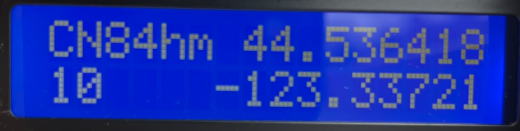
Grid Square LCD Display
LCD showing 6 digit grid square, number of satellites used for fix, and current Latitude/Longitude.
The sketch has can be customized for LCD display content and format to show time, Lat/Long, grid, etc.

Slide 4
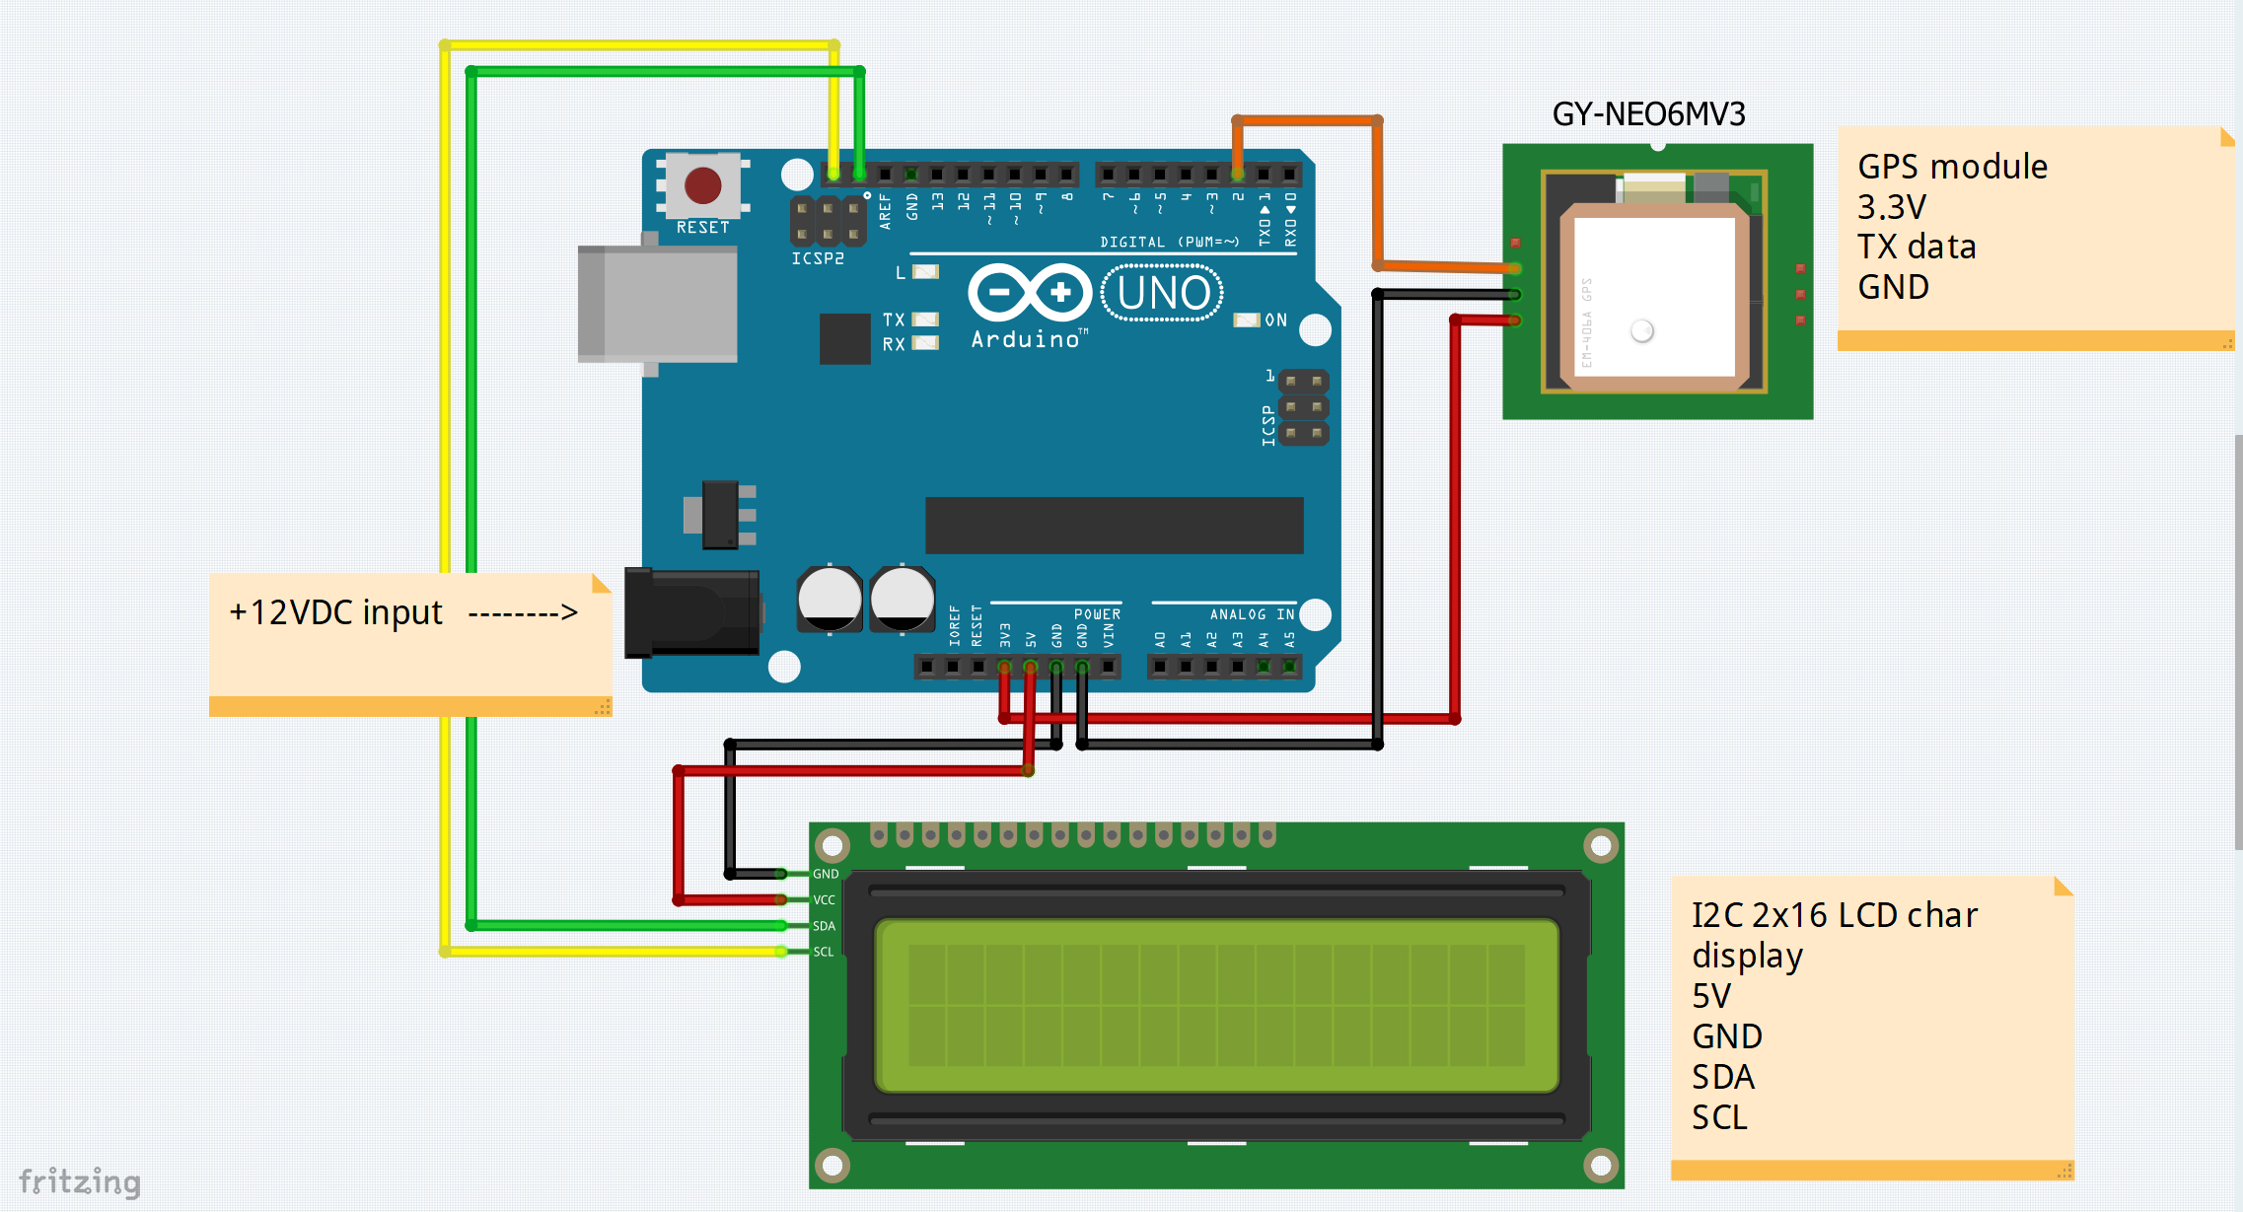
Wiring info

Slide 5
Components info and Sketch location
Parts easily obtained at Amazon.
GPS module
https://www.amazon.com/gp/product/B01D1D0F5M
I2C LCD module
https://www.amazon.com/GeeekPi-Character-Backlight-Raspberry-Electrical/dp/B07S7PJYM6
Arduino Uno Compatible module
https://www.amazon.com/ELEGOO-Board-ATmega328P-ATMEGA16U2-Compliant/dp/B01EWOE0UU/
Sketch (program) available at github.com with open access
https://github.com/bpguy/gps_grid_sq_lcd

Slide 6
Let’s talk a bit about grids….

Slide 7
Grids are usually used as 4 or 6 digit values, but can be extended.
The extra characters add further location precision
2 letters specify a 20° longitude x 10° latitude segment of the earth
2 numbers refine the segment to a 2° longitude x 1° latitude sub segment
2 letters further refine the sub segment to 5’ x 2.5’ values
Alternating numbers and letters continue refining the location

Slide 8
Grid Square resources
QST January 1989, pp. 29-30, 43 contains info on the grid square notation
W8BH.net has a nice document with an algorithm for computing grids from GPS coordinates located at http://w8bh.net/grid_squares.pdf
Next, an example spreadsheet that implements the w8bh notes for computing 10 digits

Slide 10
Thanks for your interest

