Slide 1
Portable Grid Square LCD

Slide 2
Grid Square LCD Display
Simple, portable, stand alone low cost Grid Square LCD display
Simple BOM
Arduino of about any flavor
I2C LCD
GPS module
7 Arduino jumpers, or can be soldered with hook up wire as desired.
Can be powered in several ways
Battery connected to Arduino DC input
Portable USB battery
Direct 12v from power point in vehicle to Arduino DC input

Slide 3
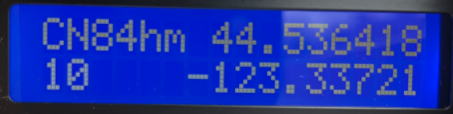
Grid Square LCD Display
Easily customizable LCD display to show time, Lat/Long, grid, etc.
Above shows 6 digit grid, number of sats in view, and Lat/Long location.

Slide 4
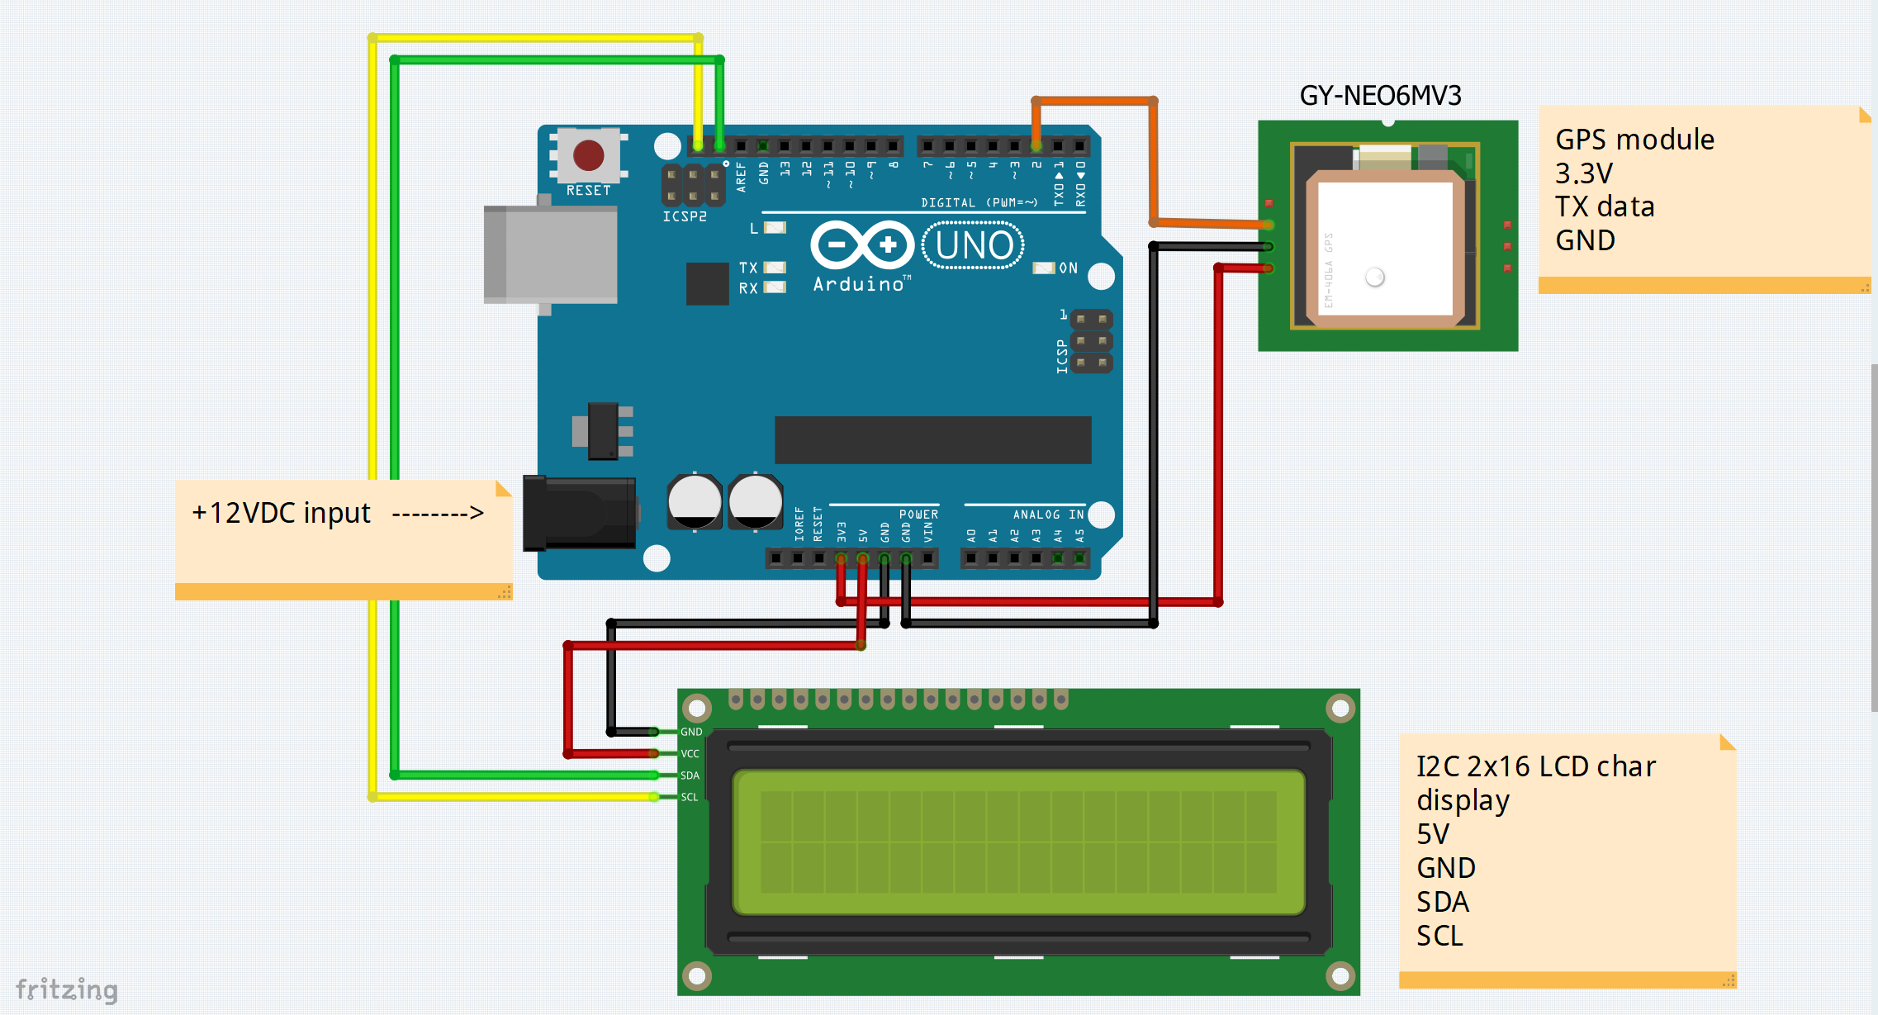
Wiring info

Slide 5
Components info and Sketch location
Parts easily obtained at Amazon.
https://www.amazon.com/GeeekPi-Character-Backlight-Raspberry-Electrical/dp/B07S7PJYM6
https://www.amazon.com/gp/product/B01D1D0F5M
https://www.amazon.com/ELEGOO-Board-ATmega328P-ATMEGA16U2-Compliant/dp/B01EWOE0UU/
Sketch (program) available at githib.com with open access.
https://github.com/bpguy/gps_grid_sq_lcd

