Slide 1


SONG RECOMMENDER USING FACIAL EXPRESSION
MENTOR:
Dr. ALBERT J MAYAN

Slide 2

PROBLEM STATEMENT :
THE PROJECT IS TO DEVELOP AN EMOTION BASED MUSIC
PLAYER WHICH IS AN ANDROID APPLICATION MEANT
FOR USERS TO MINIMIZE HUMAN EFFORTS IN MANAGING
PLAYLISTS.

Slide 3


Slide 4

There are a lot of music/song recommender system but, none has the ability to give songs based on the present human emotion.
So, we came up with the idea to use these resources to develop a app which uses Deep Learning and song datasets to recommend songs to the user based on his current emotion.
Yes, there are apps which takes user’s manual input and recommends song but, this system reduces the user’s work and makes his search low.
So, it struck us that why shouldn’t we give it a go and make it a reality for the user’s as an instant song listening app.

Slide 5
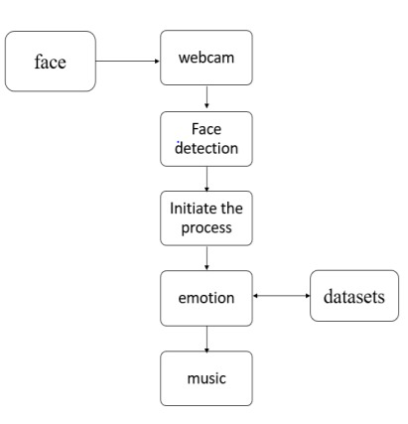
ABSTRACT:
THIS IS AN ANDROID APPLICATION WHERE A USER WILL BE ABLE TO PLAY SONGS ACCORDING TO THEIR MOOD (EMOTION).
THIS APPLICATION LETS THE USER SELECT THE LANGUAGE AND USING FACIAL EXPRESSION RECOGNITION, IT SELECTS AND PLAYS A SONG ACCORDING TO THEIR MOOD.

Slide 6
Scope:

Slide 7


Slide 8
Functional Requirements:

Slide 9
Non-Functional Requirements:

Slide 10
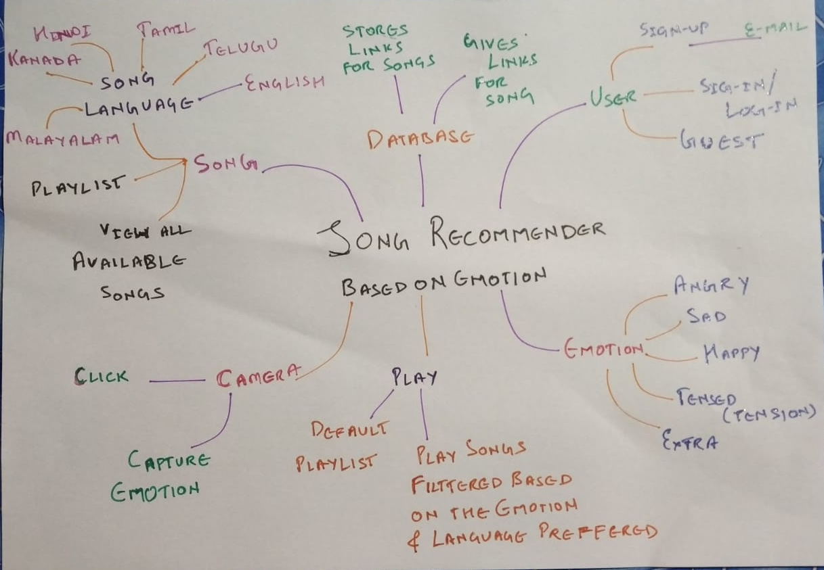
IDEATION MAP

Slide 11
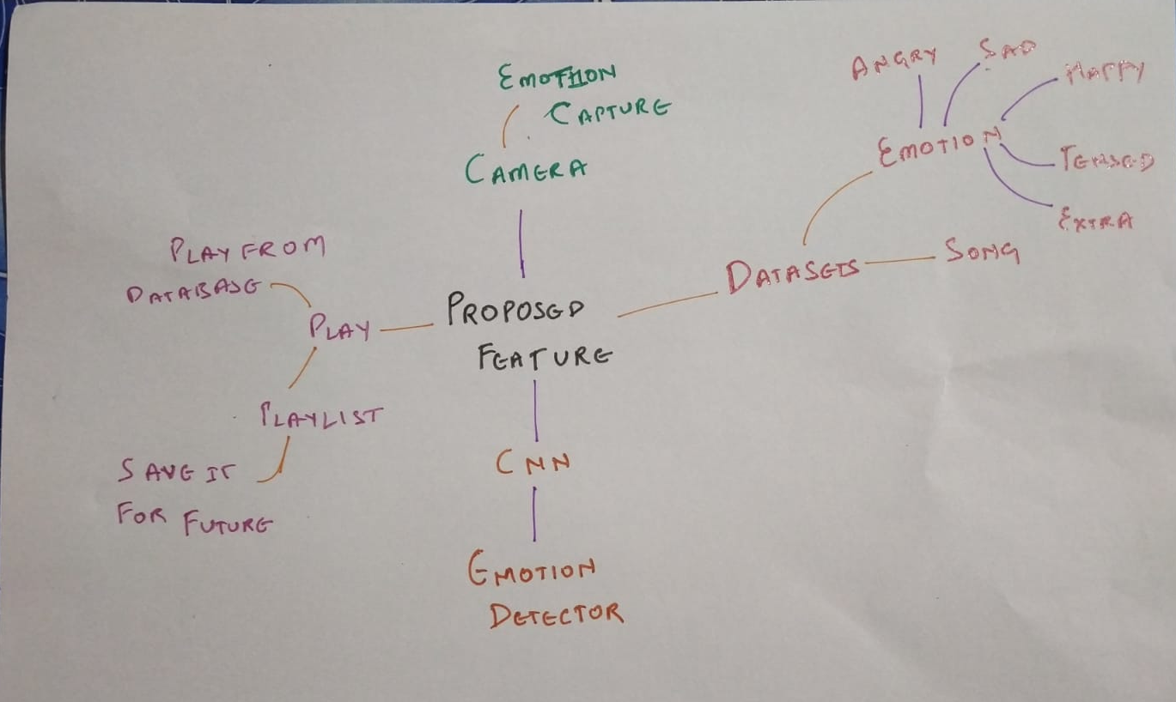
PROPOSED WORK:

Slide 12
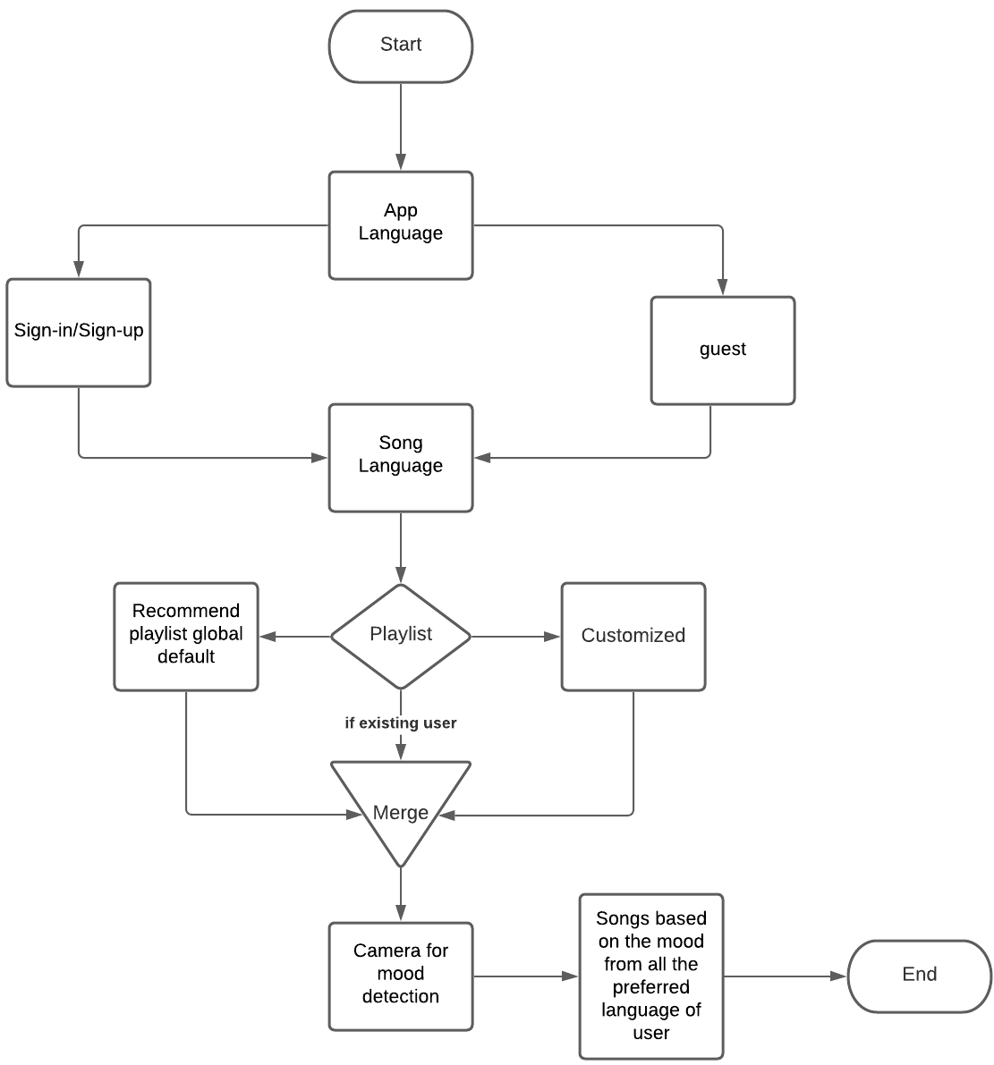
FLOW CHART:

Slide 13
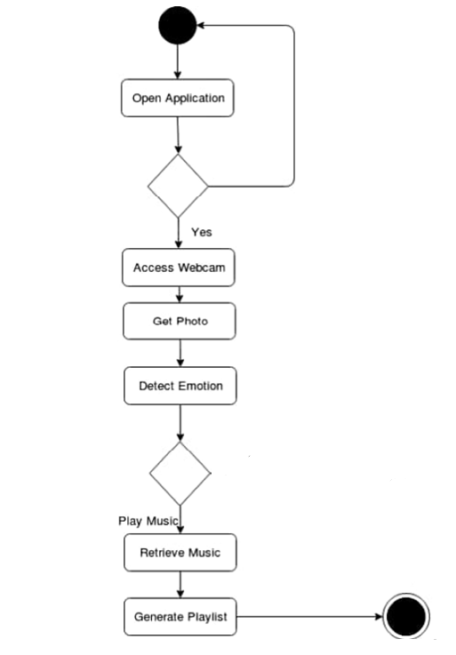
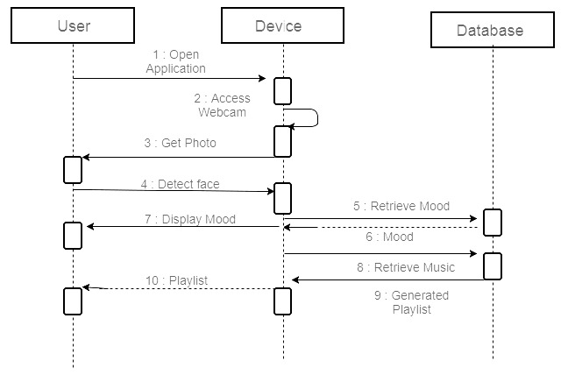
ACTIVITY DIAGRAM: SEQUENCE DIAGRAM:

Slide 14


Slide 15
Tools used:
OpenCV
Flutter(front-end)
Kraggle (Jagadeesh change whatever u want)
Postgres (database)
CNN for recognition
Add if I left out something

Slide 16
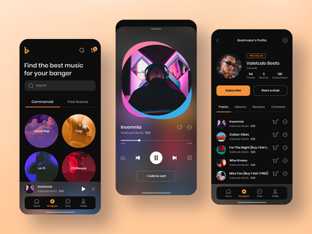
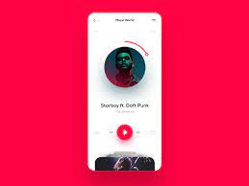
UI/UX

Slide 17
REFERENCES:
1) Spotify — Song Prediction and Recommendation System by : Sunku Sowmya Sree
Source: https://medium.com/swlh/spotify-song-prediction-and-recommendation-system-b3bbc71398ad
2) Create Music Recommendation System Using Python by : Ajinkya Khobragade
Source: https://towardsdatascience.com/create-music-recommendation-system-using-python-ce5401317159

Slide 18


