Slide 1
RD50 HV-CMOS Meeting
DESY-TB results
Harald Handerkas

Slide 2
Overview
When: 22.04.-29.4.2024
Where: DESY test beam facility
Measured Sensors
MPW4
2x topside biased (HEPHY, Liverpool)
2x backside biased (HEPHY, NIKHEF)
Performed Measurements
High statistic runs
Threshold Scans
Bias voltage Scans
Rotation scans
Beam
Particles: electrons
Energy: 4.2 GeV
Rate: ~10 kHz

Slide 3
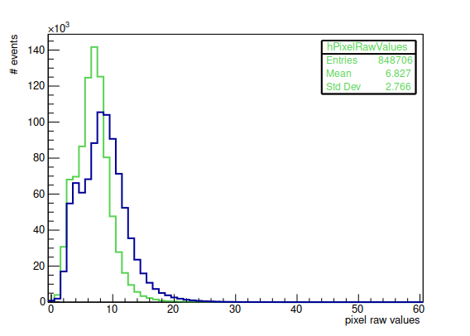
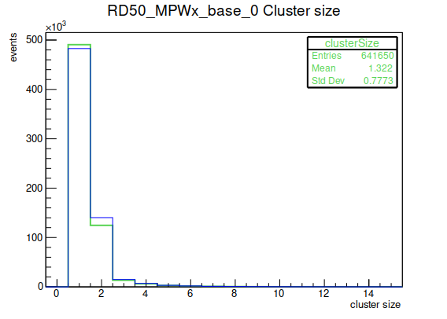
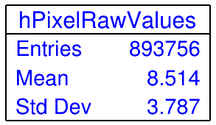
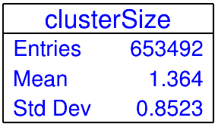
ToT and cluster size
Bias voltage: 190 V
Threshold: 20/40 mV
LSB = 25 ns
RD50_MPWx_base_ToT
HEPHY topside biased
HEPHY backside biased

Slide 4
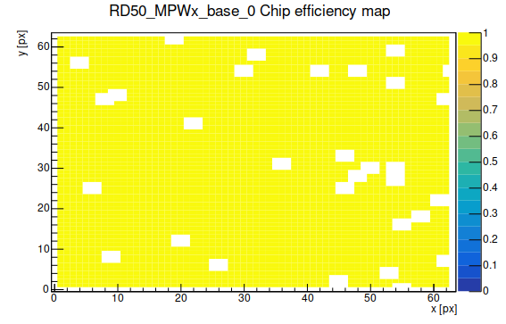
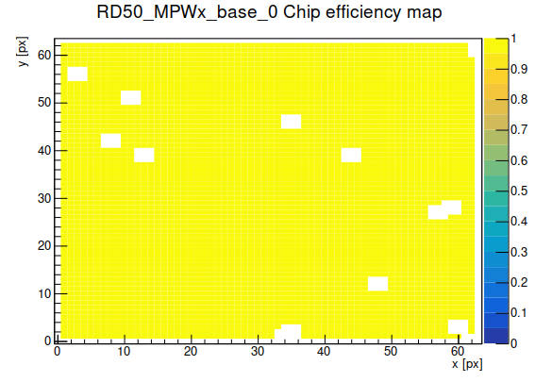
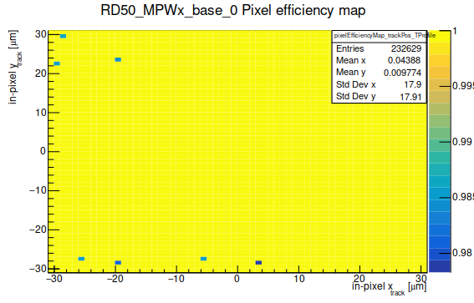
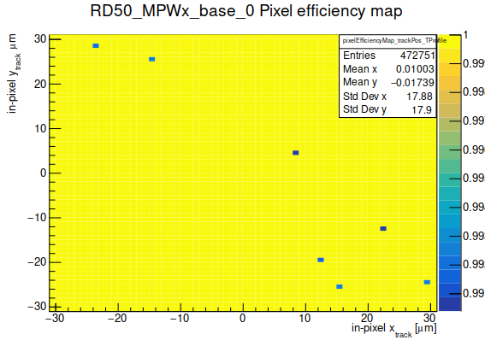
Efficiencies
HEPHY topside biased
Total efficiency: 99.9985 %
Masked pixels: 14
Used tracks: 472751
Missed tracks: 7
HEPHY backside biased
Total efficiency: 99.9961 %
Masked pixels: 31
Used tracks: 232629
Missed tracks: 9
backside
topside

Slide 5
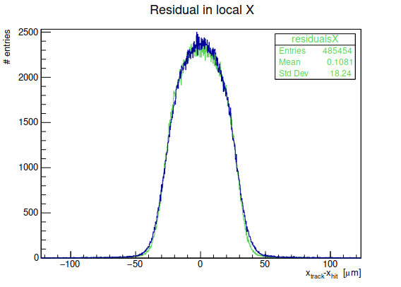
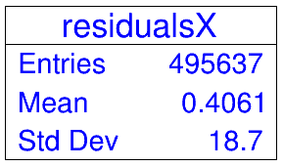
Residuals
Std Dev
binary resolution: 17.89 µm
Range: -110 µm to 110 µm
HEPHY topside biased: 18.24 µm
HEPHY backside biased: 18.70 µm
Range: no cuts
HEPHY topside biased: 19.09 µm
HEPHY backside biased: 20.01 µm
HEPHY topside biased
HEPHY backside biased

Slide 6
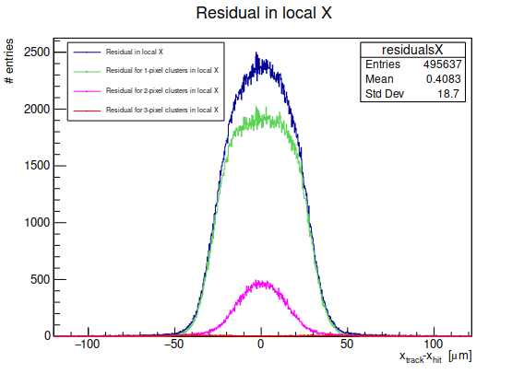
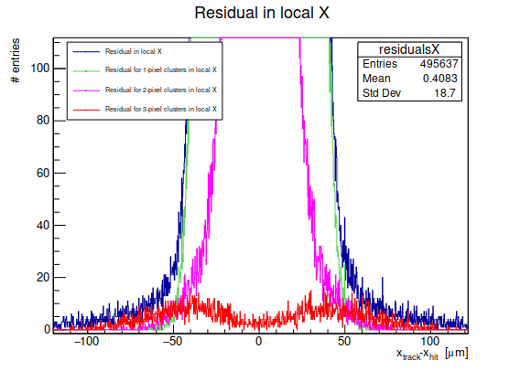
Residuals by clusters
Std dev (range: -110 µm to 110 µm)
All clusters: 18.70 µm
1-pixel clusters: 17.95 µm
2-pixel clusters: 15.60 µm
3-pixel clusters: 49.13 µm

Slide 7
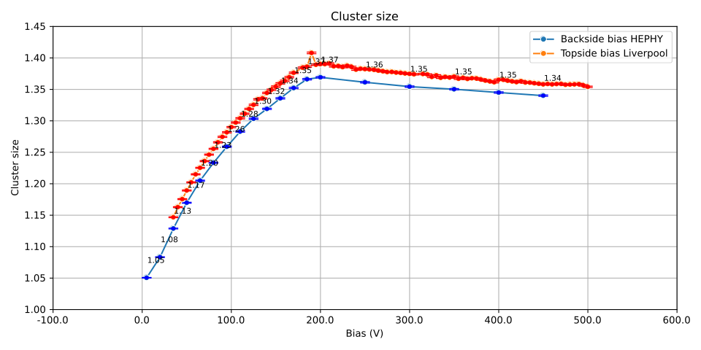
Comparison HEPHY backside biased with Liverpool topside biased
HV scan
Threshold: 30/40 mV
Cluster size increases till 200 V => full depletion
Decrease after this point due to increasing strength of E-field

Slide 8
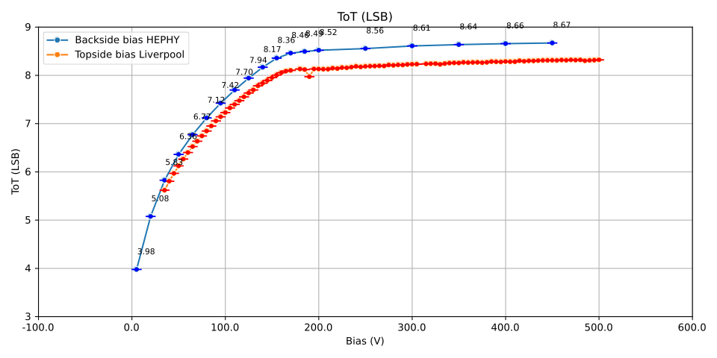
Comparison HEPHY backside biased with Liverpool topside biased
HV scan
Threshold: 30/40 mV
Saturation at 200V
=> full depletion

Slide 9
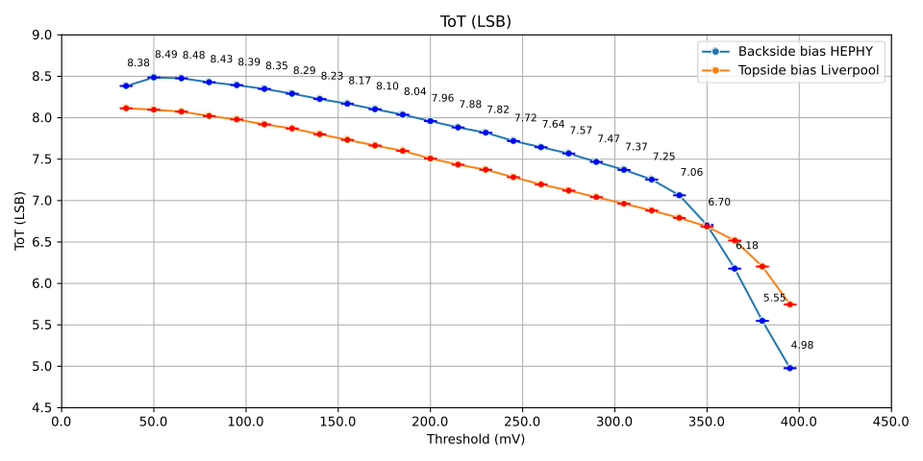
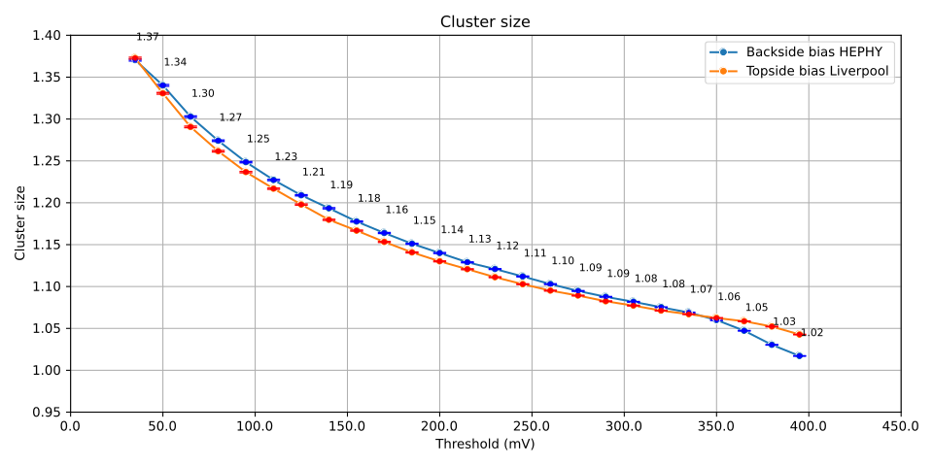
Comparison HEPHY backside biased with Liverpool topside biased
Threshold scan
Bias voltage: 190 V

Slide 10
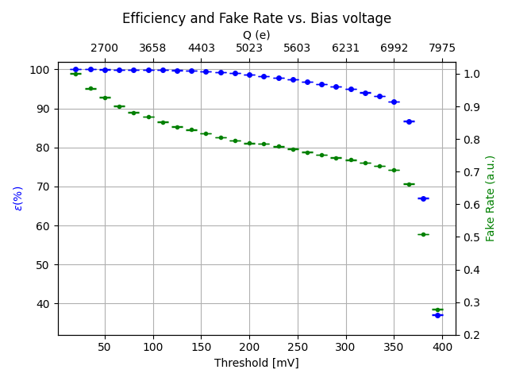
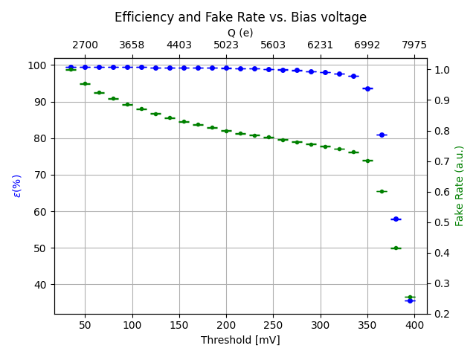
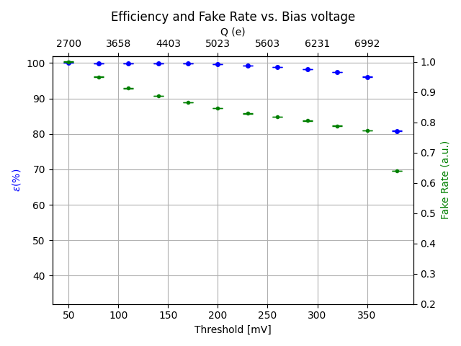
Threshold Scans
Bias voltage: 190 V
HEPHY topside biased
HEPHY backside biased
NIKHEF backside biased biased from top

Slide 11
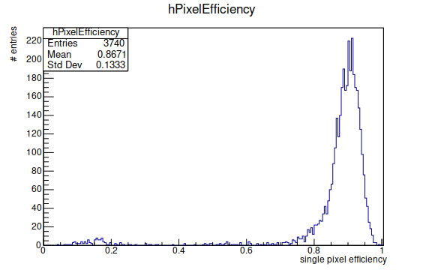
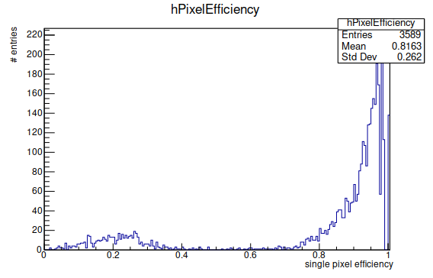
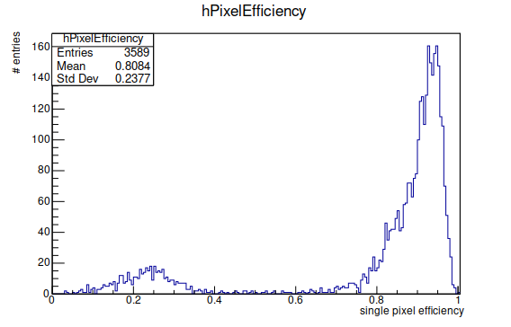
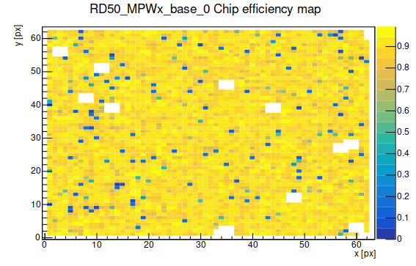
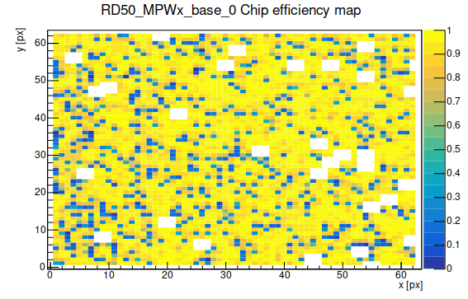
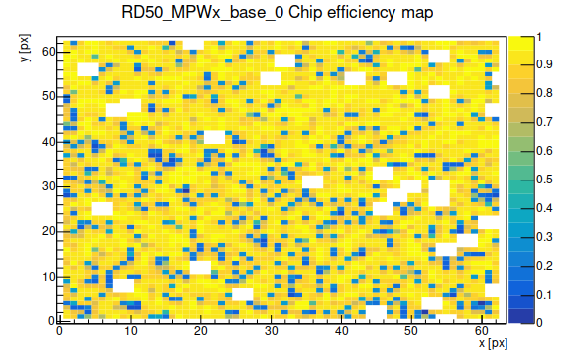
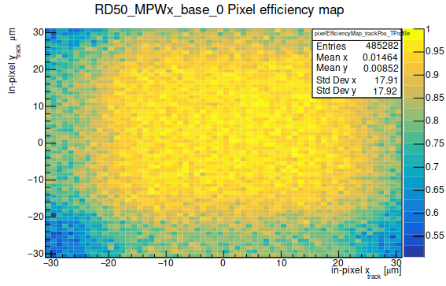
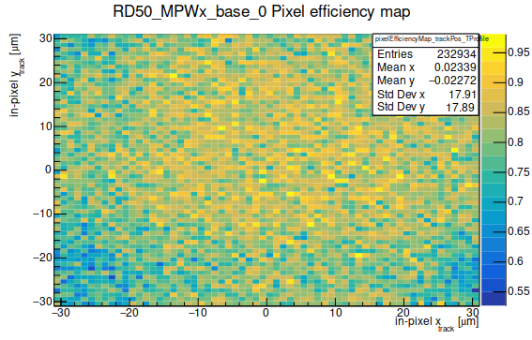
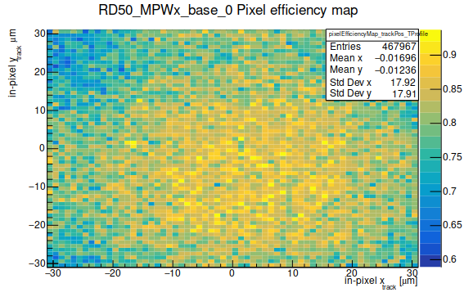
HEPHY topside biased
Threshold: 365 mV
Eff: 86 %
HEPHY backside biased
Threshold: 365 mV
Eff: 81 %
NIKHEF backside biased from top
Threshold: 380 mV
Eff: 80 %

Slide 12
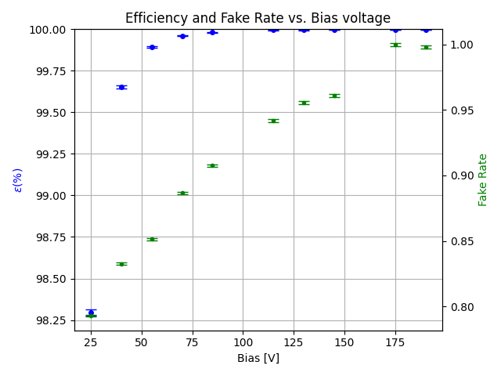
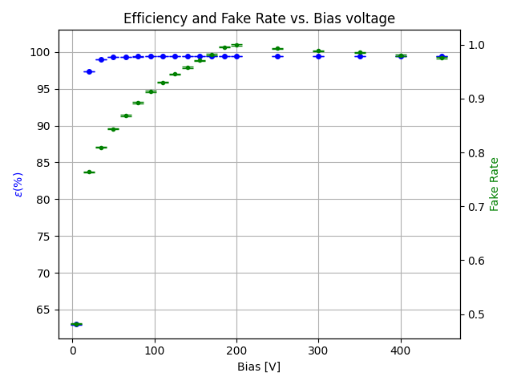
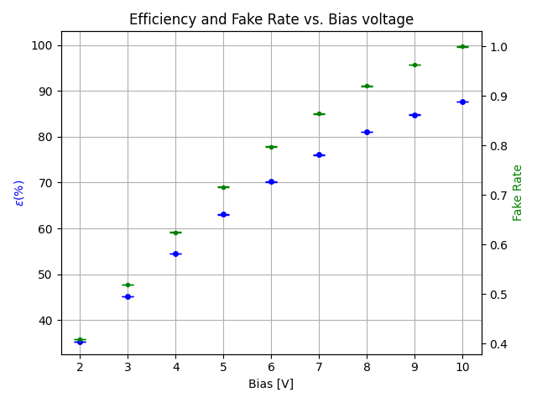
Bias Voltage Scans
Attention: different scales!
HEPHY topside biased
Threshold: 20 mV
HV: 25-190 V
HEPHY backside biased
Threshold: 40 mV
HV: 5-450 V
HEPHY backside biased
Threshold: 40 mV
HV: 2-10 V

Slide 13
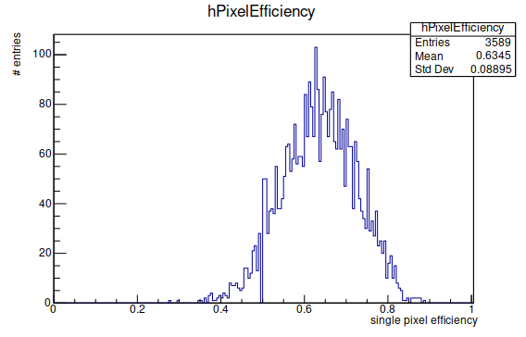
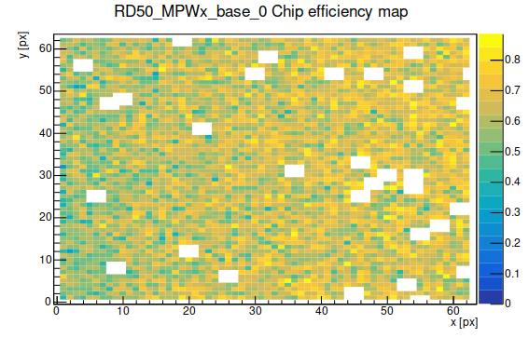
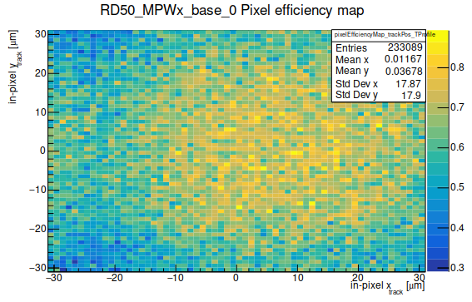
Loss of Efficiency
Single Pixel efficiency
Chip efficiency
Pixel efficiency
HEPHY backside biased
Threshold: 20 mV
HV: 5 V
Eff: 63 %

