Slide 1
Intro to Programming
Notes:
Timing
Conway's Game of Life (3m)
Installation (15m)
Intro to Programming (30m) (with 5 minute break)
Programming Exercise (10m)
Virtues of a Programmer (5m)
[1, 2, 1, 3, 1, 2, 1, 2, 2, 4, 3, 2, 2]

Slide 2
Overview
Conway's Game of Life
Installation
Programming 101
Programming Exercise
Virtues of a Programmer

Slide 3
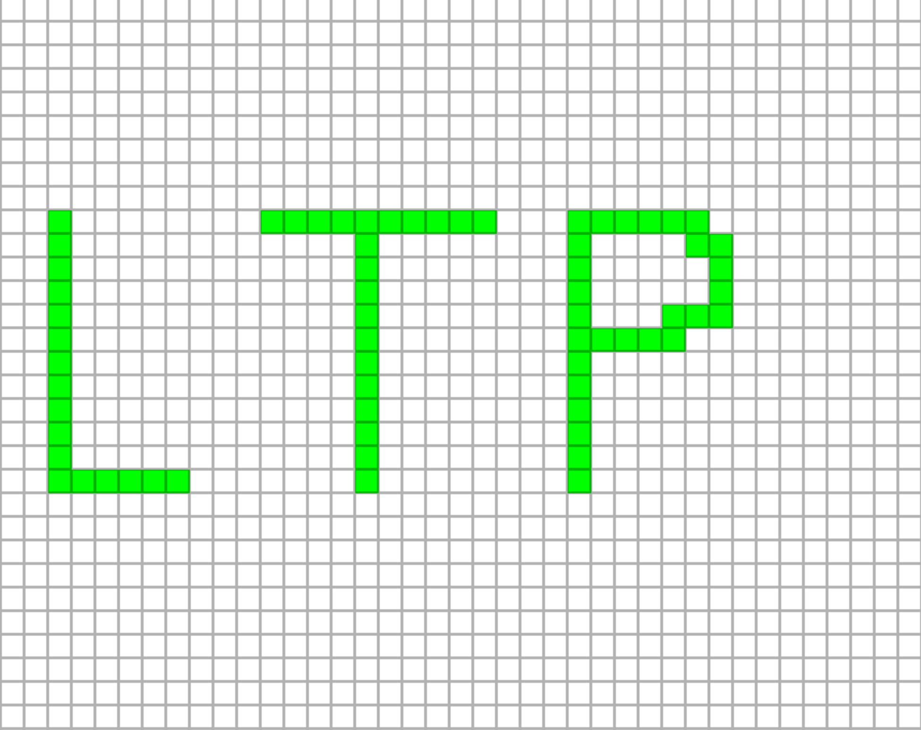
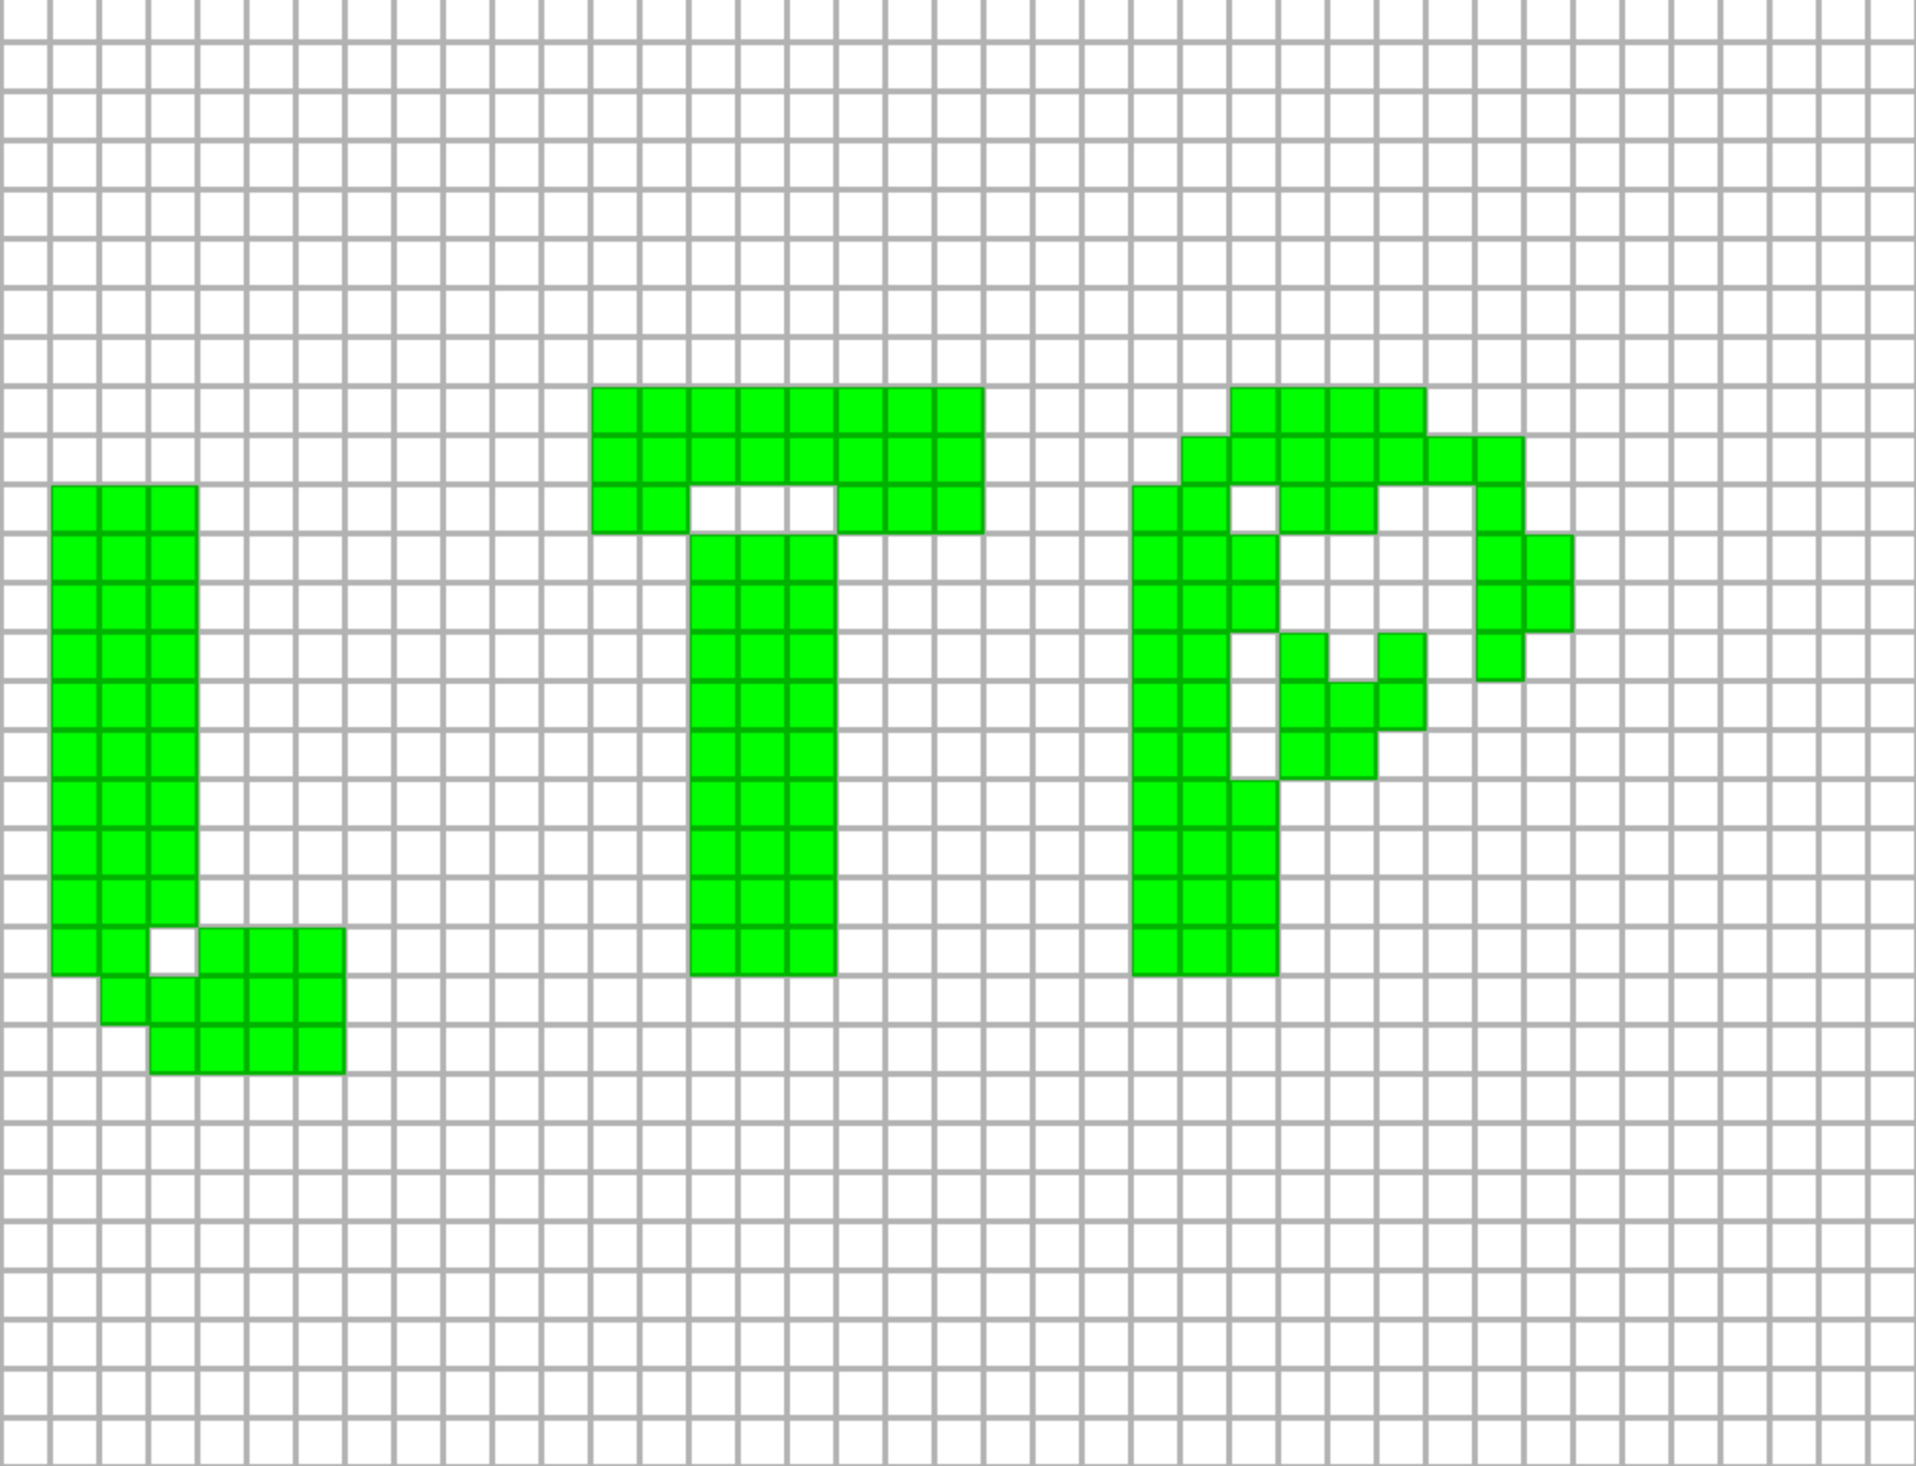
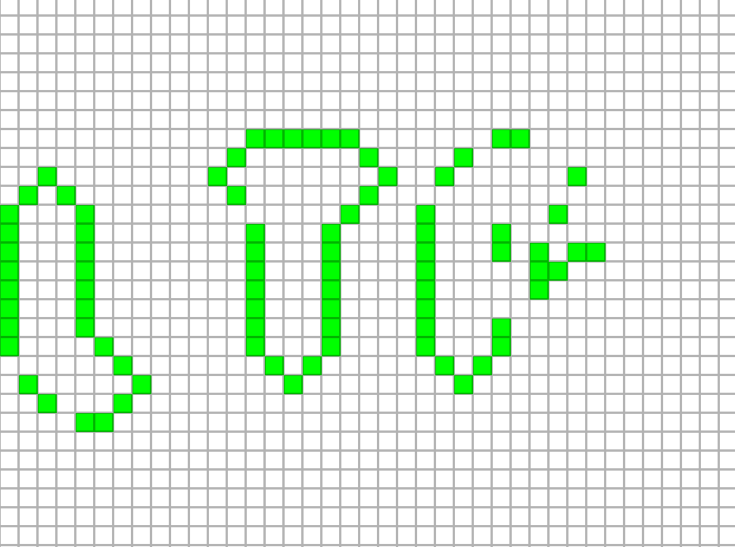
Conway's Game of Life

Slide 4
Installation
View PDF:
https://tinyurl.com/4ycs9m7t

Slide 5
Computers and Responsibilities
Computers perform massive quantities of math, logic, reasoning, record keeping, or other services for us.
It is our job to provide instructions to the computer and make sure they are correct.
It is the computer's job to execute the instructions faster than we ever could.

Slide 6
Source Code
These instructions are called the source code.
Programming is simultaneously very creative and very strict.
On the creative side, we can write a program that does whatever we want.
On the strict side, the computer expects the source code to be in a highly specific format.
This is known as a programming language

Slide 7
Strictness of Source Code
Programmers provide source code in the form of specifically formatted text.
For example, this is a well-formed python program.
(Python is a programming language we'll use today)
pi = 3.14
radius = 6
area = pi * radius * radius
if area > 100:
print("That’s a big circle!")
else:
print("That's a small circle...")

Slide 8
Strictness of Source Code
Below are some examples of common mistakes. This source code will not work!
Line 4: a colon (:) is expected, but instead we have a semicolon (;)
Line 5: This line should be "indented" but it is not. (A tab character or multiple space characters)
Line 6: "Else" should NOT be capitalized.
1 pi = 3.14
2 radius = 6
3 area = pi * radius * radius
4 if area > 100;
5 print("That’s a big circle!")
6 Else:
7 print("That's a small circle...")

Slide 9
Variables
Whenever we want the computer to remember something, we must use a variable.
"Hey boss, I just finished all the calculations for our quarterly revenue projection."
"And..."
"Not sure, I didn't hit save."
A variable is a piece of computer memory that has been given a name by the programmer.
Do this with assignment statements
my_variable_name = some value I want to remember

Slide 10
Variables
Take our previous example:
1 pi = 3.14
2 radius = 6
3 area = pi * radius * radius
4 if area > 100:
5 print("That’s a big circle!")
By the time the computer starts performing line 4, it has completely forgotten what "radius * radius" is.

Slide 11
Computers work with different types of data
The data type of a variable determines HOW we can use the variable.
Examples of data types:
Integer numbers: 5, 0, -399
Fractional numbers: 3.14, 0.0, -0.25
Boolean (truth or falsehood): True, False
Others we won't talk about today.

Slide 12
Computing New Variables
To compute something new, we combine existing variables or literals with an operator.
Literals are things like: 38, False, -0.05, etc. As opposed to variable names.
birth_year = 2006
current_year = 2025
age = current_year - birth_year
failed_drivers_test = False
can_rent_car_for_good_price = (age >= 25) and (not failed_drivers_test)

Slide 13
Break

Slide 14
List of Operators
The data type of a variable determines how it can be used with various operators.
Arithmetic operators
+, -, *, /, % take 2 numbers and produce a number.
Comparison operators
<, >, <=, >= take 2 numbers and produce a boolean.
For example (7 >= 9) is False
==, != take 2 values (of the same type) and produce a boolean.
The boolean is true if the values are the same (==) or different (!=)
and, or take 2 booleans and produce a boolean.
not take 1 boolean and produces a boolean
Inverts the value of a boolean
Careful not to mix up assignment statements (=) with equality testing (==).

Slide 15
Examples of well-formed computations
Assume that x, y, z are integers.
Assume that a, b, c are booleans.
x + y
x / 5
x > y
x != 3
a or b
a and (not b)
a != b
Computations can be as long as you want.
But if they are too long, the code can be hard to understand!
((x + y) > (5 * y)) and (x != 0) and (not b)

Slide 16
Examples of ill-formed computations
The following expressions do not make sense. Do not write code like this!
False + 3
5 > True
7 and 3
not 9
It's like I gave you a .docx file and asked you to open it with excel!

Slide 17
Conditionals
Computer programs are more interesting when they don't do the same thing every time.
If-statements allow us to conditionally execute code.
if <some_boolean_value>:
Code that executes if the value is true
You can put anything in here.
Including another if statement!
else:
Code that executes if the value is false

Slide 18
Exercise
Read the already completed "circle_intersection.py" code.
Edit "life_logic.py" according to the instructions inside.
Currently, life grows like mold. See if you can re-program it based on the instructions to make it more interesting!
If you need a hint, look inside the hint folder.
Can you instead change that code to make it less lengthy by using comparison operators such as > and <= ?
Do not change any other code!

Slide 19
Virtues of a good programmer
Diligence / attention to detail.
Communication / listening / observation.
Understanding the problem to be solved.
Finding a problem somewhere in hundreds of lines of code.
Inventing the Swiffer...

