Slide 1
Design PRoposal
Group 2:
Paul Kruchko
Bryan Jagielo
Michael Laba
Xiaong Tong
Xinfeng Shi
Ran Ao
Monika Shaeff

Slide 2
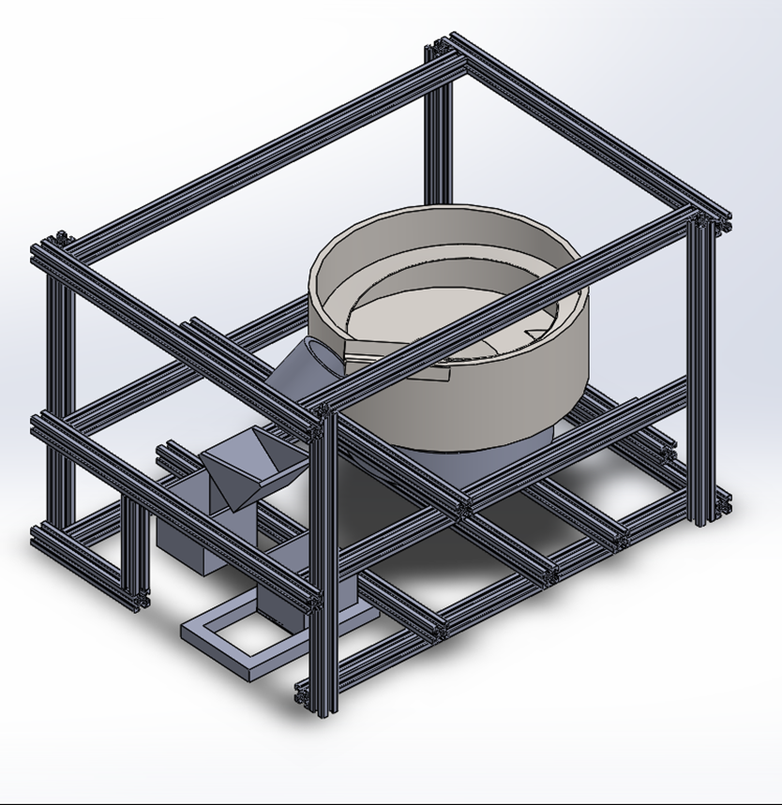
The System: An Overview
-> Designed around a vibratory bowl feeder
-> Through Closed-loop, feed-back control dispenses parts through a tube fitted with an array of light-sensors
-> Design inspiration:
http://www.youtube.com/watch?v=XlfjRkN1ddg

Slide 3
The System: An Overview, cont’d
F(s)
IN
Out
Parts
Hopper
Flow Limiter
Organizer
Counter/Velocity and Mass transfer
F(w,i(t))
Transducer
Staging Trough
M(t)
Controller
W,i(t)
Parts out
Dispenser
Driver

Slide 4
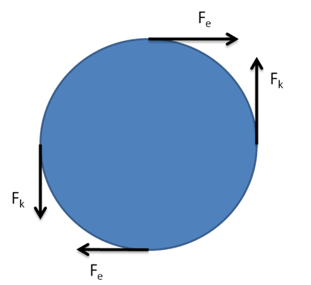
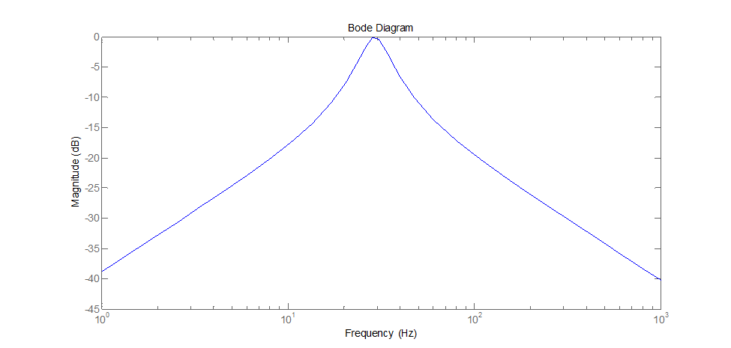
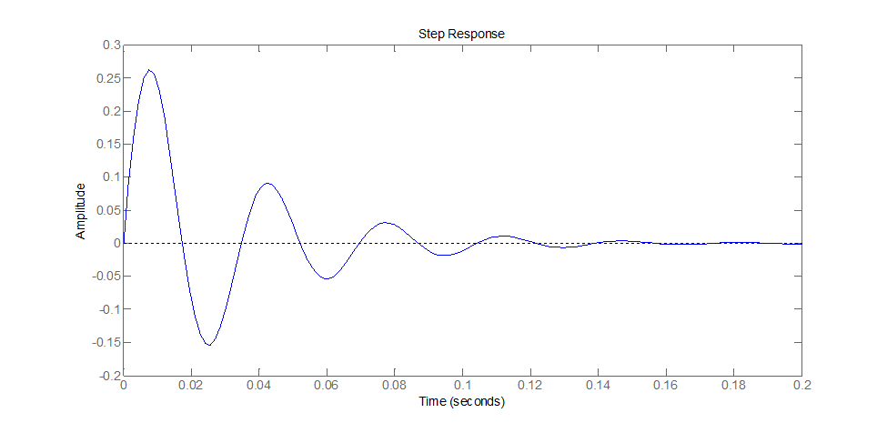
The System: The Model

Slide 5
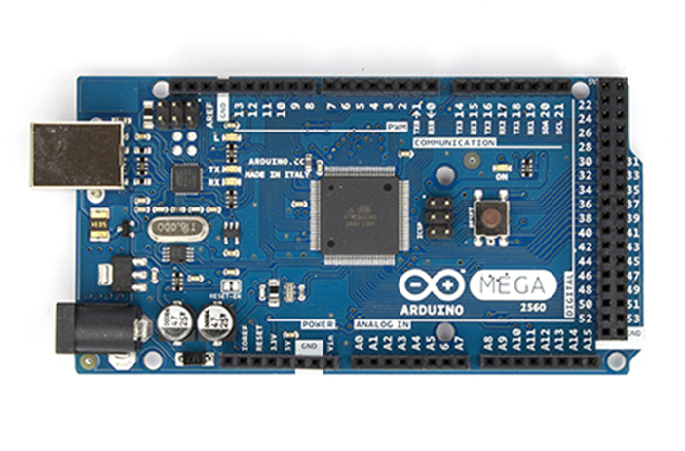
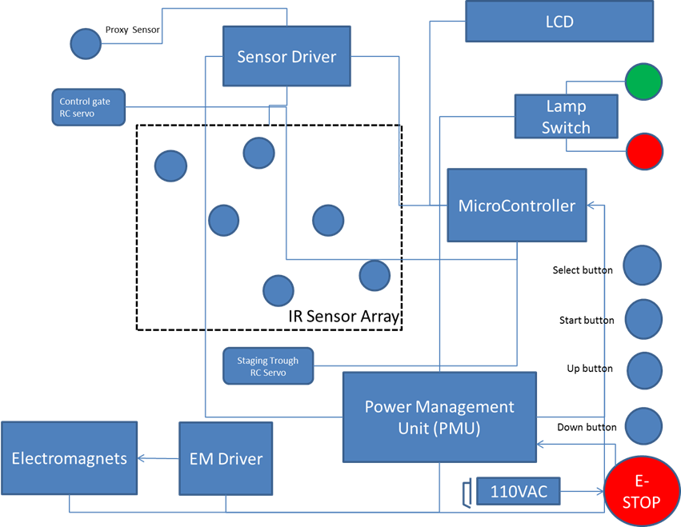
The System: Implementation

Slide 6
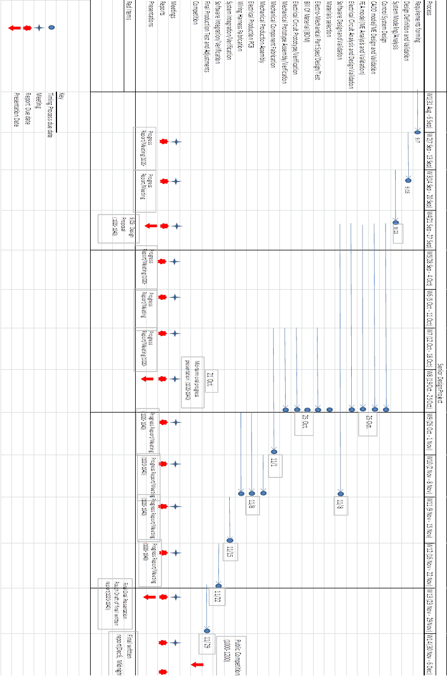
Road Map: Projected Timeline

