Slide 1
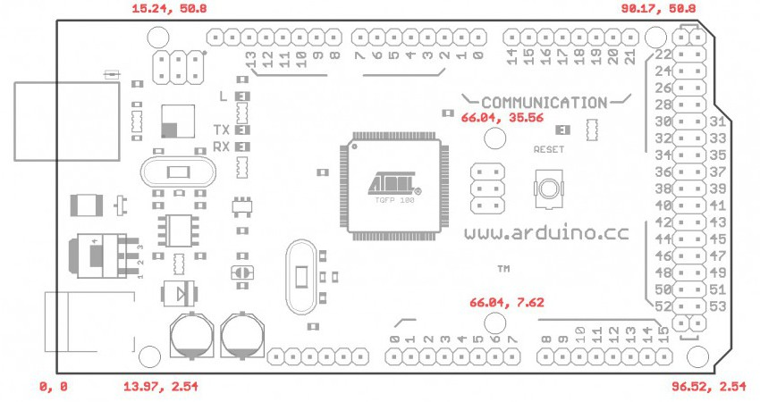
BUTTONS
SENSORS
MOTOR DRIVER
LCD
STATUS LEDS
DISPENSE SENSOR

