Slide 1
Group 2 Project Presentation: Mid-Term
Paul Kruchko- EE-Project Manager
Mike Laba-ME Design Lead
Bryan Jagielo-EE Design Lead
Monika Shaeff-CE
Ran Ao – ME
Xiaong Tong – EE
Xinfeng Shi - ME

Slide 2
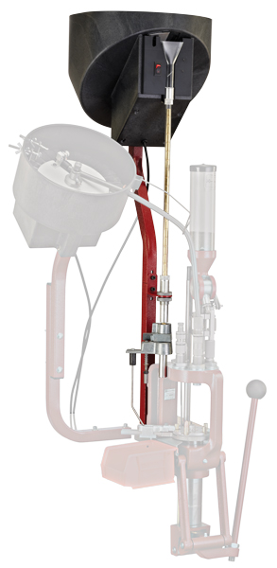
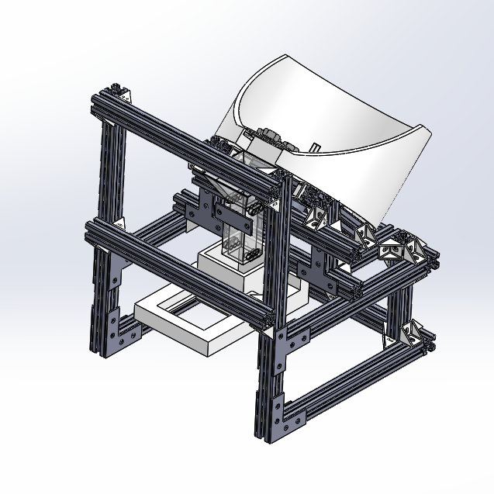
Introduction: Our Product
Rotary Parts Feeder
Inspiration for our design: bullet case feeder
* Image of Hornady Case Feeder Lock-n-Load ® taken from http://www.hornady.com/store/Case-Feeder-Lock-N-Load-110-Volt/

Slide 3
Introduction cont’d
Description: An adaptable small parts dispenser
Application: A manufacturing or packaging environment
Motivation: Hundreds to thousands of parts discarded a day.
Agenda:
Early concepts (brainstorming)
First Design
Re-design
Motion simulation
System Modeling
Motor control simulation
Sensor simulation
Current status
Next steps

Slide 4
Early Concepts
Item container
Flow limiter
Organizer
Dispenser
Holder
Counter

Slide 5
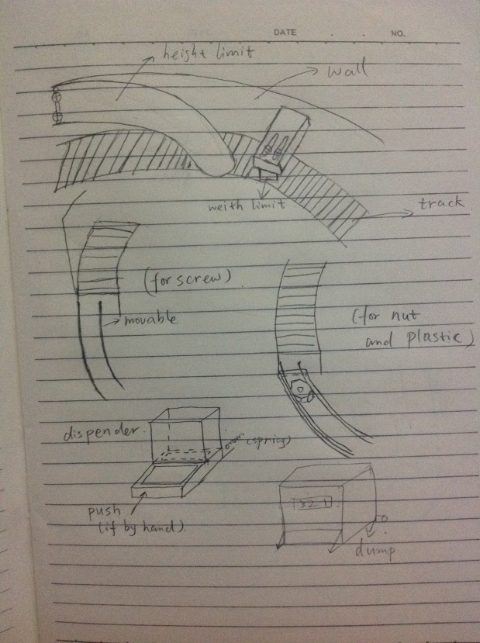
Idea about Flow limiter
Width and high limit!
Speed limit ！
Fluency of track!

Slide 6
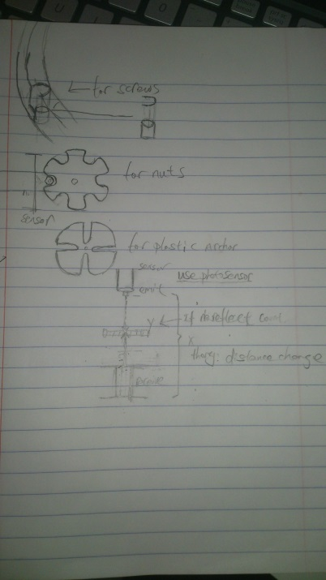
Organizer and Counter
1. Gears
2. Limit gate
How to count parts
IR sensor? Laser?
Pressure sensor?

Slide 7
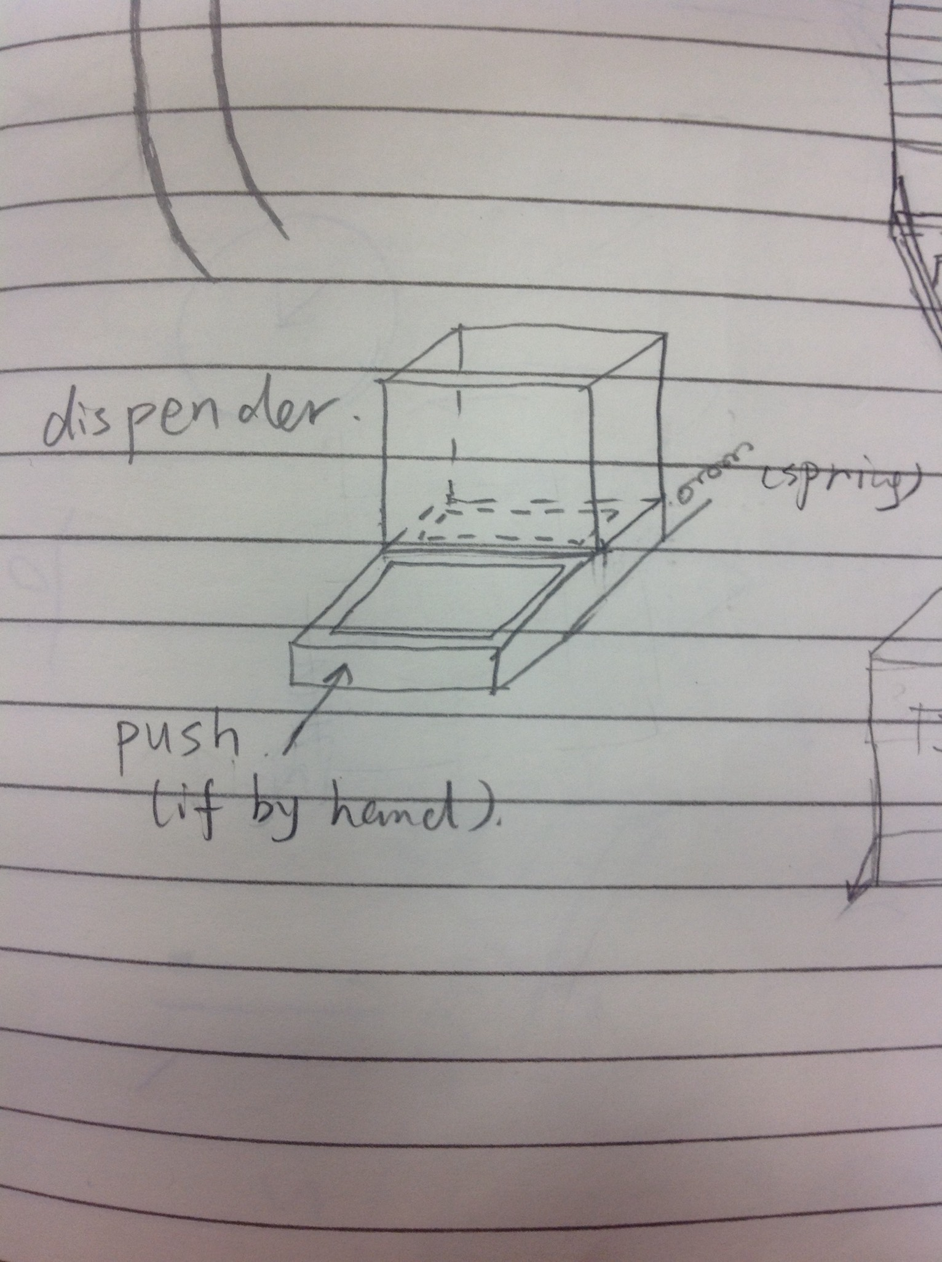
Dispenser

Slide 8
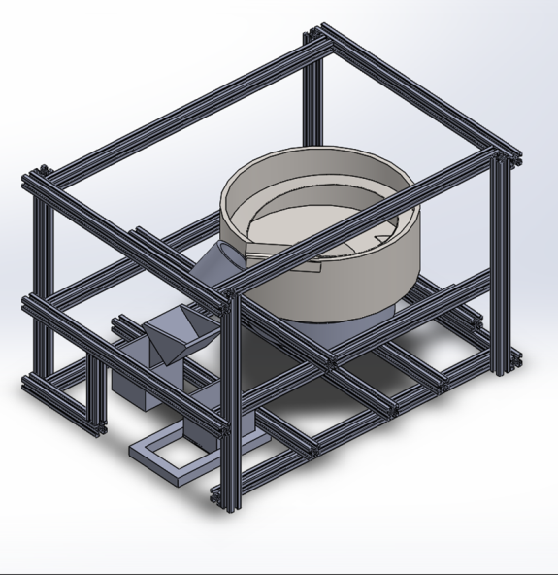
First Design: Vibrating Bowl
Idea From Major Industry.
Uses Tangential and Normal Forces for Part flow.
Bowl uses spiral and limiters for orientation.
Down Stream counting and choosing method.
Optional Rejection Bin.

Slide 9

Re-design: Rotating Feeder
The original design was too challenging
Advantages of new design
Cheaper
Easier to implement
Well defined models
Disadvantages
Opportunity for jams

Slide 10
Rotating Feeder cont’d
functional block diagram of
operation
Hopper Bowl
Rotation & Agitation
Singulation*
Transportation
Motor Speed Control
Counting
User
Dispensing
Holding
* This term was taken from: http://www.msl.ri.cmu.edu/projects/minifactory/partsfeeders.php

Slide 11
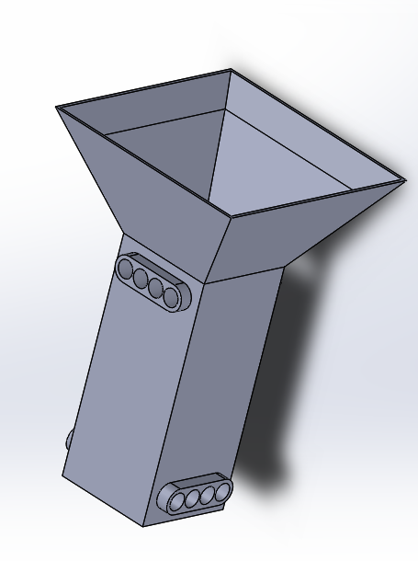
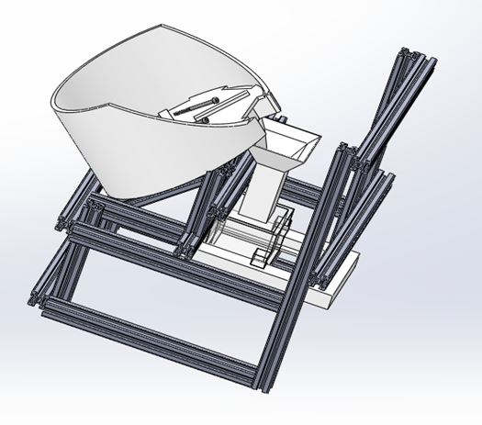
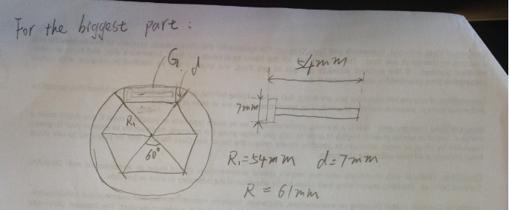
Rotating Feeder

Slide 12

Simulation of Rotating Feeder
Uses contacts to simulate.
Motor rotating at 20 RPM constantly
Bolts* are to scale models with threads for thread lock.
Group2

Slide 13
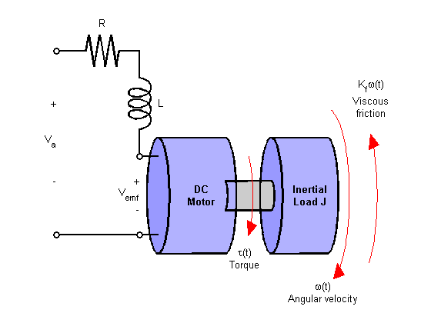
System Modeling: Motor Model
Validate motor selection
Achieve speed control
Account for variances in load torque
http://www.mathworks.com/help/control/examples/dc-motor-control.html

Slide 14
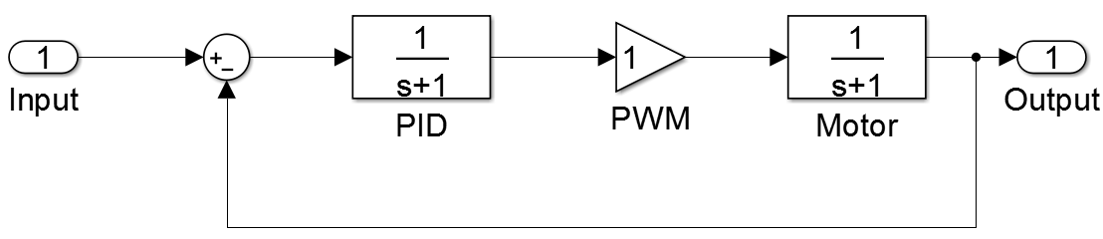
Motor & PID control simulation
Implemented PID control
Acceptable overshoot and settle time
Ready for implementation on MCU

Slide 15
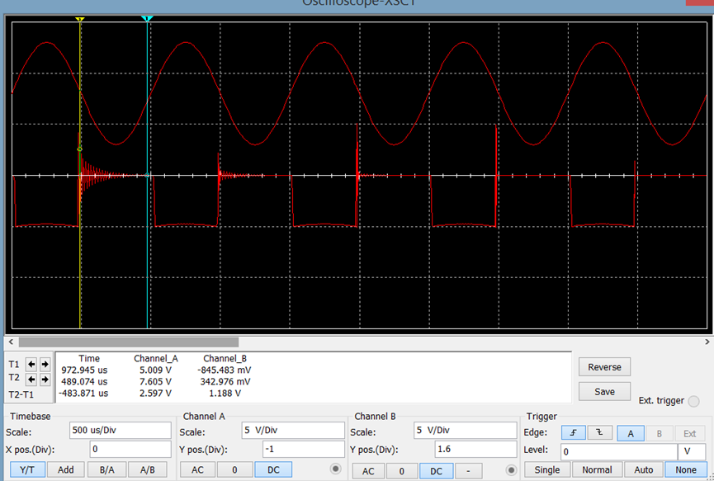

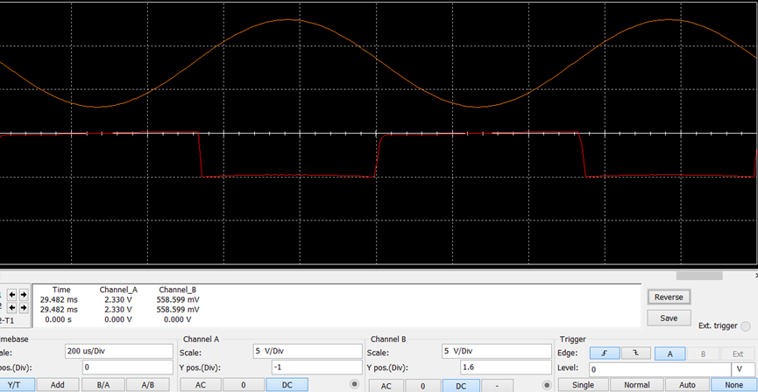
Sensor Simulation
Security
8 parallel sensors in 2 levels
Intensity
Variable luminance through LED’s resistance adjust
Accuracy
34.51us reflection time of output signal
Stability
Few signal noise, less external disturbing

Slide 16
Program Flow

Slide 17
Current Status
90% of parts purchased
Simulation: Correct motion achieved
full simulation of 5 parts achieved.
FEA: Initiated for Box
Control system designed, simulated, ready for implementation

Slide 18
Next Steps
Implement PID motor control in code
Finalize and test code
Prototype and test circuits
Mechanically assemble machine
WIN THE COMPETITION!!!

Slide 19

Questions?

