Slide 1
Overview
Set-up and motor variables
Moments of Intertia and Damping due to load (average of all parts)
Mathematical modeling of motor transfer function

Slide 2
%Control needs analysis of 12V Pittman 8224 motor with G35A wide-faced gear box

Slide 3
Set-up and motor variables

Slide 4
clc
clear all
Ke = 0.01;%[V/rad/s]
Kt = Ke;%Due to SI units
Km = Kt;%Therefore we have only one constant, a motor constant Km
Bm = 1.34e-6;% Viscous damping factor,[Nm*s/rad]
Jm = 1.62e-6;%Inertia of rotor, [kg*m^2]
La = 0.58e-3;%Armature Inductance, [H]
Ra = 1.17;%Armature Resistance, [Ohm]
n = 60.5;% Ratio of G35A gear box => wm/wl
Eff = 0.66;% Efficeincy of gear-box, losses due to gear box gear friction
neff = n*Eff;%Effective gear ratio of gear-box due to friction losses
Inl = 0.37;%No load current draw[A]
Tloss = Inl*Kt;% Torque loss due to the motor shaft [Nm]

Slide 5
Moments of Intertia and Damping due to load (average of all parts)

Slide 6
J_load = 0.0059;%[kg*m^2]
B_load = 0.0166;%[N*m*s/rad]

Slide 7
Mathematical modeling of motor transfer function

Slide 8
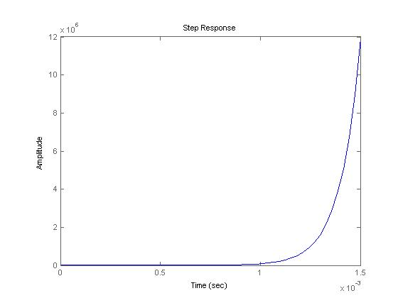
Load is reffered to motor via effective gear ratio Model obtained from Journey from Robot to Digital Human, pg. 298 By: Edward Y.L. Gu, Springer, 2013

Slide 9
Jeff = Jm + (J_load/(neff)^2);%Effective inertia experienced by motor
Beff = Bm + (B_load/(neff)^2);%Effective damping experienced by motor
num = [(-La*Tloss) (Ra+Km)];
den = [(Jeff*La) ((Jeff*Ra) + (Beff*La) - (Km*Tloss)) ((Beff*Ra) + (Km^2) - (Ra*Tloss*Km))];
Sys = tf(num, den)%System TF
% Transfer function:
% -2.146e-006 s + 1.18
% ------------------------------------------
% 3.086e-009 s^2 - 3.077e-005 s + 7.046e-005
w_n = sqrt(((Beff*Ra) + (Km^2) - (Ra*Km*Tloss))/(Jeff*La))
% resonant frequnecy
% w_n =
%
% 151.1057
z = (0.5*((Jeff*Ra)+ (Beff*La) - (Km*Tloss))/sqrt(((Beff*Ra)+(Km^2)-(Ra*Km*Tloss))/(Jeff*La)))
%damping factor
% z =
%
% -1.0181e-007
%Graph of system step response
figure(1);
step(Sys)

Slide 10
Transfer function:
-2.146e-006 s + 1.18
------------------------------------------
3.086e-009 s^2 - 3.077e-005 s + 7.046e-005
w_n =
151.1057
z =
-1.0181e-007

