Slide 1
Motor Simulation and Verifcation
Control System Team
Paul Kruchko
Bryan Jagielo

Slide 2
Goals
Determine if motor speed is within specs for application
Determine power circuit specs (peak current draw)

Slide 3
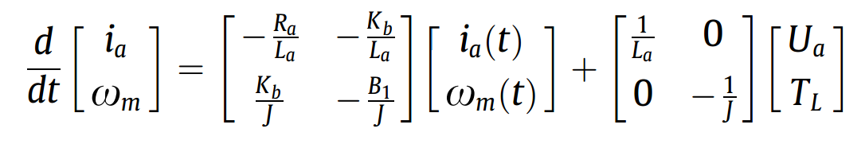
Exact Mathematical Model
Yildiz, A. (2012). Electrical equivalent circuit based modeling and analysis of direct current motors.

Slide 4
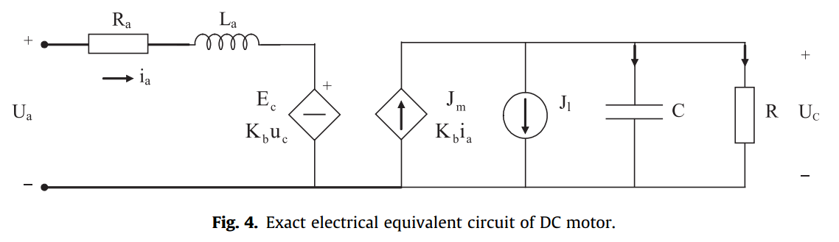
Exact Equivalent Circuit Model
Yildiz, A. (2012). Electrical equivalent circuit based modeling and analysis of direct current motors.

Slide 5
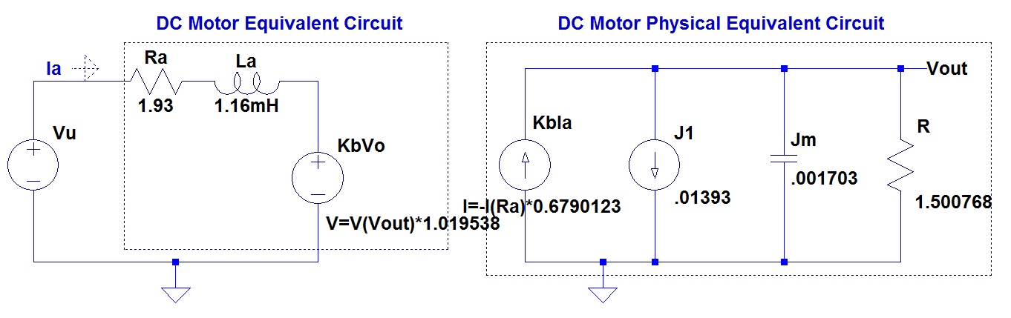
Exact Equivalent Circuit Model

Slide 6
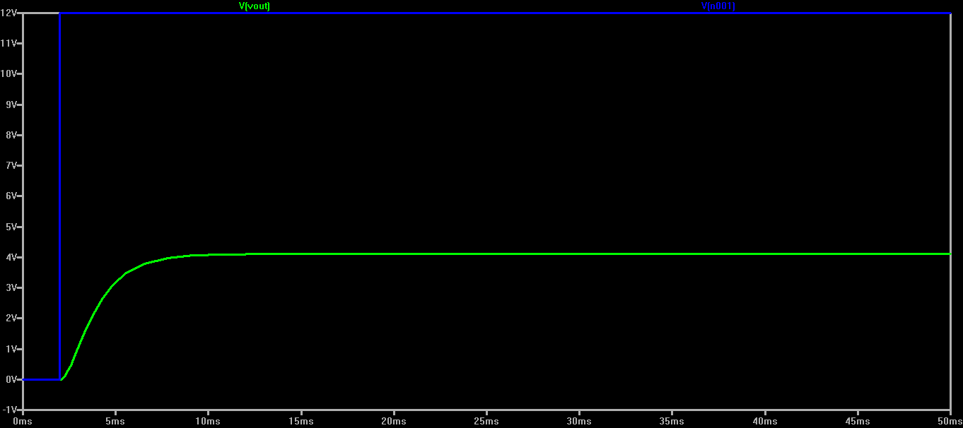
Angular Velocity with Step Response

Slide 7
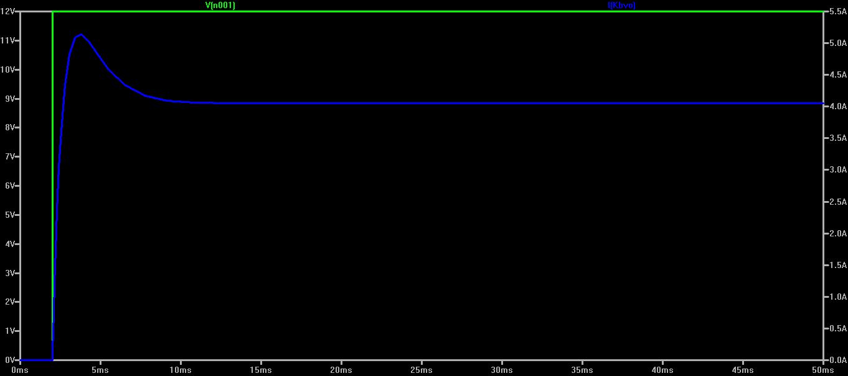
Current With Step Response

Slide 8
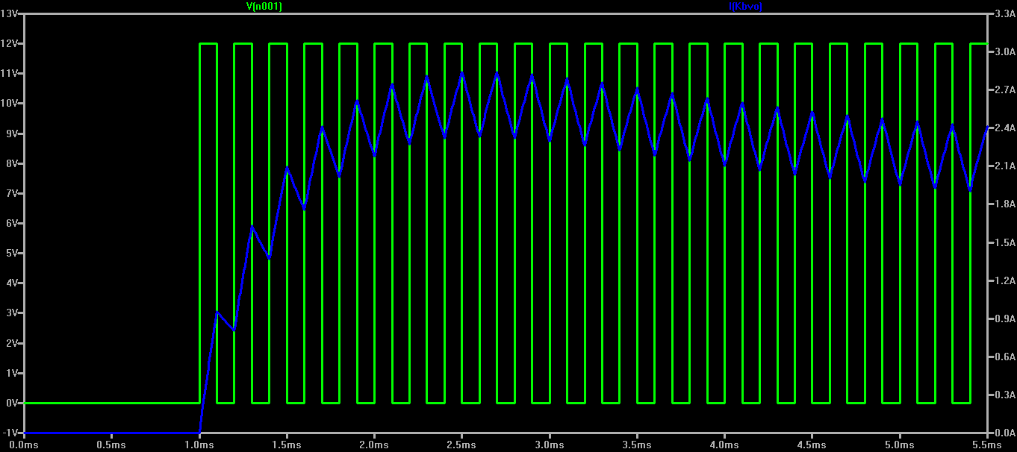
Response with 50% Duty

Slide 9
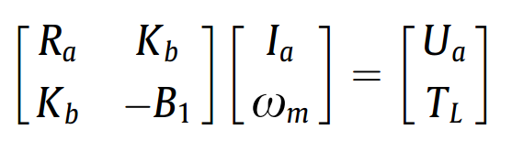
Steady State Mathematical Model
Yildiz, A. (2012). Electrical equivalent circuit based modeling and analysis of direct current motors.

Slide 10
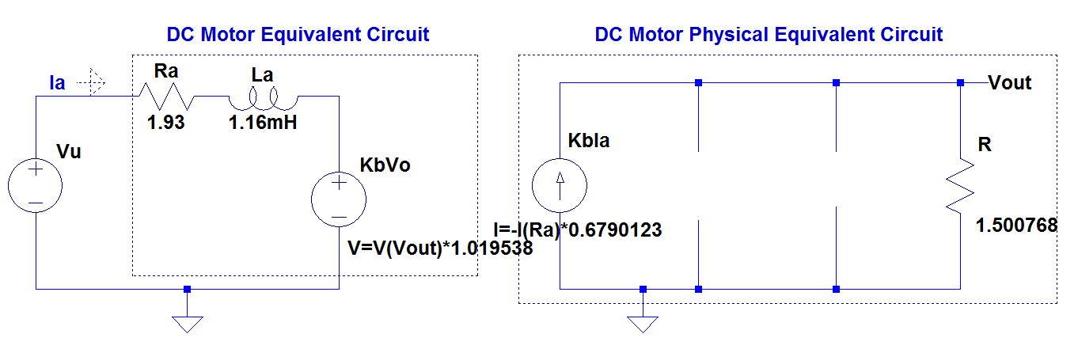
Steady State Equivalent Circuit

Slide 11
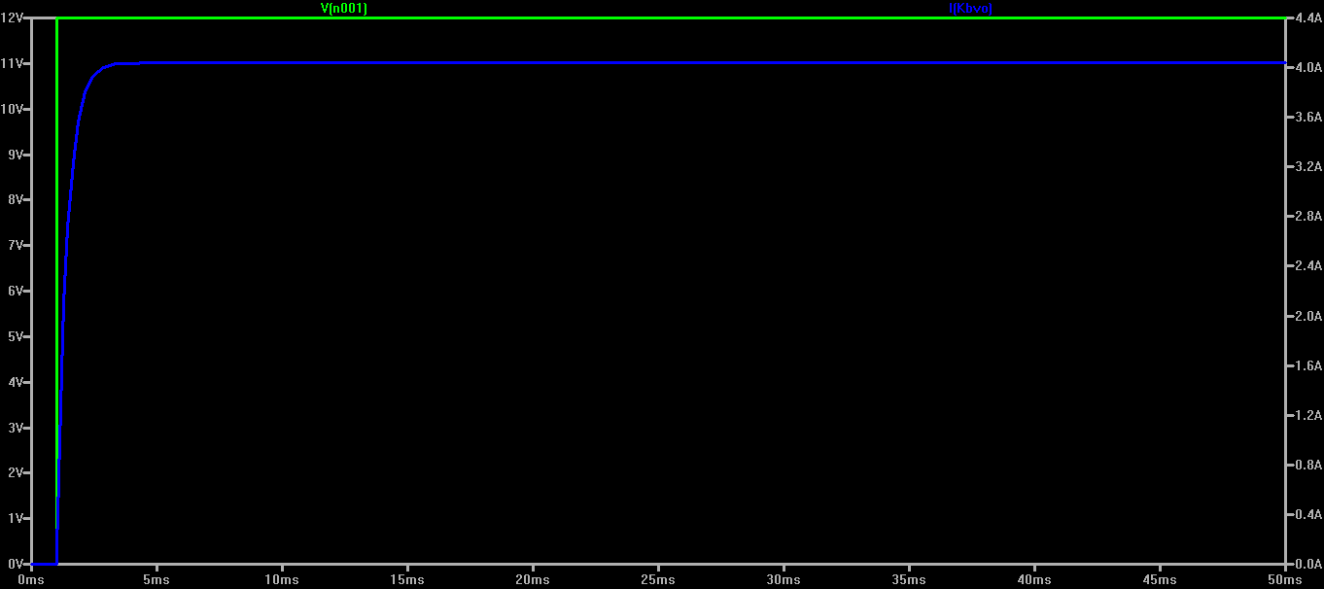
Steady State Current

Slide 12
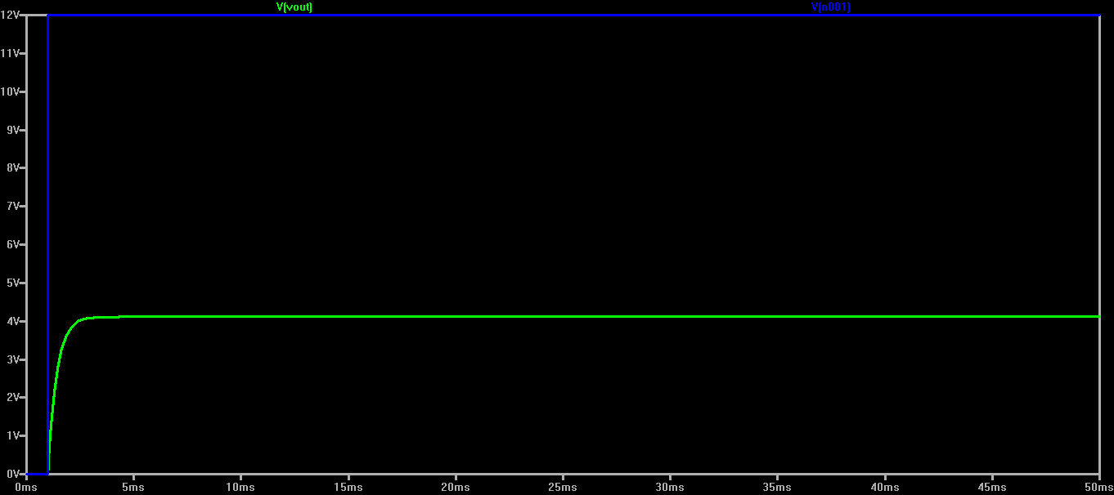
Steady State Angular Velocity

Slide 13
Simulation Results
Peak current in motor drive circuit ≈ 5.3 A
Simulated angular velocity at steady state
≈ 38.2 rpm (within spec)
Simulated angular velocity at 50% duty
≈ 19.09 rpm (within spec)
Results confirmed with datasheet

