Slide 1

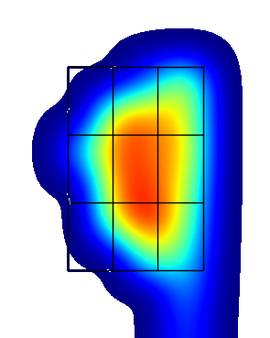
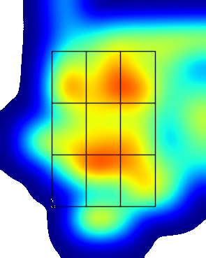

#2 Lane Brewster (L)
LHP 16 PA | AVG | SLG | Whiff % | Chase % | FPS %
FB (37) | .500 | .500 | 6% | 6% | 30%
BB (18) | .500 | .500 | 0% | 9% | 0%
CH (1) | nan | nan | nan% | 0% | nan%
LHP Overall | .500 | .500 | 5% | 7% | 19%
RHP 81 PA | AVG | SLG | Whiff % | Chase % | FPS %
FB (188) | .191 | .298 | 20% | 24% | 40%
BB (34) | .125 | .125 | 35% | 44% | 25%
CH (63) | .176 | .176 | 51% | 40% | 38%
RHP Overall | .178 | .247 | 29% | 31% | 38%
Data From: 2023 WCL
SB/ATT | OPS Last 10 G | Max EV
10-11 | .504 | 101.5
OPS LHP | OPS Overall | OPS RHP
1.062 | .591 | .506
.111
K/BB LHP | K/BB Overall | K/BB RHP
2.00 | 0.53 | 0.44
.314
GO/FO LHP | GO/FO Overall | GO/FO RHP
0.00 | 0.41 | 0.48
Pitcher View
Pitcher View
Hard Hit % LHP
23.1
Hard Hit % RHP
31.0
LHP EV | AVG EV | RHP EV
81.1 | 80.3 | 80.1

Slide 2
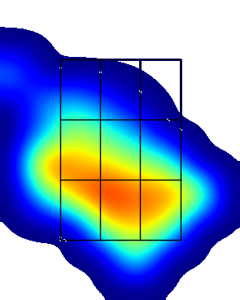
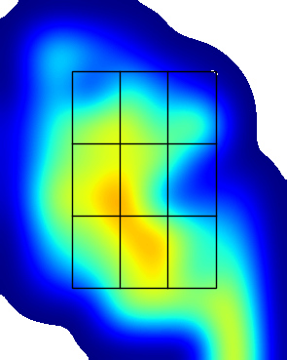
#3 Jesse Brown (R)
LHP 19 PA | AVG | SLG | Whiff % | Chase % | FPS %
FB (41) | .250 | .500 | 18% | 37% | 30%
BB (20) | 1.000 | 1.000 | 17% | 13% | 40%
CH (12) | .333 | .333 | 50% | 60% | 100%
LHP Overall | .429 | .571 | 25% | 34% | 44%
RHP 93 PA | AVG | SLG | Whiff % | Chase % | FPS %
FB (172) | .175 | .175 | 13% | 20% | 28%
BB (120) | .267 | .333 | 36% | 35% | 32%
CH (13) | .500 | .500 | 60% | 62% | 100%
RHP Overall | .244 | .308 | 23% | 29% | 32%
Data From: 2023 WCL
SB/ATT | OPS Last 10 G | Max EV
7-11 | .710 | 102.4
OPS LHP | OPS Overall | OPS RHP
1.097 | .714 | .641
.250
.238
K/BB LHP | K/BB Overall | K/BB RHP
0.67 | 0.45 | 0.41
.571
.240
GO/FO LHP | GO/FO Overall | GO/FO RHP
0.00 | 0.53 | 0.56
Pitcher View
Pitcher View
Hard Hit % LHP
23.5
Hard Hit % RHP
22.1
LHP EV | AVG EV | RHP EV
79.4 | 76.9 | 76.3

Slide 3
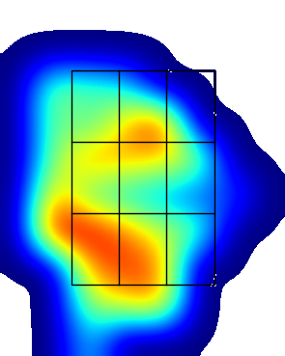
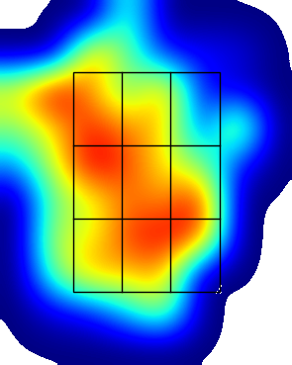
#31 Tripp Clark (R)
LHP 25 PA | AVG | SLG | Whiff % | Chase % | FPS %
FB (50) | .091 | .091 | 23% | 26% | 7%
BB (15) | 1.000 | 1.000 | 0% | 0% | 17%
CH (21) | .333 | .778 | 21% | 62% | 50%
LHP Overall | .238 | .429 | 21% | 33% | 16%
RHP 105 PA | AVG | SLG | Whiff % | Chase % | FPS %
FB (190) | .327 | .455 | 12% | 29% | 31%
BB (123) | .238 | .381 | 18% | 12% | 23%
CH (23) | .250 | .250 | 20% | 25% | 33%
RHP Overall | .289 | .410 | 14% | 22% | 26%
Data From: 2023 WCL
SB/ATT | OPS Last 10 G | Max EV
9-15 | .905 | 102.9
OPS LHP | OPS Overall | OPS RHP
.749 | .828 | .848
.143
.304
K/BB LHP | K/BB Overall | K/BB RHP
0.50 | 0.87 | 1.11
.167
.447
GO/FO LHP | GO/FO Overall | GO/FO RHP
0.29 | 1.00 | 1.31
Pitcher View
Pitcher View
Hard Hit % LHP
20.0
Hard Hit % RHP
34.1
LHP EV | AVG EV | RHP EV
78.5 | 80.7 | 81.2

Slide 4
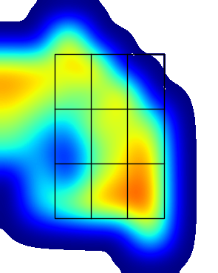
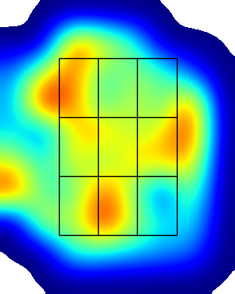
#10 Michail Crossland (R)
LHP 34 PA | AVG | SLG | Whiff % | Chase % | FPS %
FB (74) | .619 | .667 | 3% | 18% | 25%
BB (15) | .000 | .000 | 0% | 0% | 0%
CH (21) | .167 | .167 | 23% | 50% | 40%
LHP Overall | .467 | .500 | 15% | 22% | 24%
RHP 127 PA | AVG | SLG | Whiff % | Chase % | FPS %
FB (269) | .292 | .385 | 15% | 21% | 47%
BB (133) | .160 | .160 | 27% | 21% | 14%
CH (13) | .000 | .000 | 50% | 29% | 0%
RHP Overall | .235 | .304 | 19% | 21% | 33%
Data From: 2023 WCL
SB/ATT | OPS Last 10 G | Max EV
13-16 | .454 | 101.4
OPS LHP | OPS Overall | OPS RHP
1.029 | .727 | .643
.333
.355
K/BB LHP | K/BB Overall | K/BB RHP
1.33 | 1.12 | 1.07
.533
.231
GO/FO LHP | GO/FO Overall | GO/FO RHP
1.00 | 1.53 | 1.67
Pitcher View
Pitcher View
Hard Hit % LHP
13.8
Hard Hit % RHP
21.6
LHP EV | AVG EV | RHP EV
77.0 | 78.1 | 78.4

Slide 5
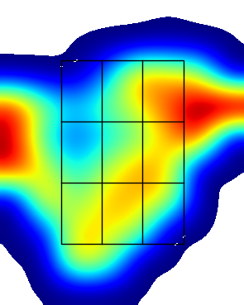
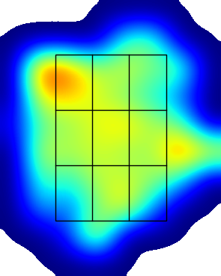
#48 Tyler Davis (R)
LHP 32 PA | AVG | SLG | Whiff % | Chase % | FPS %
FB (79) | .118 | .118 | 24% | 29% | 50%
BB (21) | .000 | .000 | 75% | 0% | 0%
CH (19) | .500 | .625 | 27% | 44% | 50%
LHP Overall | .222 | .259 | 29% | 27% | 41%
RHP 164 PA | AVG | SLG | Whiff % | Chase % | FPS %
FB (304) | .329 | .412 | 18% | 28% | 48%
BB (226) | .222 | .407 | 45% | 32% | 25%
CH (15) | .000 | .000 | 38% | 33% | 60%
RHP Overall | .311 | .446 | 27% | 30% | 40%
Data From: 2023 WCL
SB/ATT | OPS Last 10 G | Max EV
14-17 | .552 | 105.3
OPS LHP | OPS Overall | OPS RHP
.571 | .774 | .812
.500
.390
K/BB LHP | K/BB Overall | K/BB RHP
0.50 | 0.36 | 0.32
.214
.276
GO/FO LHP | GO/FO Overall | GO/FO RHP
0.50 | 0.62 | 0.64
Pitcher View
Pitcher View
Hard Hit % LHP
23.1
Hard Hit % RHP
15.9
LHP EV | AVG EV | RHP EV
78.5 | 76.8 | 76.4

Slide 6

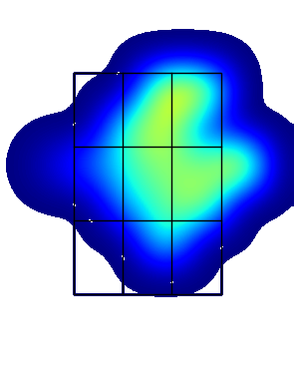
#22 Kai Gray (R)
LHP 10 PA | AVG | SLG | Whiff % | Chase % | FPS %
FB (13) | .500 | 1.000 | 11% | 50% | 33%
BB (3) | .000 | .000 | nan% | 0% | nan%
CH (5) | .000 | .000 | 75% | nan% | 100%
LHP Overall | .200 | .400 | 25% | 33% | 40%
RHP 30 PA | AVG | SLG | Whiff % | Chase % | FPS %
FB (66) | .231 | .231 | 19% | 11% | 39%
BB (32) | .000 | .000 | 43% | 0% | 11%
CH (4) | .000 | .000 | 67% | 100% | nan%
RHP Overall | .136 | .136 | 28% | 10% | 28%
Data From: 2023 WCL
SB/ATT | OPS Last 10 G | Max EV
4-5 | .593 | 98.4
OPS LHP | OPS Overall | OPS RHP
.600 | .544 | .503
.167
K/BB LHP | K/BB Overall | K/BB RHP
0.00 | 0.67 | 1.20
.000
GO/FO LHP | GO/FO Overall | GO/FO RHP
0/0 | 0.67 | 0.67
Pitcher View
Pitcher View
Hard Hit % LHP
0.0
Hard Hit % RHP
11.1
LHP EV | AVG EV | RHP EV
65.9 | 74.9 | 75.8

Slide 7
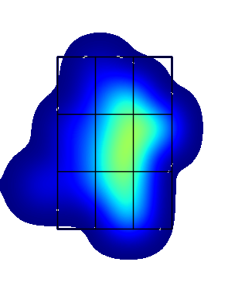
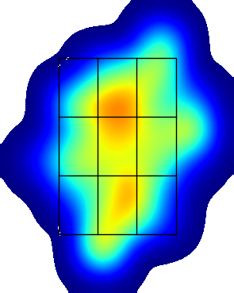
#34 Brandon Green (R)
LHP 9 PA | AVG | SLG | Whiff % | Chase % | FPS %
FB (22) | .143 | .143 | 9% | 30% | 25%
BB (6) | nan | nan | nan% | 0% | 0%
CH (5) | .000 | .000 | 50% | 67% | 25%
LHP Overall | .125 | .125 | 15% | 28% | 20%
RHP 46 PA | AVG | SLG | Whiff % | Chase % | FPS %
FB (104) | .280 | .520 | 20% | 22% | 48%
BB (58) | .231 | .462 | 24% | 17% | 8%
CH (3) | 1.000 | 1.000 | 0% | 0% | nan%
RHP Overall | .268 | .488 | 20% | 20% | 38%
Data From: 2023 WCL
SB/ATT | OPS Last 10 G | Max EV
4-5 | .505 | 94.3
OPS LHP | OPS Overall | OPS RHP
.347 | .738 | .814
.429
K/BB LHP | K/BB Overall | K/BB RHP
1/0 | 0.40 | 0.30
.250
GO/FO LHP | GO/FO Overall | GO/FO RHP
0.25 | 0.67 | 0.88
Pitcher View
Pitcher View
Hard Hit % LHP
0.0
Hard Hit % RHP
18.9
LHP EV | AVG EV | RHP EV
71.3 | 76.7 | 77.9

Slide 8
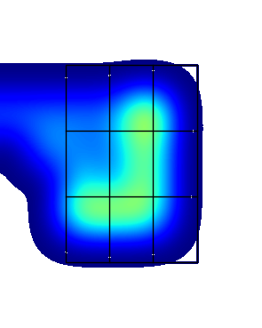
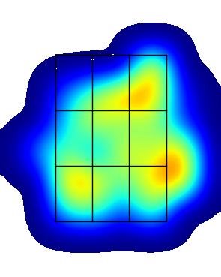
#39 Tyrus Hall (R)
LHP 16 PA | AVG | SLG | Whiff % | Chase % | FPS %
FB (35) | .143 | .143 | 15% | 16% | 30%
BB (13) | .500 | 1.000 | 0% | 0% | 25%
CH (8) | .000 | .000 | 100% | 83% | 0%
LHP Overall | .167 | .250 | 35% | 27% | 25%
RHP 62 PA | AVG | SLG | Whiff % | Chase % | FPS %
FB (143) | .286 | .314 | 27% | 23% | 38%
BB (80) | .267 | .267 | 42% | 27% | 21%
CH (9) | nan | nan | 33% | 0% | 0%
RHP Overall | .275 | .294 | 32% | 24% | 32%
Data From: 2023 WCL
SB/ATT | OPS Last 10 G | Max EV
13-14 | .579 | 95.6
OPS LHP | OPS Overall | OPS RHP
.625 | .671 | .681
.077
K/BB LHP | K/BB Overall | K/BB RHP
1.00 | 0.62 | 0.53
.350
GO/FO LHP | GO/FO Overall | GO/FO RHP
0.50 | 0.70 | 0.75
Pitcher View
Pitcher View
Hard Hit % LHP
0.0
Hard Hit % RHP
18.9
LHP EV | AVG EV | RHP EV
74.2 | 76.8 | 77.4

Slide 9
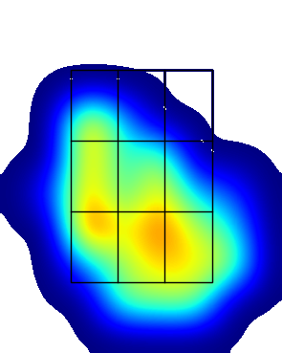
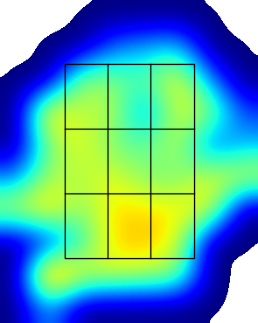
#32 Jack Johnson (R)
LHP 37 PA | AVG | SLG | Whiff % | Chase % | FPS %
FB (81) | .267 | .533 | 36% | 9% | 42%
BB (22) | .400 | .800 | 12% | 42% | 20%
CH (26) | .000 | .000 | 33% | 56% | 50%
LHP Overall | .250 | .438 | 30% | 28% | 41%
RHP 176 PA | AVG | SLG | Whiff % | Chase % | FPS %
FB (378) | .211 | .267 | 23% | 18% | 35%
BB (192) | .293 | .415 | 26% | 29% | 22%
CH (29) | .167 | .333 | 29% | 35% | 33%
RHP Overall | .238 | .313 | 24% | 23% | 32%
Data From: 2023 WCL
SB/ATT | OPS Last 10 G | Max EV
10-12 | .589 | 97.2
OPS LHP | OPS Overall | OPS RHP
.789 | .668 | .643
.200
.182
K/BB LHP | K/BB Overall | K/BB RHP
0.44 | 0.45 | 0.45
.286
.291
GO/FO LHP | GO/FO Overall | GO/FO RHP
0.40 | 0.50 | 0.52
Pitcher View
Pitcher View
Hard Hit % LHP
9.1
Hard Hit % RHP
16.5
LHP EV | AVG EV | RHP EV
75.8 | 76.5 | 76.6

Slide 10
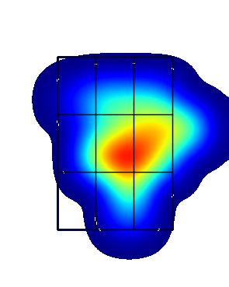
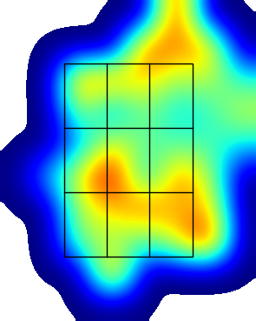
#29 Ryan Magdic (L)
LHP 16 PA | AVG | SLG | Whiff % | Chase % | FPS %
FB (31) | .333 | .333 | 27% | 7% | 29%
BB (20) | .000 | .000 | 0% | 0% | 29%
CH (2) | nan | nan | nan% | 0% | nan%
LHP Overall | .167 | .167 | 15% | 4% | 25%
RHP 50 PA | AVG | SLG | Whiff % | Chase % | FPS %
FB (115) | .263 | .526 | 25% | 36% | 46%
BB (37) | .300 | .500 | 22% | 24% | 33%
CH (49) | .333 | .500 | 16% | 24% | 50%
RHP Overall | .326 | .628 | 21% | 31% | 46%
Data From: 2023 WCL
SB/ATT | OPS Last 10 G | Max EV
0-1 | 1.032 | 100.5
OPS LHP | OPS Overall | OPS RHP
.542 | .936 | 1.048
.333
K/BB LHP | K/BB Overall | K/BB RHP
1.50 | 1.11 | 1.00
.263
GO/FO LHP | GO/FO Overall | GO/FO RHP
0.00 | 0.67 | 0.86
Pitcher View
Pitcher View
Hard Hit % LHP
22.2
Hard Hit % RHP
25.5
LHP EV | AVG EV | RHP EV
77.7 | 79.8 | 80.2

Slide 11
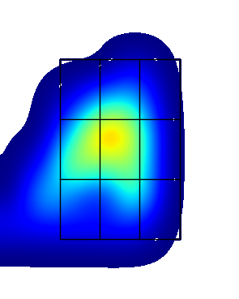
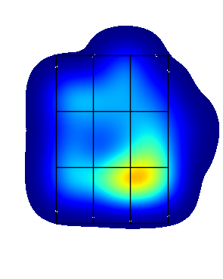
#23 Kieper Pate (R)
LHP 12 PA | AVG | SLG | Whiff % | Chase % | FPS %
FB (31) | .000 | .000 | 30% | 12% | 25%
BB (9) | .000 | .000 | 50% | 25% | 0%
CH (11) | .000 | .000 | 14% | 100% | 25%
LHP Overall | .000 | .000 | 29% | 18% | 23%
RHP 24 PA | AVG | SLG | Whiff % | Chase % | FPS %
FB (62) | .000 | .000 | 19% | 23% | 20%
BB (36) | .111 | .111 | 25% | 25% | 0%
CH (5) | .000 | .000 | 50% | 50% | 0%
RHP Overall | .053 | .053 | 23% | 25% | 12%
Data From: 2023 WCL
SB/ATT | OPS Last 10 G | Max EV
1-1 | .238 | 97.5
OPS LHP | OPS Overall | OPS RHP
.083 | .200 | .261
.333
K/BB LHP | K/BB Overall | K/BB RHP
0.33 | 0.40 | 0.43
.000
GO/FO LHP | GO/FO Overall | GO/FO RHP
0.00 | 0.44 | 1.00
Pitcher View
Pitcher View
Hard Hit % LHP
12.5
Hard Hit % RHP
5.6
LHP EV | AVG EV | RHP EV
68.6 | 69.7 | 70.2

Slide 12
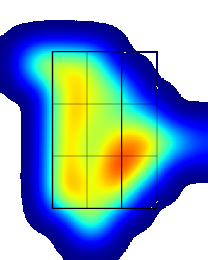
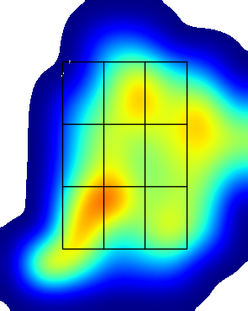
#4 Marco Pirruccello (L)
LHP 35 PA | AVG | SLG | Whiff % | Chase % | FPS %
FB (69) | .438 | .562 | 19% | 21% | 31%
BB (46) | .286 | .429 | 38% | 8% | 0%
CH (5) | .000 | .000 | 0% | 50% | nan%
LHP Overall | .375 | .500 | 22% | 18% | 11%
RHP 136 PA | AVG | SLG | Whiff % | Chase % | FPS %
FB (314) | .311 | .419 | 20% | 23% | 38%
BB (53) | .300 | .300 | 0% | 4% | 0%
CH (113) | .172 | .241 | 39% | 38% | 46%
RHP Overall | .284 | .371 | 23% | 25% | 36%
Data From: 2023 WCL
SB/ATT | OPS Last 10 G | Max EV
10-18 | .844 | 99.1
OPS LHP | OPS Overall | OPS RHP
1.071 | .808 | .746
.400
.136
K/BB LHP | K/BB Overall | K/BB RHP
2.00 | 0.83 | 0.65
.455
.286
GO/FO LHP | GO/FO Overall | GO/FO RHP
6.00 | 0.66 | 0.48
Pitcher View
Pitcher View
Hard Hit % LHP
23.5
Hard Hit % RHP
21.0
LHP EV | AVG EV | RHP EV
80.7 | 78.1 | 77.7

Slide 13
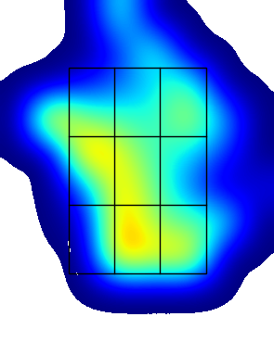
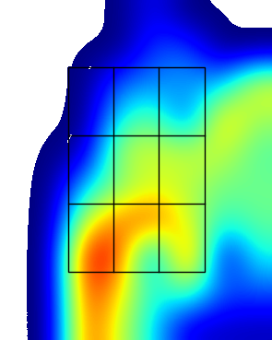
#17 Hudson Shupe (L)
LHP 30 PA | AVG | SLG | Whiff % | Chase % | FPS %
FB (59) | .235 | .235 | 11% | 25% | 44%
BB (54) | .333 | .444 | 42% | 25% | 31%
CH (3) | nan | nan | 0% | 50% | 0%
LHP Overall | .269 | .308 | 23% | 26% | 37%
RHP 151 PA | AVG | SLG | Whiff % | Chase % | FPS %
FB (298) | .411 | .562 | 12% | 21% | 48%
BB (77) | .000 | .000 | 39% | 22% | 21%
CH (112) | .333 | .513 | 23% | 43% | 36%
RHP Overall | .339 | .480 | 19% | 26% | 40%
Data From: 2023 WCL
SB/ATT | OPS Last 10 G | Max EV
10-12 | .613 | 98.3
OPS LHP | OPS Overall | OPS RHP
.675 | .876 | .917
.250
.312
K/BB LHP | K/BB Overall | K/BB RHP
0.57 | 1.24 | 1.57
.222
.444
GO/FO LHP | GO/FO Overall | GO/FO RHP
1.00 | 0.97 | 0.96
Pitcher View
Pitcher View
Hard Hit % LHP
4.2
Hard Hit % RHP
17.4
LHP EV | AVG EV | RHP EV
72.3 | 76.7 | 77.5

Slide 14
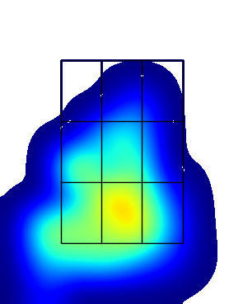
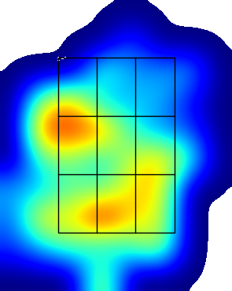
#13 Russell Young (R)
LHP 25 PA | AVG | SLG | Whiff % | Chase % | FPS %
FB (54) | .667 | .889 | 33% | 19% | 31%
BB (20) | .167 | .167 | 29% | 38% | 0%
CH (15) | .000 | .000 | 29% | 43% | 33%
LHP Overall | .368 | .474 | 33% | 29% | 28%
RHP 111 PA | AVG | SLG | Whiff % | Chase % | FPS %
FB (283) | .250 | .479 | 26% | 20% | 31%
BB (132) | .269 | .269 | 23% | 30% | 25%
CH (22) | .375 | .375 | 9% | 25% | nan%
RHP Overall | .247 | .371 | 24% | 24% | 29%
Data From: 2023 WCL
SB/ATT | OPS Last 10 G | Max EV
7-9 | .452 | 101.0
OPS LHP | OPS Overall | OPS RHP
.954 | .793 | .758
0/0
.071
K/BB LHP | K/BB Overall | K/BB RHP
0.80 | 0.65 | 0.62
.583
.289
GO/FO LHP | GO/FO Overall | GO/FO RHP
1.00 | 0.46 | 0.41
Pitcher View
Pitcher View
Hard Hit % LHP
0.0
Hard Hit % RHP
13.8
LHP EV | AVG EV | RHP EV
74.5 | 74.8 | 74.9

