Slide 1

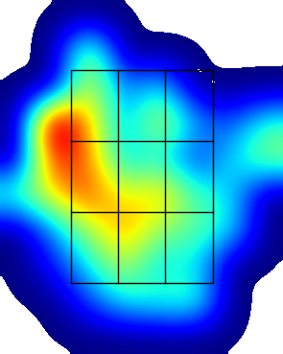
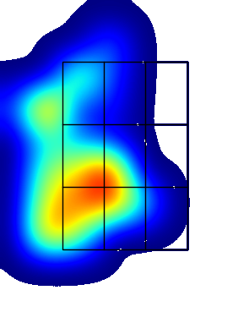

Joey Adge
LHP PA | AVG | SLG | Whiff % | Chase % | FPS %
FB ()
BB ()
CH ()
LHP Overall
RHP PA | AVG | SLG | Whiff % | Chase % | FPS %
FB ()
BB ()
CH ()
RHP Overall
Data From:
SB/ATT | OPS Last 10 G | Max EV
OPS LHP | OPS Overall | OPS RHP
.
.
K/BB LHP | K/BB Overall | K/BB RHP
.
.
GO/FO LHP | GO/FO Overall | GO/FO RHP
Pitcher View
Pitcher View
Hard Hit % LHP
30.8
LHP EV | AVG EV | RHP EV
76.0 | 75.9 | 75.9
Hard Hit % RHP
17.6

