Slide 1

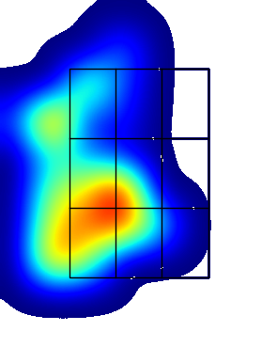
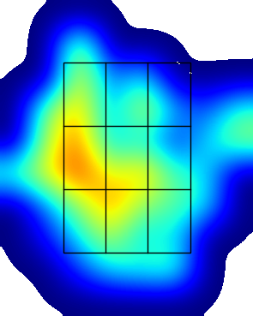

Joey Adge
LHP PA | AVG | SLG | Whiff % | Chase % | FPS %
FB ()
BB ()
CH ()
LHP Overall
RHP PA | AVG | SLG | Whiff % | Chase % | FPS %
FB ()
BB ()
CH ()
RHP Overall
Data From:
SB/ATT | OPS Last 10 G | Max EV
 |  | 98.2
OPS LHP | OPS Overall | OPS RHP
.
.
K/BB LHP | K/BB Overall | K/BB RHP
.
.
GO/FO LHP | GO/FO Overall | GO/FO RHP
Pitcher View
Pitcher View
Hard Hit % LHP
30.8
LHP EV | AVG EV | RHP EV
76.0 | 75.3 | 75.0
Hard Hit % RHP
15.2

Slide 2
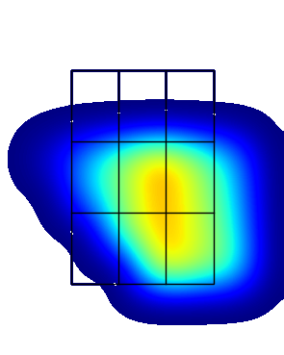
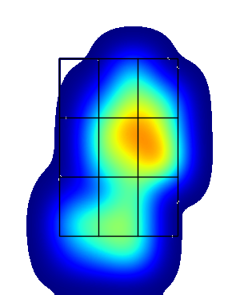
Kyle Anderson
LHP PA | AVG | SLG | Whiff % | Chase % | FPS %
FB ()
BB ()
CH ()
LHP Overall
RHP PA | AVG | SLG | Whiff % | Chase % | FPS %
FB ()
BB ()
CH ()
RHP Overall
Data From:
SB/ATT | OPS Last 10 G | Max EV
 |  | 93.7
OPS LHP | OPS Overall | OPS RHP
.
.
K/BB LHP | K/BB Overall | K/BB RHP
.
.
GO/FO LHP | GO/FO Overall | GO/FO RHP
Pitcher View
Pitcher View
Hard Hit % LHP
0.0
LHP EV | AVG EV | RHP EV
74.0 | 75.8 | 76.3
Hard Hit % RHP
17.6

Slide 3
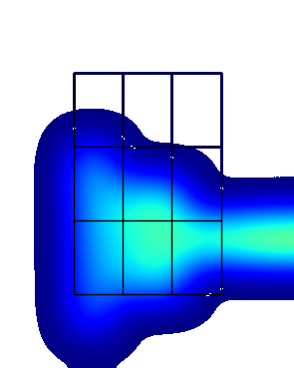
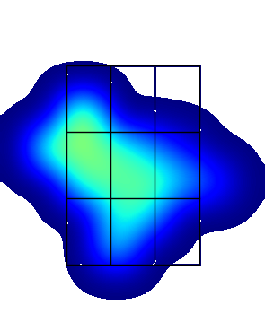
Nolan Austin
LHP PA | AVG | SLG | Whiff % | Chase % | FPS %
FB ()
BB ()
CH ()
LHP Overall
RHP PA | AVG | SLG | Whiff % | Chase % | FPS %
FB ()
BB ()
CH ()
RHP Overall
Data From:
SB/ATT | OPS Last 10 G | Max EV
 |  | 96.0
OPS LHP | OPS Overall | OPS RHP
.
.
K/BB LHP | K/BB Overall | K/BB RHP
.
.
GO/FO LHP | GO/FO Overall | GO/FO RHP
Pitcher View
Pitcher View
Hard Hit % LHP
0.0
LHP EV | AVG EV | RHP EV
72.0 | 71.9 | 71.8
Hard Hit % RHP
23.1

Slide 4
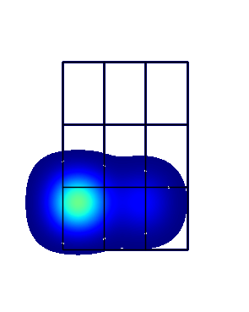
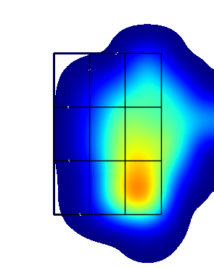
Joey Baran
LHP PA | AVG | SLG | Whiff % | Chase % | FPS %
FB ()
BB ()
CH ()
LHP Overall
RHP PA | AVG | SLG | Whiff % | Chase % | FPS %
FB ()
BB ()
CH ()
RHP Overall
Data From:
SB/ATT | OPS Last 10 G | Max EV
 |  | 98.2
OPS LHP | OPS Overall | OPS RHP
.
.
K/BB LHP | K/BB Overall | K/BB RHP
.
.
GO/FO LHP | GO/FO Overall | GO/FO RHP
Pitcher View
Pitcher View
Hard Hit % LHP
50.0
LHP EV | AVG EV | RHP EV
82.1 | 71.5 | 70.0
Hard Hit % RHP
7.1

Slide 5
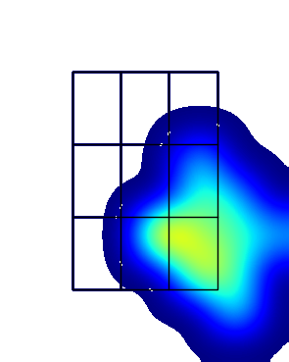
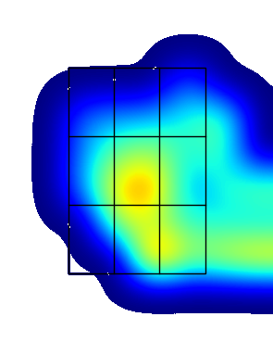
Felix Chenier-Rondeau
LHP PA | AVG | SLG | Whiff % | Chase % | FPS %
FB ()
BB ()
CH ()
LHP Overall
RHP PA | AVG | SLG | Whiff % | Chase % | FPS %
FB ()
BB ()
CH ()
RHP Overall
Data From:
SB/ATT | OPS Last 10 G | Max EV
 |  | 95.8
OPS LHP | OPS Overall | OPS RHP
.
.
K/BB LHP | K/BB Overall | K/BB RHP
.
.
GO/FO LHP | GO/FO Overall | GO/FO RHP
Pitcher View
Pitcher View
Hard Hit % LHP
16.7
LHP EV | AVG EV | RHP EV
79.6 | 75.0 | 73.4
Hard Hit % RHP
5.6

Slide 6
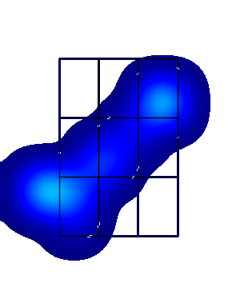
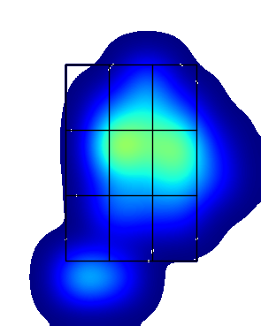
Landon Clark
LHP PA | AVG | SLG | Whiff % | Chase % | FPS %
FB ()
BB ()
CH ()
LHP Overall
RHP PA | AVG | SLG | Whiff % | Chase % | FPS %
FB ()
BB ()
CH ()
RHP Overall
Data From:
SB/ATT | OPS Last 10 G | Max EV
 |  | 86.7
OPS LHP | OPS Overall | OPS RHP
.
.
K/BB LHP | K/BB Overall | K/BB RHP
.
.
GO/FO LHP | GO/FO Overall | GO/FO RHP
Pitcher View
Pitcher View
Hard Hit % LHP
0.0
LHP EV | AVG EV | RHP EV
69.7 | 68.9 | 68.7
Hard Hit % RHP
0.0

Slide 7
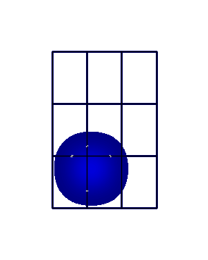
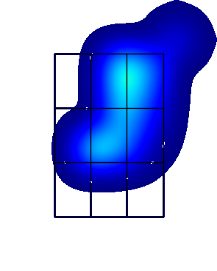
Austin Coyle
LHP PA | AVG | SLG | Whiff % | Chase % | FPS %
FB ()
BB ()
CH ()
LHP Overall
RHP PA | AVG | SLG | Whiff % | Chase % | FPS %
FB ()
BB ()
CH ()
RHP Overall
Data From:
SB/ATT | OPS Last 10 G | Max EV
 |  | 77.1
OPS LHP | OPS Overall | OPS RHP
.
.
K/BB LHP | K/BB Overall | K/BB RHP
.
.
GO/FO LHP | GO/FO Overall | GO/FO RHP
Pitcher View
Pitcher View
Hard Hit % LHP
0.0
LHP EV | AVG EV | RHP EV
62.4 | 66.5 | 67.6
Hard Hit % RHP
0.0

Slide 8
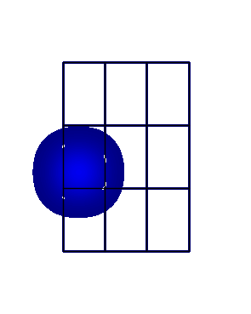
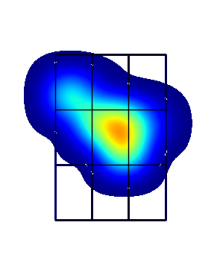
Bennett Freiter
LHP PA | AVG | SLG | Whiff % | Chase % | FPS %
FB ()
BB ()
CH ()
LHP Overall
RHP PA | AVG | SLG | Whiff % | Chase % | FPS %
FB ()
BB ()
CH ()
RHP Overall
Data From:
SB/ATT | OPS Last 10 G | Max EV
 |  | 95.2
OPS LHP | OPS Overall | OPS RHP
.
.
K/BB LHP | K/BB Overall | K/BB RHP
.
.
GO/FO LHP | GO/FO Overall | GO/FO RHP
Pitcher View
Pitcher View
Hard Hit % LHP
0.0
LHP EV | AVG EV | RHP EV
63.9 | 77.0 | 79.6
Hard Hit % RHP
40.0

Slide 9
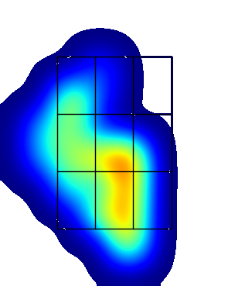
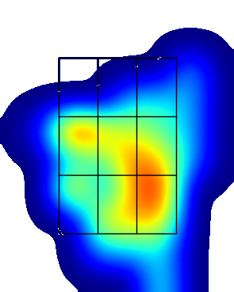
Drew Giannini
LHP PA | AVG | SLG | Whiff % | Chase % | FPS %
FB ()
BB ()
CH ()
LHP Overall
RHP PA | AVG | SLG | Whiff % | Chase % | FPS %
FB ()
BB ()
CH ()
RHP Overall
Data From:
SB/ATT | OPS Last 10 G | Max EV
 |  | 99.4
OPS LHP | OPS Overall | OPS RHP
.
.
K/BB LHP | K/BB Overall | K/BB RHP
.
.
GO/FO LHP | GO/FO Overall | GO/FO RHP
Pitcher View
Pitcher View
Hard Hit % LHP
16.7
LHP EV | AVG EV | RHP EV
76.9 | 78.0 | 78.4
Hard Hit % RHP
26.9

Slide 10
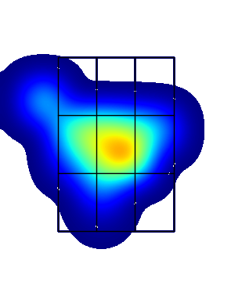
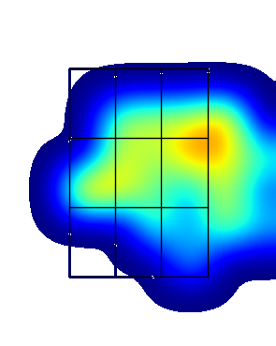
Tyler Glowacki
LHP PA | AVG | SLG | Whiff % | Chase % | FPS %
FB ()
BB ()
CH ()
LHP Overall
RHP PA | AVG | SLG | Whiff % | Chase % | FPS %
FB ()
BB ()
CH ()
RHP Overall
Data From:
SB/ATT | OPS Last 10 G | Max EV
 |  | 96.6
OPS LHP | OPS Overall | OPS RHP
.
.
K/BB LHP | K/BB Overall | K/BB RHP
.
.
GO/FO LHP | GO/FO Overall | GO/FO RHP
Pitcher View
Pitcher View
Hard Hit % LHP
25.0
LHP EV | AVG EV | RHP EV
75.7 | 77.0 | 77.2
Hard Hit % RHP
13.6

Slide 11
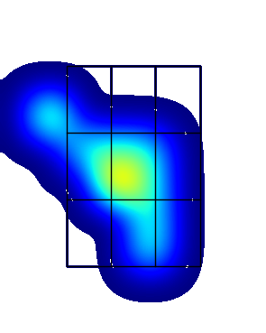
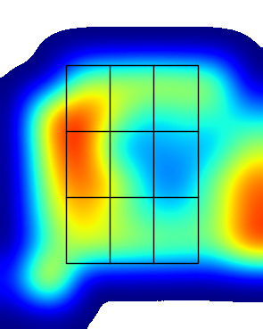
Nathan Gray
LHP PA | AVG | SLG | Whiff % | Chase % | FPS %
FB ()
BB ()
CH ()
LHP Overall
RHP PA | AVG | SLG | Whiff % | Chase % | FPS %
FB ()
BB ()
CH ()
RHP Overall
Data From:
SB/ATT | OPS Last 10 G | Max EV
 |  | 95.4
OPS LHP | OPS Overall | OPS RHP
.
.
K/BB LHP | K/BB Overall | K/BB RHP
.
.
GO/FO LHP | GO/FO Overall | GO/FO RHP
Pitcher View
Pitcher View
Hard Hit % LHP
16.7
LHP EV | AVG EV | RHP EV
79.2 | 78.2 | 77.8
Hard Hit % RHP
21.1

Slide 12
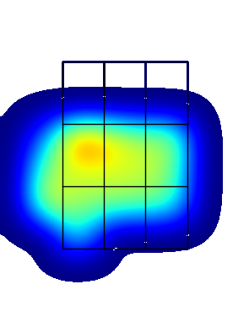
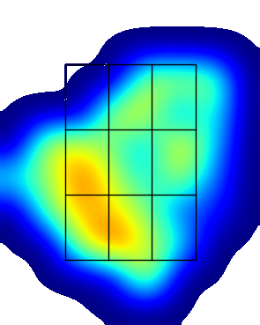
Thomas Green
LHP PA | AVG | SLG | Whiff % | Chase % | FPS %
FB ()
BB ()
CH ()
LHP Overall
RHP PA | AVG | SLG | Whiff % | Chase % | FPS %
FB ()
BB ()
CH ()
RHP Overall
Data From:
SB/ATT | OPS Last 10 G | Max EV
 |  | 99.5
OPS LHP | OPS Overall | OPS RHP
.
.
K/BB LHP | K/BB Overall | K/BB RHP
.
.
GO/FO LHP | GO/FO Overall | GO/FO RHP
Pitcher View
Pitcher View
Hard Hit % LHP
18.2
LHP EV | AVG EV | RHP EV
77.8 | 76.8 | 76.5
Hard Hit % RHP
15.2

Slide 13
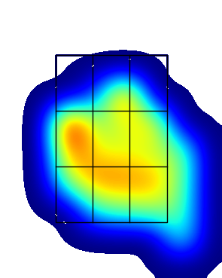
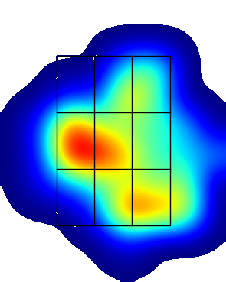
Jude Hall
LHP PA | AVG | SLG | Whiff % | Chase % | FPS %
FB ()
BB ()
CH ()
LHP Overall
RHP PA | AVG | SLG | Whiff % | Chase % | FPS %
FB ()
BB ()
CH ()
RHP Overall
Data From:
SB/ATT | OPS Last 10 G | Max EV
 |  | 99.4
OPS LHP | OPS Overall | OPS RHP
.
.
K/BB LHP | K/BB Overall | K/BB RHP
.
.
GO/FO LHP | GO/FO Overall | GO/FO RHP
Pitcher View
Pitcher View
Hard Hit % LHP
23.1
LHP EV | AVG EV | RHP EV
80.0 | 77.7 | 77.0
Hard Hit % RHP
24.4

Slide 14
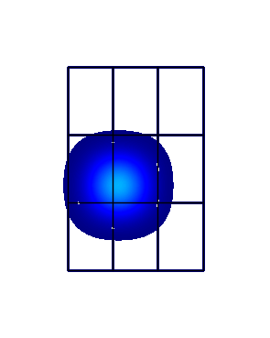
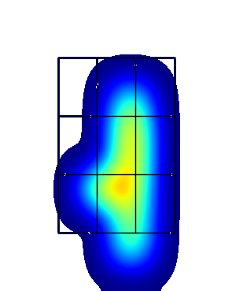
Collin Hysell
LHP PA | AVG | SLG | Whiff % | Chase % | FPS %
FB ()
BB ()
CH ()
LHP Overall
RHP PA | AVG | SLG | Whiff % | Chase % | FPS %
FB ()
BB ()
CH ()
RHP Overall
Data From:
SB/ATT | OPS Last 10 G | Max EV
 |  | 91.4
OPS LHP | OPS Overall | OPS RHP
.
.
K/BB LHP | K/BB Overall | K/BB RHP
.
.
GO/FO LHP | GO/FO Overall | GO/FO RHP
Pitcher View
Pitcher View
Hard Hit % LHP
0.0
LHP EV | AVG EV | RHP EV
82.1 | 81.6 | 81.5
Hard Hit % RHP
50.0

Slide 15
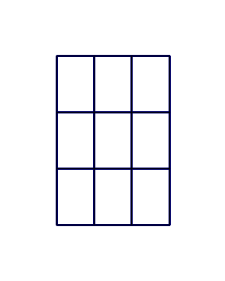
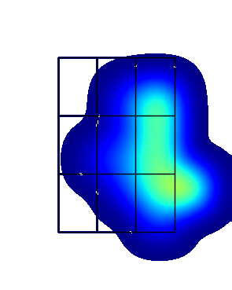
Rei Kimura
LHP PA | AVG | SLG | Whiff % | Chase % | FPS %
FB ()
BB ()
CH ()
LHP Overall
RHP PA | AVG | SLG | Whiff % | Chase % | FPS %
FB ()
BB ()
CH ()
RHP Overall
Data From:
SB/ATT | OPS Last 10 G | Max EV
 |  | 90.4
OPS LHP | OPS Overall | OPS RHP
.
.
K/BB LHP | K/BB Overall | K/BB RHP
.
.
GO/FO LHP | GO/FO Overall | GO/FO RHP
Pitcher View
Pitcher View
Hard Hit % LHP
N/A
LHP EV | AVG EV | RHP EV
nan | 72.6 | 72.6
Hard Hit % RHP
12.5

Slide 16
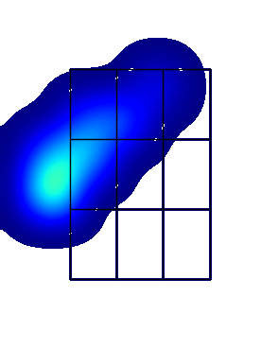
Noah Loew
LHP PA | AVG | SLG | Whiff % | Chase % | FPS %
FB ()
BB ()
CH ()
LHP Overall
RHP PA | AVG | SLG | Whiff % | Chase % | FPS %
FB ()
BB ()
CH ()
RHP Overall
Data From:
SB/ATT | OPS Last 10 G | Max EV
 |  | 85.2
OPS LHP | OPS Overall | OPS RHP
.
.
K/BB LHP | K/BB Overall | K/BB RHP
.
.
GO/FO LHP | GO/FO Overall | GO/FO RHP
Pitcher View
Pitcher View
Hard Hit % LHP
N/A
LHP EV | AVG EV | RHP EV
nan | 71.0 | 71.0
Hard Hit % RHP
0.0

Slide 17
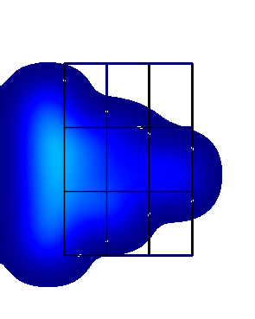
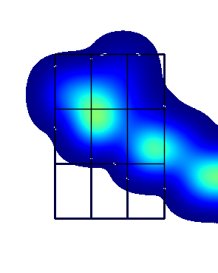
Anthony Manuel
LHP PA | AVG | SLG | Whiff % | Chase % | FPS %
FB ()
BB ()
CH ()
LHP Overall
RHP PA | AVG | SLG | Whiff % | Chase % | FPS %
FB ()
BB ()
CH ()
RHP Overall
Data From:
SB/ATT | OPS Last 10 G | Max EV
 |  | 90.8
OPS LHP | OPS Overall | OPS RHP
.
.
K/BB LHP | K/BB Overall | K/BB RHP
.
.
GO/FO LHP | GO/FO Overall | GO/FO RHP
Pitcher View
Pitcher View
Hard Hit % LHP
0.0
LHP EV | AVG EV | RHP EV
65.1 | 68.7 | 71.3
Hard Hit % RHP
14.3

Slide 18
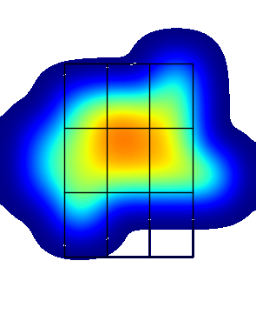
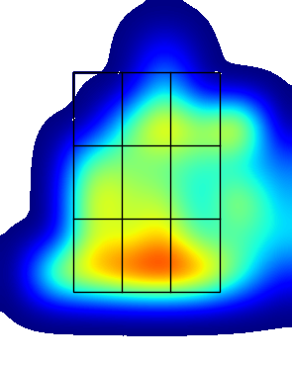
Cooper Neville
LHP PA | AVG | SLG | Whiff % | Chase % | FPS %
FB ()
BB ()
CH ()
LHP Overall
RHP PA | AVG | SLG | Whiff % | Chase % | FPS %
FB ()
BB ()
CH ()
RHP Overall
Data From:
SB/ATT | OPS Last 10 G | Max EV
 |  | 96.3
OPS LHP | OPS Overall | OPS RHP
.
.
K/BB LHP | K/BB Overall | K/BB RHP
.
.
GO/FO LHP | GO/FO Overall | GO/FO RHP
Pitcher View
Pitcher View
Hard Hit % LHP
0.0
LHP EV | AVG EV | RHP EV
79.7 | 76.2 | 75.4
Hard Hit % RHP
16.7

Slide 19
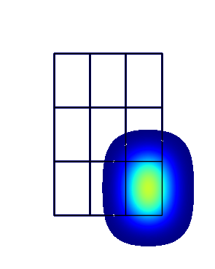
Manny Recchi
LHP PA | AVG | SLG | Whiff % | Chase % | FPS %
FB ()
BB ()
CH ()
LHP Overall
RHP PA | AVG | SLG | Whiff % | Chase % | FPS %
FB ()
BB ()
CH ()
RHP Overall
Data From:
SB/ATT | OPS Last 10 G | Max EV
 |  | 92.3
OPS LHP | OPS Overall | OPS RHP
.
.
K/BB LHP | K/BB Overall | K/BB RHP
.
.
GO/FO LHP | GO/FO Overall | GO/FO RHP
Pitcher View
Pitcher View
Hard Hit % LHP
N/A
LHP EV | AVG EV | RHP EV
nan | 92.0 | 92.0
Hard Hit % RHP
100.0

Slide 20
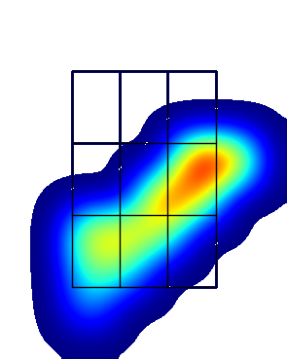
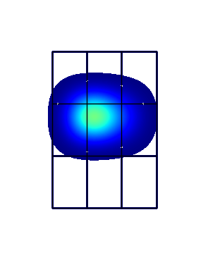
Andrew Stucky
LHP PA | AVG | SLG | Whiff % | Chase % | FPS %
FB ()
BB ()
CH ()
LHP Overall
RHP PA | AVG | SLG | Whiff % | Chase % | FPS %
FB ()
BB ()
CH ()
RHP Overall
Data From:
SB/ATT | OPS Last 10 G | Max EV
 |  | 102.9
OPS LHP | OPS Overall | OPS RHP
.
.
K/BB LHP | K/BB Overall | K/BB RHP
.
.
GO/FO LHP | GO/FO Overall | GO/FO RHP
Pitcher View
Pitcher View
Hard Hit % LHP
50.0
LHP EV | AVG EV | RHP EV
87.6 | 85.7 | 82.0
Hard Hit % RHP
50.0

Slide 21
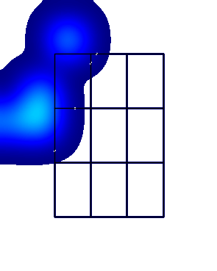
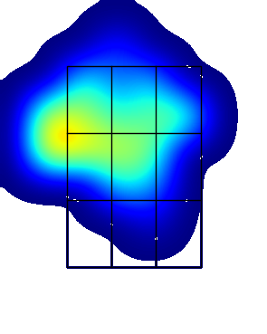
Jared Sucro
LHP PA | AVG | SLG | Whiff % | Chase % | FPS %
FB ()
BB ()
CH ()
LHP Overall
RHP PA | AVG | SLG | Whiff % | Chase % | FPS %
FB ()
BB ()
CH ()
RHP Overall
Data From:
SB/ATT | OPS Last 10 G | Max EV
 |  | 90.2
OPS LHP | OPS Overall | OPS RHP
.
.
K/BB LHP | K/BB Overall | K/BB RHP
.
.
GO/FO LHP | GO/FO Overall | GO/FO RHP
Pitcher View
Pitcher View
Hard Hit % LHP
0.0
LHP EV | AVG EV | RHP EV
71.8 | 75.1 | 75.8
Hard Hit % RHP
7.1

Slide 22
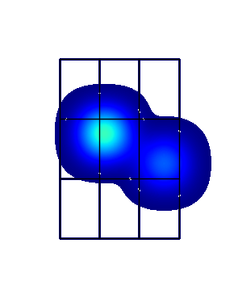
Robin Villeneuve
LHP PA | AVG | SLG | Whiff % | Chase % | FPS %
FB ()
BB ()
CH ()
LHP Overall
RHP PA | AVG | SLG | Whiff % | Chase % | FPS %
FB ()
BB ()
CH ()
RHP Overall
Data From:
SB/ATT | OPS Last 10 G | Max EV
 |  | 92.8
OPS LHP | OPS Overall | OPS RHP
.
.
K/BB LHP | K/BB Overall | K/BB RHP
.
.
GO/FO LHP | GO/FO Overall | GO/FO RHP
Pitcher View
Pitcher View
Hard Hit % LHP
50.0
LHP EV | AVG EV | RHP EV
83.6 | 83.6 | nan
Hard Hit % RHP
N/A

Slide 23
LHP PA | AVG | SLG | Whiff % | Chase % | FPS %
FB ()
BB ()
CH ()
LHP Overall
RHP PA | AVG | SLG | Whiff % | Chase % | FPS %
FB ()
BB ()
CH ()
RHP Overall
Data From:
OPS LHP | OPS Overall | OPS RHP
.
.
K/BB LHP | K/BB Overall | K/BB RHP
.
.
GO/FO LHP | GO/FO Overall | GO/FO RHP
Pitcher View
Pitcher View

Slide 24
LHP PA | AVG | SLG | Whiff % | Chase % | FPS %
FB ()
BB ()
CH ()
LHP Overall
RHP PA | AVG | SLG | Whiff % | Chase % | FPS %
FB ()
BB ()
CH ()
RHP Overall
Data From:
OPS LHP | OPS Overall | OPS RHP
.
.
K/BB LHP | K/BB Overall | K/BB RHP
.
.
GO/FO LHP | GO/FO Overall | GO/FO RHP
Pitcher View
Pitcher View

Slide 25
LHP PA | AVG | SLG | Whiff % | Chase % | FPS %
FB ()
BB ()
CH ()
LHP Overall
RHP PA | AVG | SLG | Whiff % | Chase % | FPS %
FB ()
BB ()
CH ()
RHP Overall
Data From:
OPS LHP | OPS Overall | OPS RHP
.
.
K/BB LHP | K/BB Overall | K/BB RHP
.
.
GO/FO LHP | GO/FO Overall | GO/FO RHP
Pitcher View
Pitcher View

Slide 26
LHP PA | AVG | SLG | Whiff % | Chase % | FPS %
FB ()
BB ()
CH ()
LHP Overall
RHP PA | AVG | SLG | Whiff % | Chase % | FPS %
FB ()
BB ()
CH ()
RHP Overall
Data From:
OPS LHP | OPS Overall | OPS RHP
.
.
K/BB LHP | K/BB Overall | K/BB RHP
.
.
GO/FO LHP | GO/FO Overall | GO/FO RHP
Pitcher View
Pitcher View

